Slide 1
What is Culture?
There are many definitions
Linton (1945)
‘The culture of a society is the way of life of its members; the collection of ideas and habits, norms and values, which they learn, share and transmit from generation to generation’
http://www.youtube.com/watch?v=WcEfzHB08QE&feature=player_embedded#!

Slide 2
Social Construction
A social construction is something which is not biological or natural occurring. It is something which is created through culture and therefore changes across time, place and situation.
Examples of socially constructed ideas include culture itself, gender roles, crime and deviance.

Slide 3
Culture
The first few slides show pictures of what a lot of people think of when they think of cultures
You need to reflect on the culture of your family
Think about the things you do as a family
What does your family value
You will be creating a spider diagram of your families culture

Slide 4


Slide 5


Slide 6


Slide 7

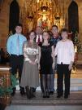
Religion?

Slide 8

Do you eat together every evening?

Slide 9



Football?

Slide 10
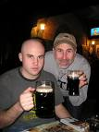
Going to the pub?

Slide 11
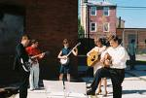


Music?

Slide 12

Library and books?

Slide 13

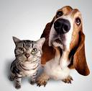

Animals?

Slide 14
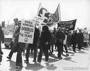
Politics?

Slide 15


Picnics ? Walking ? Outdoor
activity?

Slide 16
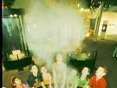
Museums?

Slide 17
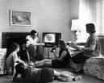
Watching T.V. as a family?

Slide 18


What Christmas traditions
do you have?

Slide 19

Talking?

Slide 20

Travel?

Slide 21
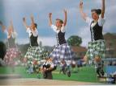
Dancing?

Slide 22
Activity
Create a diagram with your family in the middle , draw them as stick people .Write the most important things close to you all and then put things relatively near or close depending on their importance. (you don’t need to use the things mentioned in the slide show you can just put all your own things in or some of both)
Write down any funny traditions you have when travelling in the car or at Christmas or birthdays
If you really don’t want to do your own family
you can make up a pretend family but let us know that’s what you
Would rather do today and it should be realistic

Slide 23
Culture from different perspectives
Durkheim (1963) Functionalist
Believed that a shared culture is necessary to society to run smoothly. Having shared patterns of behaviour helps everyone play their part.
Karl Marx (Marxist) believed that culture is really just the ideology of the ruling-class which gives a false-class consciousness (convincing us that life is fair so that we accept exploitation)

Slide 24
Post-Modernists
They believe that culture is more fluid and people can take up different aspects of it through choice e.g we can eat curry, wear a kilt and go line dancing !!
Strinati – Post Modernist - says that now people have more leisure time and less solid identity from class, community and religion culture is more about lifestyles and tastes.

Slide 25
Plenary
Can you accurately define the term ‘culture’ using a writer’s name, examples of elements of culture and a perspective?
Look at the culture of the Nayar. Complete the tasks by hand or on your chromebooks

