Slide 1

Pres
Ents

Slide 2
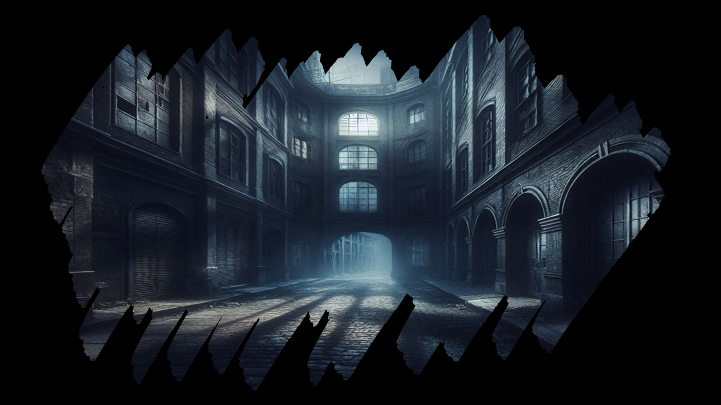

Slide 3
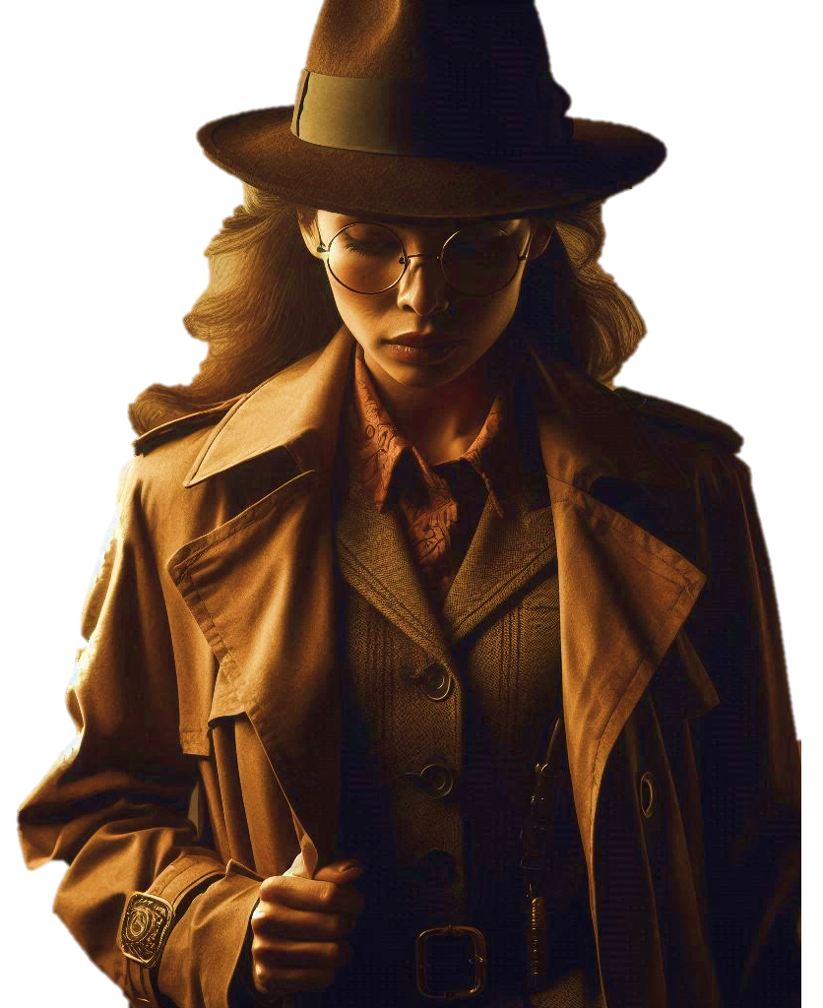

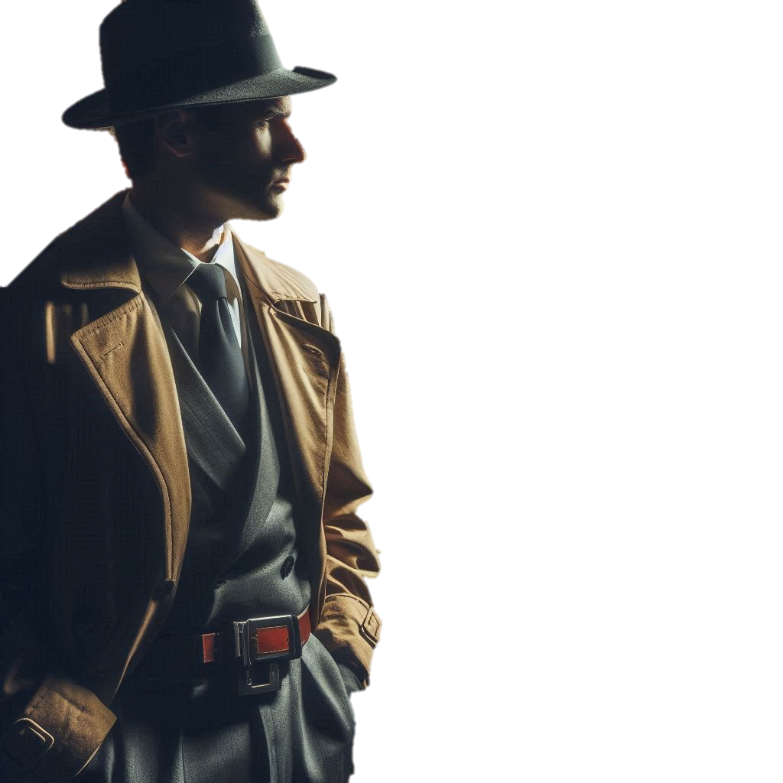
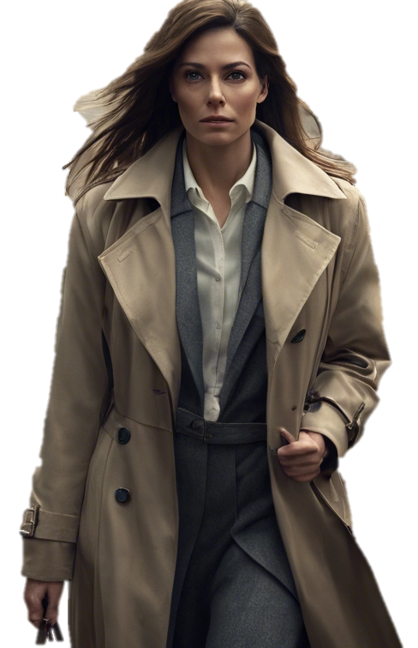

Modern Society…
Kick-started by
The Enlightenment
The
Sociological Detectives
Crime and Deviance

Slide 4
Crime and Deviance
Episode 1
AN IMMERSIVE SOCIOLOGICAL SIM. OF SORTS…
People confuse four words and then wonder why the world doesn’t make sense.
Crime. Deviance. Order. Control. They’re related, but they ain’t synonyms. Not even close.
Crime is what the law says.
Deviance is what the crowd decides.
Social order is the fiction we all agree to maintain.
And social control is absolutely everything we do to make people conform.
This city runs on all four, simultaneously, in every street, every day and every night.
My job is to know which one I’m looking at. And tonight, it’s your job too.
Welcome to my world.
And if you want to know a bit about it before we begin, be my guest.
Crime, Deviance, Social Order and Social Control

Slide 5
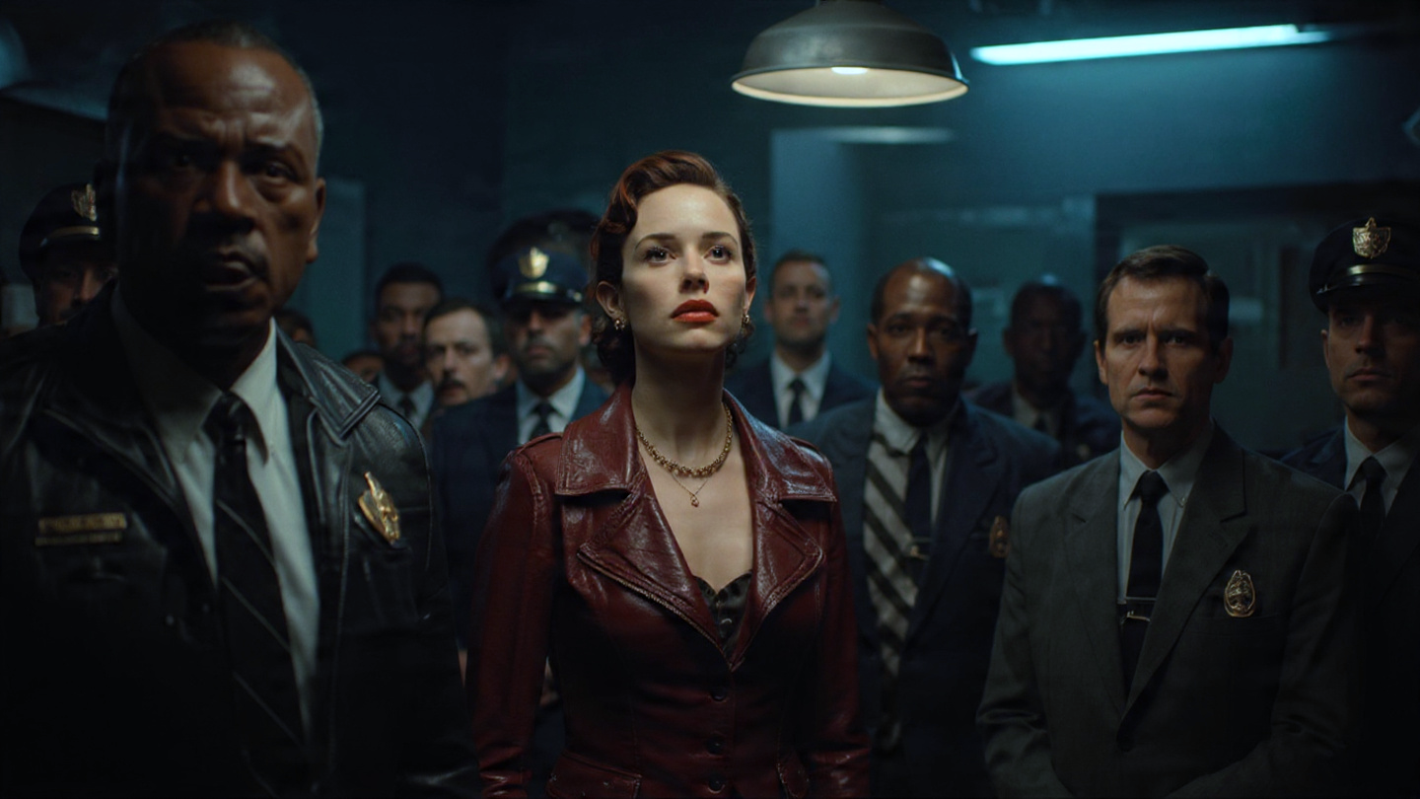
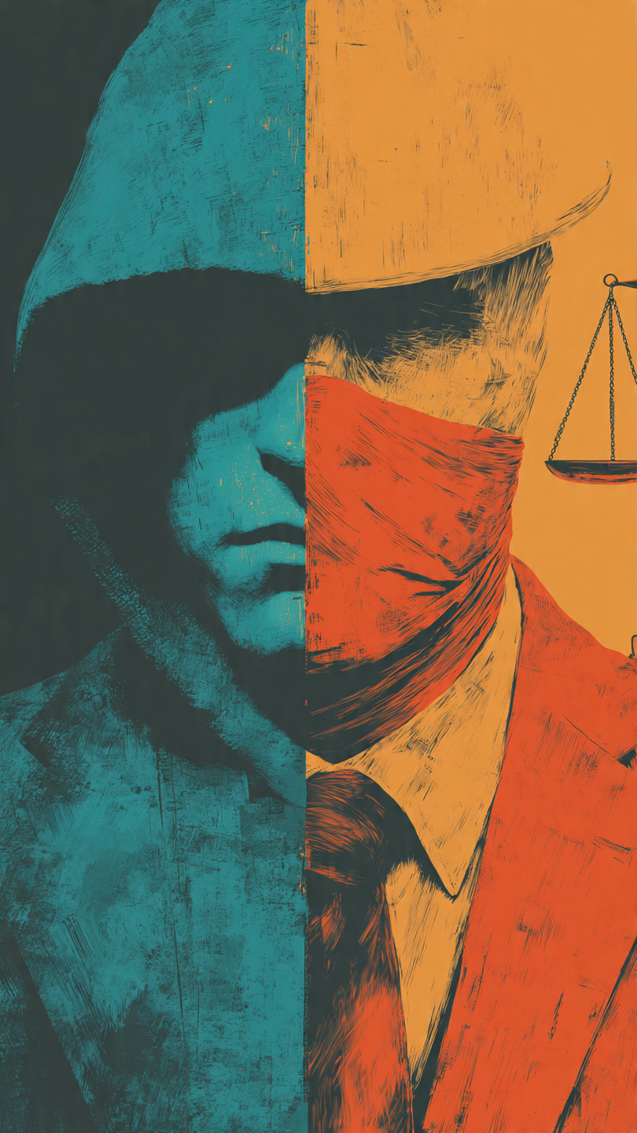
Briefing
Concept: Social Control
Crime. Deviance. Order. Control.
Every mechanism – formal, informal, visible and invisible, cruel and gentle - by which society persuades or makes its members to maintain that order. Courts and prisons play a part. But gossip, shame, love, habits play a much larger role than most people ever know. Or even suspect…
Buckle up kid. It’s going to be a ride.
And even though they say “every journey begins with a single step” in your case, there’s four basic things you need to understand: crime, deviance, social order and social control.
Now, I don’t wanna hold your hand about it rookie, but I’m guessing we’d both find it helpful if you at had at least a nodding acquaintance with all four before you’re let loose on the unsuspecting citizens of this fair town.
A designation I use loosely, so don’t say you haven’t been warned.
Tonight’s your first night on the job so stick close to me, listen to what I tell you,
make the right choices and laugh at my jokes.
And remember, while this ain’t no textbook learning there’s plenty of things you can pick-up if you pay attention, ask the right questions and act like you’ve got some idea about what’s going on.
Concept: Crime
An action that violates the criminal law.
Simple. Clear. Brutal.
The government has decided, through legislation, that an action warrants punishment. Break the law and get caught? You’re a criminal. It doesn’t matter what anyone thinks or feels about it. Do the crime. Do the time. Unless you’ve got a good lawyer. There’s always that get-out-of-jail-free card.
Concept: Deviance
An action that violates the social norms of a particular group or society. Which includes crime, obviously, but also more. Much, much, more.
Deviance plays to the invisible jury of people passing judgment through looks, whispers, angry asides and the occasional punch to the gut.
Concept: Social Order
The stable, predictable, patterns of behaviour that allows society to function. People stop at red lights. They queue, pay rent, turn up to school or work. Not because they love the system, but because the system is so deeply embedded that questioning it feels like questioning how you breathe. Durkheim called it ‘value consensus.’ Foucault called it a prison. We’ll meet those two gentlemen again. Don’t know where, don’t know when.

Slide 6
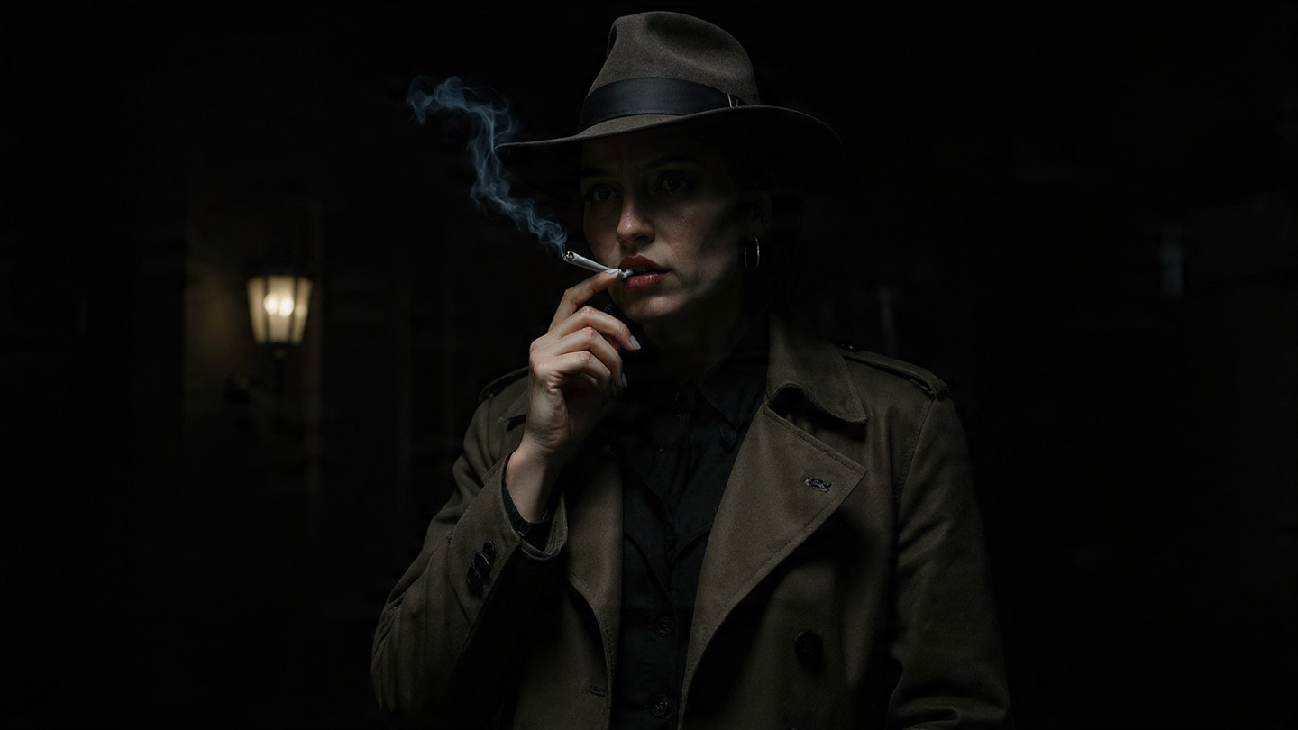
MISSION BRIEF
Briefing
Crime. Deviance. Order. Control.
Nicely done rookie. You’ve passed your first test with flying colours.
Now you’re here I guess you want to know what’s going on?
Well, tonight you’re going to dip your toes into the fetid cesspool of a place I’m proud to call “somewhere I don’t have to live because I’ve got the money to live elsewhere”. Also known as AnyTown to the poor saps unlucky or desperate enough to call it home.
And we’re the folk who’s job it is to make sense of the place and the people. An elite group of Sociological Detectives - of which, if you play your cards right, you’ll be the next generation.
Think about it rookie. Look and learn and in a few years time you could be me. Ain’t life grand?
So that’s the background. Consider yourself briefed.
And listen carefully kid. I will be asking questions

Slide 7
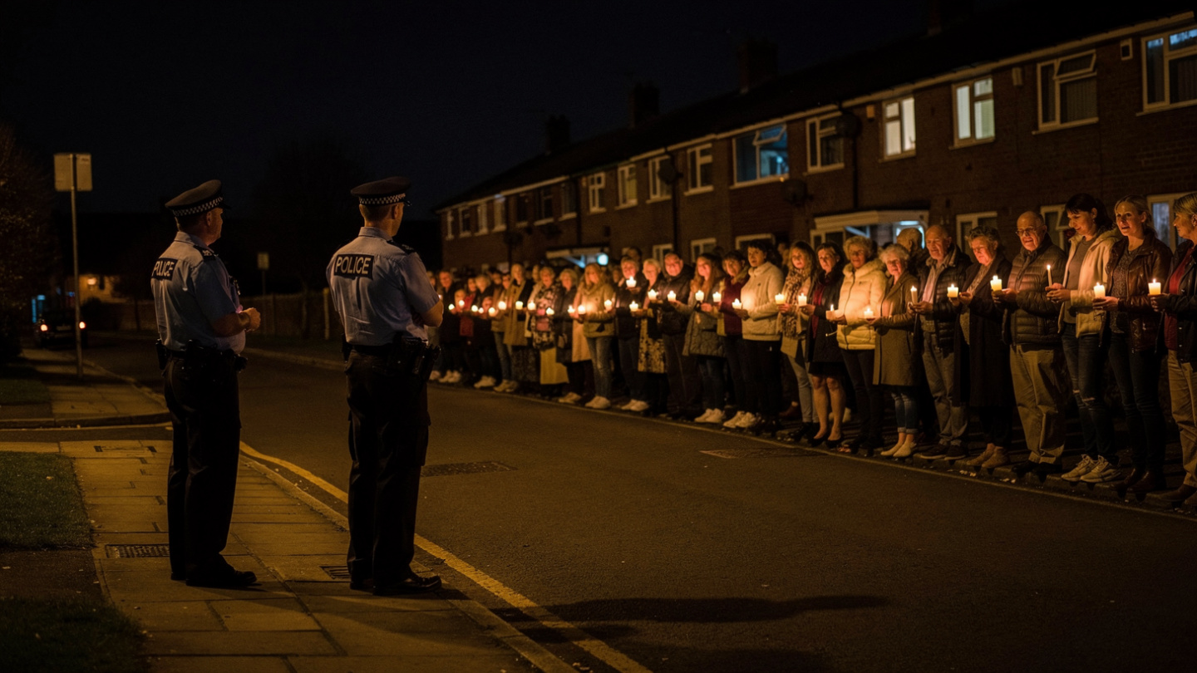
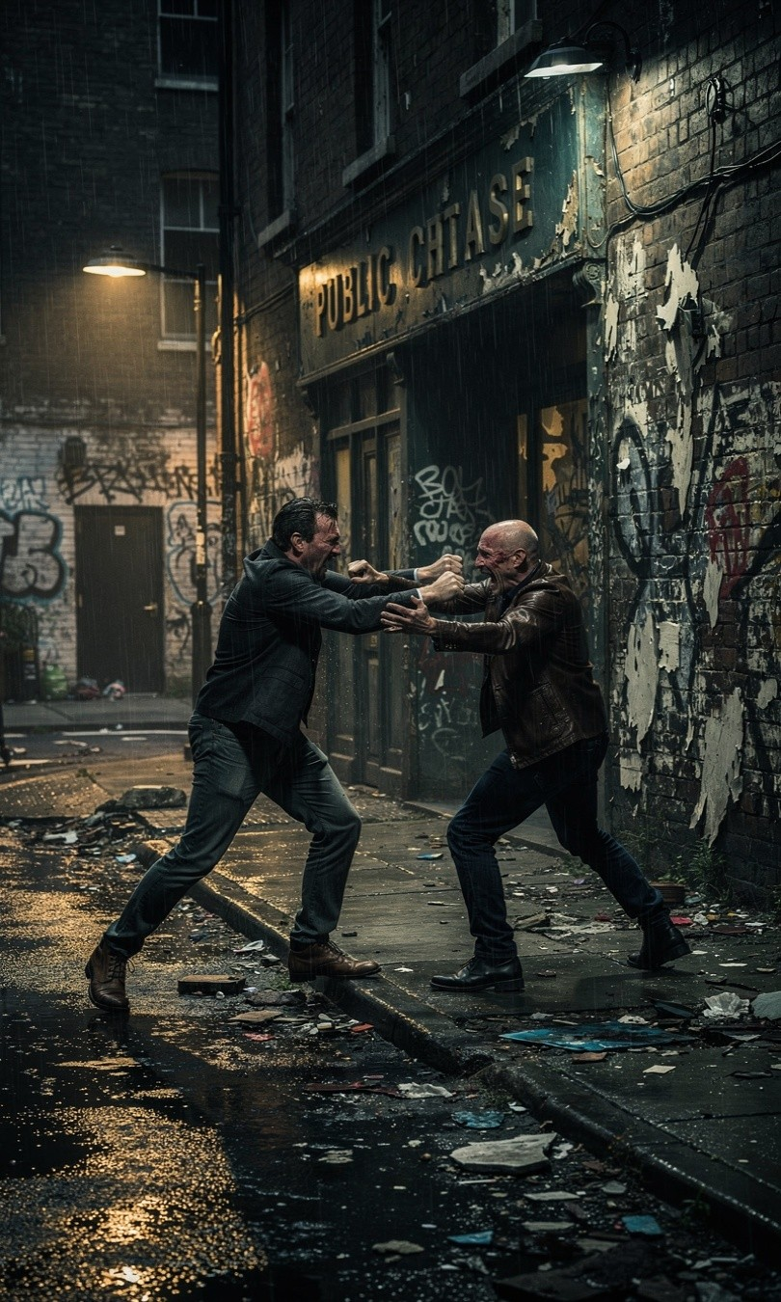
A Walk on the Wild Side
IN THE CITY
Saturday night. It’s late but starting to get early. Ferris Court housing estate, south side of the city. I’m parked in an unmarked car with a lukewarm cup of coffee, a cold sausage roll and a growing realisation I should have made something more of my life.
To my left: Two men, early thirties, stumble out of the pub and start shouting and fighting. Actual bodily harm is being committed. It’s a crime.
It’s also deviant by most community standards and it’s a regular thing with these two bozos.
But some residents just stand watching from their windows. They haven’t called the police. It’s just an everyday breakdown of social order that everyone expects to contain itself. Nothing (much) to see here.
To my right: a candlelit Vigil.
Forty or so people, all ages, standing silently in the road. They’re commemorating a 15-year-old who was stabbed here six months ago.
The road is technically blocked and that’s a public order offence, but two officers on the edge of the crowd are just watching and waiting.
Letting it happen.
Some forms of disorder are actually the most powerful mechanisms of social order around.
I’d say it’s your choice, kid, but I’m not just here for the ride. And you’re here to learn so if it’s all the same to you – and even if it isn’t – we’re going to start by investigating the fight. Think about it as your first lesson in social control and the natural order of rank. Well get back to the Vigil later. They ain’t going nowhere.

Slide 8
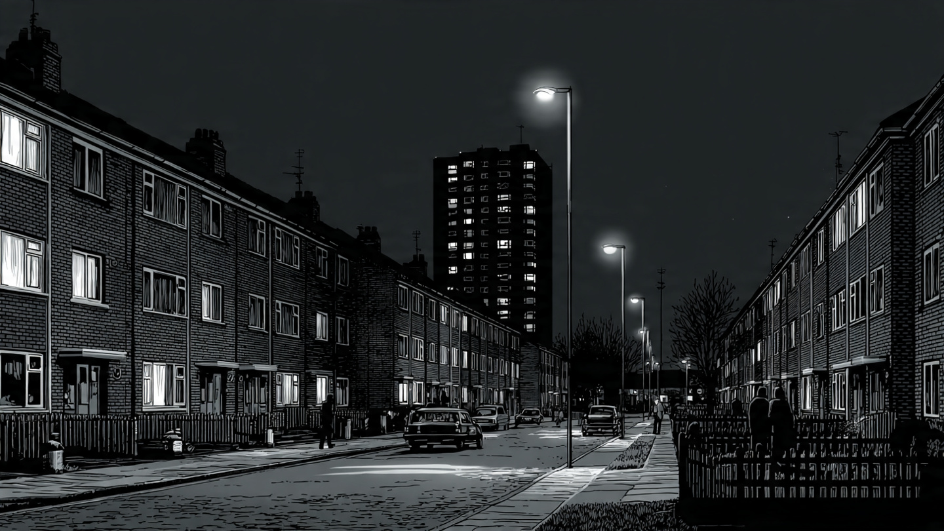
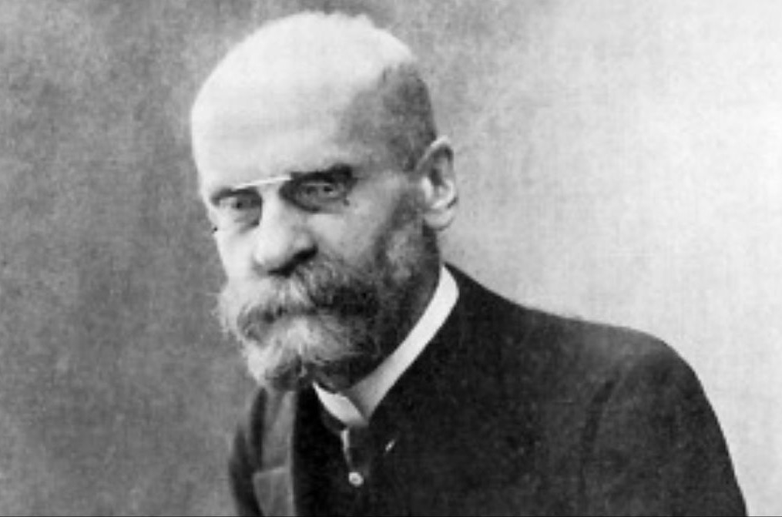
Saturday Night’s Alright
On the face of it, it’s simple: ABH is a crime and crime is punishable by the law. But, if you look a little closer, things aren’t always that easy. The rubberneckers at the window complicate things because they’re not calling the police. Watching two grown men slugging out their differences seems to be a part of the very fabric of local social order.
See, these people deal with problems in their own way. We may not like it. We may not agree with it. But as Sociological Detectives our job is to empathise, understand and explain it.
A hundred years ago, Emile Durkheim understood this. He said crime is a normal feature of social life. Not in the sense it’s okay, but that a society without crime would be a nightmare for everyone. Which sounds pretty dumb until you realise no-one would know where to draw the line between acceptable and unacceptable behaviour. Every conceivable human depravity would go unpunished. Which. let me assure you kid, absolutely no-one wants to see. Except the depraved. Obviously.
Anyway, this guy Durkheim argued one of the functions of crime is to define boundaries: to show us the line between what’s right and what’s wrong. Acceptable and unacceptable. What we tolerate and what we don’t.
Theory: Durkheim (1895)
Evidence
In “The Rules of Sociological Method” Durkheim argued crime is a normal, necessary and functional part of everyday social life. It defines moral boundaries and creates social solidarity. A community’s shared response to deviance reinforces the very norms that were violated by the deviant behaviour.
EMILE DURKHEIM - (1858–1917)
Choosing to focus on the fight lets you map all 4 concepts simultaneously. It’s criminal (ABH), deviant (norm violation) and embedded in local social order - predictable, manageable, contained. The absence of the police (formal social control) is evidence of informal social control: the community managing its own norms.

Slide 9
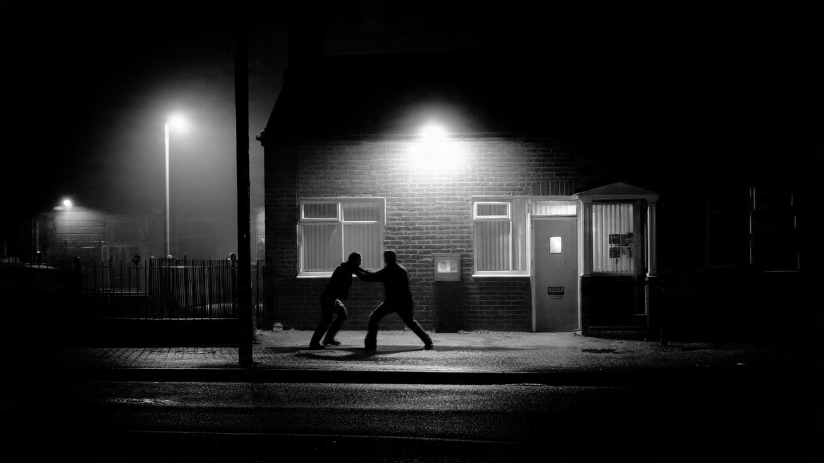
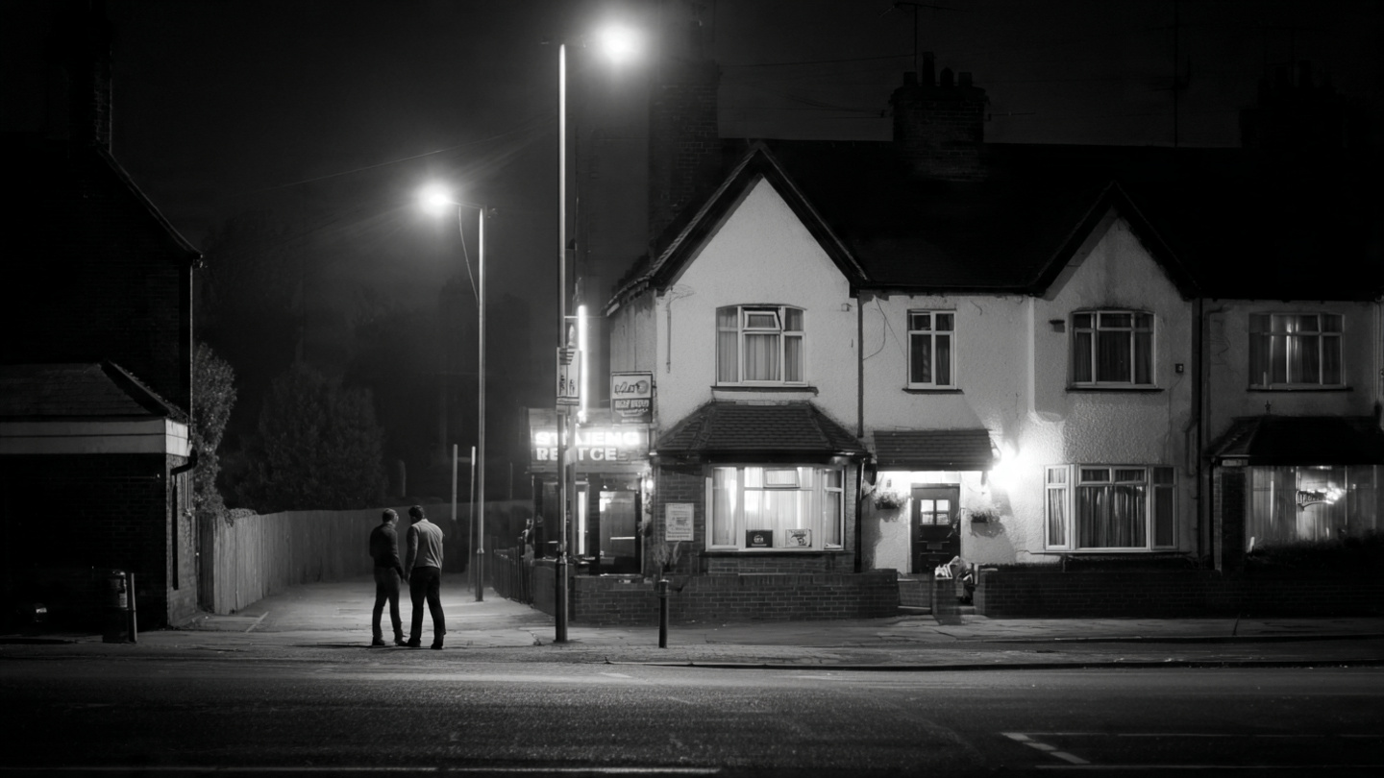
A Crossed Line
The people watching? A strange-but-true moment. They know where the line is because these two men occasionally cross it.
It’s a blunt instrument maybe (not quite as blunt as bare knuckles). But it works. We know what’s right by being constantly exposed to what’s not.
Which is fine as far as it goes.
But here’s another question for you.
There’s a line that’s been crossed here, but the rubberneckers haven’t called the police. That’s a deliberate choice not to deploy formal social control.
And without the police around to step in and restore the boundaries, things can quickly get out of hand. Capiche?
Or maybe they know something we don’t?

Slide 10
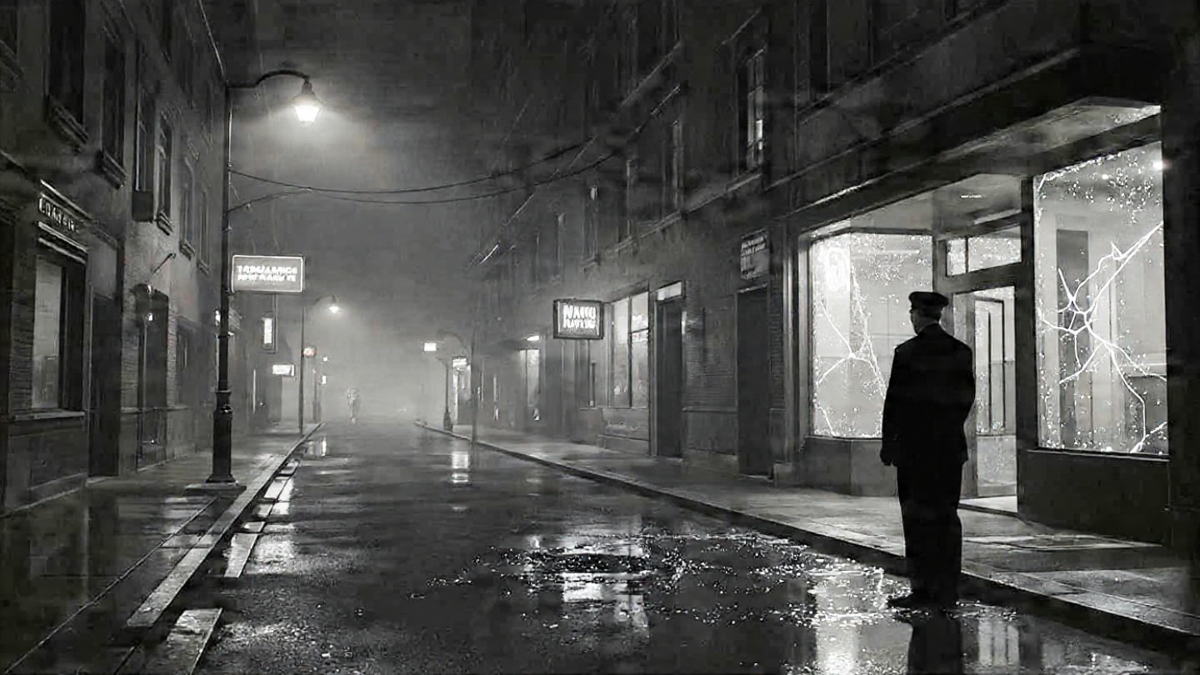
The Ties That Bind
Analysis
Interesting choice. You seem to be thinking along the same lines as a guy called Travis Hirschi. He argues most people look at deviance the wrong way. What needs explaining is conformity – why people obey the law. The obvious way of looking at it is because they’re afraid of the consequences if they don’t. But we’re not in the market for the obvious. Obvious reeks of desperation and a lack of imagination – and as a Sociological Detective that’s something you’ve got in spades. Imagination that is. Not desperation.
Anyway, Hirschi says it’s the effectiveness, or not, of informal social controls that’s key to understanding deviance. Think about it rookie.
What keeps people in line, walking the straight and narrow path? Not fear of arrest, that’s for sure. No criminal I’ve ever met did their crimes safe in the knowledge they’d be caught…
It’s attachment to others, commitment to conventional goals, involvement in routine activities and belief norms are legit that’s key for Hirschi. Those residents are managing this situation through informal means: everyone knows these two fighting muppets. The community’s shared expectation this will burn itself out is a powerful form of social control – but be careful, kid, not everyone sings from the same hymn sheet. And not everyone agrees that the police only get called those times when informal bonds go pear-shaped.
You’ve distinguished between formal social control (police, courts, prisons) and informal social control (community norms, peer pressure, gossip, the weight of expectations…). Hirschi shows these are not competing mechanisms. They operate simultaneously, with informal usually doing the heavier lifting.
Theory: Hirschi (1969)
Hirschi argues four types of social bond - attachment, commitment, involvement and belief - explain conformity, and by extension, deviance. Where these bonds are strong, informal social control succeeds. Where they break down, formal control becomes necessary..

Slide 11
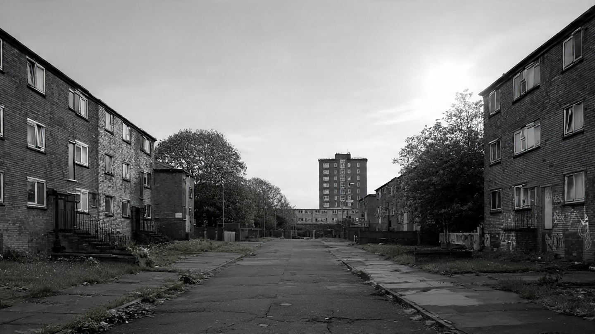
The Mirror Cracked
Perspective: Right Realism
Hirschi’s part of a Right Realist gang that says crime’s not caused by issues like poverty or inequality: it’s a lack of social control, pure and simple.
See, according Right Realists people commit crime when their bonds to society weaken – an idea borrowed from something called Control Theory.
In a nutshell?
Strong bonds = conformity. Weak bonds = deviance.
Now, this is okay when you’re taking about small tight-knit communities where everyone’s pretty much on the same page: shared beliefs, shared values, shared morals, shared norms.
Places where “this is how we do things here” and informal social controls do the heavy lifting. No cops, no courts, just raised eyebrows, neighbourly gossip and the silent threat of being the odd one out. Keeps people in line better than any badge.
But here’s what you’ve got to ask yourself, kid. What happens if everyone’s not playing happy families?
Right realism emerged in the 1970s - 80s and sees crime as a real, growing problem requiring tough control measures. From this perspective crime is a rational choice, although biological factors (predispositions towards crime) and poor socialisation, particularly in the so-called “underclass”, increase risk. Welfare dependency is also undermines personal discipline. In terms of solutions, zero‑tolerance policing, harsher punishments and stronger family discipline have all featured as possible remedies.
Perspective: Control Theory
For Control Theory the major question is “Why don’t people commit crime all the time?” and the answer is that social bonds and self‑control restrain us. So if those bonds weaken or break, crime becomes much more likely. In this respect, Control Theory explains why people conform rather than why they commit crimes. It informs crime prevention programmes and highlights the importance of institutions like family, school and community in crime control initiatives.

Slide 12
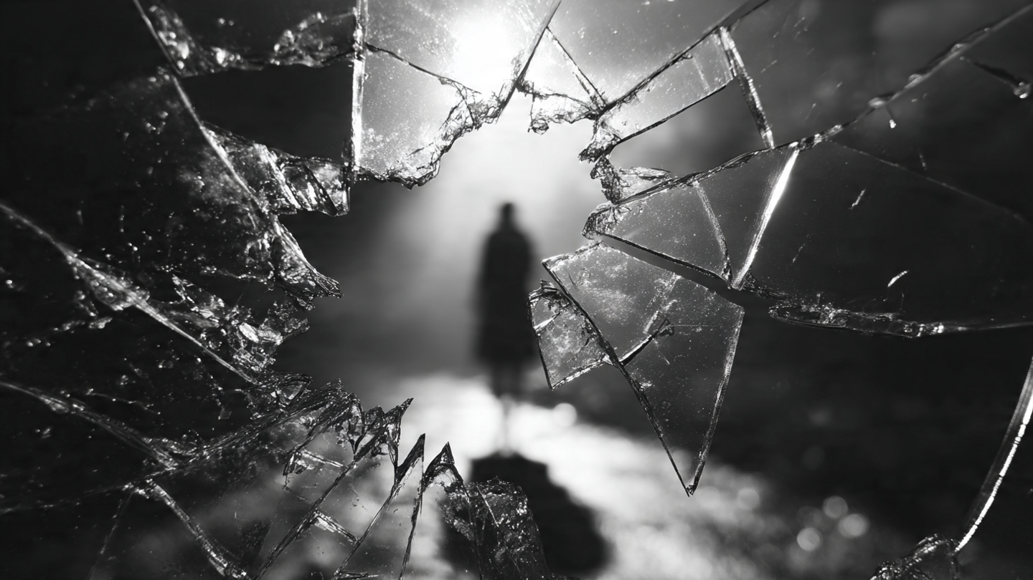
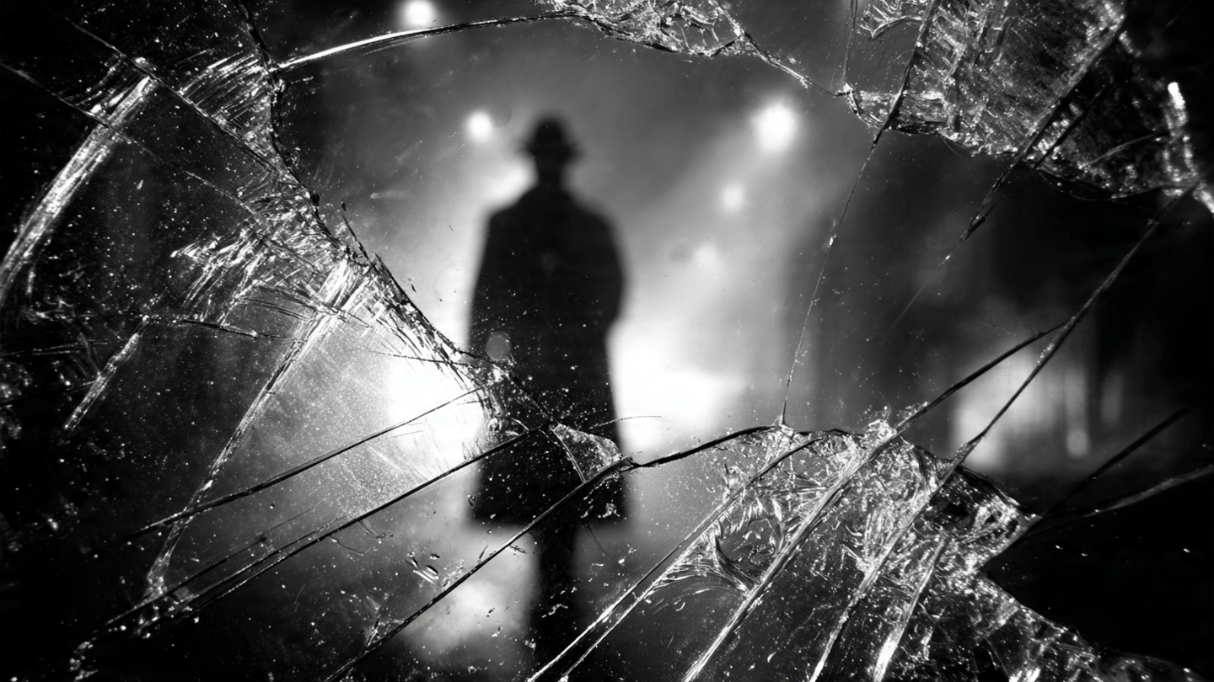


From Side To Side…
When we get a mix of different cultures, classes and competing interests, things start to look a little different.
No shared values, no shared expectations, no easy way to shame someone into playing by rules they never signed up for. Where inequality runs deep, the mirror we hold up to society starts to crack.
In simple terms? The rich play by one set of rules, the rest of us by another. Trust evaporates. Neighbourhood ties snap like cheap shoelaces.
And when the informal stuff breaks?
A society where everyone’s watching everyone, but nobody’s watching out
for each other.
So yeah, kid, informal control works great in cosy, tight-knit communities, but out in the pluralist jungle? It’s just another tool that breaks when you need it most. And that, by my reckoning, means it’s time to wrap this one up.
Unless you want to try another angle?
Perspective: Pluralism
Pluralism is a perspective that stresses how social groups compete against each other in the economic market place. In this respect societies involve individuals and groups pursuing their own (sectional) interests. Competition is based on the desire for power, such as making proﬁts or gaining market share (economic power) or inﬂuencing decisions made by governments (political power). Bottom line? Life is a power struggle and if you want to win you need to compete any way you can.

Slide 13
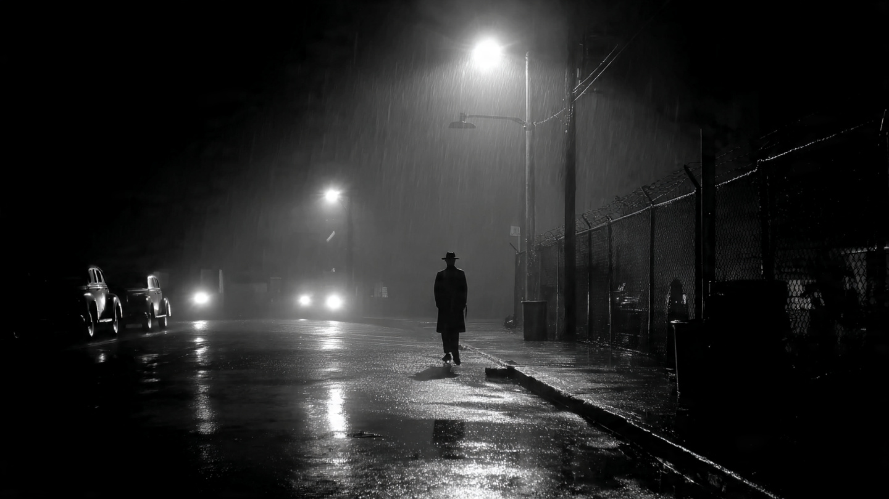
The Darkness on the Edge of Town
According to a rival gang of Left Realists headed up by Lea and Young (1982), when a community stops calling the cops, it ain’t because everyone’s tight, like some cosy little crime‑watching family. Sometimes silence isn’t solidarity. It’s alienation.
See, working-class districts get the short end of every stick that’s going. Marginalised, pushed to the edges, treated like background noise by the very institutions, cops, courts, and politicians, meant to protect them. Sure, there’s cops cruising around, but they ain’t there to help. Not so much a service, more an occupying force.
So don’t be surprised when people stop believing the system’s on their side. They don’t report crime because they don’t expect justice, just hassle. That’s not cohesion. That’s not some sort of community spirit. That’s neighbourhoods learning the hard way the government’s door only opens one way.
So maybe you’re right, kid. People have got Informal control all wrong.
It fills a vacuum. It’s not a preference.
Theory: Left Realism
Crime is a real, everyday problem, especially for working‑class communities and must be taken seriously without resorting to punitive right‑wing policies. It emphasises relative deprivation, marginalisation, and subculture as key drivers of offending, showing how inequality and blocked opportunities create pressure toward crime. Most crime is intra‑class and harms the disadvantaged most. Left Realists advocate community‑based policing, stronger relationships between police and the public and practical social reforms to reduce inequality. Their approach blends structural causes with realistic, achievable crime‑reduction strategies.

Slide 14
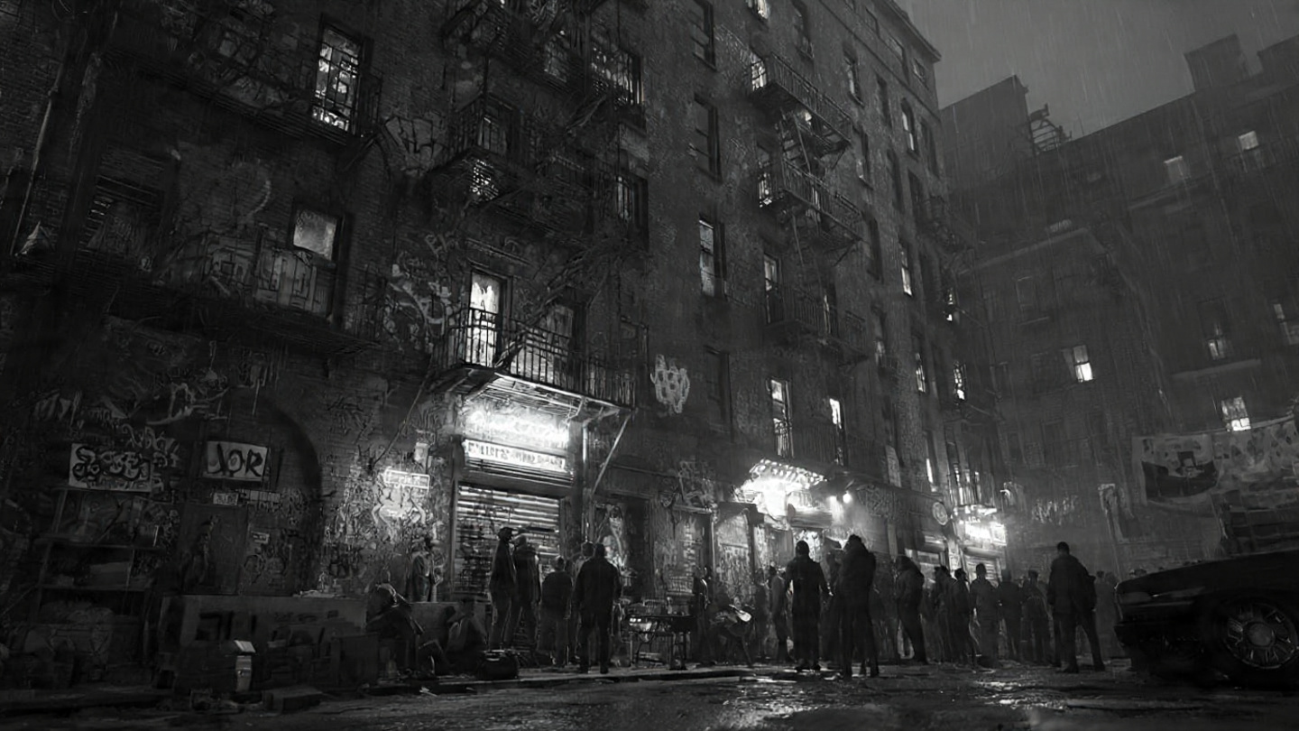
The Sound of Breaking Glass
Talking of which, you’re right informal social controls are important. But they’re not the only game in town. Not by a long shot.
Take Wilson and Kelling (1982) and their Broken Windows theory where they put it into language even ordinary joe’s like us can understand:
“If a window in a building is broken and is left unrepaired, all the rest of the windows will soon be broken…one unrepaired broken window is a signal that no one cares, and so breaking more windows costs nothing”.
But if you want to be a bit more sociological, minor forms of disorder, like windows in a disused warehouse being broken and left unrepaired, lead to bigger, more-serious, problems. See, if thugs and crims think “no-one’s bothered” about their area then no-one’s going to stop them when they move in and start to commit all kinds of crimes – from drug-dealing to running sex workers and serious violence.
And when informal controls can’t cope, who ya gonna call?
Although, before we get too carried away, the alternative ain’t necessarily everything it’s cracked up – pun intended - to be.
Theory: Broken Windows
Broken Windows draws on a range of well-known human ecological ideas and observations about crime popularised 40 – 50 years previously in the work of Chicago School theorists such as Park, Burgess, Shaw and McKay – the latter argued crime flourished as a consequence of “socially disorganised spaces”.
Wilson and Kelling however, took a relatively simple proposition – “Disorder and crime are linked” – and elevated it into both a more-general explanation for crime and, ultimately, a practical way of limiting or eliminating crime in an area.

Slide 15

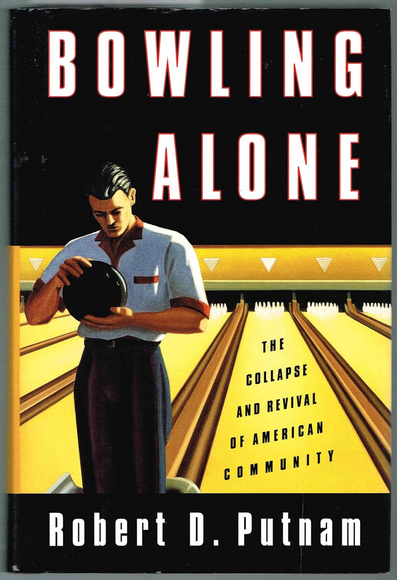
Networking
Concept: Social Capital
Social capital refers to the resources, trust, and benefits people gain from their relationships and networks. It’s about how connections between individuals and groups help them achieve goals, solve problems, and maintain resilient communities.
Communal networks are built from favours, a shared history and the occasional borrowed lawnmower.
When people are connected, information moves fast. Support moves faster. Someone starts acting out? The network notices. Not to punish but to pull them back in before they drift too far. It’s hard to spiral out of control when one half the town knows your parents and the other half knows exactly who your friends are.
Sure, it sounds like a sad spiral of decline. But you’re right to raise an eyebrow, kid. The spiral ain’t inevitable – at least that’s what some dude by the name of Robert Puttnam (2000) said. He argued communities can be a lot more resilient than Right Realists let on. They don’t just fall apart when trouble strolls into town.
That’s because of social capital – the networks based on trust and norms of reciprocity baked into the DNA of some communities. These are the ones that get the balance between formal and informal social control right. These are the ones where order is maintained, but not at the expense of everyone’s freedom of action.
In simple terms? It’s the difference between a neighbourhood and a collection of houses that happen to share a postcode. See, when people know, trust and help each other, trouble gets contained
Deviance becomes a blip, not a trend. A bad night, not a moral apocalypse. Because in a community with real social capital, one person’s mistake doesn’t become everyone’s problem.
It’s resilience, kid. Not the flashy kind. The quiet, everyday kind that keeps a community from cracking under pressure.
It’s getting late. You want to wrap this up?
Or are you still keen to go back and see if there’s anything we’ve missed?
Evidence: Trust
In a high‑trust community, people don’t look at each other like potential suspects. They assume the best until proven otherwise. That means when someone slips up - a bad decision, a moment of madness - folks don’t immediately jump to the conclusion everything’s going to hell.
Trust is like a neighbourhood watch without the fluorescent jackets. It keeps panic from spreading. It stops one broken window from turning into a street full of smashed glass.
Evidence: Norms of Reciprocity
In simple terms norms of reciprocity refers to the idea that if you help me, I’ll help you. Conversely, if you hurt me I’ll hurt you, back. Doing someone a favour involves the unspoken rule that at some point you can ask them for a favour in return. These rules aren’t written, but they are understood. Break them and no-one calls the police. You just find yourself frozen out of the networks that keep people afloat.

Slide 16
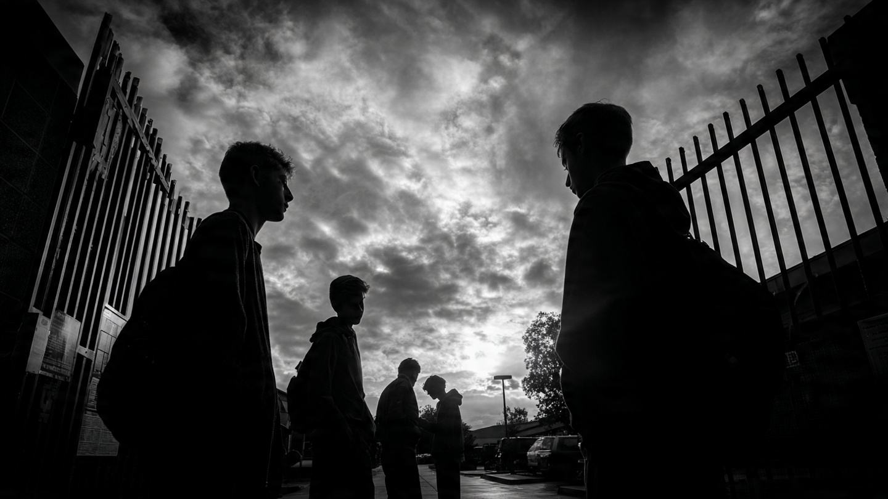
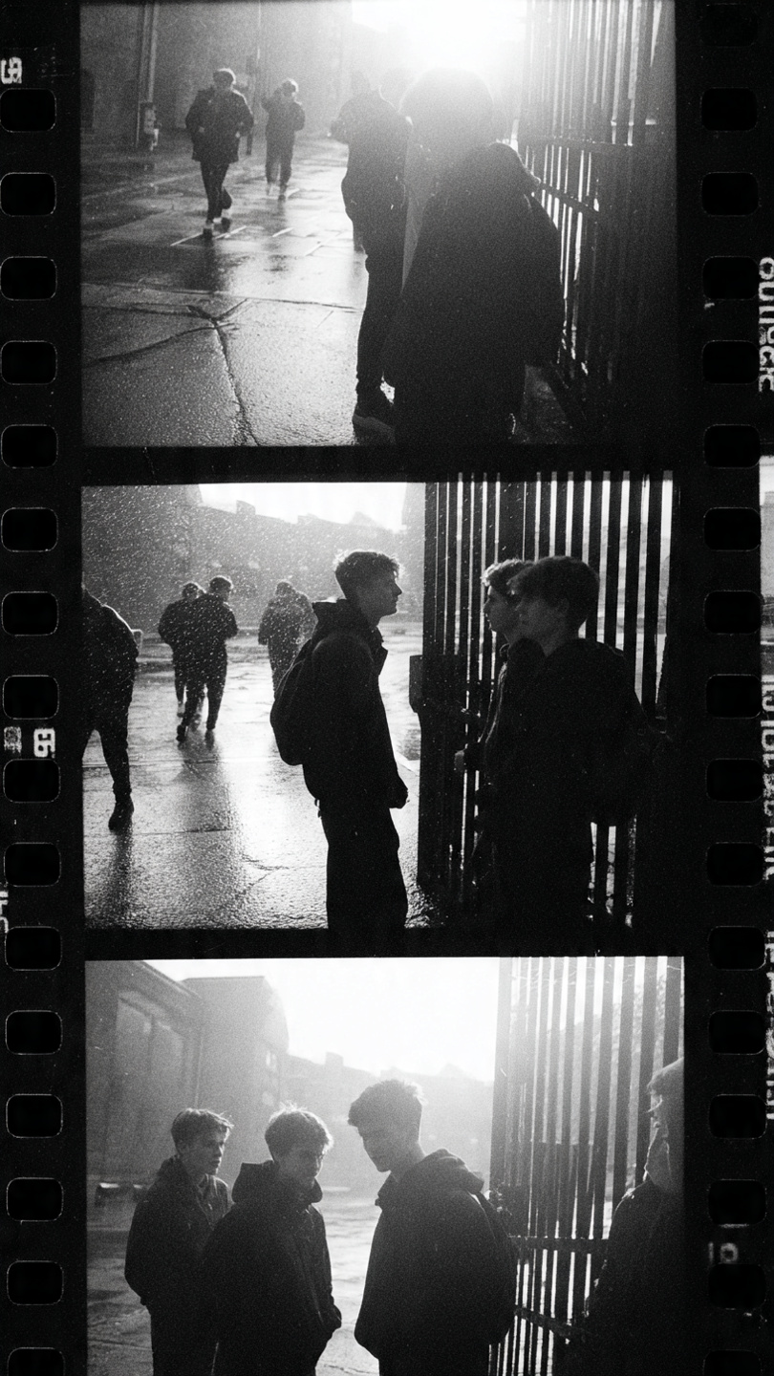
The Saints and the Roughnecks
Evidence: The Saints
Unlike Wilson and Kelling, William Chambliss took a less benign view about how formal social controls work in the real world of mean streets and even meaner street cleaners. Formal social control’s not blind, but it can be one-eyed. See, Chambliss looked at two groups of kids: one from a leafy suburb where the neighbours bake muffins and call the cops by their first names, the other from the wrong side of tracks where the trains stopped running a long, long, time ago.
“The Saints and the Roughnecks” he called them and it don’t take a genius to work out which one’s which. And when crime time comes to town, guess who’s behaviour gets labelled a “youthful misdemeanour” and who gets a record that sticks harder than gum to the sole of your shoe?
See, that’s the problem. Formal social control doesn’t fall evenly. It falls hardest where it’s always fallen: on the already‑marginalised. The kids without social capital, who don’t have a lawyer in the family or a teacher ready to vouch for their “potential.” Once the system tags you as deviant, it never stops. It just circles back.
Again and again and again…
“Eight promising young men of good, stable, white upper-middle-class families, active in school affairs, were some of the most delinquent boys at Hanibal High School. While community residents and parents knew these boys occasionally sowed a few wild oats they were totally unaware that sowing wild oats completely occupied their daily routine. The Saints were constantly occupied with truancy, drinking, wild driving, petty theft and vandalism. Yet not one was officially arrested for any misdeed during the two years I observed them”.
Concept: Social Capital
Social capital refers to the resources, trust, and benefits people gain from their relationships and networks. It’s about how connections between individuals and groups help them achieve goals, solve problems, and maintain resilient communities.
Communal networks are built from favours, a shared history and the occasional borrowed lawnmower.
When people are connected, information moves fast. Support moves faster. Someone starts acting out? The network notices. Not to punish but to pull them back in before they drift too far. It’s hard to spiral out of control when one half the town knows your parents and the other half knows exactly who your friends are.
Evidence: The Roughnecks
“My observations during the same two years of another gang of Hanibal High School students, six lower-class white boys known as the Roughnecks [revealed something very different]. The Roughnecks were constantly in trouble with police and community even though their rate of delinquency was about equal with that of the Saints. What was the cause of this disparity?

Slide 17
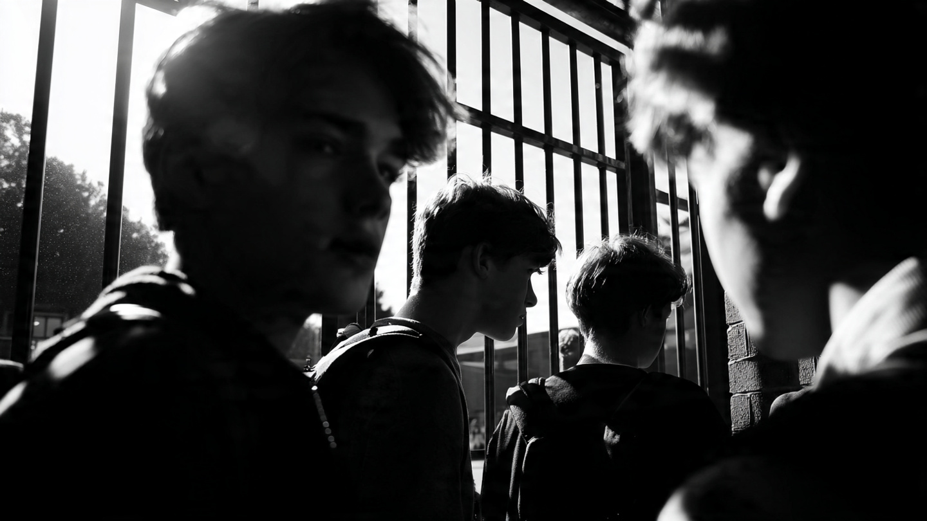
The Saints and the Roughnecks
You get watched more. Stopped more. Reported more.
Hell, let’s not mince words: you get punished more.
And every new encounter becomes evidence you’re the problem.
Unlike the golden‑child version of you across town, you don’t get a warning, a wink and a ride home. You never get the benefit of the doubt.
A second, a third or fourth chance…
See, Chambliss saw formal social controls as designed to maintain a certain kind of order. One where the working class and the underserving poor get prison, while the middle class who run the system get “understanding” and a chance to go to rehab to “learn how to become better people”.
It’s a system that keeps tightening the screws on the same old suspects. Shining a spotlight on crime, for sure. But only in certain directions.
But hey, it’s getting early. What say we wrap this up now?
Unless you’re still keen to check-out that vigil?
CONCEPT: FORMAL vs INFORMAL SOCIAL CONTROL // ► Choice A or B → Slide 7 (Path A final outcome)

Slide 18
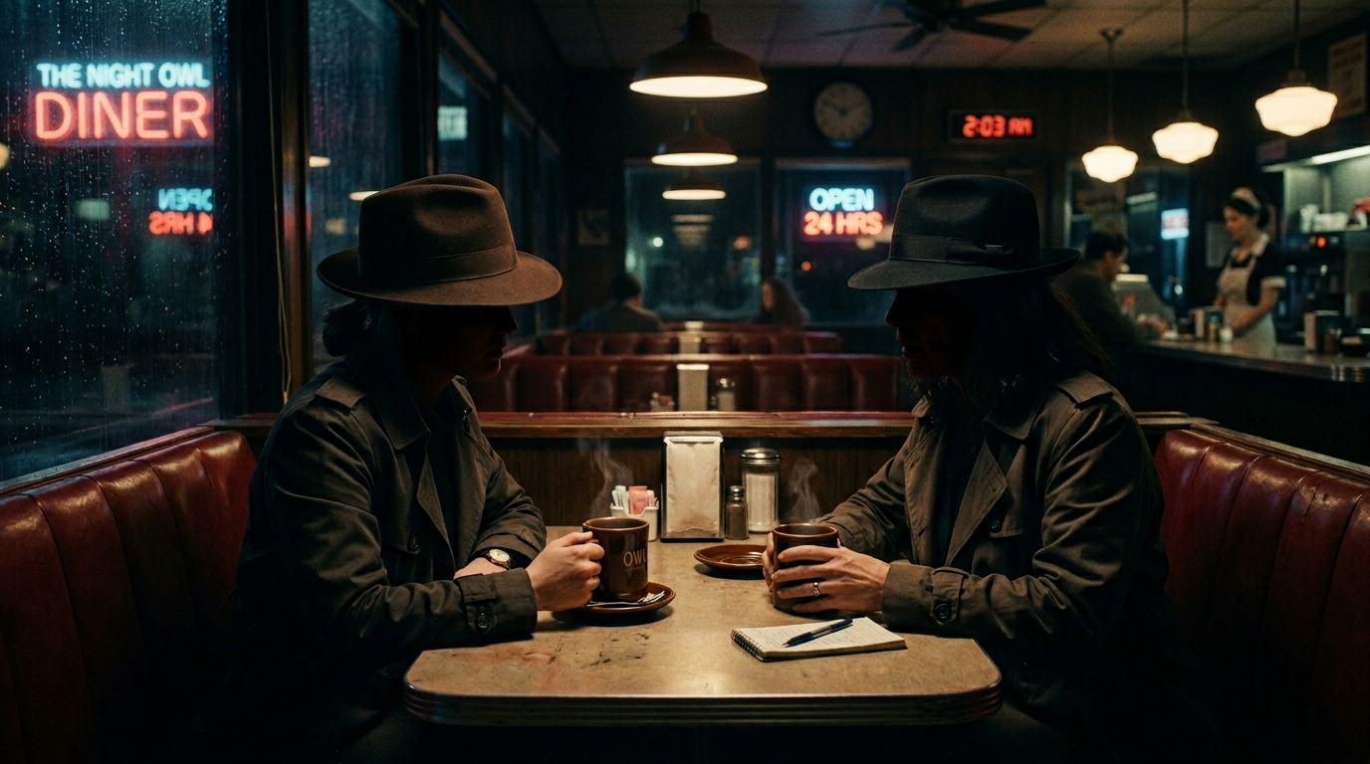
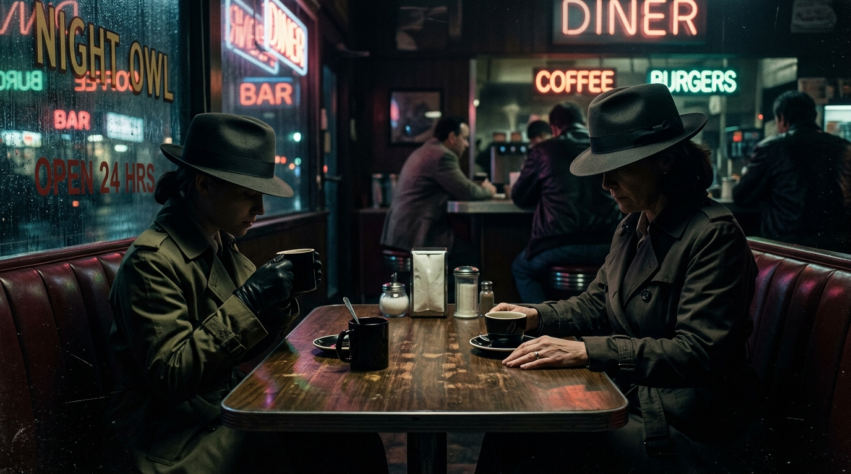
Time For The Leaving
It’s been an interesting shift, but it’s time to wrap this up and kick back in the diner while we plan our next move.
So what have we learned from the fight? Well, crime and social order aren’t always the polar opposites some would have you believe. Crime can fold into social order if a community’s informal control mechanisms are strong enough to contain it. Speaking of which, social control operates at two levels simultaneously: formal in the shape of the police and informal where a community self-manages a situation.
But here’s the thing. Informal social control depends on value consensus. Everyone pulling for the same team. But in unequal or diverse communities or relationships it can fracture – the mirror cracks and the state rushes in to replace what communities can’t maintain.
That’s a lot to take in and if you don’t think you’re up-to-speed with it then my advice is to play it again. In every crime scene there’s always more to find, different paths to take.
Otherwise, drink up kid. That vigil won’t wait forever.
DETECTIVE MACK
Key Insight: Crime and deviance can be embedded within social order rather than opposed to it. The mechanisms of informal social control are often more powerful than formal ones.
Four Concepts Mapped: Crime (ABH on the statute); deviance (norm violation); social order (the community’s stable expectations); social control (informal bonds, not police).

Slide 19
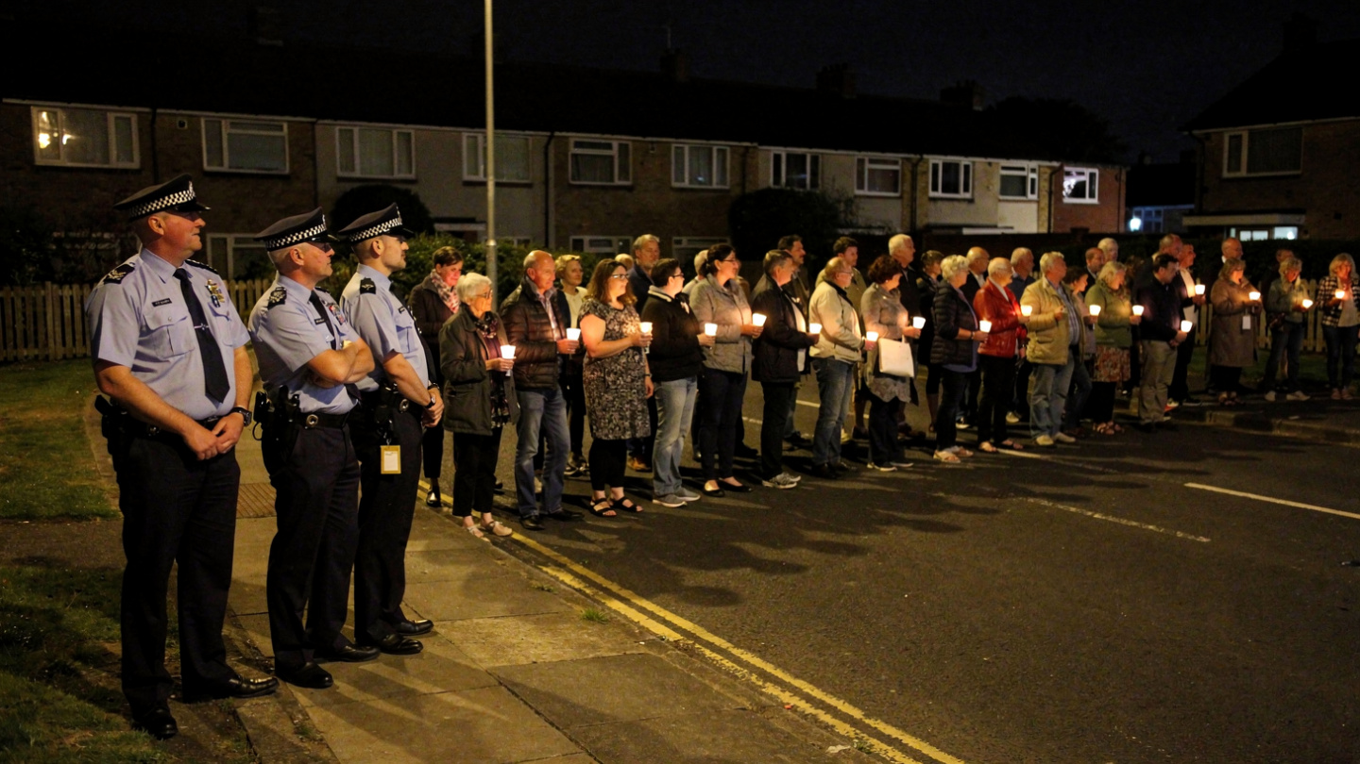
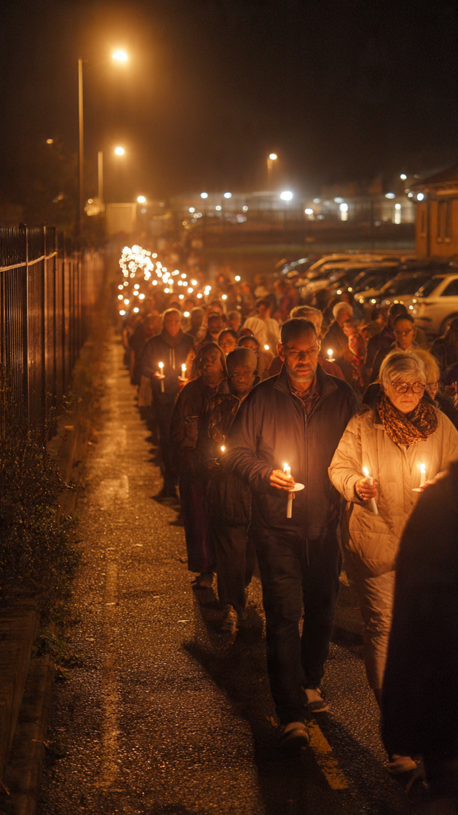
Keep a Light on Those You Love
Wise choice rookie and I’ll tell you this for free ‘cos, trust me, you ain’t seen nothing yet: the vigil is the genuinely confounding case. Let me lay out the paradox for you.
Forty people blocking a public road? By the letter of the Law, that’s an offence. The road is obstructed. In formal legal terms, that’s a crime.
It’s also, in the opinion of roughly zero people present, deviant. Nobody in that crowd thinks they’re breaking a norm. Just the opposite. They think they’re enforcing one: a 15-year-old’s death should be publicly acknowledged, collectively grieved and politically responded to. They think they’re the Good Guys here.
And here’s what makes it sing sociologically: those officers on the edge of the crowd are exercising social control. But they’re not using it to enforce the law. They’re using it to not enforce the law. Their professional judgment is that doing so would provoke more social disorder than permitting the offence. And there’s the paradox. They’re agents of social control tolerating a crime to maintain social order…
And that paradox produces two different lines of enquiry, rookie.
Is the vigil is being policed and controlled at the discretion of the officers present?
Or is it being done by the participants themselves?
Evidence: The Vigil
The vigil maps all four concepts in paradoxical relationship: it’s criminal (public order offence), not deviant (normatively legitimate to everyone present), a mechanism of social order (collective grief and solidarity), and an object of discretionary social control (police toleration is itself a control decision).

Slide 20
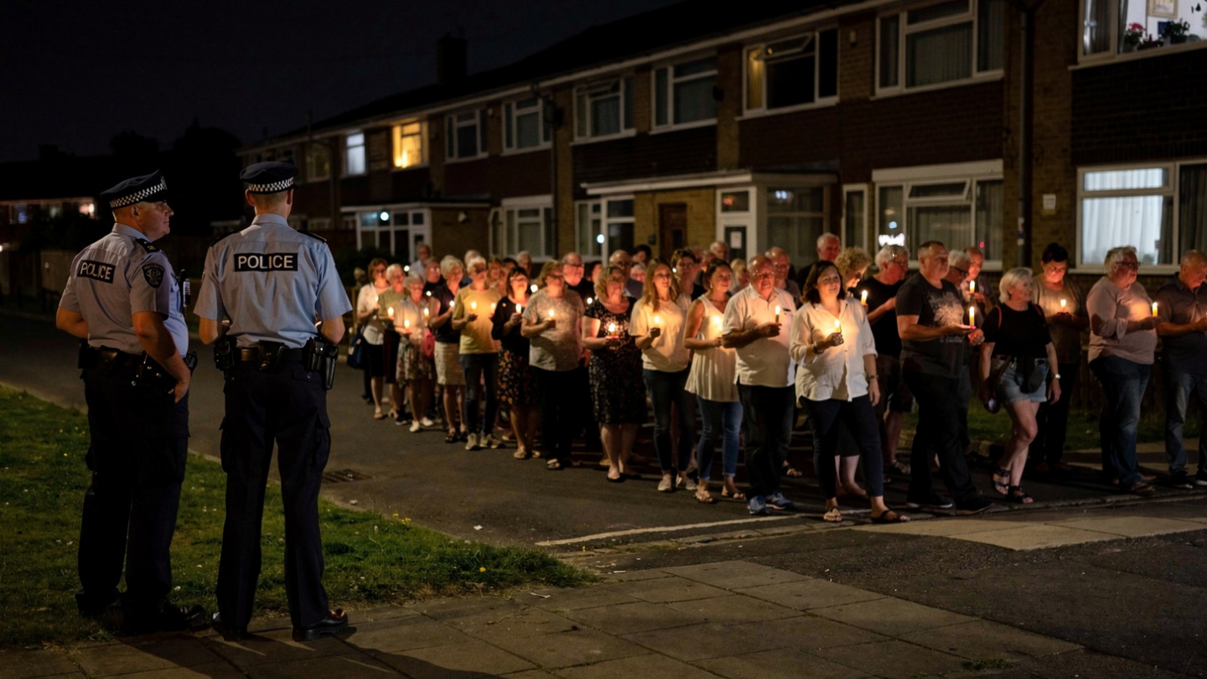
Police Discretion: For Better…
LEVEL 2 → B → A
You’ve put your finger on the most interesting feature of the entire apparatus of formal social control, kid: discretion. The law is blunt. It says “Obstructing a highway is an offence”. Full stop. A police officer is not blunt. They look at 40-odd people holding candles and photos of a 15 year-old girl and make a call: the social cost of arrest exceeds tolerating the crime. That’s not a cop-out. It’s social control operating in its most sophisticated way.
Reiner’s (2000) work on police culture shows discretion isn’t an aberration from the system. It is the system. The police don’t enforce all laws all the time. They can’t. They choose what to enforce, in what contexts, against which targets. And that choice is a form of power kid. Shaped by organisational culture, community relations, political pressure and the officer’s own reading of what produces order.
Not justice. Order. Social control and law are not the same thing.
The law is a resource. Control is what you do with it and to put it bluntly, what you choose not to do with it.
Analysis
Sharp analysis rookie. We’ll make a detective of you yet. Police discretion reveals the gap between formal law and social order. The law criminalises the vigil. Social control allows it. This only makes sense if you understand the goal of social control is to maintain order - and order is not always the same as following the strict letter of the law.
Theory: Reiner: Crime and Control in Britain
Reiner argues police discretion is not an exception to formal social control, it ain’t something the cops dreamt up for their own amusement. It is its primary mechanism. Officers use their experience – their socialisation as cops – to read social contexts and apply selective enforcement.
And when you think of like that, the decision not to arrest someone is as much an exercise of power as the decision to arrest them…

Slide 21
Police Discretion: Or Worse?
You’re right. “Discretion” can be a double-edged sword. That’s what Chambliss showed when he observed “The Saints and the Roughnecks” back in ‘73. If you’ve read it, you know what I’m going to say. If you haven’t, here’s the short and sweet version.
See, the discretion that allows the vigil to proceed is the same discretion that gets a Black teenager stopped and searched on his way home from school while his white counterpart wonders what song to play next on his iphone.
It’s exercised by the same officers, under the same law but it produces different outcomes depending on who the target is.
What it says is social control ain’t neutral, even when it’s looking at you with a smile on its face. It’s still looking at you, kid. It leaves us with what the High-Ups in City Hall call “a democratic accountability problem”. Or as you and I might put it, Who Watches the Watchmen?
That’s the truth, kid. Formal mechanisms shot through with informal biases that replicate the social order they claim to be merely maintaining.
Theory: Chambliss (1973)
One of the main takeaways from Chambliss’ study is that police discretion systematically favours groups that conform to dominant cultural perceptions: the behaviour of the middle class “Saints”, on the few occasions it attracted the attention of the police, was never criminalised. Similar behaviour by the “Roughnecks”, however, resulted in each member of the group being arrested at least once. “Social order”, it seems, is maintained for some at the expense of others.
Evaluation
The interesting thing about police discretion is how it can be seen as both a positive and negative feature of policing.
Positive in the sense it gives the police some control over how to apply the law. In particular it allows individual officers to assess situations and decide whether or not a strict application of the law is in the best interests of maintaining social order.
On the other hand, the ability to exercise discretion means officers can discriminate – both in favour of or against - different individuals and groups.
Evidence: The Saints and the Roughnecks
Two groups of High School boys. “The Saints” – white, middle-class, good school, well-presented. They committed minor crimes constantly: truancy, petty theft, reckless driving. The police never arrested them. Hell, they hardly even looked at them. Teachers forgave them. The community excused them. “The Roughnecks” same school, white, working-class. Similar crimes, arrested repeatedly. Labelled delinquent. Future life chances damaged accordingly.
Analysis
Powerful reasoning rookie. Chambliss shows police discretion isn’t random. It’s patterned by things like class, cultural capital and, in other contexts, race, age and sex. Here, the vigil is tolerated partly because it reads as legitimate grief. The same crowd in different clothes or a different neighbourhood might be treated differently. Discretion is always differential – and so is social control.

Slide 22
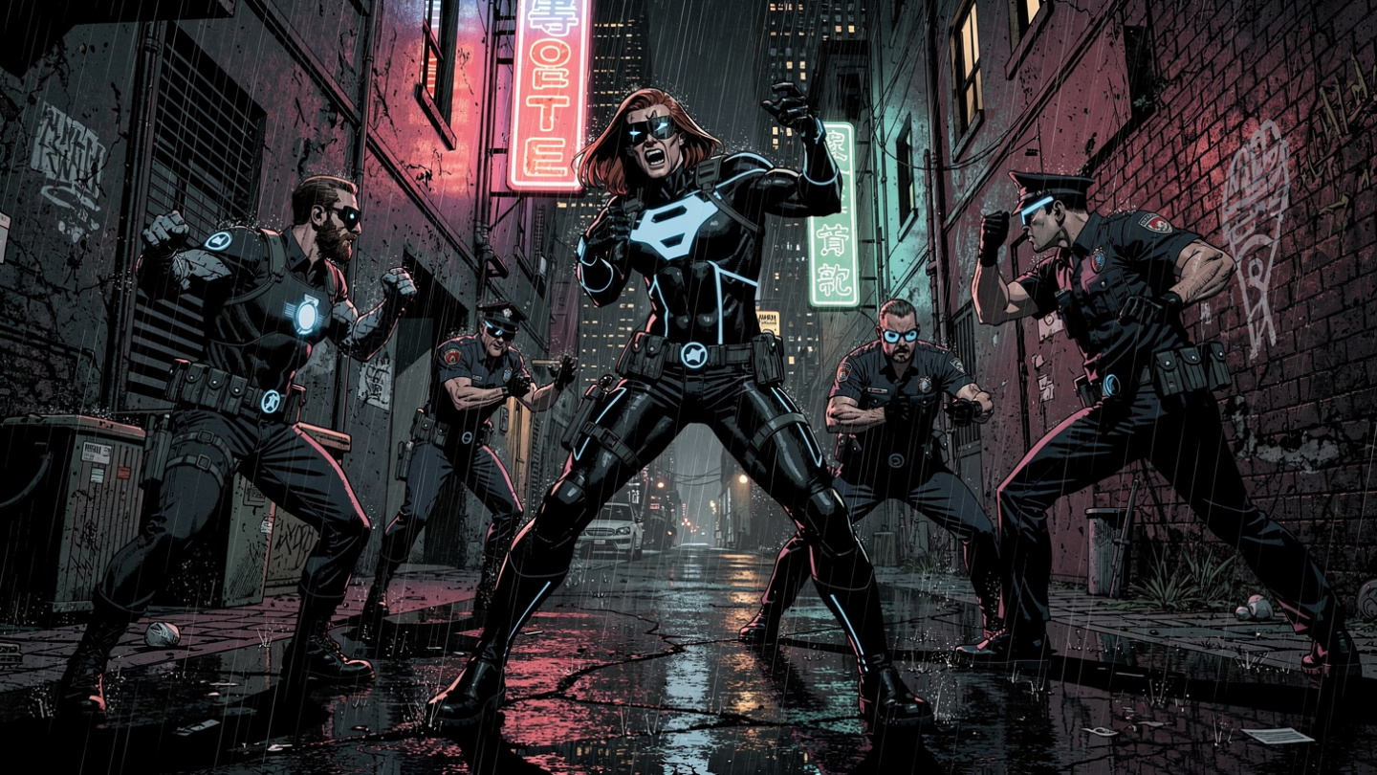
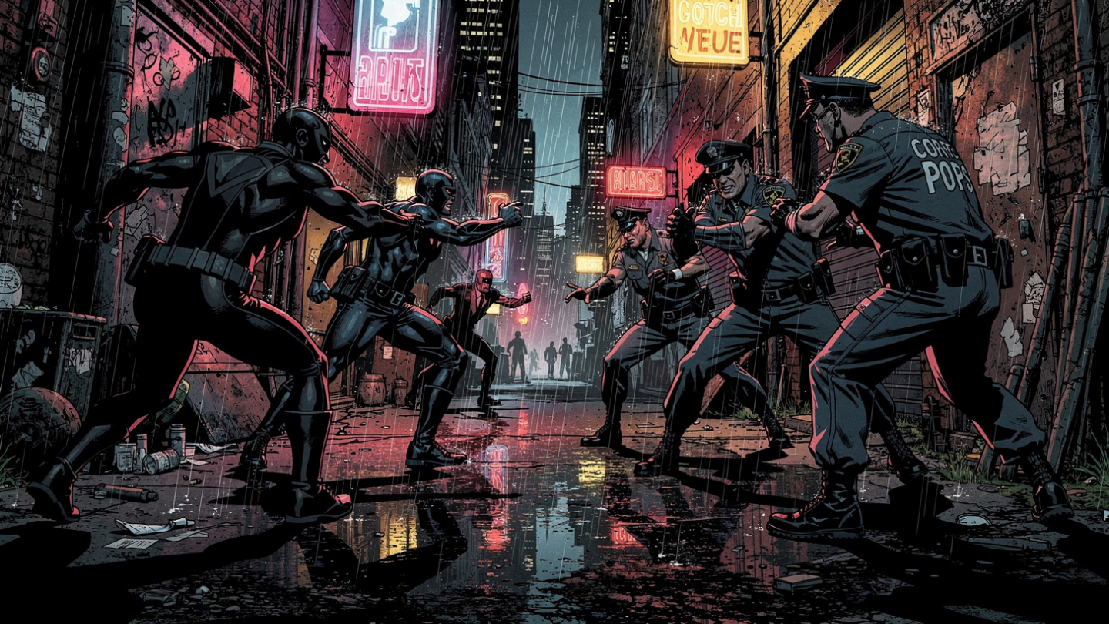
Critical Criminology
Theory: Critical Criminology
Critical criminology was – maybe still is? - a neo-Marxist attempt to combine Traditional Marxist ideas about structure - deviance as an expression of human diversity struggling to break free from the chains imposed by capitalist social structures - and Interactionist theories of agency; the idea of people making choices about their behaviour within the context of capitalist societies. The upshot of this was what Taylor, Walton and Young (1973) called a "fully social theory of deviance"
This is an idea pushed by the founders of Critical Criminology, three dudes going by the names Taylor, Walton and Young (1973). When they looked at crime and deviance they didn’t just see sad sack losers who make life a misery for the majority confronted by a thin blue line of everyday heroes doing their damnedest to hold back the rising tide.
They saw deviance as class conflict. And criminals were on the front line of resistance to bourgeois hegemony (that’s “middle-class leadership” to you and me). Criminals were transformed from lowlife scumbags – and quite a few high-flying ones as well – into heroic freedom fighters battling against a corrupt and corrupting capitalist system.
Okay, So I’m exaggerating to make a point.
But you get the picture. Critical criminology said ideas about crime, criminality and law were based on the ability of the rich and the powerful to impose their definitions of normality on everyone else. As I said, kid. Social control ain’t neutral.
And it’s not so much a question of “maintaining law and order” and more one of “who’s law and who’s order?”
Theory: Taylor, Walton and Young (1973)
Their book “The New Criminology” was long on problems with every other theory of crime and a lot shorter on what they could be replaced with. However, the upshot was a “fully social theory of deviance” that combined understanding a criminal act in terms of the structural forces pushing people into crime and the social reaction to that behaviour.

Slide 23


Let’s Get Real…
Perspective: Left Realism
Left realism developed, in part, as a reaction to the various forms of punitive policing and retributive justice favoured by right realists and solutions to the problem of crime. For Young (1997) it’s central concern was with "deconstructing crime into its fundamental components" - a square of crime centred around the relationship between four interconnected sides:
The police, victims of crime, criminal offenders and the general public.
By the mid-80’s, allegedly citing “musical differences”, Young had left the band to form the Left Realists (with his good friend and collaborator John Lea). I’m messing with you, rookie. The real reason he split was “irreconcilable ideological differences”.
Young, unlike his ex-fellow radical criminologists, saw law-and-order campaigns targeting certain types of crime and disorder as something more than ways to distract the working class from their exploitation by the rich.
Crime is real, kid. Nasty, brutish, hurtful and it leaves a bad taste in the mouth. And guess who suffered the most? The very people – the working-class and marginalised ethnic minority communities - idealised by radical criminologists. You couldn’t make it up.
And for Young, getting real about crime and criminality meant not only seeing crime as a choice, something certain people deliberately decided to do, but also understanding how and why communities needed formal social control to work for them rather than against them: policing had to be responsive, accountable and legit.
Analysis
Young (1984) suggests critical criminology was both idealistic in its representation of deviants and a form of ‘left functionalism’.
Rather than crime being functional for “society as a whole” radical criminology was accused of seeing it as serving the interests of a ruling class.

Slide 24
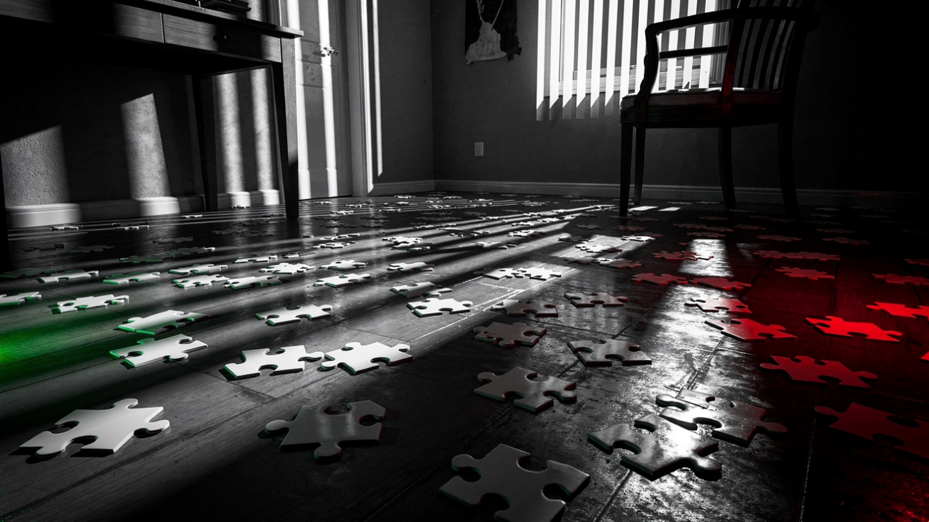

Whose Side Are You On?
Left Realism takes a pot-shot at the over-critical left by taking community needs seriously. The vigil shows formal social control that’s locally legitimate and welcomed. Not because it’s weak, but because it’s wise. The officers maintain order precisely by not enforcing the law in a heavy-handed show of strength. The critical criminology guys had been so busy condemning the cops they’d forgotten to ask what communities actually needed: formal control to be sensitive, responsive and accountable, not absent.
See, for Young, understanding crime, order and control didn’t mean taking sides. It meant thinking about all sides of the puzzle. Or what he called
“the square of crime”.
See, when you’re trying to understand why some places are as disordered as puzzle pieces scattered across the floor, while others are as orderly as a completed puzzle, you need to keep everyone in the picture. Bottom line?
The officers who let the vigil continue are, in Young’s book, doing the right thing: reading the community room, supporting the informal social order mechanisms that already operate and positioning formal control as a resource available to the community rather than as a militarised occupying force.
Job done in my book.
Evaluation
Military (or occupation) policing is relatively common in America and involves the police playing an occupying and pacifying role that involves imposing order, through a physical show of strength conspicuously designed to induce fear and apprehension. Community ‘consent’ is neither sought nor freely given.
Lea (2007) argues this type of policing has significant consequences for how crime and deviance are constructed. Information about crimes supplied by the public, for example, is likely to be "low grade and general" and supplemented by "police initiated" information gathering focused around high levels of surveillance technology. The general focus is on establishing and maintaining public order; crime control is part of this process, but not the central objective.
Evidence: The Square of Crime
The Realist argument is that to really understand and explain crime and criminality you need to understand the behaviour of four sides of the equation: offender, victim, police and community. Social control that ignores the needs of a community, for example, simply alienates people and they stop co-operating with the police. Effective social control promotes social order when it’s locally responsive and democratically accountable.

Slide 25
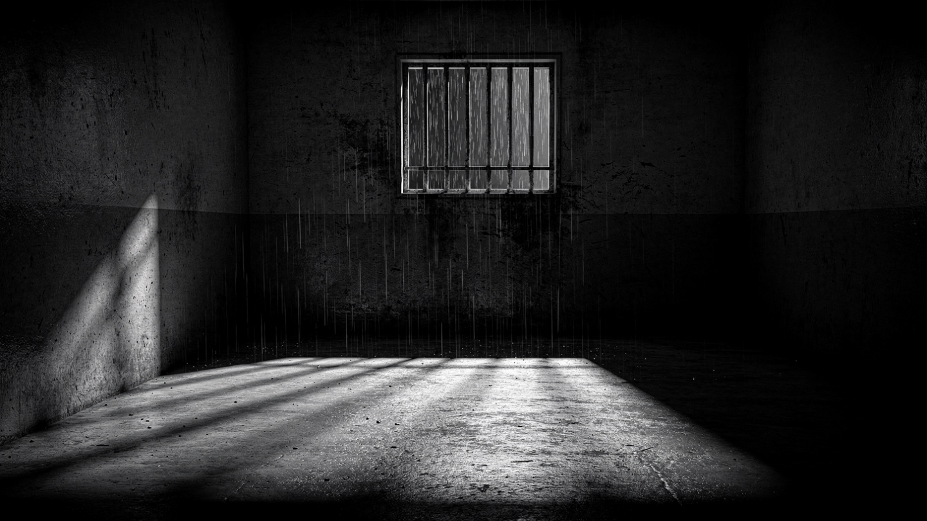
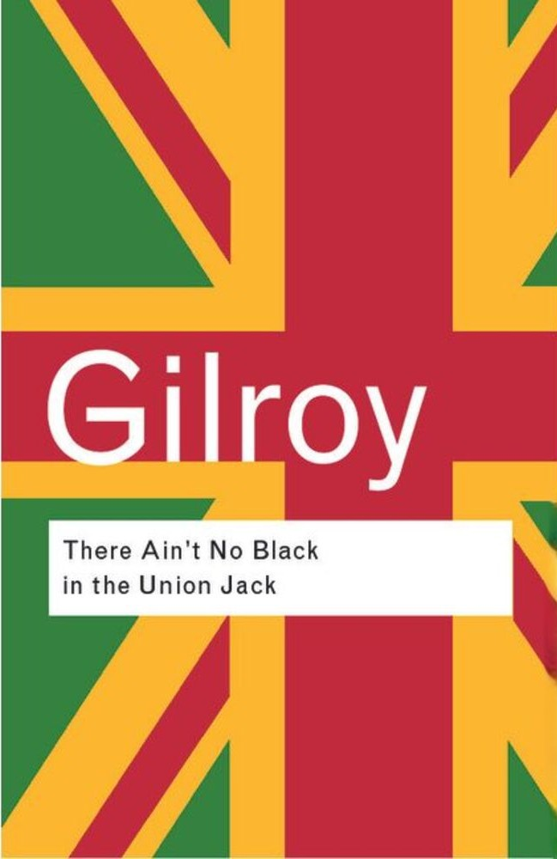
Who’s Law? Who’s Order?
But there again, who says they don’t have a point? Maybe social order and social control don’t exist for the ultimate benefit of us all.
Maybe, like Gilroy (1987) says, in Britain racism wasn’t – still isn’t - incidental to social control and political order, it was – and stays - embedded in how crime’s defined and policed.
Maybe, like Scraton (1999) argues, the criminal justice system works to protect the rich and powerful and punish the lower classes. Maybe ideas about “order” and “control” are just polite ways of saying “let’s keep things the way they are ‘cos we’re winning”. Maybe that’s how the system’s designed to work?
Maybe saying we need to limit or control police and judicial discretion over things like stop and search, who gets arrested and who gets to walk, who gets bail and who gets jail is
missing the point. Spraying perfume on a dustbin may disguise the stink, but that doesn’t mean it ain’t just a bin full of rubbish.
So what’re they saying?
When you’re looking at crime, deviance, order and control you can only understand the first two by understanding who’s in control and how that order works for them.

Slide 26
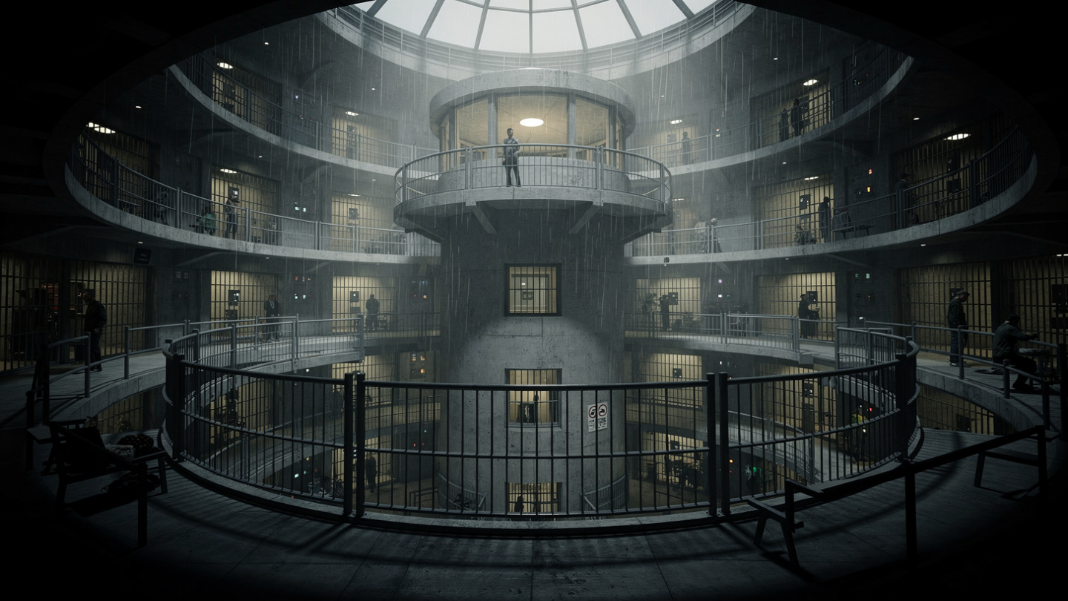
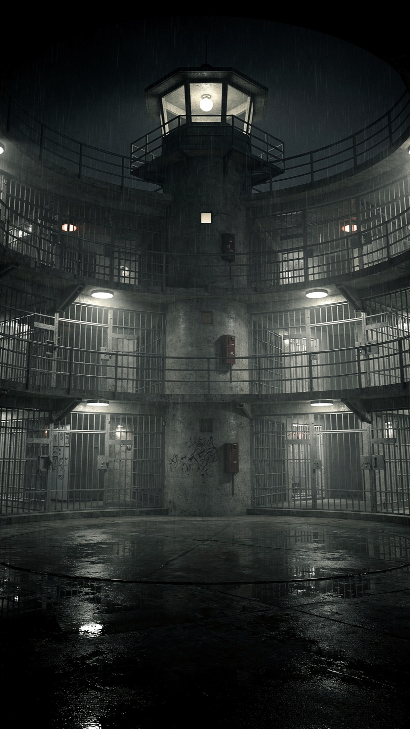
We Are All Prisoners…
Evidence: The Panopticon
Now here’s something to consider. Maybe we’ve been thinking about crime, deviance, order and control all wrong. You stray from the straight and narrow and society steps in to put you back on the right path. Maybe not quite so politely as that, but you get the drift. Control is what the State does to ordinary joe’s to keep things orderly. What if that’s no-longer the case?
Sure, the State likes to control things – and we can argue over whether it’s for everybody’s benefit or just a select few – but what if modern social control has achieved something far more elegant and far more total? What if it’s made us control ourselves? What if we’re living in a modern Panopticon prison where our every move may – or may not – be watched, catalogued, databased…
Look at the vigil again, this time through Foucault’s eyes. The police aren’t just tolerating it, they’re present. They’re visible and that visibility is itself a form of control. The crowd performs its grief according to the norms of a legitimate public demonstration: candles, silence, photos, the language of memorial rather than protest. Why?
Because they know the difference between what is tolerated and what isn’t. They’ve already disciplined themselves. Power is working. Silently. Independently.
Nobody needed to issue an order.
Foucault (1983) argued the panoptic prison, (Bentham’s late 18th century architectural design that allowed a small number of warders to constantly monitor a large number of prisoners without the latter knowing exactly when they were being watched) represented ‘the essence of power’ because it was based on differential access to knowledge. The warders were powerful precisely because they knew what each prisoner was doing at all times.
Surveillance was also, he argued (1980), both ‘global and individual’. Warders could view both the whole prison and individual prisoners.
The Panopticon is a metaphor for the entire control apparatus of modern societies – schools, hospitals, offices, factories, homes, streets. We’re all under a constant gaze we’ve internalised to such a degree that we perform normality for an audience that may not even exist. But that’s the essence of social control. We never know when we’re being monitored – which gives us an incentive to behave in ways that maintain order.

Slide 27
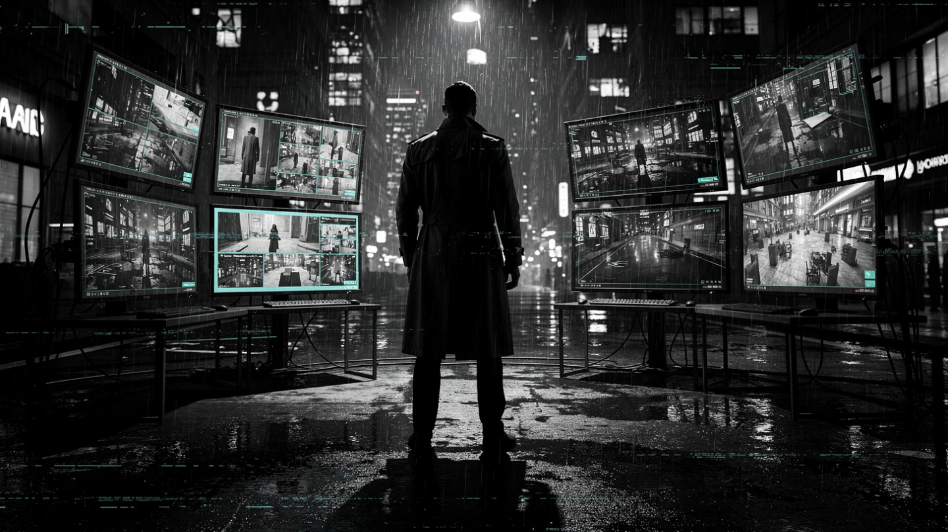
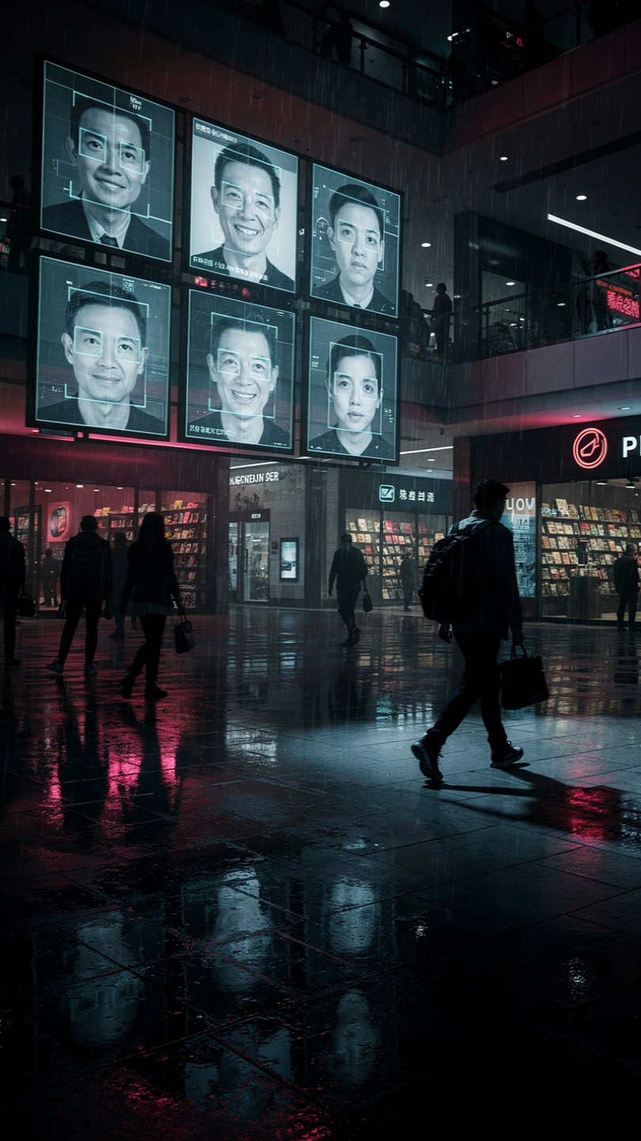
Of Our Own Device(s)
See kid, there’s an argument being made by people who know about these things that the nature of control is changing. It’s less about hitting people over the head with big sticks until they do as they’re told and more about convincing us to cooperate in our own control.
That’s because power, as Foucault (1983) put it, is increasingly opaque - “hard to see“ to the likes of you and me – particularly in this digital age of mobile devices that track your location, web sites that know everything they need to know about what you like, dislike and shouldn’t be liking and AI chatbots that refuse your request for a loan or deny you a job. Bottom line? As we happily play with our shiny new toys we’re unaware of the power governments, the police and private corporations hold over us.
Don’t get me wrong.
The nature of power hasn't changed – the forces of law’n’order will still crack heads when they feel they have to - but how we think about and experience power in everyday life has changed.
In the past, control was largely based on fear. Nowadays, it’s transformed into increasingly subtle modes of domination, from CCTV surveillance, facial recognition and doorbell cameras that rat you out to the cops, to the social media sousveillance we freely perform for nothing more than a few likes and follows.
Evidence: Sousveillance
Sousveillance means watching “from below”: the recording / monitoring of activities by individuals rather than authorities, through wearable or portable technology like smartphones, body‑cams and smart glasses.

Slide 28


Disneyfied
That’s an interesting take, kid. When people talk about “social control” they tend to see it as a one-way street: from top to bottom. Either you obey or something bad happens, if you get my drift. But two guys called Shearing and Stenning said modern corporations like Disney have learnt how to control huge crowds without resorting to violence. Take Disneyland. Social controls there are invisible: people don’t know they’re being pushed in the directions Disney wants them to go. They’re also pervasive. You can’t escape them ‘cos they cover all aspects of your stay.
And here’s the good bit, kid. These controls are embedded in things that sound less alarming and more-friendly. Like “safety issues”. Would you disobey a direction if it might put you and your family in danger? Sweet, eh?
This creates a situation of apparently consensual control - people seem to willingly participate in their own control (as with, for example, the use of CCTV cameras in shops and arcades) but which is actually coercive. They just don’t recognise it as such.
And if you think about it, this is what’s happening in the vigil. The participants aren’t butting heads with the cops: they’re cooperating in their own control because to do so makes it safe to protest and get their message across. Everyone’s a winner.
But maybe some more than others…
Theory: Shearing and Stenning (1985)
Disneyland, they argue, is a subtle system of control (what you can do, who you can do it with and where you can do it), designed to keep people moving through the theme park without an awareness of being controlled. Control is disguised; "embedded in less threatening structures", such as "health and safety“ to convince people it’s in their best interests to cooperate. Similarly, to resist being controlled risks "endangering your own safety and that of others".

Slide 29
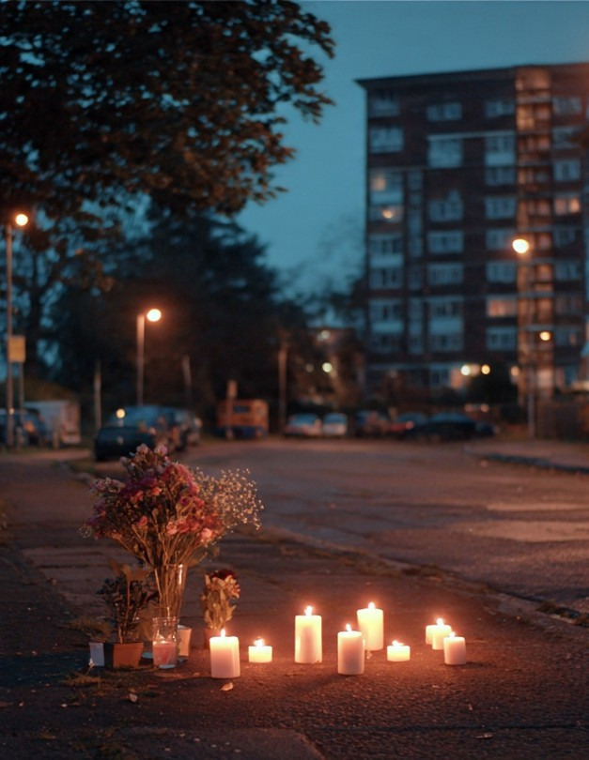
Everything Together All At Once…
While it might look simple and straightforward – the authorities let them march and in return they do so respectfully and quietly – there’s a lot more going on here.
On the one hand the vigil performs normatively acceptable grief. Candles. Silence. Flowers. The whole nine yards. But look closer and you’ll see it performing something else: 40 people blocking a road at night, refusing to be invisible, demanding a 15-year-old’s death is treated as something other than just another crime statistic. That isn’t just simple compliance with the norms of acceptable demonstrating. It’s also occupying public space with collective grief in a way that refuses the privatization of suffering.
This is what Foucault called ‘practices of the self’, the everyday ways people shape who they are. But, here’s the kicker, these aren’t some sort of free-floating lifestyle choices. They’re choices shaped by social institutions – families, schools, courts, governments – and the norms of society.
What he’s saying, in a roundabout way, is these practices give us ways “to be individuals” while also funnelling us into socially acceptable ways of being. A bit like Disneyland but with a lot less Mouse.
And that’s something you’ve learnt, rookie. Social order isn’t just maintained. It’s constantly being renegotiated, at the micro level, by every vigilant act of compliance and creative non-compliance.
And on that note, maybe it’s time we called it a night?
Concept: Privatization of Suffering
In “Liquid Modernity” Bauman (2000) argues that in contemporary modern societies suffering is both widespread but increasingly shouldered privately rather than collectively (except on rare occasions when populations are actively encouraged to express public mourning for one of the Great and the Good – the death of Princess Diana (1997) being a good example). For Bauman the idea of suffering becoming a personal burden rather than a shared social condition comes about as traditional social solidarities weaken and collective institutions withdraw from the public realm.
Concept: ”Practices of the Self”
These are the everyday techniques people use to shape their sense of self – fundamental beliefs about “who we are”. While some see The Self as some sort of fixed essence that comes from within (“our true self”) Foucault, in common with later writers like Judith Butler, saw self-formation as performative: something we have to do (“perform”) rather than something we naturally are.
The significance of this for crime and deviance is it shows how we come to police our own behaviour through an internalised discipline that leads us, for example, to conform to the expectations of others, to avoid being labelled criminal or deviant – as we can see in the example of the Vigil that “polices itself” in the shadow of the legal power represented by the police officers.

Slide 30
Time For The Leaving
Well rookie, I don’t know about you but I feel I learnt something tonight.
Both the fight and the vigil told us something about crime, deviance, order and control in their different ways - the vigil, in particular, told us interesting things about social order: it’s not the absence of crime or deviance – something Durkheim suggested when he argued they’re “normal” features of any society – it’s the management of them.
And social control’s not just the police, it’s every mechanism by which that management operates: our internalised norms, the tactical tolerance of a technical crime to preserve communal solidarity, 40-odd people with candles deciding their right to publicly grieve outweighs any public order statute.
All four concepts are present in that one scene.
None of them mean what you thought they meant before you looked closely enough. I’d say we’re done here..
You’re welcome to revisit the vigil if you think there’re things you’ve missed or just want to get straight. Otherwise take a break. You’ve earned it.

Slide 31
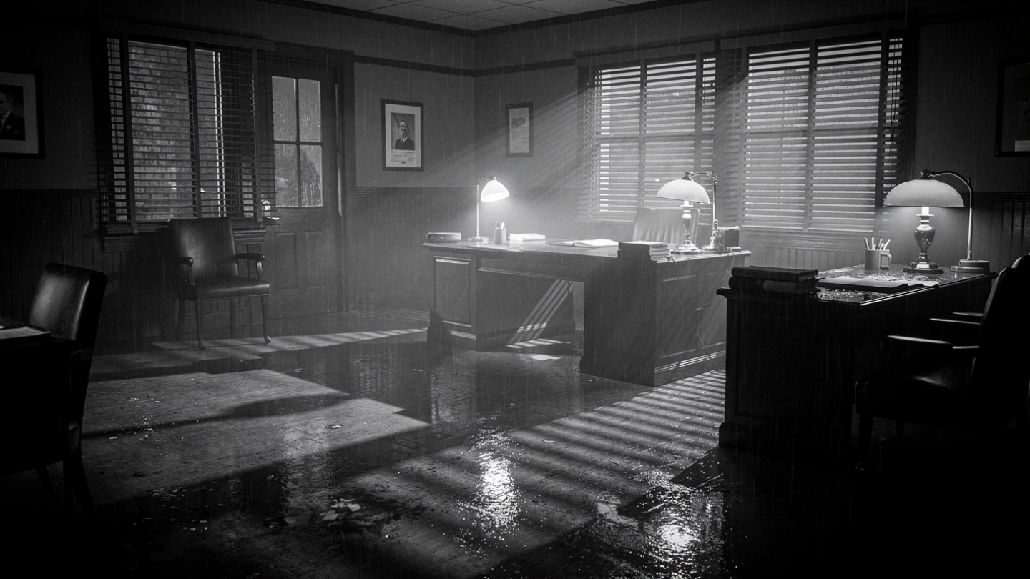
End of Episode 1
Next Episode
Episode 2
The Relativity of
Crime and Deviance
shortcutstv.com

Slide 32
Crime. Deviance. Order. Control.
In this simulation you take the role of a Sociological Detective investigating a range of different incidents. In Episode 1, for example, these take the form of a street fight and a candlelight vigil.
You are accompanied by an older, wiser and generally grubbier colleague whose job it is to help you, a rookie detective, get up to speed in your new line of work.
Your job is to listen to what they say and make appropriate decisions about what to do next. These decision-points are indicated by white hyperlinks that take you to another part of the story. There are no wrong decisions, just alternative paths to follow.
Some pages have orange hyperlinks that bring up one of 6 types of information:
Analysis: This highlights a possible discussion point about something you’ve just read.
Evaluation: This highlights arguments, points of possible criticism and the like.
Theory: Provides a brief overview of the named theory.
Perspective: Provides a short overview of a particular perspective on crime and deviance.
Concept: Provides some additional information about the concept in question.
Evidence: Provides some additional information about the ideas under discussion.
So if you’re up-to-speed, let’s get this show back on the road…

