Slide 1
Click to Open
Information
Analysts
The ABC of Investigating
Your Eyes Only

Slide 2
Click to Open
.
Training Day
Good investigators are, as somebody probably once said, made not born.
And if they didn’t they should have.
So, with this in mind, your Instructors have decided you need, as students, to get into the habit of analysing and assessing critical texts.
Like the one your Instructor has just provided.
Once you’ve analysed and understood the information it contains, start the next stage of your training.
Information
Analysts
The ABC of Investigating
Your Eyes Only

Slide 3
You have previously been given a document to analyse by your Instructor.
This document will now be the basis for further training in the ABC investigation method designed to enhance your ability to remember and review information efficiently and effectively. This involves practicing
three simple techniques:
Attaching new information to what you already know.
Broadening your understanding by expanding your knowledge.
Challenging your understanding.

Slide 4
Attach
Link what you’ve just learned to what you already know.
Building on what you already know is a good way to develop knowledge and understanding.
Identify and briefly explain at least one way the information you’ve just learned connects to previous information you’ve learned.
Once you’ve done this, move on to the next task.
Attachment is used to help generate deeper levels of knowledge about what you’re studying by linking new information to the things you already know.
Attaching new information to old information in this way creates a stronger bond between the two, making it more likely you can successfully recall information when you need it in an exam.
Attachment can also help you generate new levels of understanding by comparing what you know to the new information you receive and evaluating it accordingly.

Slide 5
Broaden
Widen the scope of your understanding.
You should always be looking to dig deeper and extend your knowledge and understanding of whatever you’re studying.
Identify and briefly explain at least one thing you would like to know more about from the information you’ve just analysed.
Once you’ve done this, move on to the final task.
This task is designed to stimulate your curiosity by encouraging you to ask further questions about the information you’ve just received.
This is useful because neurological studies have shown curiosity makes us more open and receptive to learning. It makes learning easier and more enjoyable, so it actually makes us better at it.
The more curious you are about what you’re studying, the more-likely you are to be successful at studying it.

Slide 6
Challenge
Critically review the information you’ve just received.
It’s important not to take ideas on trust and you should always assess the strengths and weaknesses of information.
Identify and briefly explain at least one question you have about the information you’ve just been given.
?
Thinking about ways to question or criticise information helps you develop the key skill of evaluation.
Taking a critical approach gives you a deeper understanding of what you’re studying and helps you actively engage with the information - something that increases your curiosity.
Actively looking for answers also enhances your ability to remember information because your brain processes and stores the information more effectively.
?
?
?

Slide 7
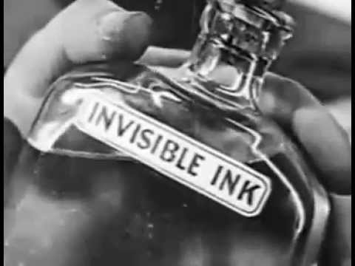
An
Invisible Ink
Production
for

Slide 8
An
Invisible Ink
Production
for
ShortCutstv

Slide 9
Click to Close
An
Invisible Ink
Production
for
ShortCutstv
Information
Analysts
The ABC of Investigating
Your Eyes Only

Slide 10
Click to Close
Information
Analysts
The ABC of Investigating
Your Eyes Only

