Slide 1
Acquiring “the Knowledge” of London's Layout Drives Structural Brain Changes
Katherine Woollett, Eleanor A. Maguire
Current Biology
Volume 21 Issue 24 Pages 2109-2114 (December 2011)
DOI: 10.1016/j.cub.2011.11.018
Copyright © 2011 Elsevier Ltd Terms and Conditions

Slide 2
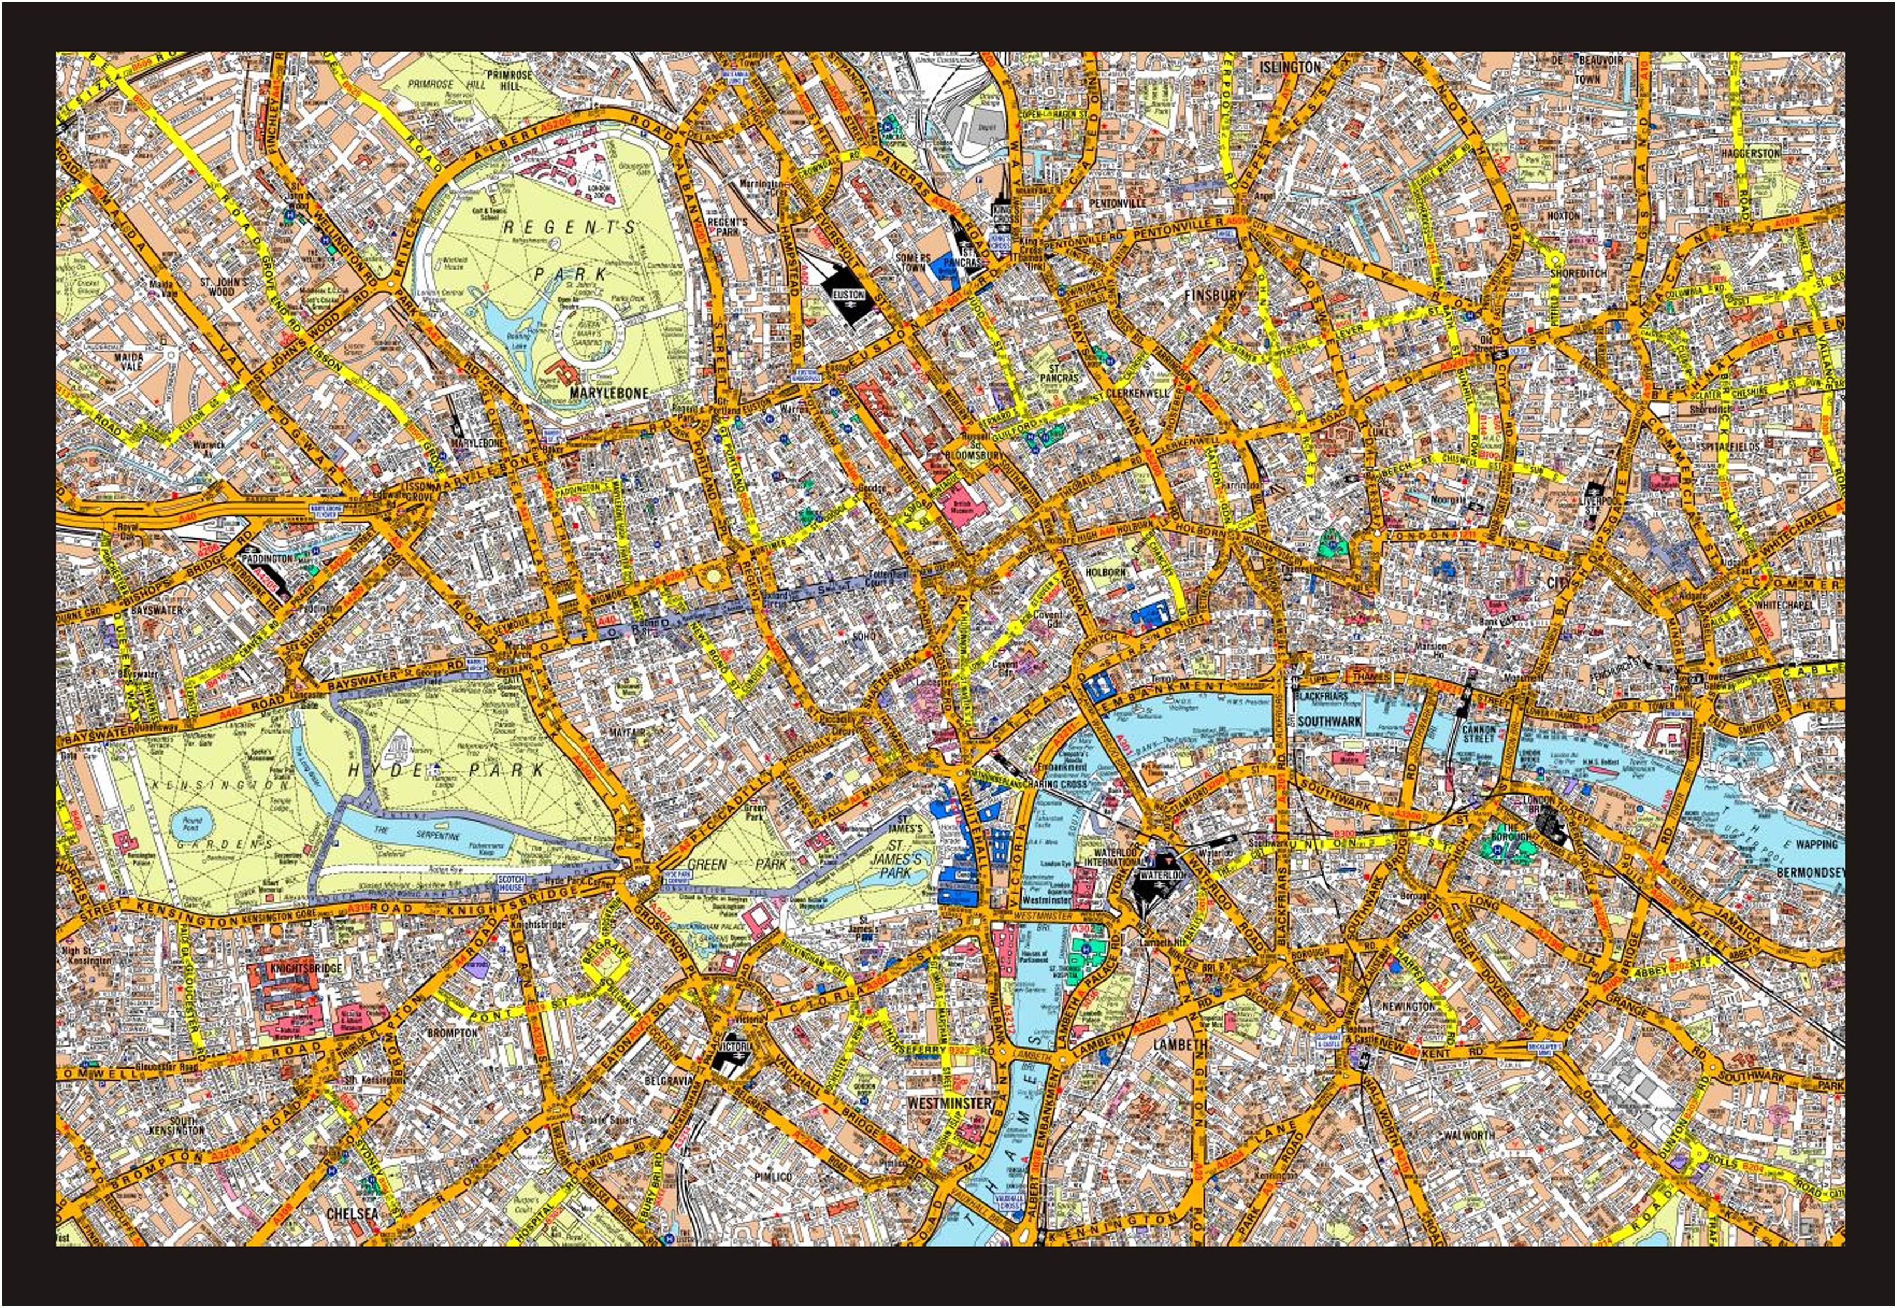
Figure 1
Current Biology 2011 212109-2114DOI: (10.1016/j.cub.2011.11.018)
Copyright © 2011 Elsevier Ltd Terms and Conditions
Notes:
Central London
Trainee taxi drivers must acquire “the Knowledge” of London's layout within a 6-mile radius of Charing Cross train station. This map shows just a part of the total area that must be learned. Map reproduced by permission of Geographers' A-Z Map Co. Ltd. © Crown copyright 2005. All rights reserved. License number 100017302.

Slide 3
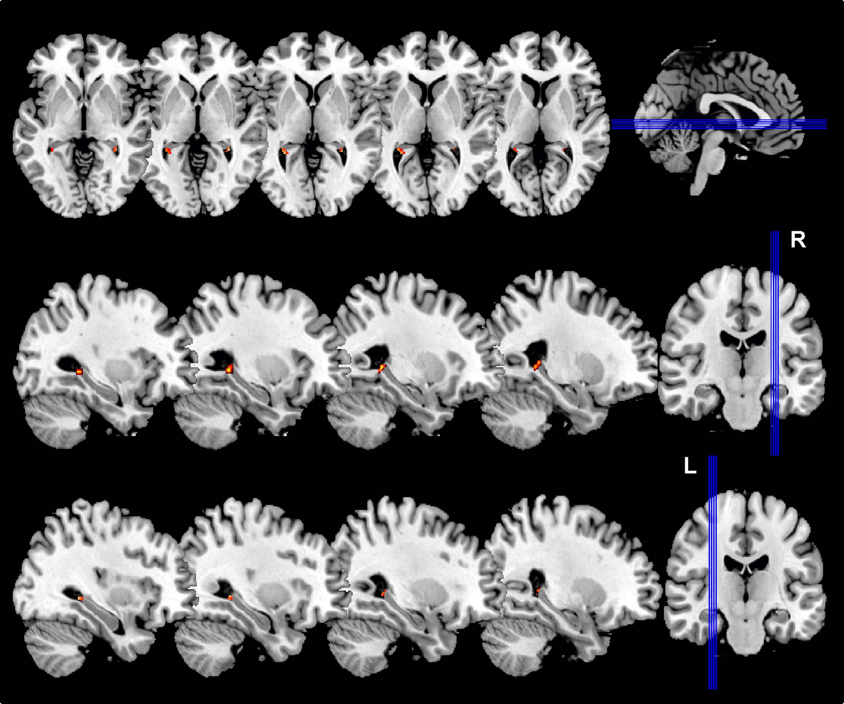
Figure 2
Current Biology 2011 212109-2114DOI: (10.1016/j.cub.2011.11.018)
Copyright © 2011 Elsevier Ltd Terms and Conditions
Notes:
Gray Matter Volume Changes between T1 and T2 in Qualified Trainees
Gray matter (GM) volume increased in the most posterior part of the hippocampus bilaterally between T1 and T2 as a result of acquiring a detailed representation of London's layout. This change was only apparent in the trainees who qualified. The upper row shows axial views, and the middle and lower rows show sagittal views through the right (R) and left (L) sides of the brain, respectively, that encompass the GM changes (shown in orange and yellow) in the peak voxels detailed in the text.

Slide 4
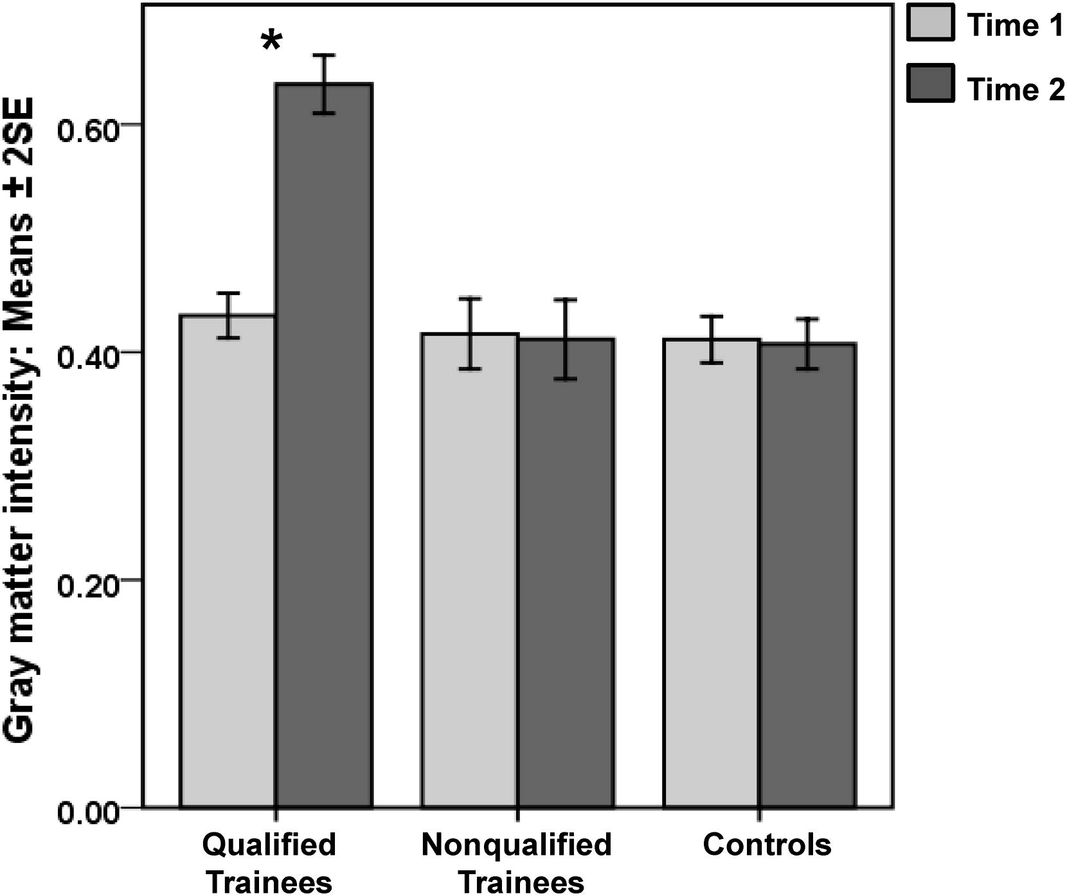
Figure 3
Current Biology 2011 212109-2114DOI: (10.1016/j.cub.2011.11.018)
Copyright © 2011 Elsevier Ltd Terms and Conditions
Notes:
Plot of Gray Matter Intensities across Groups and Time
GM intensity values were extracted from the four peak hippocampal voxels identified by the HDW procedure (see text for details). Here we show a plot from one of those peaks (the others resulted in very similar plots) at 20, −37, 10 in the right posterior hippocampus. Only the qualified trainees experienced a significant increase in posterior hippocampal gray matter between T1 and T2; this change was evident in every qualified trainee. Data are presented as means ± two standard errors of the mean. ∗p < 0.05.

