Slide 1


Evaluating Crime
Reduction Strategies
2. Scared Straight?

Slide 2
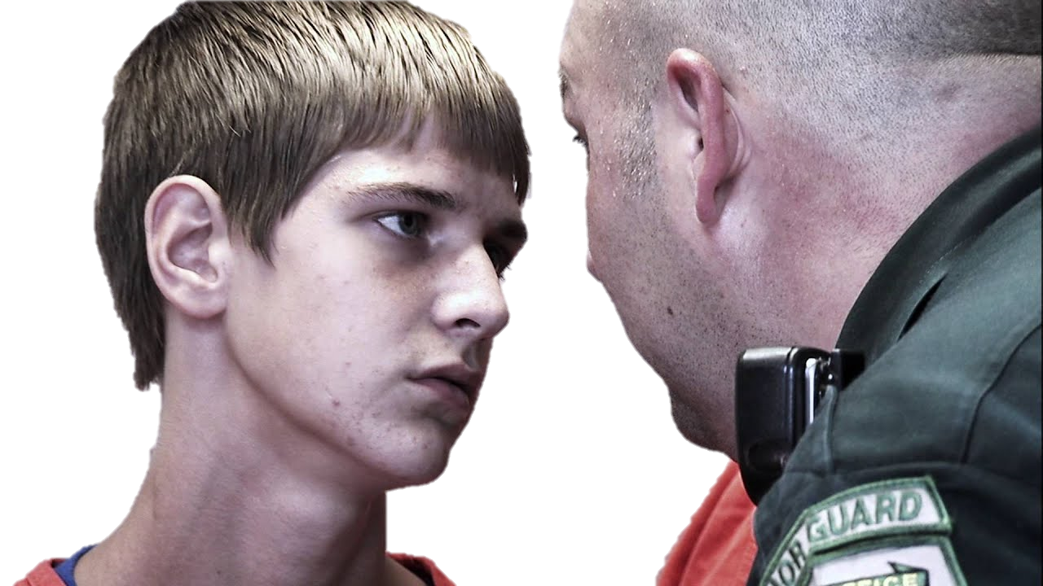
Petrosino et al (2013)
“'Scared Straight’ and other juvenile awareness programs
for preventing juvenile delinquency”
Scared Straight programmes are underpinned by deterrence theory: the claim that if punishment is swift, severe and certain it will deter criminal behaviour.
The aim is to reduce crime by exposing young people to realistic depictions of prison life. By demonstrating its harshness this will deter potential juvenile defenders before they start on a life of crime. They will be “scared straight”.
Effect on Re-offending Rates?
Reduction
Mixed
No Impact
Increase
Notes:
Notes:
Reduction: causes overall decrease in offending
Mixed Impact: Reduces offending for some types of crime but may increase offending for other types
No impact: Neither reduces nor increases offending
Increase: causes overall increase in offending.

Slide 3

Petrosino et al (2013)
“'Scared Straight’ and other juvenile awareness programs
for preventing juvenile delinquency”
A Mixed Impact outcome means Scared Straight programmes have either increased or reduced crime / reoffending in some small way that has not had a statistically-significant effect on reoffending.
This is not the case here…
Effect on Re-offending Rates?
Reduction
No Impact
Increase
Notes:
Notes:
Reduction: causes overall decrease in offending
Mixed Impact: Reduces offending for some types of crime but may increase offending for other types
No impact: Neither reduces nor increases offending
Increase: causes overall increase in offending.

Slide 4

Petrosino et al (2013)
“'Scared Straight’ and other juvenile awareness programs
for preventing juvenile delinquency”
A No Impact outcome means Scared Straight programmes have had no statistically-significant effect on reoffending in terms of either an increase or decrease in crime.
This is not the case here…
Effect on Re-offending Rates?
Reduction
Mixed
Increase
Notes:
Notes:
Reduction: causes overall decrease in offending
Mixed Impact: Reduces offending for some types of crime but may increase offending for other types
No impact: Neither reduces nor increases offending
Increase: causes overall increase in offending.

Slide 5
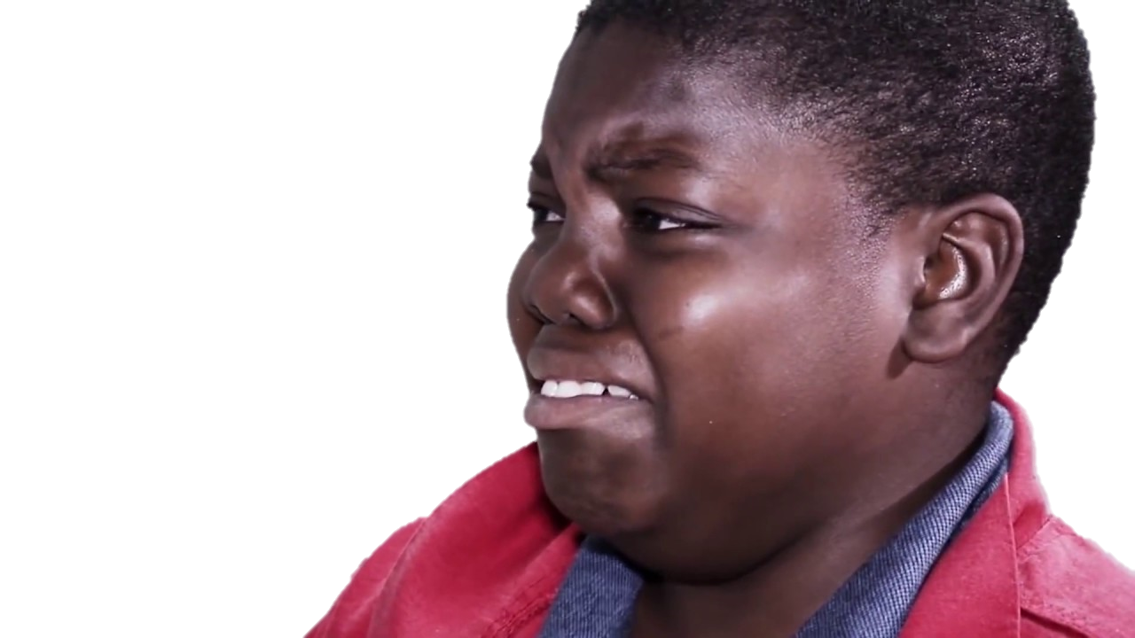
Petrosino et al (2013)
“'Scared Straight’ and other juvenile awareness programs
for preventing juvenile delinquency”
A Reduced Offending outcome means Scared Straight programmes have caused a statistically-significant decrease in reoffending.
This is not the case here…
Effect on Re-offending Rates?
Mixed
No Impact
Increase
Notes:
Notes:
Reduction: causes overall decrease in offending
Mixed Impact: Reduces offending for some types of crime but may increase offending for other types
No impact: Neither reduces nor increases offending
Increase: causes overall increase in offending.

Slide 6
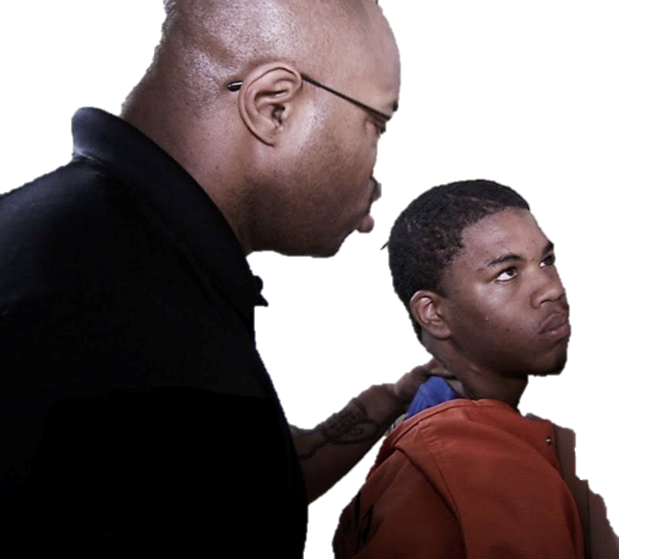
Petrosino et al (2013)
“'Scared Straight’ and other juvenile awareness programs
for preventing juvenile delinquency”
Petrosino et al’s meta-analysis concluded Scared Straight programmes led to an increase in both reoffending and reconvictions when compared with those who had not participated in the Programs:
Reoffending was nearly 70% higher for juveniles who participated in the programme compared with those who did not
The researchers concluded Scared Straight interventions were actually “more harmful than doing nothing”.
Possible Reasons?

Slide 7
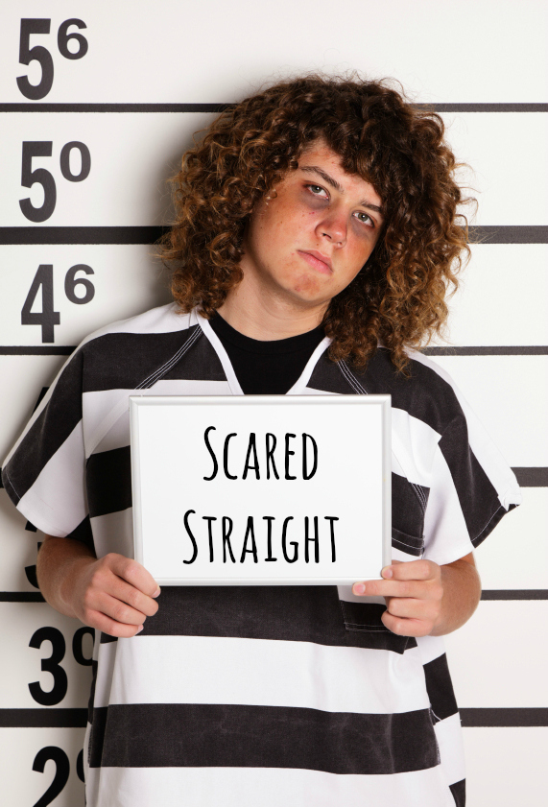
Petrosino et al (2013)
“'Scared Straight’ and other juvenile awareness programs
for preventing juvenile delinquency”
Possible Weaknesses?
Possible reasons for the ineffectiveness of Scared Straight programmes:
juveniles rarely think “long-term” so they fail to make the connection between their behaviour and its future consequences
assumes the severity and brutality of prison deters offending. But countries like Norway that focus on respect and rehabilitation have lower rates of crime
if no-one commits crimes expecting to be caught, prison is not a deterrent
using fear as a deterrent is counterproductive. Extreme fear leads to the risk of denial, particularly among those, such as juveniles, most susceptible to threats.

Slide 8
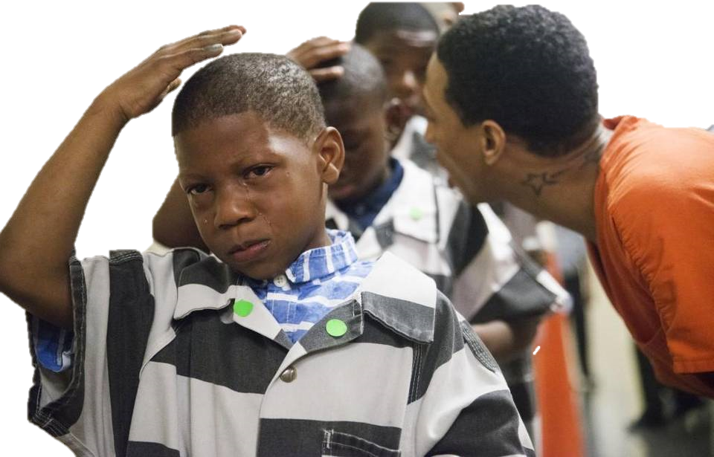
Petrosino et al (2013)
“'Scared Straight’ and other juvenile awareness programs
for preventing juvenile delinquency”
Possible weaknesses in the studies include:
All studies in the meta-analysis were conducted in the United States.
None of the studies were conducted after 1992
Credits

Slide 9
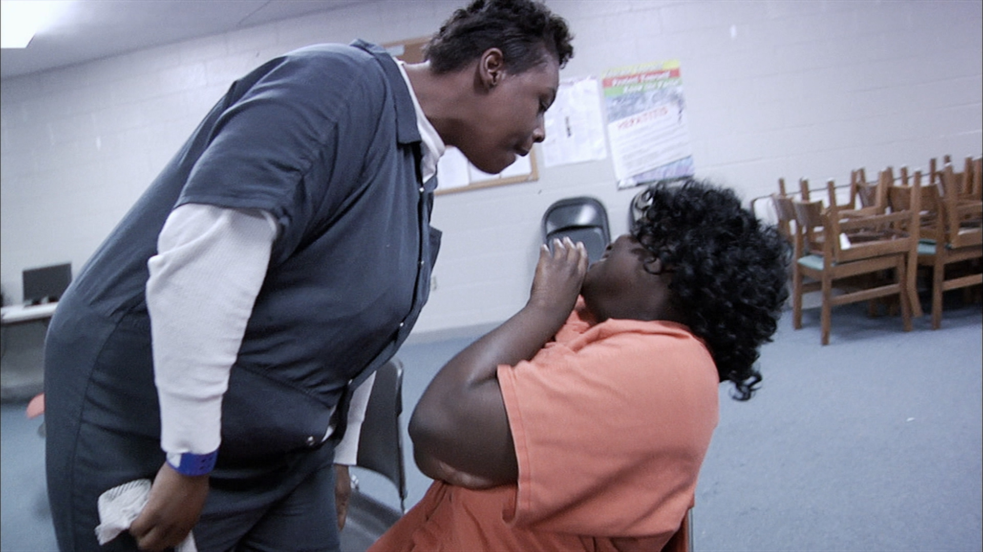
ShortCutstv
www.shortcutstv.com

