Slide 1


Evaluating Crime
Reduction Strategies
1. Dog-Training Programmes in Prisons

Slide 2

Cooke and Farrington (2016)
“The Effectiveness of Dog-Training Programs in Prison:
A Systematic Review and Meta-Analysis of the Literature”.
Review of 7 studies investigating the effectiveness of prison-based
Dog-Training Programmes (DTPs) as a means of reducing
reoffending (recidivism)
DTPs involve offenders training service dogs (such as guide and therapy dogs) to increase their chances of adoption.
Effect on Re-offending Rates?
Reduction
Mixed
No Impact
Increase
Notes:
Notes:
Reduction: causes overall decrease in offending
Mixed Impact: Reduces offending for some types of crime but may increase offending for other types
No impact: Neither reduces nor increases offending
Increase: causes overall increase in offending.

Slide 3

Cooke and Farrington (2016)
“The Effectiveness of Dog-Training Programs in Prison:
A Systematic Review and Meta-Analysis of the Literature”.
A Mixed Impact outcome means that DTP has either increased or reduced crime / reoffending in some small way that has not had a statistically-significant effect on reoffending.
This is not the case here…
Effect on Re-offending Rates?
Reduction
No Impact
Increase
Notes:
Notes:
Reduction: causes overall decrease in offending
Mixed Impact: Reduces offending for some types of crime but may increase offending for other types
No impact: Neither reduces nor increases offending
Increase: causes overall increase in offending.

Slide 4
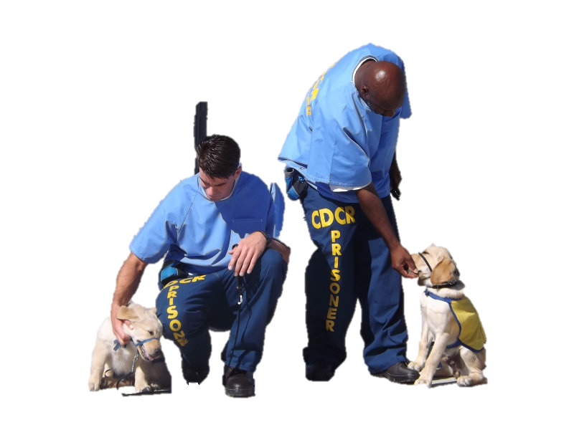
Cooke and Farrington (2016)
“The Effectiveness of Dog-Training Programs in Prison:
A Systematic Review and Meta-Analysis of the Literature”.
A No Impact outcome means DTP has had no statistically-significant effect on reoffending in terms of either an increase or decrease in crime.
This is not the case here…
Effect on Re-offending Rates?
Reduction
Mixed
Increase
Notes:
Notes:
Reduction: causes overall decrease in offending
Mixed Impact: Reduces offending for some types of crime but may increase offending for other types
No impact: Neither reduces nor increases offending
Increase: causes overall increase in offending.

Slide 5

Cooke and Farrington (2016)
“The Effectiveness of Dog-Training Programs in Prison:
A Systematic Review and Meta-Analysis of the Literature”.
An Increased Offending outcome means DTP has caused a statistically-significant increase in reoffending.
This is not the case here…
Effect on Re-offending Rates?
Reduction
Mixed
No Impact
Notes:
Notes:
Reduction: causes overall decrease in offending
Mixed Impact: Reduces offending for some types of crime but may increase offending for other types
No impact: Neither reduces nor increases offending
Increase: causes overall increase in offending.

Slide 6

Cooke and Farrington (2016)
“The Effectiveness of Dog-Training Programs in Prison:
A Systematic Review and Meta-Analysis of the Literature”.
Cooke and Farrington’s meta-analysis concluded that DTPs led to a decline in both reoffending and reconvictions when compared with those who had not participated in the Programs.
36% difference in reoffending rates between the DTP (experimental) group and a control group of offenders.
32% of DTP (experimental) group were reconvicted
68% of control group were reconvicted
Possible Reasons?

Slide 7

Cooke and Farrington (2016)
“The Effectiveness of Dog-Training Programs in Prison:
A Systematic Review and Meta-Analysis of the Literature”.
Possible Weaknesses?
Cooke and Farrington suggested 5 possible reasons for the effectiveness of DTPs on inmates:
increased empathy for dogs and subsequently people
learning patience with the dog helps inmates cope and stay out of trouble on release
successful training of service dogs empowers inmates to achieve goals in wider society
increasing emotional intelligence and coping skills helps inmates bond with people outside prison
having to stay trouble free to be in the programme

Slide 8

Cooke and Farrington (2016)
“The Effectiveness of Dog-Training Programs in Prison:
A Systematic Review and Meta-Analysis of the Literature”.
Credits
Cooke and Farrington suggested 4 possible weaknesses in the studies they reviewed:
small sample sizes
differences in how DTPs were conducted in the primary studies
lack of randomisation into treatment and control groups
the majority of the evidence comes from US studies
These weaknesses may mean the original studies are not all directly comparable - something that will impact on the reliability of the data.
The US-centric nature of the studies may impact on their general validity.

Slide 9
ShortCutstv
www.shortcutstv.com

