Slide 1
Mass Media as a Social Institution
The institutionalization of mass media has been driven by a series of intellectual and technological innovations, including writing and paper, the printing press, radio, television, and the computer.
Americans are able to obtain information from a wide variety of media. These media can be grouped into four categories: print, audio, visual, and online.

Slide 2
The Institutionalization of Mass Media
Writing and Paper
With the development of agriculture, trade became more complex.
Writing made records of trades easier to remember and calculate.
Paper made writing more portable.
The Printing Press
Hand copying of books was a long, laborious, and costly process.
During the 1450s Gutenberg developed a movable-type printing press that made books, and hence the skill of reading, more common.

Slide 3
The Institutionalization of Mass Media
The Industrial Age
With industrialization, the forces of advertising, urbanization, and rising literacy led to the newspaper.
The development of electronic media such as movies, radio, and television brought entertainment into people’s homes.
The Information Society
The computer and the Internet revolutionized communication and information storage.
Information society: A community in which the exchange of information is the main social and economic activity

Slide 4
Click on the image to play the Interactive.

Slide 6
Mass Media in the United States
Americans obtain information from a wide variety of media. These media can be grouped into four categories, but some scholars claim this division is artificial.
Print Media
Audio Media
Newspapers, magazines, and books
Large but declining audience
48 percent read a newspaper daily; 85 percent read a magazine regularly; 25 percent read more than 10 books a year
Sound recordings (CDs, vinyl records, music videos and MP3s) and radio
Wide variety of radio formats: news, talk, classic rock, religion, etc.
99 percent have radio at home
Notes:
–

Slide 7
Mass Media in the United States
Americans obtain information from a wide variety of media. These media can be grouped into four categories, but some scholars claim this division is artificial.
Visual Media
Online Media
Movies, television, videocassettes, DVDs
Television reaches one of the largest audiences, with 98 percent having television at home
Internet services such as e-mail, online chat groups, social-networking sites, and online shopping
65 percent have Internet access at home
Notes:
–

Slide 8
Mass Media in the United States
Convergence
Media convergence: The idea that the media are merging and are no longer separate entities
Examples: newspapers available online, Internet radio, e-books
Media Consumption
On average, each American spends nearly 3,600 hours a year using media
Individual usage rates are affected by age, education, and income

Slide 9
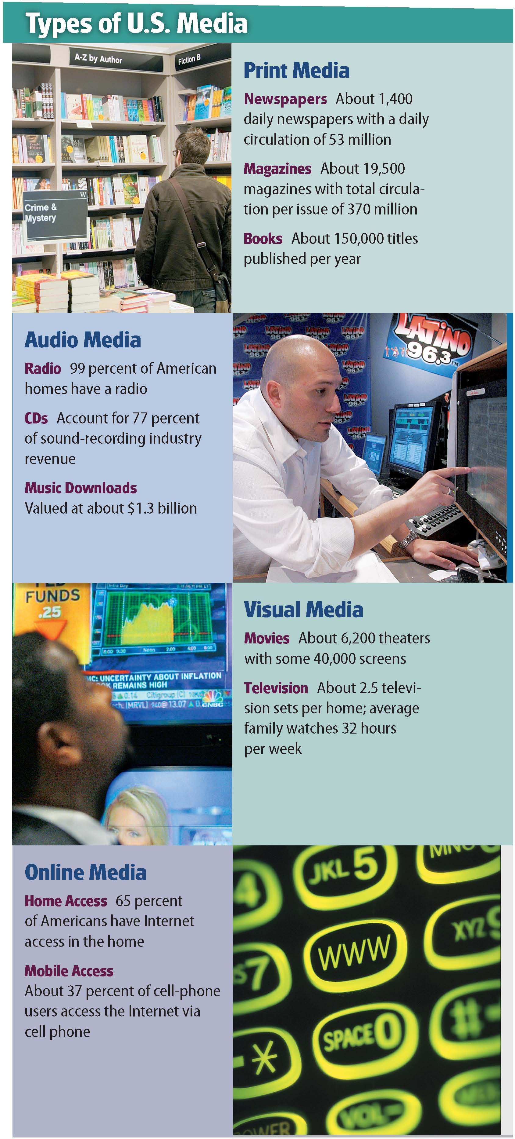

Slide 10
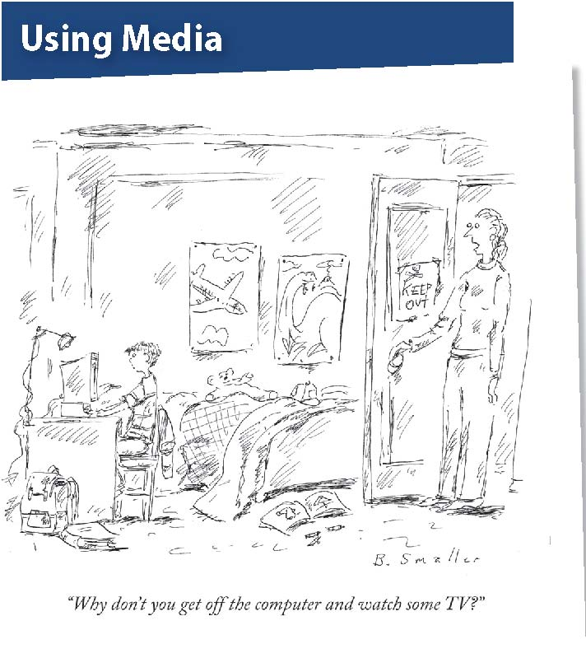

Slide 11
Perspectives and Issues in Mass Media
The three sociological perspectives differ in the way they view mass media. Functionalists focus on the ways mass media help to preserve social stability. Conflict theorists focus on how mass media reinforce the existing social order. Interactionists look at the impact of mass media on social interaction.
Sociologists are interested in the power of the media and how mass media affects children and civic and social life.

Slide 12
Sociological Perspectives on Mass Media
Functionalist Perspective
Media keep track of what is happening, interpret information, transmit cultural values, and entertain people. These functions support the stability and smooth operation of society.
People need to know what is going on around them to be productive in society.
Media can consciously or inadvertently help pass on society’s basic values and beliefs.

Slide 13
Sociological Perspectives on Mass Media
Conflict Perspective
Media convinces people to accept the existing power structure.
Knowledge-gap hypothesis: the wealthy and better-educated acquire new information more quickly, creating a divide
Digital divide: gap between those with access to new technology and others
Representation of certain groups in the media might reinforce social inequality.

Slide 14
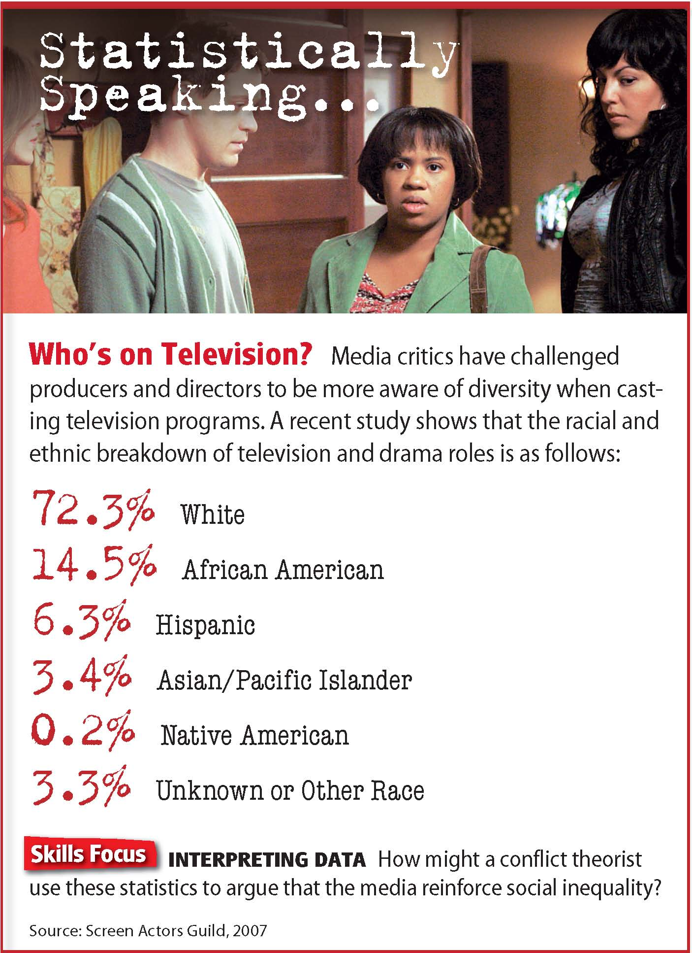

Slide 15
Sociological Perspectives on Mass Media
Interactionist Perspective
Mass media shape everyday social interactions. Many people plan events around media.
Some consider gatherings to watch television and the like to be social events. Others think watching television is essentially a solitary event.
Some see the Internet as a new method of social interaction, while others view the Internet as a threat to social interaction.

Slide 16
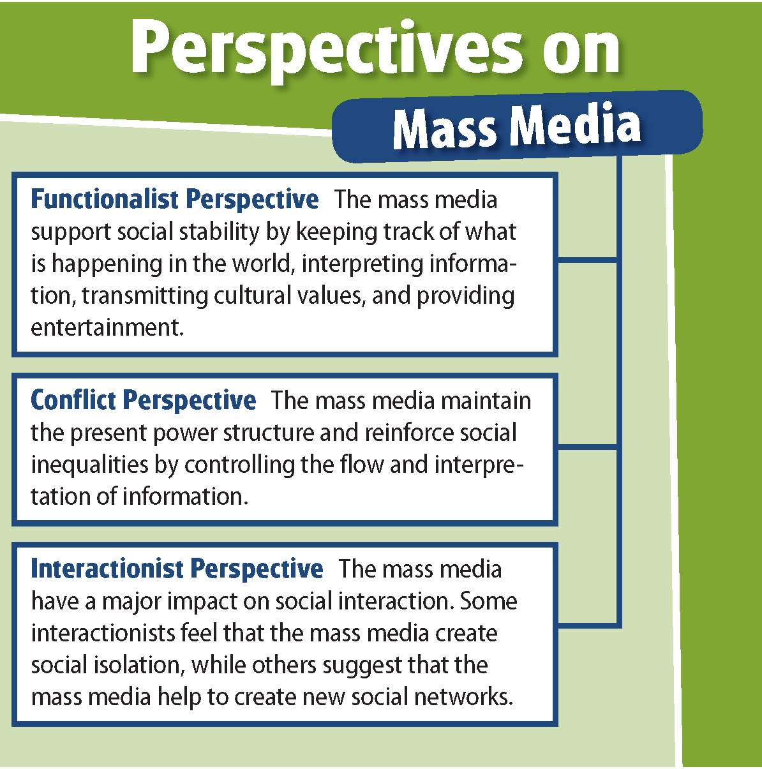

Slide 17
Contemporary Mass-Media Issues
Mass Media and Children
Watching television is the primary after-school activity for most students.
Many worry that seeing violence on television encourages actual violence.
Links have been found between large amounts of television viewing and low test scores.
Children are targeted by advertisers.

Slide 19
Contemporary Mass-Media Issues
Mass Media and Civic and Social Life
Some argue that people have become less socially active as television has become more common.
Social capital: Everything that makes up a community
The Internet may also lead to withdrawal from community life, although some argue that online communities are taking the place of face-to-face interaction.

Slide 20
Contemporary Mass-Media Issues
The Power of the Media
Many feel that the new media wield too much power.
Spiral of silence: As news media offer repeated opinions, more people accept these opinions, and people who disagree are less likely to voice their views.
Agenda setting: The media do not tell people what to think, but what to think about.
Gatekeepers: Media figures decide what the agenda is in a particular story.
Opinion leaders: Respected individuals are the first to evaluate messages and their importance.

Slide 22
Sociology in Today’s World
Video Games and Violence
A series of school shootings in the 1990s led many to believe real-life violence was encouraged by violence encountered in video games and on television.
First-person shooter game players use an assortment of weapons to fight off enemies.
Newspapers put blame of school shootings on these games.
Sociologist Karen Sternheimer began a study to test the link between games and violence.
Sternheimer’s study found no correlation between video games and the rate of violence among teens.
Studies that seem to support the correlation do not take into account important factors such as poverty, neighborhood stability, or family relationships, according to Sternheimer.
Notes:
–

