Slide 1
Classic
Psychological
Studies
ShortCutstv
Bandura,
Ross & Ross (1961)
presents

Slide 2
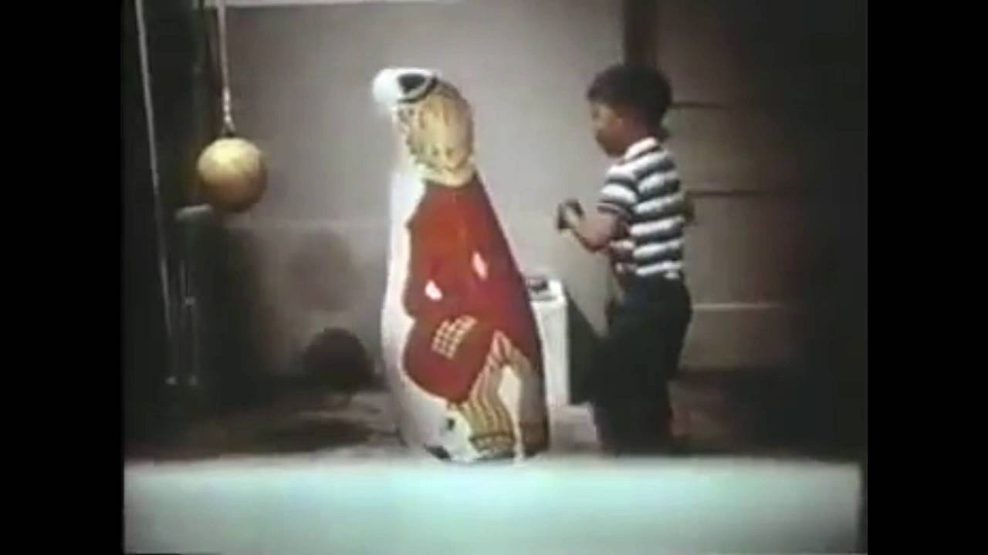
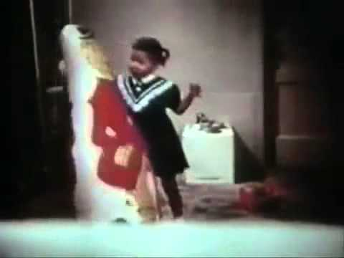
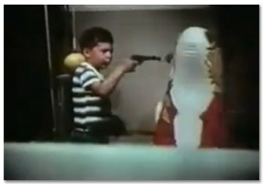
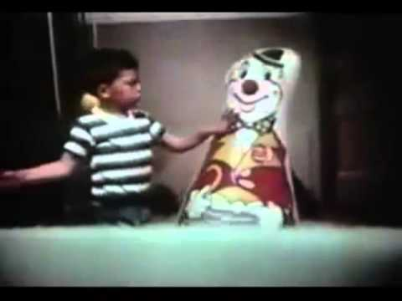
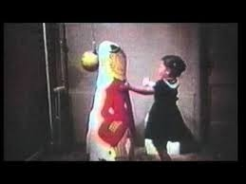
The Bobo Doll Experiment
Aim
Procedure
Findings
Conclusions
Evaluation

Slide 3
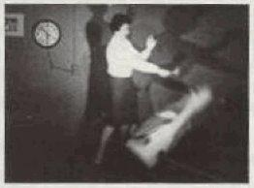
Aim
To test whether children can learn aggressive behaviour through imitation.

Slide 4
Procedure
72 Children (36 boys / 36 girls) divided into three groups:
Aggressive Condition
Non-Aggressive Condition
Control Condition
Adult model entered the room and played with the toys. The model behaved aggressively to the Bobo doll, kicking it and hitting it with a mallet
Adult model played with the toys nicely and ignored the Bobo doll
No adult model
The children were taken into a room with attractive toys in it, but not allowed to play with them.
This produced mild arousal (annoyance)
Finally, the children were taken into a room with toys and a Bobo doll in it,
allowed to play and their behaviour recorded
Notes:
Click on each sub-heading (aggressive condition, non-aggressive condition and control condition) to reveal information about each.
Click on Procedure once to reveal further information about the procedure.
Click on Procedure again to reveal final piece of information.

Slide 5
Findings
Children in the aggressive condition were much more likely to play aggressively with the Bobo doll than both of the other two groups of children

Slide 6
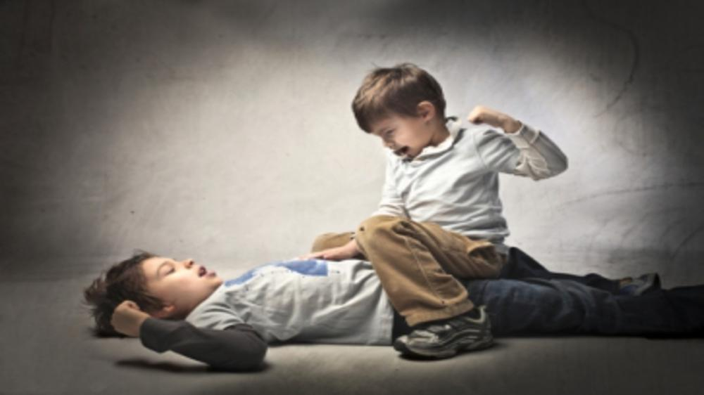
Conclusions
Aggression can be learnt through imitation, by observing aggressive models
This has implications for media violence, particularly the propensity for children to copy the violence they see

Slide 7
Evaluation
Strengths
Weaknesses
This is a classic study
As a controlled experiment, it is reliable as it can be replicated
Has many important real world implications
How ethical was the study?
Lacks validity as the situation was artificial and the children were aware they were part of a study. This could have led to demand characteristics
The presence of the mallet may have led to the weapons effect
Even young children know the difference between play / fantasy violence and the real thing
Notes:
Click on Strengths to reveal each strength (i.e. click on strengths 3 times to reveal 3 pieces of information in turn).
Click on Weaknesses to reveal each weakness (i.e. click on weaknesses 4 times to reveal 4 pieces of information in turn).

Slide 8
ShortCutstv
shortcutstv.com

