Slide 1
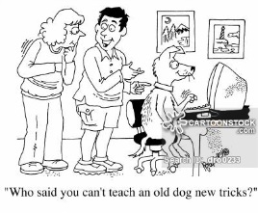
The impact of digital forms of communication:

Slide 2
The impact of digital forms of communication:
The impact of digital forms of communication:
1. Age and Digital Communication
Read pages 23-24
Identify three patterns identified by Ofcom regarding age and digital communication
Explain 3 reasons why younger people are more likely to be users of digital communication (refer directly to Boyle)
3. Read the study on page 23 – What reasons does Berry identify for older people not using the internet
4. Using your knowledge – explain the impact of not using digital communication on older people. Try to identify as many effects as possible.

Slide 3
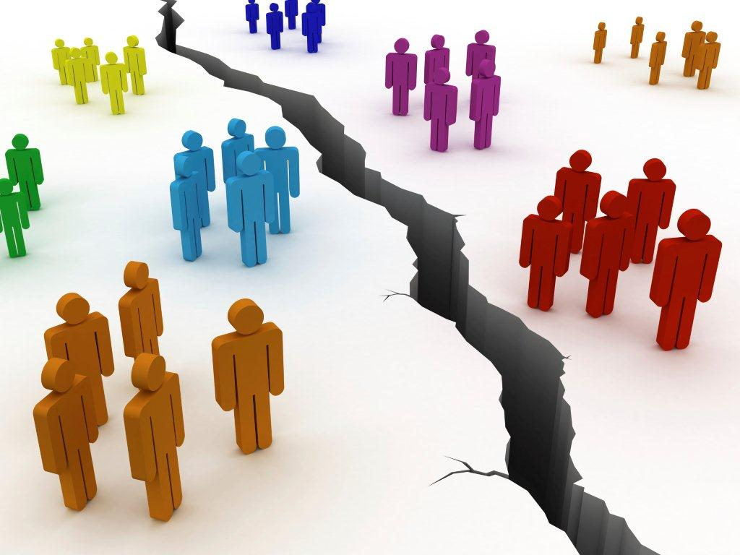
The impact of digital forms of communication:
2. Social Class and Digital Communication:
Read the article, what does Chaplin the links are between social class and digital communication
Read the study The Digital Divide, by Mertens and D’Haenens – what differences in internet use do they identify between the working and middle classes
Using your knowledge and pages 23-24, describe the ways in which the working classes might be negatively affected by limited use of digital communication. Consider the impact on the following:
Education
Health
Employment
Leisure
Maintaining relationships

Slide 4
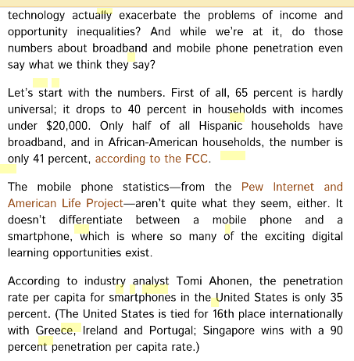
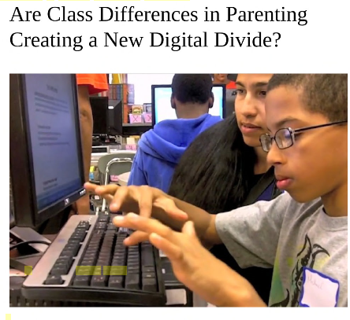
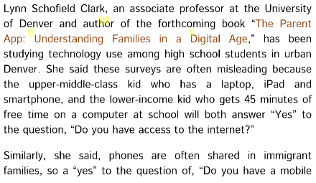
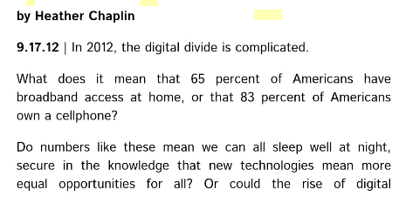
The impact of digital forms of communication:
2. Social Class and Digital Communication:

Slide 5
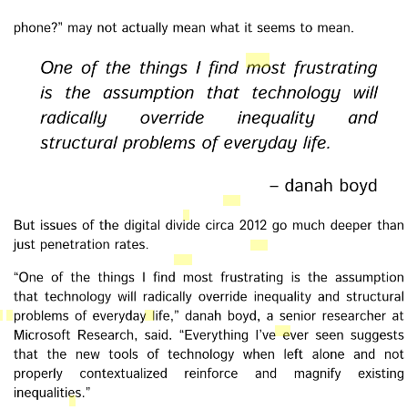
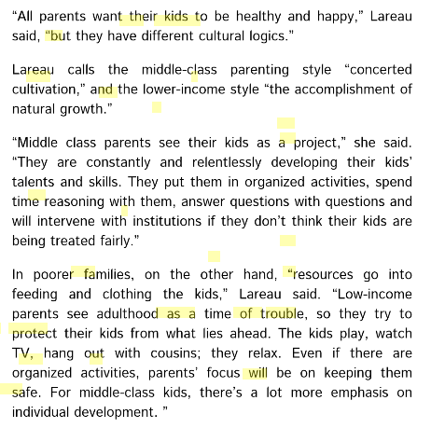
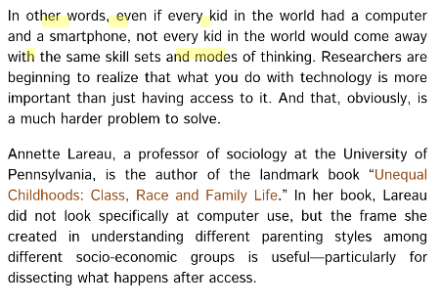
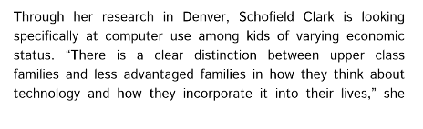

Slide 6
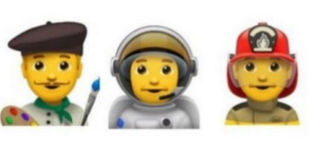

The impact of digital forms of communication:
3. Gender and Digital Communication:
Use the information in your textbook and your own knowledge to make notes on the 4 areas identified in your booklet.
4 most important trends + reasons | Reason for gendered difference: Patriarchal ideology
Gendered socialisation | Gender Stereotypes

Slide 7
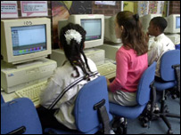

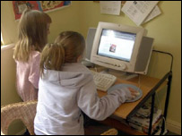
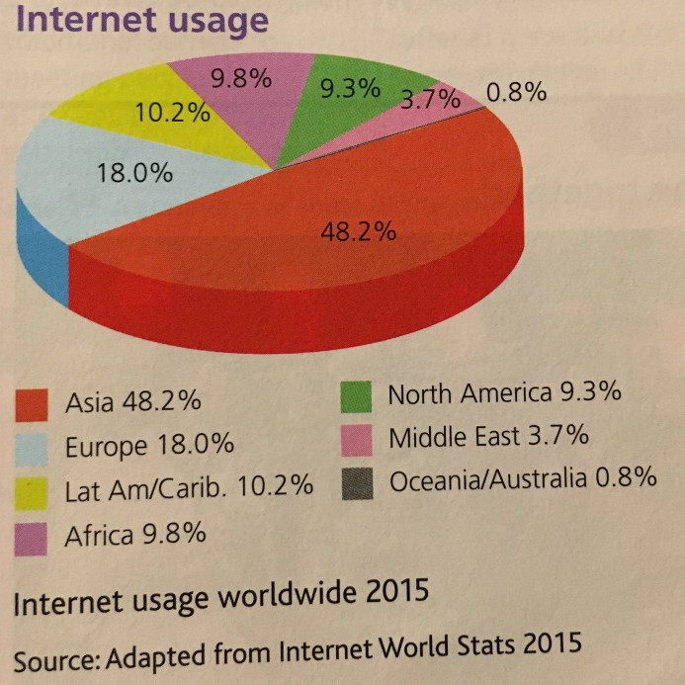
Dealing with a digital underclass
Net access at school "is not enough" Net access for all, irrespective of social class or wealth is essential, says technology analyst Bill Thompson. My daughter has a new laptop. She needs one for school, especially since she will be starting her GCSE coursework in September. And I am tired of being kicked off my main desktop machine so she can check her e-mail, chat to her friends or compose frighteningly eloquent letters complaining about the iniquities of her school's plan to install unisex toilets. Coincidentally, her laptop arrived just as I was reading a newly-published book about the early days of computing. Electronic Brains grew out of a radio series produced by its author, Mike Hally, and is an excellent introduction to the men and women whose work laid the foundations of the computing revolution. Looking at Lili's sleek new computer I could not help reflect on how far we have come. There are now five computers in our house and we probably have the processing capacity of the entire continental United States from 1955 at our disposal. My family may be part of the digital elite, but the latest report from the eSociety team at the London School of Economics makes it clear that too many families in the UK are seriously disadvantaged when it comes to computer use and Internet access.
 | While the digital divide between rich and poor worlds is far more severe and needs to be addressed, we cannot ignore the divisions within our own country If you fight your way through the usual headline-grabbing claims that parents want stronger laws to clamp down on online pornography, the 'UK Children Go Online' report provides clear evidence of the digital divide between the children of parents who are confident net users and those who are unable to offer their children support or guidance. Net illiterate 'failing children' Just as children of professional parents get more help with schoolwork, have more books at home, watch less TV and - in many cases - have a privileged private education to ensure that they are pushed through exams and on to university, so the children of poorer, working class families are less likely to have computers or net access at home. Even when they do their parents are not able to act as guides and teachers or encourage the sophisticated use of network tools like search engines. The result is a growing split between those who "get" the net and those for whom it is a poorly-exploited resource. Since many schools now set homework and course work on the assumption that students have net access at home, those on the wrong side of the fence are left at a serious disadvantage. The findings are hardly surprising, but it is useful to have a clear statement of the scale of the problem to present to politicians and policy-makers. And while the digital divide between rich and poor worlds is far more severe and needs to be addressed, we cannot ignore the divisions within our own country. Education and awareness are part of the solution, and it is reassuring to see that media regulator Ofcom sees web skills as part of the wider area of "media literacy" which it is trying to promote.
Home net use: A privilege or a right? I have worked for many years with the BBC's own WebWise campaign, and it too can make a difference. We can not leave it to the market to encourage a critical approach to internet use because, just as with television, the content providers would prefer us not to look too closely at what they are offering or to be aware of the alternatives. Google wants us to stick with Google, just as Yahoo! or MSN or Ask Jeeves want their existing users to stick with them - an educated marketplace is an unpredictable one. But we need more than education: we need to get poorer families online in the first place, so that they have an internet connection to learn about. Access from public libraries or school is not going to be enough. Our children need to be able to hook up to the net from home, any time they want. Perhaps television can come to the rescue. Sometime in the next seven years the UK is going to move from analogue to digital transmission for all television and radio. The government has just set up Switchco to make sure it all goes smoothly. When it happens everyone who wants to watch TV will need a home computer. It won't actually look like a computer, as it will be hidden inside a digital set-top box or even built into the TV, but that's what it will be. Everyone with Freeview or Sky+ or cable has one already. Eventually Switchco is going to have to give everyone who has not already switched to digital a free set top box. They are denying this at the moment, as admitting it would stop people going out and buying the boxes themselves, but it is pretty obvious that it will happen. Specialised The computers in today's set top boxes are specialised, attached to low-resolution TV screens which are no good for close-up activities like e-mailing or browsing the web. But the price of hardware is falling dramatically. The CEO of chip maker AMD, Hector Ruis, has said that he sees a $100 laptop as a real possibility in three years or so. Nicholas Negroponte, founder of the MIT Media Lab, has also launched a campaign for a $100 computer for less developed countries. Suppose that instead of giving people a set top box we gave them a real computer, with a socket for a TV signal and a socket for a monitor? Suppose that it came with a screen, keyboard and mouse, and had wireless networking built in? We'd have a wired Britain overnight, especially if the work of the community broadband network was given more support in providing low-cost net access for all. This is something we have to take seriously as a society, and it would be a great task for an incoming government of whatever party. Bill Thompson is a regular commentator on the BBC World Service programme Go Digital.
The impact of digital forms of communication:
4. Location and Digital Communication
What does the pie chart show? Describe the findings
2. How could you explain these findings?
3. What impact would this have?

