Slide 1
Applying sociological theories to digital forms of communication: Marxism, Feminism and Postmodernism

Slide 2
Applying sociological theories to digital forms of communication: Marxism
What does it mean to have a ‘free’ media when the nation’s TV channels, news outlets, radio stations, search engines and social media platforms are owned by a handful of giant corporations? What does it mean to have ‘independent media’ when many of our most influential media organisations are controlled by individuals and Boards that are so closely connected with vested interests?
This short report shows that just three companies dominate 71% of the national newspaper market – a market that may be shrinking but is still crucial when it comes to setting the agenda for the rest of the news media. When online readers are included, just five companies dominate some 80% of market share. In the area of local news, six giant conglomerates account for 80% of all titles while the 50-plus publishers have less than 20% of the remaining titles. We are facing an increasing number of news deserts given the fact that 36 million UK citizens – some 57% of the total population - do not have a local daily paper that is able to dedicate itself to matters of concern to their community. And where there is still a local press presence, some 85% of local government areas are faced with a monopoly or duopoly supply of local outlets.
Sky, effectively controlled by Rupert Murdoch’s 21st Century Fox empire, is by far the UK’s biggest broadcaster and continues to dominate the pay TV landscape. ITV is making huge profits on the back of its format sales and faces fewer and fewer obligations to serve domestic audiences. Meanwhile, Channel 5 is already owned by a US giant, Viacom International, and there are constant rumours that the government is keen to sell off Channel 4 to the highest bidder. Two companies have nearly 40% of all commercial local analogue radio licences and control two-thirds of all commercial digital stations. Only 14% of non-BBC stations are now independently owned while radio news is provided either by the BBC or by Sky.
Is the internet any different to this? UK search is overwhelmingly dominated by Google while the most popular apps like Instagram and WhatsApp are owned by Facebook, itself by far the most popular social media site.
The BBC remains a powerful presence in broadcasting and online but its budget has been severely cut by the last two licence fee deals, its independence has been undermined, and it is increasingly being told by government to be mindful of its impact on the wider commercial market.
We believe that concentration within news and information markets in particular has reached endemic levels in the UK and that we urgently need effective remedies. This kind of concentration creates conditions in which wealthy individuals and organisations can amass huge political and economic power and distort the media landscape to suit their interests and personal views. Urgent reform is needed in order both to address high levels of concentration in particular media markets and to protect against further concentration in others.
We hope that this report will provide data and arguments that will be useful to groups and individuals who want to see a far more pluralistic media structure in which a genuine diversity of views, voices and opinions are aired.
Read the introduction to the Media Reform Coalition.
Why is it a problem for the media to be controlled by so few people?
What can be done about this?

Slide 3
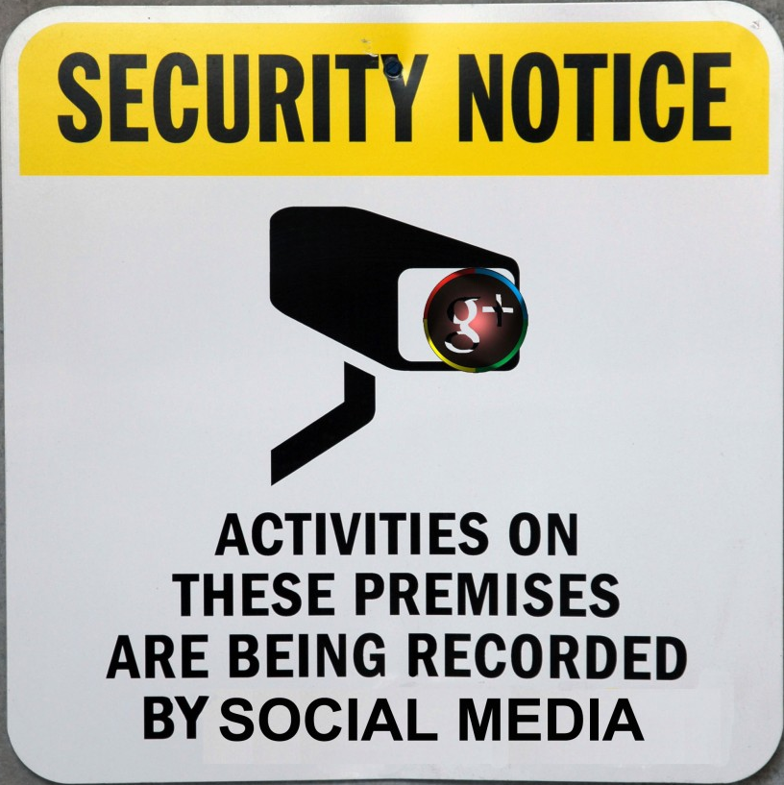
Applying sociological theories to digital forms of communication: Marxism
Summarise the argument of Cornford and Robins (1999) – The continuation of power being concentrated in the hands of the view
Explain how media convergence supports the argument that new forms of media benefit the bourgeoisie
Explain the impact of de-regulation of the media and digital communication
Explain the Marxist argument that digital communication provides a new form of surveillance
Add examples to the key points in the summary table.

Slide 4
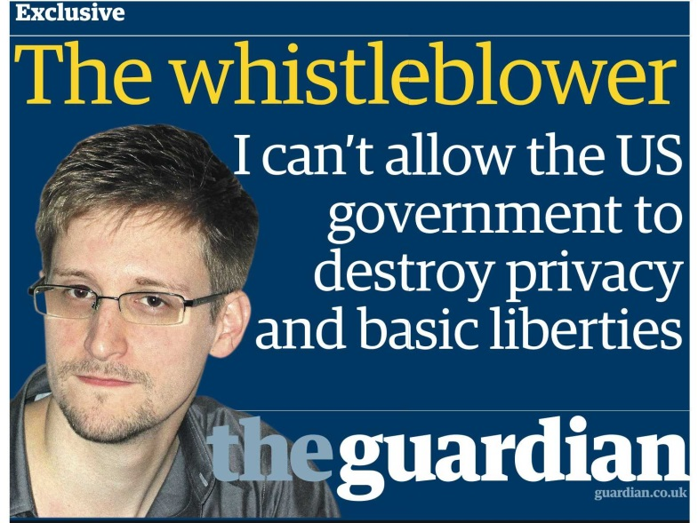
Applying sociological theories to digital forms of communication: Marxism
The Snowden Report
Watch the video, then read the article on page 10:
What did Snowden’s revelations show the NSA had been doing?
What were the effects of this?
How does this reflect Marxist ideas?

Slide 5
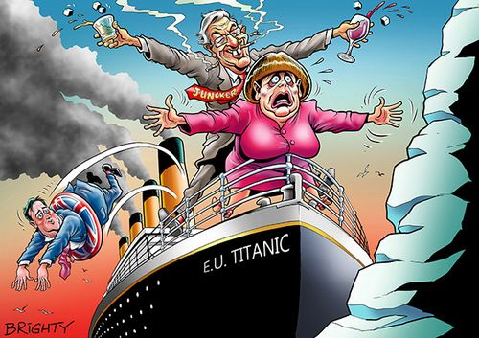
Applying sociological theories to digital forms of communication: Marxism
Social media and democracy:
Read the article: Is social media killing democracy and listen to the debate.
How could this link to Marxist ideas about democracy.
Notes:
http://www.bbc.co.uk/programmes/articles/2WyPqhdbcpHDN9z0KdBt5Tp/will-big-data-and-social-media-destroy-democracy?intc_type=singletheme&intc_location=arts&intc_campaign=hayfestival2018&intc_linkname=socialmedia_contentcard2
Also look for thinking allowed programme:
https://www.bbc.co.uk/programmes/b0b1sycx

Slide 6
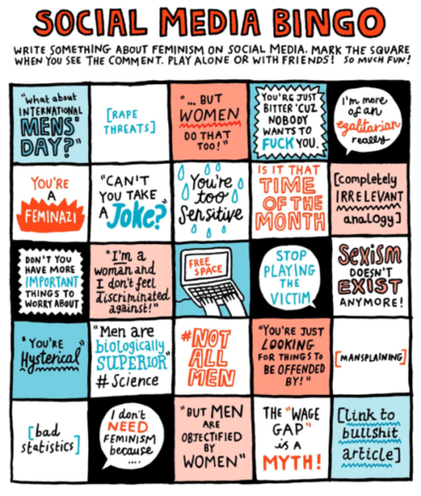
Applying sociological theories to digital forms of communication: Feminism
Read the article on the feminist response to new forms of digital communication.
Answer the following:
Identify and explain ways in which digital media has helped the feminist movement
Identify and explain ways in which digital media has hindered the feminist movement.

Slide 7
Applying sociological theories to digital forms of communication: Feminism
Haraway – Cyborg theory

Slide 8
Applying sociological theories to digital forms of communication: Feminism
Read pages 12-14 and answer the following:
Describe two trends regarding women and digital communication:
Explain how Haraway suggests that technological advances could benefit women
Explain how cyborgs enable women to over come traditional forms of oppression
Explain how Nakamura suggests technological advances could benefit women from ethnic minority groups
Explain how exploitation of women and children furthered through new forms of digital communication (make notes on examples of exploitation and reasons for it)

Slide 9
Applying sociological theories to digital forms of communication: Feminism
Feminist responses: Fourth Wave Feminism:
Watch the video and read page 14-15
What is meant by Fourth Wave Feminism
Give examples of how digital communication have contributed to Fourth Wave Feminism (use your knowledge ad research)

Slide 10
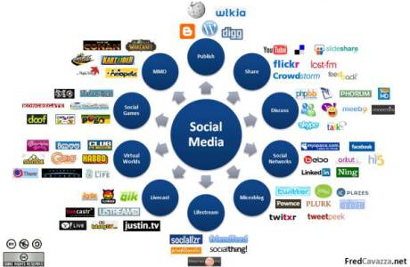
Applying sociological theories to digital forms of communication: Postmodernism
Work as a group to
Add definition of each characteristics.
Complete the table to show how each characteristic links to digital forms of communication and try to come up with your own examples.

Slide 11
Applying sociological theories to digital forms of communication: Postmodernism
Read pages 16- 18 and answer the following:
Explain the findings of Bjorklund, Hart, Case and Elliot
What does this suggest about how facebook is useful for understanding identity?
How do some post-modernists suggest that increased digital communication has an impact on social control?
Spend some time investigating the Why We Post website. Explain some of the findings (https://www.ucl.ac.uk/why-we-post/).
How does this reflect post-modernist theory
What are the strengths and weaknesses of the methodology of the project?
How does research into digital communication differ from traditional forms of research?

Slide 12
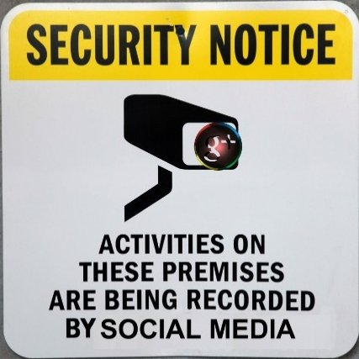
Applying sociological theories to digital forms of communication: Summary
1. Reread the section of the textbook and the appropriate section from the unit guide for your theory (Marxism, Feminism or Postmodernism).
2. Make a mind map showing the key arguments, concepts, studies, examples for this theory (I DO WANT A MINDMAP)
3. Move on to the next sheet, using what you know add opposing or supporting evidence from your theory to this mind map. Make it really clear.
4. Do the same at the last sheet.

Slide 13
How to answer the Globalisation and the Digital Social World questions.
Q3: ‘Statement’. Evaluate this point of view. (16)
Spend 20 minutes on this question
4 marks for AO1 – Knowledge and understanding
4 marks for AO2 - Application
8 marks for AO3 – Evaluation
This is on page 31 of your course handbook

Slide 14
High band – Sample answer
‘Digital social communication has reduced social inequality’ Evaluate this point of view (16)
Digital social communication refers to messaging others via technology such as the internet. Some argue that the increase in use of digital social communication can widen participation in democracy and has the potential to help people in their pursuit of life chances.
For example, digital social media is a means in which the public can participate in the democratic system. Members of the public can contact their MPs through email, Twitter or create an online petition that can be shared through social networks. Jurgenson argues how social networks were a useful tool in which people could make connections with each other in the lead up to what became the Egyptian social revolution. This links to the pluralistic theory of mass media: that the wider the range of media providers, the wider the range of opinions being shared which leads to a more equal political system.
Some argue that when people communicate through digital social media, they are not face to face, and therefore, the interaction is free of anyone being pre-judged based on how they appear. This was true in the research by Bloustein and Wood: Second Life research, in which there seemed to be a post-modern opportunity to create a self-identity free from being judged on appearance. For example, research by the charity group SCOPE (2000) found that the leisure habits of 11-15 year olds were similar between people with and without disabilities e.g. online activities such as social gaming. This point links strongly to Goffman’s presentation of the self: as the players of online games never meet in person, a person who may face prejudice and discrimination due to their body or the way they look, might feel empowered by the greater control of the presentation of their self to others.
However, other researchers are less optimistic about the equalising effects of digital social communication. For example, access to digital social communication does rely on the means to pay for online access. Although the price of devices has come down over time, the more affluent will be more privileged in using digital social communication.
The data that can be collected from the use of digital social media can lead to greater surveillance and therefore manipulation of the public. Foucault argued that over time, Governments and powerful institutions would develop sophisticated means of surveillance over the population. Websites such as youarewhatyoulike.com and a TED talk by Golbeck, 2013, regarding “Why Social Media Likes Say More Than You Think”, might lead to a more unequal society in the sense that those in power gain even more control over the public. This point has strong links to Marxist ideas that the state manipulates the public in order to maintain the power of the bourgeoisie.
Digital social media may also be criticised from a feminist point of view as there is a large amount of evidence describing the level of patriarchy that is online. Many examples of misogyny exist online shown by the work of Ringrose et al (2013) who found evidence of how sexting between teenagers led to a traditional control and exploitation of girls via the possession of photos stored on mobile phone devices.
To conclude, digital social communication can be used in ways to both reduce and further social inequality. If we took a global view on this question, the gap in internet access between different countries around the world suggests that the global village is an unequal one.
AO1 – 4 out of 4 marks AO2 – 4 out of 4 marks AO3 – 7 out of 8 marks Total = 15 out of 16 marks

Slide 15
How to answer the Globalisation and the Digital Social World questions.
Q3: ‘Statement’. Evaluate this point of view. (16)
Commentary | What this means
Excellent knowledge and range of material: wide variety of key studies referred to, as well as logical and accurate theoretical links | Need to include a range of evidence – studies, theories, concepts, information/statistics
A good balance of a ‘for’ and an ‘against’ side. | Argue both sides
The answer could have more sustained evaluation such as evaluating the specific arguments on the ‘for’ side more directly, for example what detail was there behind the evidence found by SCOPE charity regarding how people with disabilities may engage with other people online? | Try to directly link evaluations with points made – i.e. identify a weakness in the evidence or provide a direct challenge
The conclusion does make a judgement but could be more developed: only a brief mention of global inequalities in internet access etc. This could be improved with an example or study evidence. | Explain your conclusion fully.

Slide 16
How to answer the Globalisation and the Digital Social World questions.
Q3: ‘Statement’. Evaluate this point of view. (16)
Structure: Treat it like a tennis match.
Present argument in support of statement – support with sociological knowledge.
Present argument that opposes statement – support with sociological knowledge
X 3
Conclusion that directly answers the question.
Each point should have:
Point
Study
Explained

Slide 17
How to answer the Globalisation and the Digital Social World questions.
Q3: Evaluate the Marxist view that global advances in digital forms of communication maintain
inequalities in society. [16]
Structure: Treat it like a tennis match.
Present argument in support of statement – support with sociological knowledge.
Present argument that opposes statement – support with sociological knowledge
X 3
Conclusion that directly answers the question.

