Slide 1
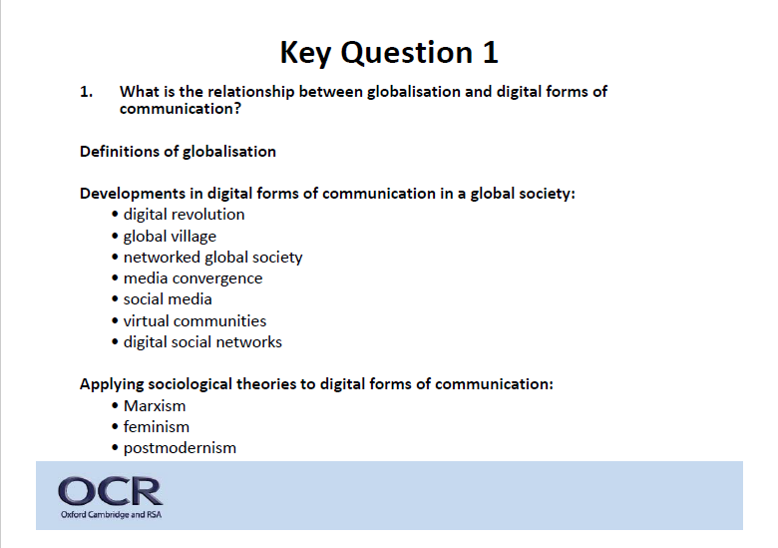
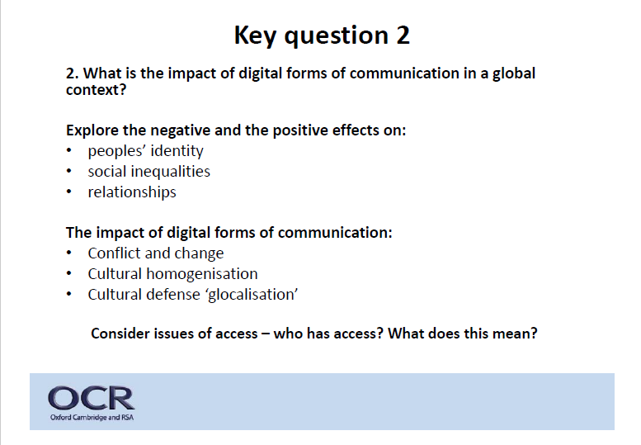
Globalisation and the Digital Social World

Slide 2
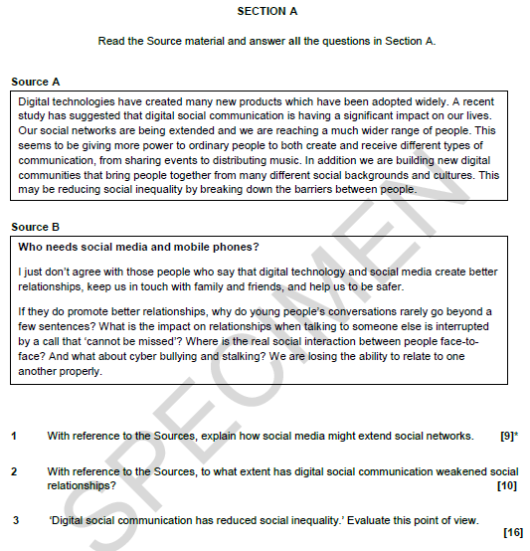
Globalisation and the Digital Social World
Examined on the same paper as the education unit.
Worth 35 marks in total (education is worth 70)
3 questions.
2 questions refer to sources.
Last question is an argument question.

Slide 3
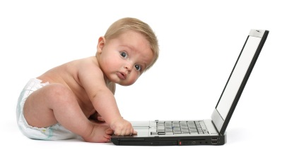
Are you a digital native?
Adapted from: Digital Natives, Digital Immigrants
By Marc Prensky. From On the Horizon (NCB University Press, Vol. 9 No. 5, October 2001)
Digital Natives. Our students today are all “native speakers” of the digital language of computers, video games and the Internet.
So what does that make the rest of us? Those of us who were not born into the digital world but have, at some later point in our lives, become fascinated by and adopted many or most aspects of the new technology are, and always will be compared to them, Digital Immigrants.
The importance of the distinction is this: As Digital Immigrants learn – like all immigrants, some better than others – to adapt to their environment, they always retain, to some degree, their "accent," that is, their foot in the past. The “digital immigrant accent” can be seen in such things as turning to the Internet for information second rather than first, or in reading the manual for a program rather than assuming that the program itself will teach us to use it. Today’s older folk were "socialized" differently from their kids, and are now in the process of learning a new language. And a language learned later in life, scientists tell us, goes into a different part of the brain.
There are hundreds of examples of the digital immigrant accent. They include printing out your email (or having your secretary print it out for you – an even “thicker” accent); needing to print out a document written on the computer in order to edit it (rather than just editing on the screen); and bringing people physically into your office to see an interesting web site (rather than just sending them the URL). I’m sure you can think of one or two examples of your own without much effort. My own favorite example is the “Did you get my email?” phone call. Those of us who are Digital Immigrants can, and should, laugh at ourselves and our “accent”. “

Slide 4
Are you a digital native?
SO WHAT?
You use and know lots
about digital communications and social media
BUT
• have you thought about it from a sociological perspective
GLOBALISATION…
What does this mean?
Why might I be asking you about your internet usage?
Consider the spread of the internet…

Slide 5
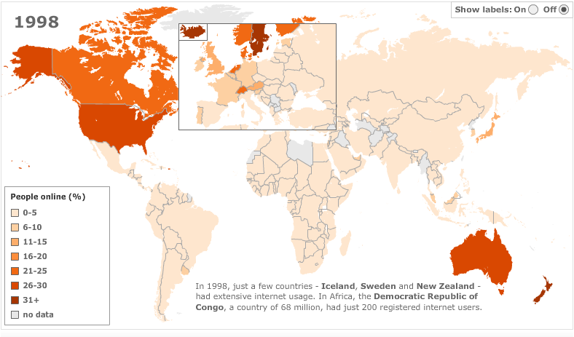
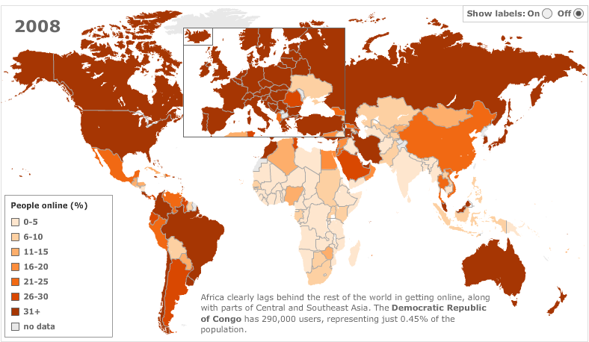
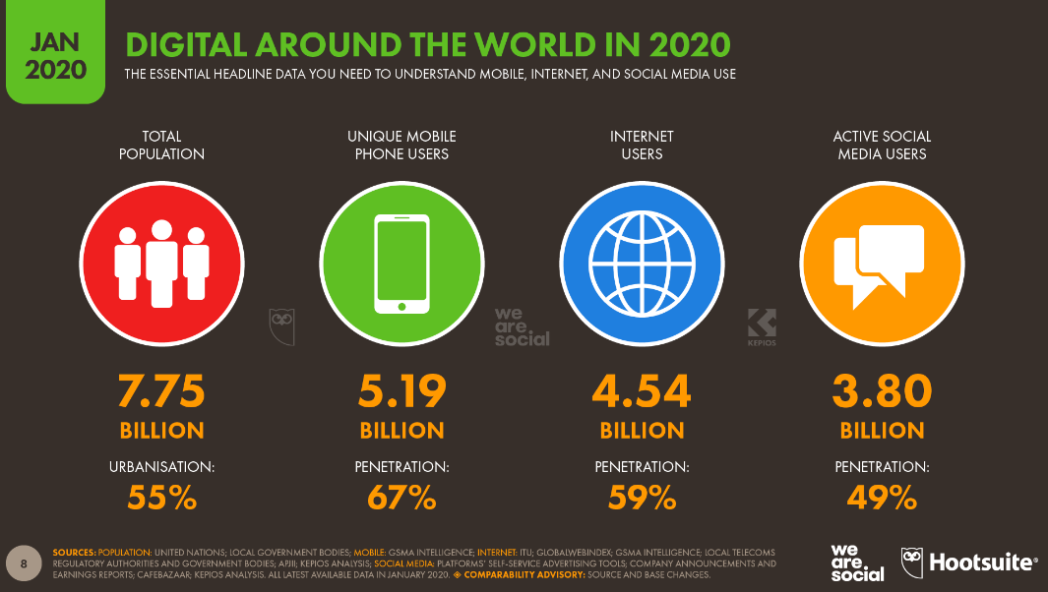
Sociology is about explaining the social world
The social world has changed
Sociology is seeking to investigate this…

Slide 6
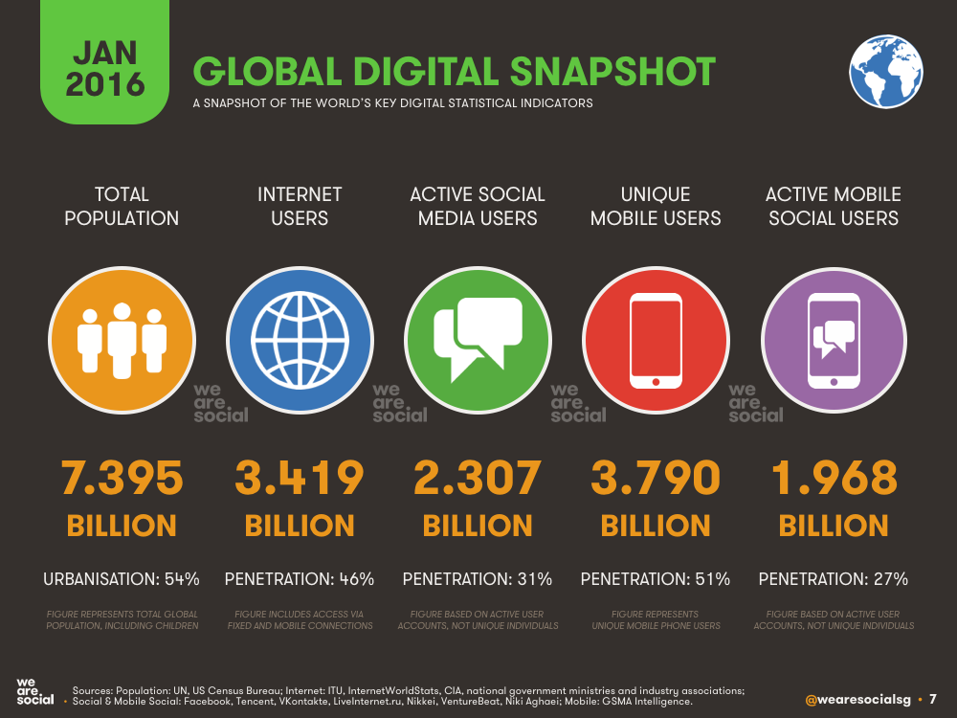
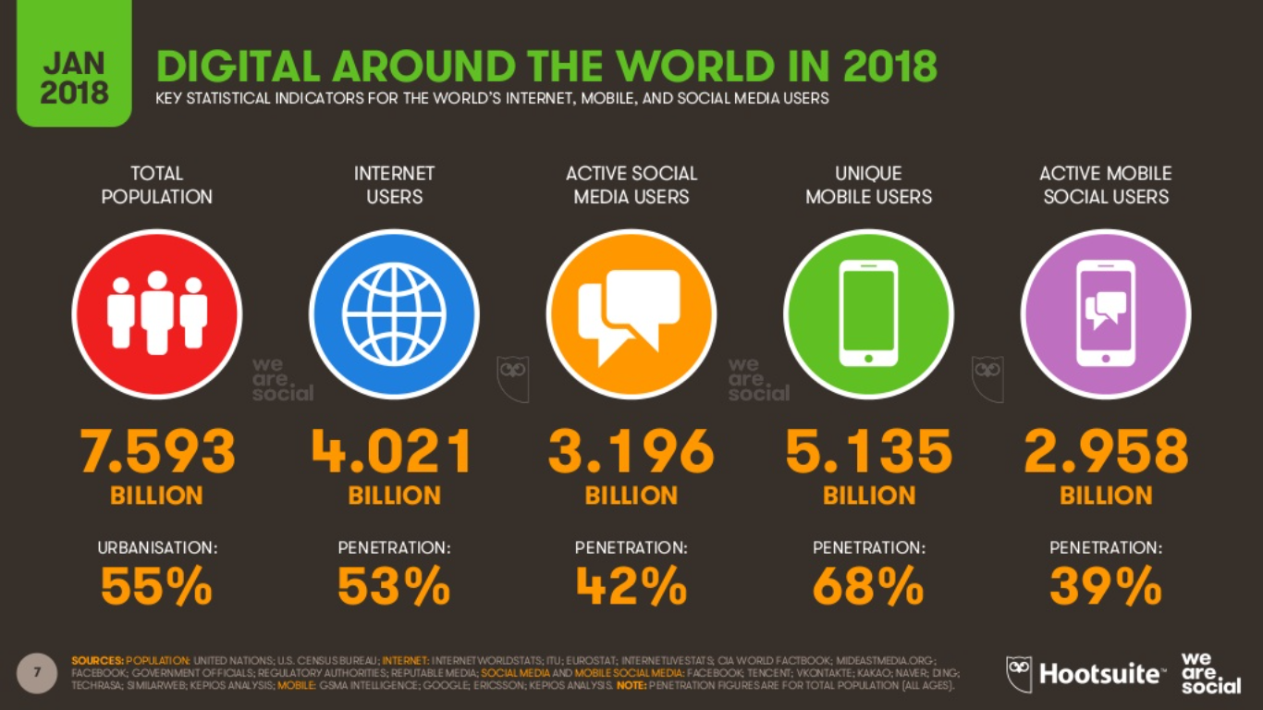

Slide 7
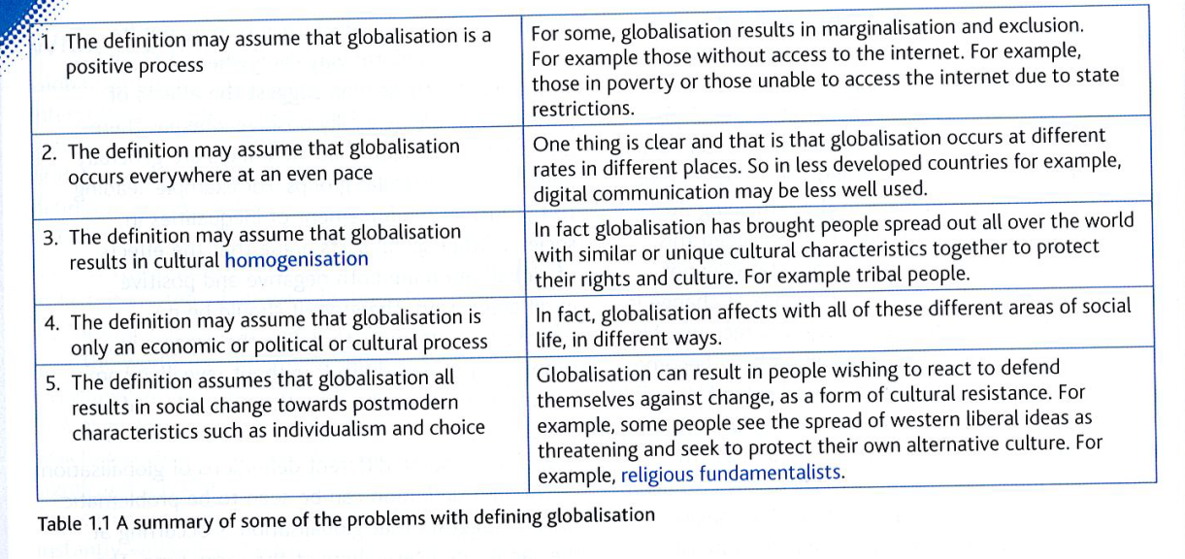
Globalisation
Read through problems with defining globalisation. With these in mind, write your own definition of globalisation. You might find it easier to do this as a diagram rather than in a paragraph. Try to include some of the following concepts in your work:
interconnection/connection of different parts of the world
greater geographical mobility
movement of people, ideas, goods, services
multiculturalism
spread of different values, ideas and lifestyles
greater awareness of global issues (e.g. deforestation)
increasing role of technology in our lives
internet and mobiles providing greater communication
links to postmodernism
transnational corporations and international trade
McDonaldization.

