Slide 1


Interactionism
The behaviour of and interaction between individuals determines how society works.
Many sociologists argue that society is determined by the behaviour and interaction of individuals.
This is an example of an action theory because emphasise is placed on the action of individuals as opposed to structural theories which focus on structure and society.
Interactionists don’t see structures as important, but they do suggest that each of use responds to social structures in our own ways. We aren’t just products of socialisation, we all have free will and are able to make choices.
Jonathan Gershuny (1992)
Analysed gender roles within the home:
Some women decide they want to work outside of the home demonstrating individual choice.
Some men took on more childcare and housework showing how this has become more acceptable in society. This demonstrates large scale social change.
Interactionist (or interpretivist) theories start with the idea that all individuals interpret society around them – people try to make sense of society. Interactionists say that culture come from people’s own ideas of how people interact with each other.
Marxists say interactionists don’t pay enough attention to the fact that some social groups are more powerful than others.
Functionalists say they don’t acknowledge the importance of the socialisation process.

Slide 2

Feminism
Argue society is patriarchal and women do not have equal rights and opportunities to men.
Radical Feminists.
Believe that society is structured to oppress women, and the society itself needs to change. They believe there’s an imbalance of power in all relationships and that women are expected to be subservient to men.
Marxist Feminists.
Argue that women are exploited by capitalist societies which are run by men.
Liberal Feminists.
Want equal rights and opportunities for women. They believe introducing more opportunities for women into the existing structures of society is the best way to bring about equality.
Radical feminists criticise liberal feminists for not acknowledging that all relationships are patriarchal.

Slide 3

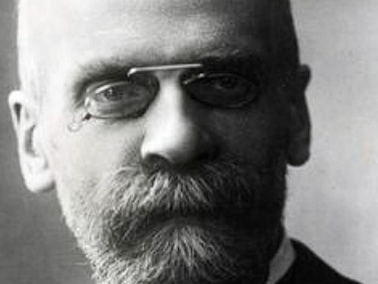
Functionalism
The individual is a product of society.
Emile Durkheim argued that society is made up of institutions which all have a useful function. Different institutions work together to ensure society performs for the benefit of all.
The function of the family is to socialise children.
The function of education is to prepare young people for society.
The function of religion is to unite society through shared beliefs.
Functionalism is a type of consensus structuralism as it states that society is structured to function harmoniously.
Interactionists argue that functionalists don’t focus enough on the individual.
Marxists say functionalists ignore the unequal power of some groups.

Slide 4

The New Right
Traditional values are important.
The New Right argue that a nuclear family is one of the most important social institutions. They argue that traditional roles within the nuclear family are crucial to maintain social order.
New Right theorists believe society needs values and institutions to maintain social order. New Right theories focus on subjects including family, education and welfare.
Many people disagree with New Right theories. In particular feminists criticise the New Right’s ideas of traditional family roles which feminists view as reinforcing a patriarchal society.
Like functionalism, the New Right is a form of consensus structuralism.
Charles Murray
argued the traditional family is under threat, which has led to a decline in moral standards and the breakdown of society.

Slide 5

Post Modernism
A reaction to modernism. Argues that society is changing and has moved on from modernism.
Postmodernists argue that society is no longer ordered and structured in the same way and is now more flexible with a greater choice of cultures and lifestyles as a result of globalisation.
Functionalists disagree with postmodernism as it ignores the role of institutions.
Interactionists disagree with postmodernism because it ignores how individuals interact.
Marxists disagree with postmodernism because it ignores inequalities.
Modernism: the period of industrialisation and urbanisation that began with the Industrial Revolution, when rational, scientific thinking was valued. Modernist theories include Marxism and Functionalism.

Slide 6
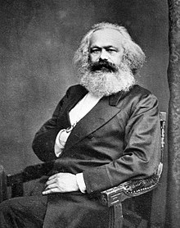
Marxism
The individual is the product of economic forces.
Karl Marx focused on the effects of capitalism. He thought that a society’s economic system (infrastructure) influenced its non-economic institutions (the superstructure) and that the superstructure determined a society’s beliefs and values.
Neo-Marxism is a 20th century version of Marxism, developed to be more relevant to the modern world.
Neo-Marxists focus on how ideology is communicated and enforced by the ruling class to maintain its power.
Marx believed the most important force in society is class conflict.
In capitalist societies, workers are employed to produce goods which are sold by their employers for profit.
Only a bit of this money ends up in the workers’ wages – most of it’s kept by the employer.
Marx said that if workers were allowed to notice the unfairness of this they’d revolt. So to avoid revolution, the capitalist system shapes the superstructure to make sure that the workers accept their lot in life.
Institutions like the family, education and religion are part of the superstructure. They lead individuals into accepting the inequalities of capitalism.
Functionalists say Marx put too much emphasis on the role of economic structures in shaping ideas and beliefs.
Interactionists argue Marx put too much emphasis on class and not enough on individuals.
Postmodernists argue social class doesn’t have such an important influence on individual identity any more.
Marx believed society was divided into two classes:
Bourgeoisie – the ruling class.
Proletariat - the working class.

