Slide 1
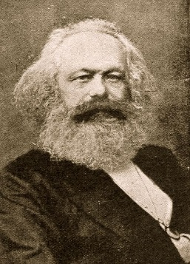

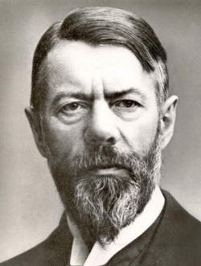
Weberian
Why did Weber disagree with Marx?
Weber’s 4 social classes
What did Weber mean by life chances?
Stratification according to Weber
Negative evaluation
Positive evaluation
Explain how class can stratify us
Class
Examples of how status can stratify us
Status
Examples of how party can stratify us
Party

