Slide 1

KILLING THE QUESTION
ShortCutstv

Slide 2

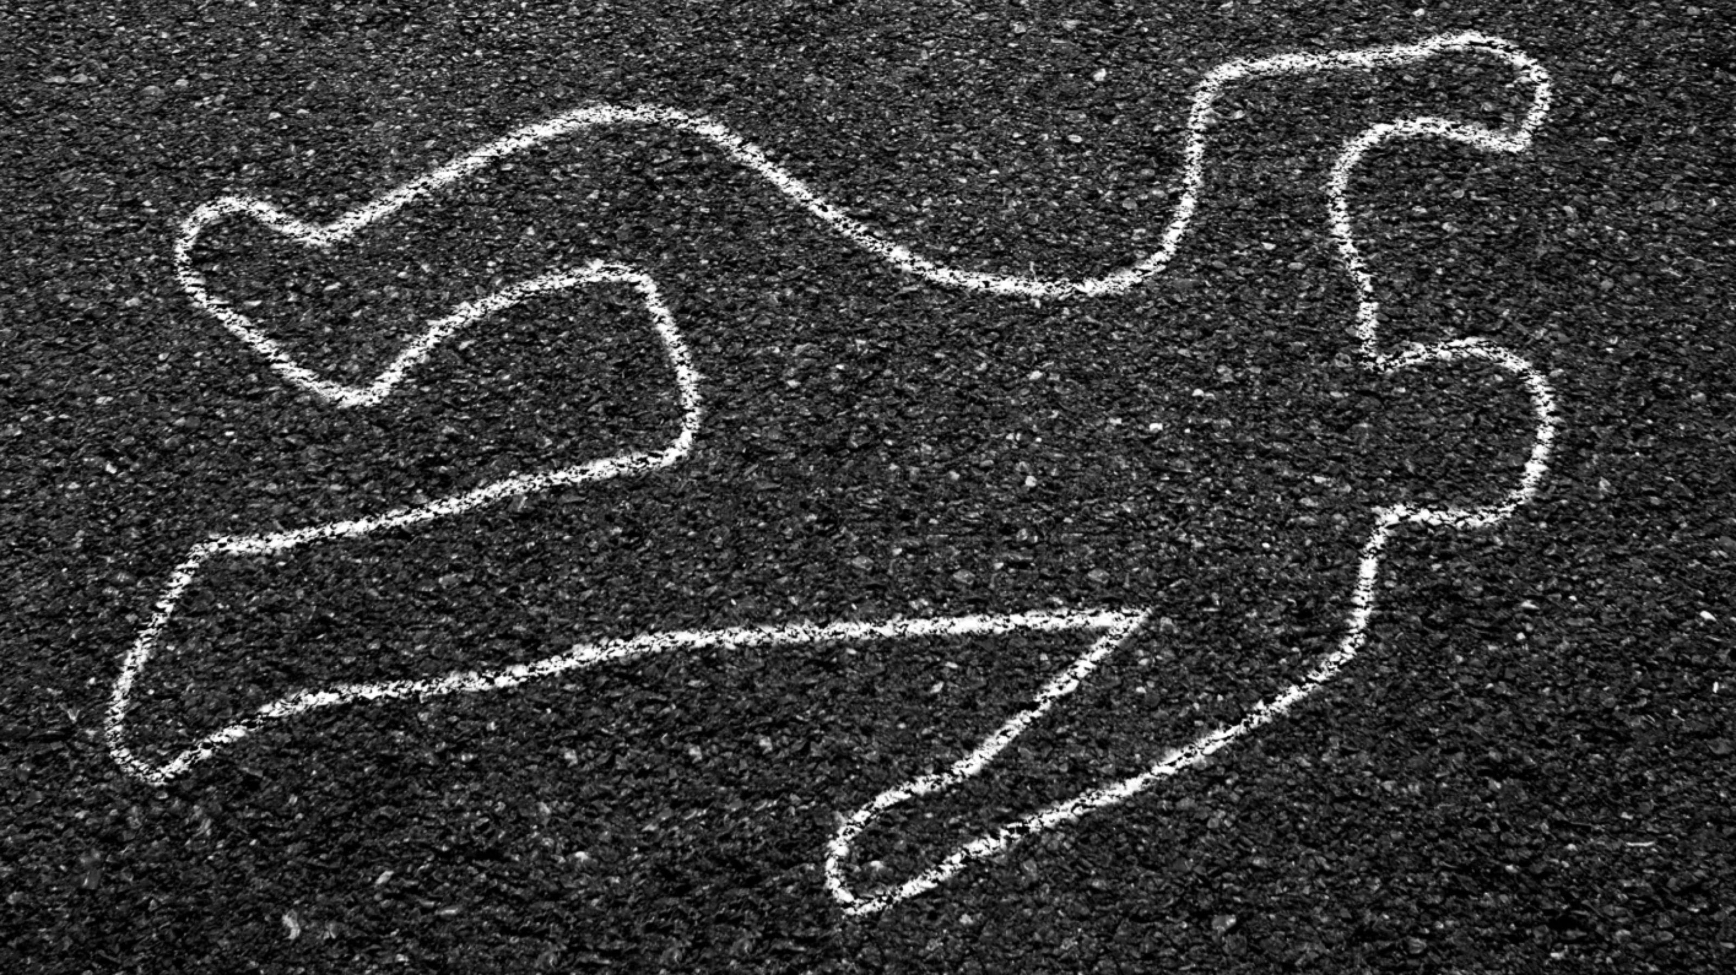

Evidence
Some functionalist sociologists argue that crime and deviance are caused by the inability of some people to gain the rewards of society, for example because of educational underachievement. Those members of society whose opportunities are blocked cannot achieve the goals of society by socially approved means.
Conclusions?
Agnew
Criticisms?
General Strain Theory
Examples?
Durkheim
Social stability
Social change
Examples?
“Evaluate the usefulness of functionalist approaches in understanding crime and deviance”.
Criticisms?
Matza
Conventional / subterranean values.
Examples?
Merton
Criticisms?
Strain Theory
Examples?
Conclusions?
Criticisms?
Conclusions?
Conclusions?
Evidence?

Slide 3

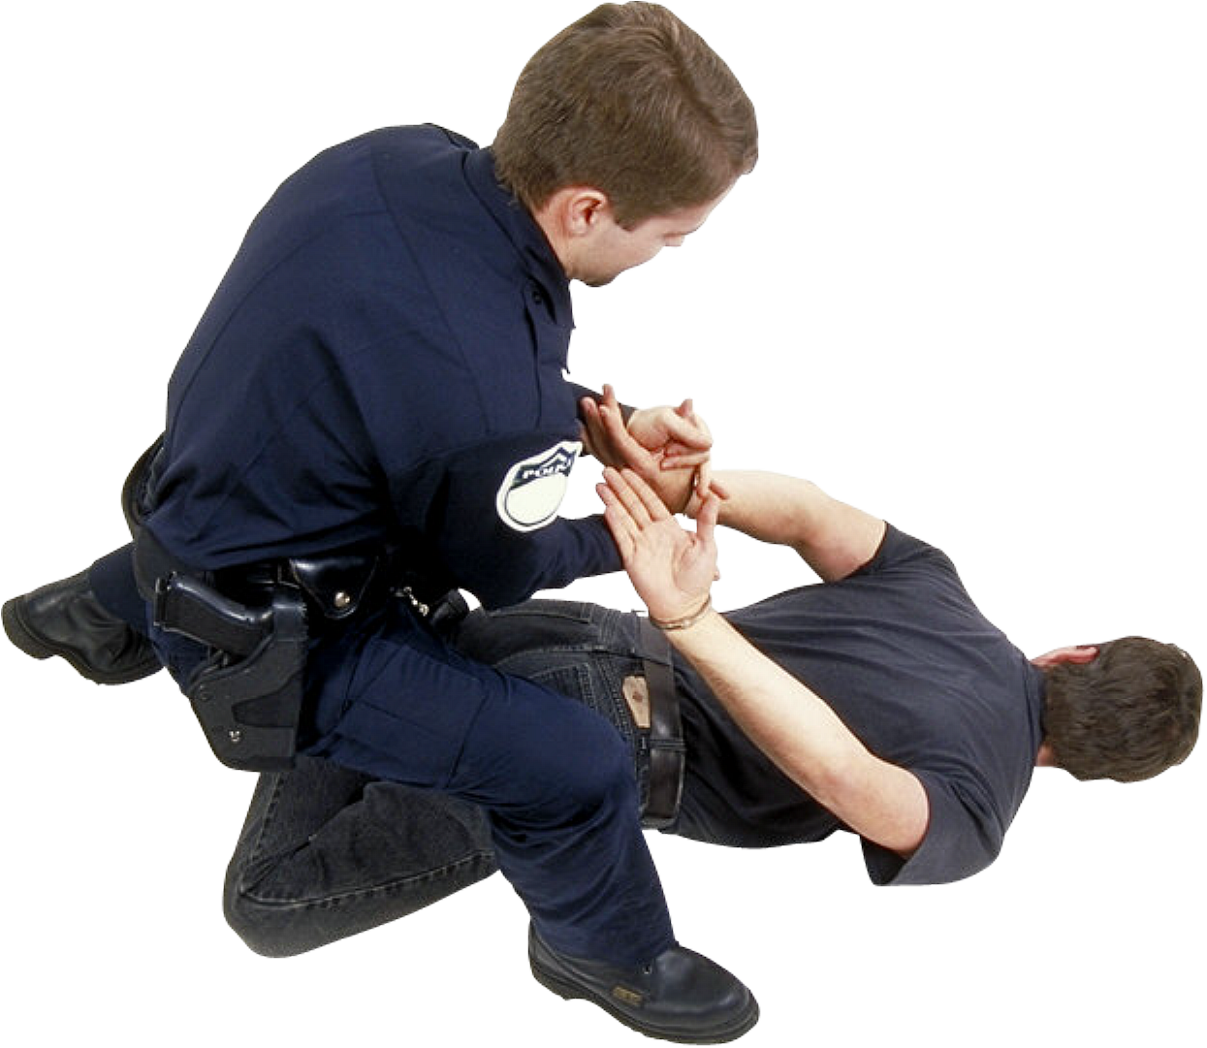
Introduction
Durkheim
Criticisms?
Conclusions?
Social stability
Social change
Examples?
Merton
Criticisms?
Conclusions?
Strain Theory
Examples?
Conclusion
Matza
Conclusions?
Conventional / subterranean values.
Examples?
Criticisms?
Agnew
General Strain Theory
Examples?
Criticisms?
Conclusions?

