Slide 1
Topic/Objective: Marxism
 | LEARNING OUTCOMES/ KEY QUESTIONS | KEY WORDS
ALL E-D | Outline key concepts in Marxist Theory | Proletariat Bourgeoisie Ruling class ideology Exploitation Alienation Capitalism Capitalist Conflict Economic determinism False class consciousness Oppression Monogamous nuclear family Unit of consumption
MOST B-C | Explain the Marxist View of the Family (Engels, Zaretsky, Althusser)
SOME A-A* | Evaluate Marxist Views of the Family
Notes:
All have the River Thames featured in the stories.

Slide 2
Key Terms - Marxism
Proletariat
Bourgeoisie
Ruling class ideology
Exploitation
Alienation
Capitalism
Capitalist
Conflict
Economic determinism
False class consciousness
Oppression
Monogamous nuclear family
Unit of consumption

Slide 3
How much profit?
30 workers work on the production line to make the ready salted flavour of Hickman’s Potato Chips. The bags are sold at a wholesale price for 50p per bag.
Each worker works for 8 hours a day and is paid minimum wage of £6.08 per hour.
In an 8 hour shift, 15,000 bags of the crisps can be produced.
In terms of raw material costs (potatoes, salt, oil and packaging) the crisps cost 9p per bag. Power and machinery costs is an extra 1p per bag.
How much net profit is made in a day after all costs have been accounted for?

Slide 4
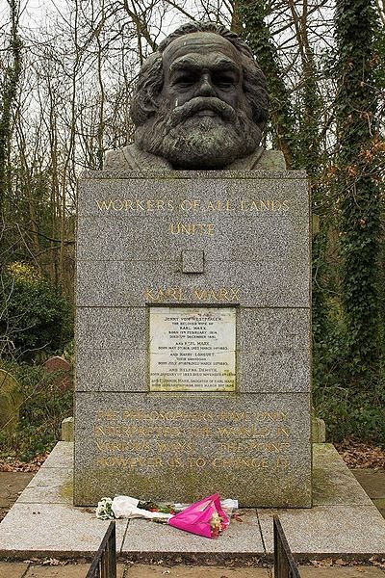
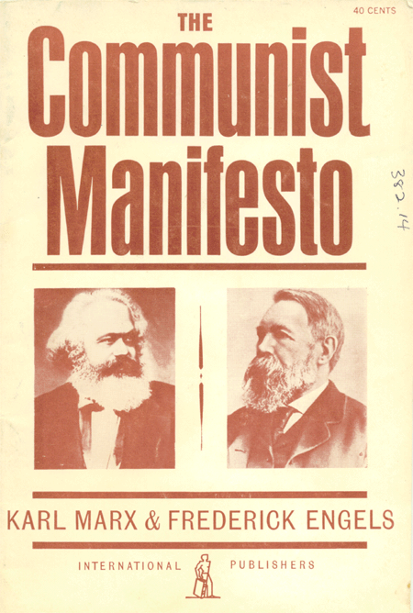

Slide 5
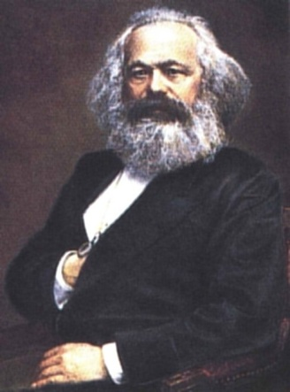
Marxist Theory & The Family
Before going in to detail – How do you think Marxists might view the Family?
What are the key principles within Marxism?
> Class Conflict
> Suppression of the W/C
> Dominant Ideology
Essentially we will be looking at how the Family contributes to the maintenance of Capitalist Society
Karl Marx (1818-1883)
> False Class Consciousness
> Ideological State Apparatus & Repressive State Apparatus

Slide 6
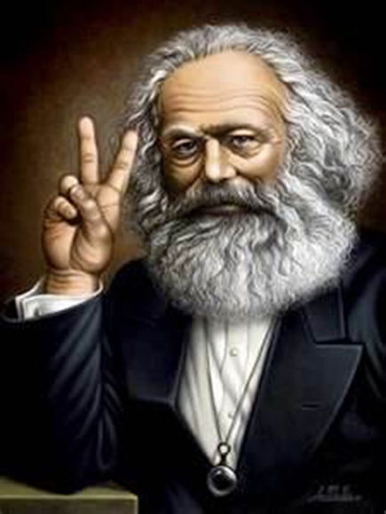
From each according to his ability, to each according to his needs

Slide 7
The history of all hitherto existing society is the history of class struggles.

Slide 8
A spectre is haunting Europe; the spectre of Communism.

Slide 9
The theory of Communism may be summed up in the single sentence: Abolition of private property.

Slide 10
In place of the bourgeois society, with its classes and class antagonisms, shall we have an association, in which the free development of each is the condition for the free development of all.

Slide 11
The proletarians have nothing to lose but their chains. They have a world to win.
WORKING MEN OF ALL COUNTRIES, UNITE!

Slide 12
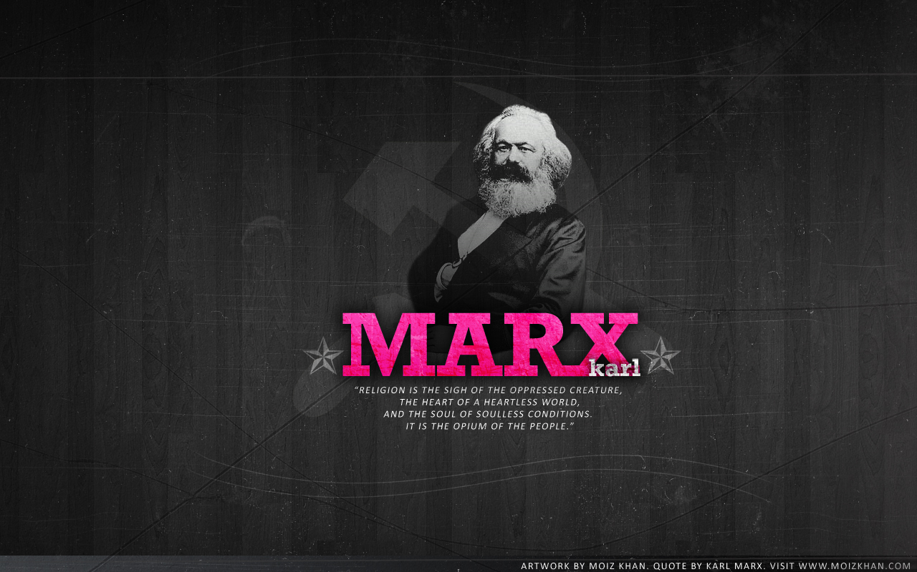

Slide 13
The philosophers have only interpreted the world, in various ways. The point, however, is to change it.

Slide 14
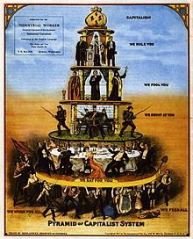
Social Class

Slide 15
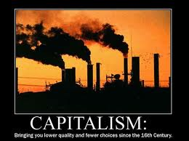

Slide 16

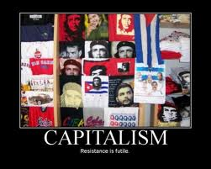

Slide 17
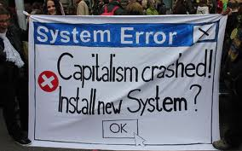
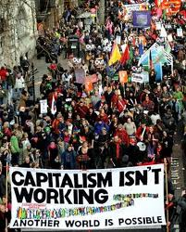
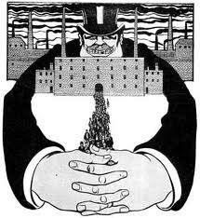

Slide 18
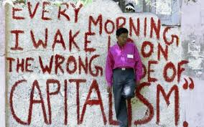



Slide 19
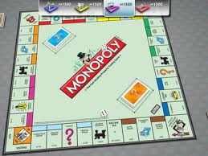

Slide 20


Marxists think society is based on CONFLICT between 2 classes...
The Bourgeoisie
The people who OWN the MEANS OF PRODUCTION (ie, land, tools, raw materials and factories etc)
The Proletariat
The working classes who WORK for the bourgeoisie.

Slide 21
This conflict is based the view that the relationship between a boss and a worker is an exploitative one.
The worker does what the boss tells them.
Everything is for the benefit of the boss or RULING CLASS (Bourgeoisie)
Nothing is for the benefit of the proletariat.
They are the ones that create the goods, but they see none of the profits.

Slide 22
The surplus profit created by capitalist business then goes to the owners of the means of production (the bourgeoisie)
It makes them richer, and more powerful.
Often the means of production and the wealth they have is inherited, and this is how the bourgeoisie is maintained.
The working classes see none of the benefits.
As a result they suffer alienation. They have no attachment to the goods they produce or job satisfaction because they will see none of the rewards.

Slide 23
However, Marx argued that the proletariat (working class) are suffering from false consciousness. They are unaware they are being exploited.
Marx said the ruling classes (bourgeoisie) use their ideas (ideology) to control people and keep people in their place.
For example, we are taught to be punctual, compliant and work hard – and we might get a promotion.
When actually, all these things help production – create more money for the bourgeoisie.

Slide 24
Marxists think that all the institutions of society are used to uphold capitalist values...
All aid the capitalist system and bourgeoisie by passing on capitalist norms and values
The family
Education system
The media
The workplace
Religion
The government
Law system

Slide 25
3 Marxist perspectives on how the family helps capitalism...
Inheritance of property
Ideological function of the family
The family as a unit of consumption.

Slide 26
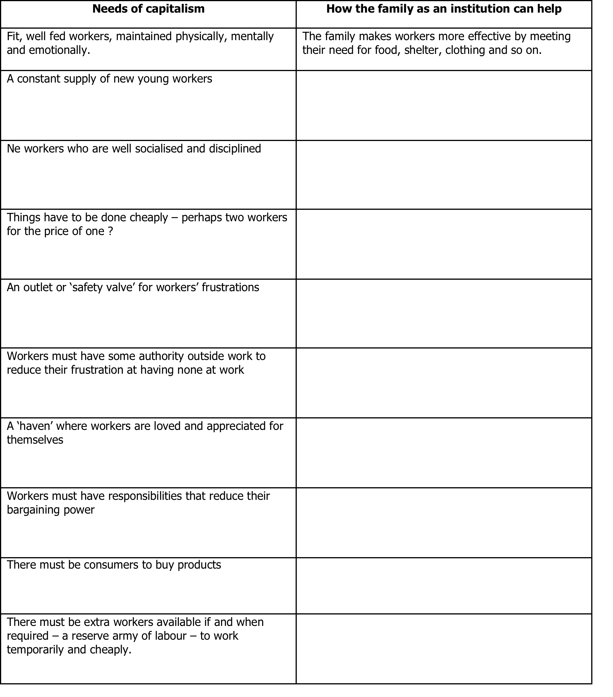
How does the Family support the needs of K.
Activity

Slide 27
3 Marxist perspectives on how the family helps capitalism...
Inheritance of property
Ideological function of the family
The family as a unit of consumption.

Slide 28
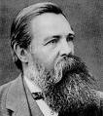
Engels argues that the Nuclear Family developed as a response to industrialisation and the growing trend to ‘Own’ Private Property.
Engels (1820 – 1895)
Monogamous Marriage ensured that women would be economically dependant on their male partners & as such would not stray & mother children by other men.
The Nuclear Family was set up so that capital (wealth) could legally be passed on to ‘Heirs’ (Children) – Money could stay within the Family.
Women become ‘Glorified Prostitutes’ – producers of heirs in exchange for economic security.
Monogamous Relationships were favoured so that men could be sure that their children really were their biological children
Is Engels’ argument realistic?
Explain your answer

Slide 29
Origins of the Family?
Activity
Draw a timeline to show Engel’s view of how families have evolved.

Slide 30
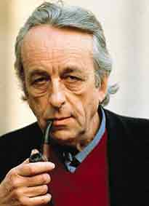
Louis Althusser
Modern or neo-Marxist
Argues that the family is a part of the Ideological State apparatus.
These are the different ways in which capitalist ideology (ideas) are passed on to all members of society.
The family is used to pass on these capitalist values to children.
Fact: Althusser murdered his wife!

Slide 31
Task
Make a list of 5 basic personal (not educational) qualities required to be a good worker.
Now, for each quality, think about how the family might be a training ground for each of these qualities...how are these qualities promoted by family life?

Slide 32
Be punctual...
Be polite to your boss....
Don’t talk back...

Slide 33
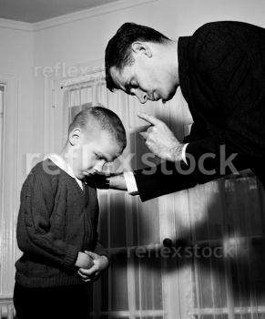

The family mirrors work life...
It teaches respect for authority and hierarchies of power...

Slide 34

The family mirrors work life...
It teaches that we are paid for working hard...

Slide 35

Parsons argued that the family is like a warm bath...

Slide 36


Zaretsky (1986)
The family provides ‘a cushion’ from the effects of ‘Alienating Work’.
Families separate & fragment individuals from the rest of community – this dampens revolutionary potential.
(Divide & Conquer)
The family allows the worker to relax, refresh and unwind after a days work.
This means that the worker can then feel revitalised for work the next day.
What is meant by False Class Consciousness?
Why is False Class Consciousness useful here?

Slide 37

BUT, Zaretsky (1976) thinks the haven that the family offers aids false consciousness...
Zaretsky argues the family is a private place where exploited workers can relax and be themselves
But, this is an illusion. Nuclear families tend to mean that men are exploited at work and women are exploited at home as domestic slaves.
Women teach their children capitalist norms and values as part of primary socialisation and they look after their husbands health, diet and wellbeing and ensure he is fit for work...needed to keep capitalism going

Slide 38
So, Zaretsky argues that family life if essential for the continution of capitalist society...
To socialise the next generation of workers into capitalist norms and values...
To keep the current generation of men healthy and fit for work...
And also, to allow the head of the household to be ‘king of his castle’ – he can be boss of his home to compensate for being bossed about/exploited at work.
The family are a unit of consumption (buying goods created by the bourgeoisie)

Slide 39
The family as a unit of consumption

Slide 40
Consumption = Buying
Before industrialisation, the family was a unit of production (they made what they had) Now they are a unit of consumption (they buy)
Family units spend A LOT. More than a single person household.
The family is an important market.
Food, clothing, cars, holidays etc...this all adds up!
Who benefits – the bourgeoisie.
The goods are sold at a profit. http://www.youtube.com/watch?v=JZ8G2a8cp5M

Slide 41
Marxism – What was the question?
Proletariat
Bourgeoisie
Ruling class ideology
Exploitation
Alienation
Capitalism
Capitalist
Conflict
Economic determinism
False class consciousness
Oppression
Monogamous nuclear family
Unit of consumption
Glorified Prostitutes
Haven

Slide 42
Key Writers
Engels
Althusser
Zaretsky

Slide 43
How useful are these writers?
Are there ideas applicable today?
Evidence?
Who would disagree?

Slide 44
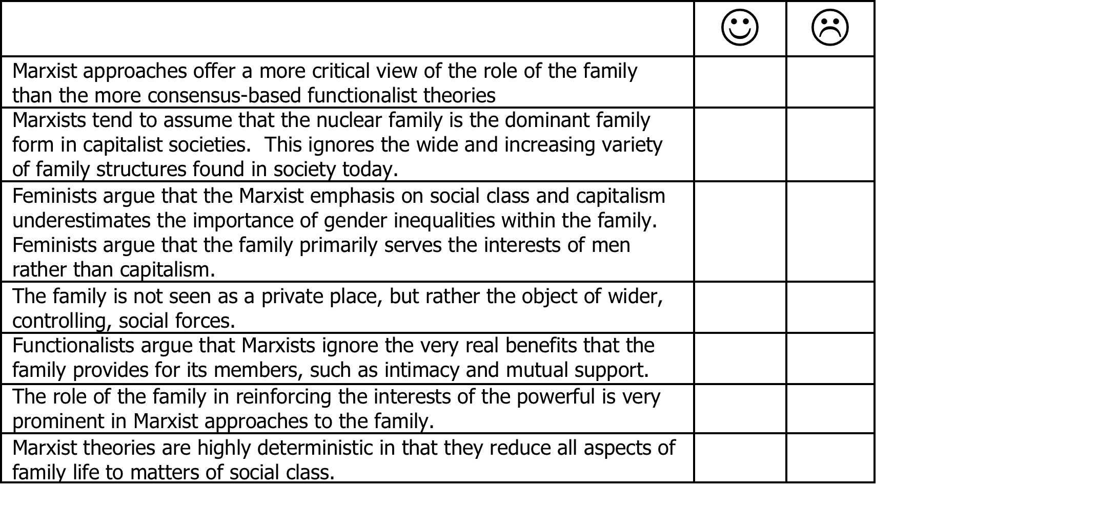
Evaluation Grid

Slide 45
Evaluation
The Marxist view is too simplistic: traditional Marxism assumes the workers are male, that housewives are female, and that there are only two classes.
Ignores the benefits of a capitalist economy to individuals and society (Functionalists)
Little Marxist research on alternatives to the family...Marxism is an ANTI-FAMILY view.
No explanation of why the family flourishes in non-capitalist societies.
Please complete the evaluation grid and any other points you can think of?

Slide 46
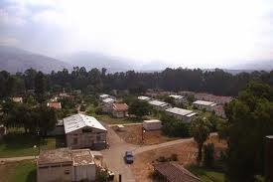
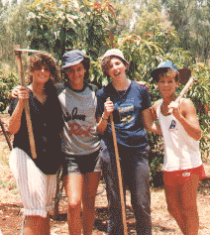
Kibbutz
Kibbutzim are popular in Israel (though becoming less so)
They are communes or collectives of people who all live and work together like a large family.
They tended to consume what they produced.
They stress equality between members – no real hierarchies, everyone owns the means of production.
They were based on the principles of socialism and Zionism.

Slide 47
Task
Create a 30 second to one minute advert is advertising the benefits of living in a family (as put forward by Functionalists)
Then, create an advert that uses the same format, but this time, the negatives associated with living in a family (like the anti-family Marxist view)

Slide 48
Criticisms of Marxist Theory of the Family
Remember:
It is crucial to critique & evaluate!
You can use theories to support and/or refute other theories!
> Is the family primarily centred around work?
> Is the Nuclear Family popular within Society?
> What might Functionalists have to say about the Marxist view on the Family?
Why would Marxists Argue that the Nuclear Family is a Universal Institution?
> Are women ‘Glorified Prostitutes’ within the Family?

Slide 49
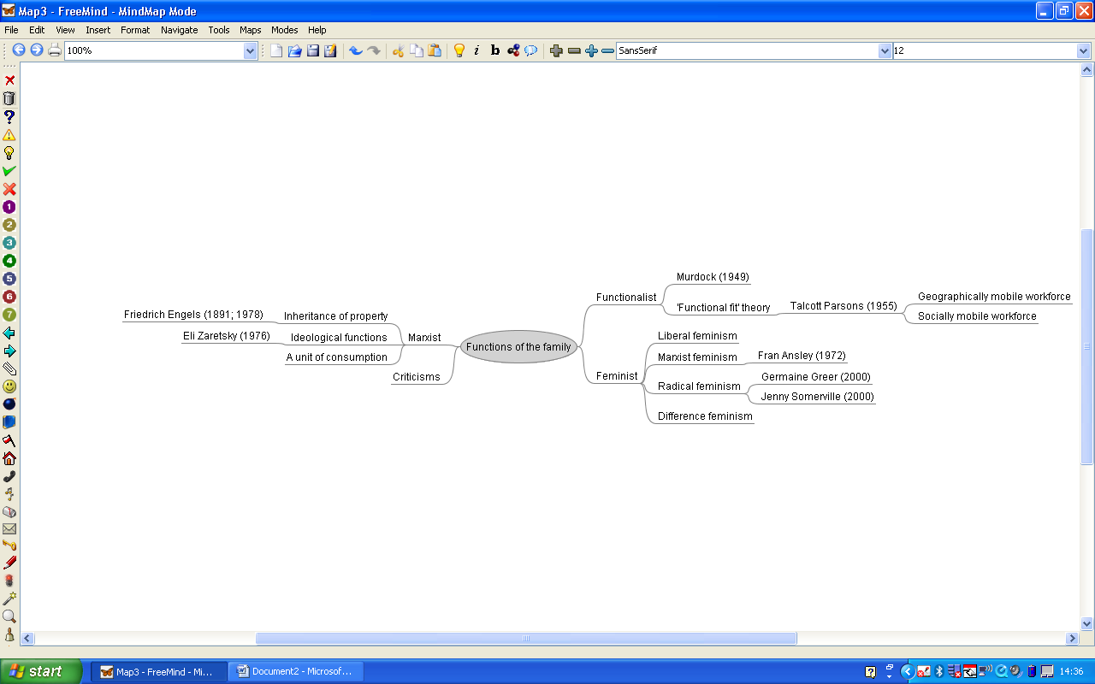

Slide 50
Alternative phrasings
Write 3 alternatives to each of these...
‘Parsons said...’
‘Lewis thinks Andrews is wrong and says...’
‘I think...’
– remember NEVER write I think

Slide 51
‘Parsons said...’
Parsons suggested...
Parsons put forward the idea that...
Parsons asserted that...
A study by Parsons found that...
Parsons concept of.....suggests...

Slide 52
‘Lewis thinks Andrews is wrong and says...’
In comparison to Andrews, Lewis suggests...
However, Lewis discredits Andrews and suggests...
On the other hand, Lewis disagrees with Andrews and...
Andrews’ ideas were criticised by Lewis, who put forward the idea...
Andrews was counter argued by Lewis...
An opposing view was put forward by Lewis...

Slide 53
‘I think...’
It could be said that...
One might say...
It could be suggested that...
One could put forward the idea that...
It may be said...

Slide 54
Question 2:
Assess the view that the family ‘serves the needs of capitalism’ (24 marks)

