Slide 1
Marxist Perspectives on the Family
An introduction to Marxism and family sociology

Slide 2
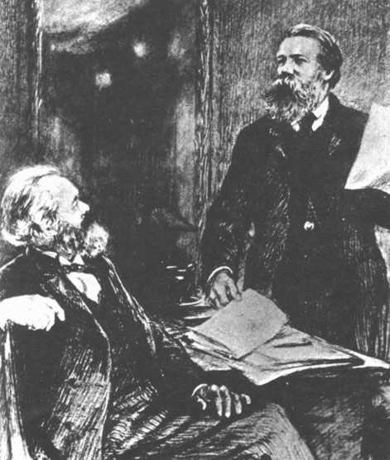
The importance of Frederick Engels
Marx himself didn’t pay much attention to the role of the family
It was his friend and collaborated Engels who attempted to trace the evolution of the family through time in “The Origin of the Family”

Slide 3
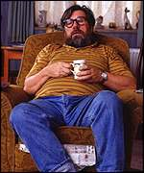
Engels’ Conclusions 1
The monogamous bourgeois nuclear family developed to help solve the problem of the inheritance of private property – men needed to know who their children were in order to pass on their property to their heirs
The family is therefore designed to control women and protect property

Slide 4
Engels’ Conclusions 2
The bourgeios nuclear family emerged with capitalism
It is patriachical – it is designed to guarantee and perpetuate male power through the inheritance of property
It therefore serves the interests of capitalism

Slide 5
Marxists say the family serve capitalism is 4 ways
The family socialises children – thereby reproducing both labour power and an acceptance of capitalism (false consciousness).
Women’s domestic work is unpaid which benefits capitalism.
The family acts as a safety valves for the stresses and frustrations of working class men.
The family as a unit of consumption buys the goods and services provided by capitalism.

Slide 6

Zaretsky
Zaretsky claimed the family “props up” capitalism
The family is one place where male workers can feel they have power and control. This helps them accept their oppression in wider society

Slide 7
Criticisms of Marxist View
Anthropologists have suggested that the emergence of the nuclear family didn’t actually coincide with the emergence of capitalism
The Marxist view ignores family diversity. It sees the nuclear family as being simply determined by the economy.

