Slide 1

Social Policy and the Family
L/O: demonstrate a knowledge and understanding of how social policy has impacted on the structure of the family (AO1).
Starter:
What has Dave got to do with your family?

Slide 2

Who were the new right?
A sociological perspective from around the last 50 years.
“The family plays a key point in shaping the moral order of society”
What is the moral order of society?

Slide 3
Who were the new right?
The family should provide children with the following values:
Discipline
Respect
Civility
Responsibility

Slide 4
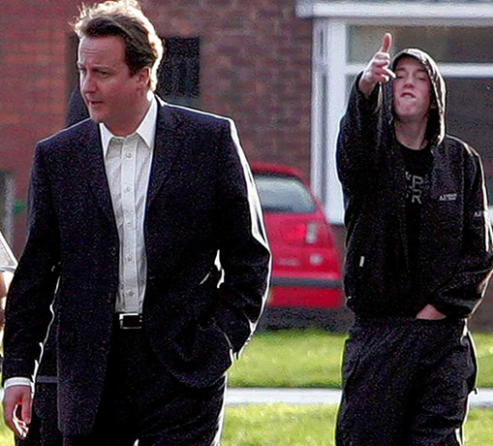
Is 21st century Britain providing these values?

Slide 5


Why is it that Britain has a culture of chavs, teenage mothers and 12 year olds with 17 ASBOs?

Slide 6


Slide 7

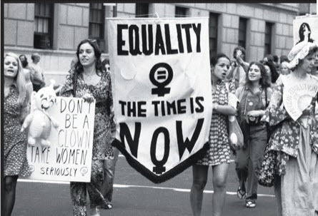
Why is the nuclear family disappearing?

Slide 8
Why is the nuclear family disappearing?
New Right sociologists believe the following events/policies have led to a breakdown in the nuclear family. Can you explain why?
1967 Abortion act - legal abortion through NHS
1967 Sexual Offences Act – Decriminalised homosexuality (if you were over 21 [18 in 1994; 16 in 2000])
1969 Divorce Reform Act – Cheaper and less legally complicated to get a divorce.
1970 Equal Pay Act - women get equal pay in the same role as men.
1975 Sex Discrimination Act – women can’t be discriminated against due to gender.
2002 Adoption and Children Act – same sex couples allowed to adopt
2005 – Same sex civil partnerships recognised by law
2009 Human Fertilisation and Embryology Act – lesbians recognised as parents in the case of IVF.
2014 – Same sex marriage legalised

Slide 9

She is a New Right Sociologist.
Gays just want the benefits of the life that heterosexuals have. They don’t actually want children.
Gays only want babies as a “trophy”. They can show them off to other gay couples.

Slide 10
Put the lovely Pat Morgan’s head on for 15 minutes.
Look at the list of acts that directly affected families and think of them from her perspective.
Why are they contributing to a nuclear family melt-down?

Slide 11
Why is the nuclear family disappearing?
New Right sociologists believe the following events/policies have led to a breakdown in the nuclear family. Can you explain why?
1967 Abortion act - legal abortion through NHS
1967 Sexual Offences Act – Decriminalised homosexuality (if you were over 21 [18 in 1994; 16 in 2000])
1969 Divorce Reform Act – Cheaper and less legally complicated to get a divorce.
1970 Equal Pay Act - women get equal pay in the same role as men.
1975 Sex Discrimination Act – women can’t be discriminated against due to gender.
2002 Adoption and Children Act – same sex couples allowed to adopt
2005 – Same sex civil partnerships recognised by law
2009 Human Fertilisation and Embryology Act – lesbians recognised as parents in the case of IVF.
2014 – Same sex marriage legalised

Slide 12



What do you think Pat had to say about the Welfare System in the UK?

Slide 13
Your views
Do you agree with Morgan’s view that gay couples only want children as trophies?
In your opinion, what is right or wrong with the arguments that:
a) the contraceptive pill encourages females to have multiple partners?
b) it encourages people to have extra-martial affairs?
5 mins to write your answers/organise ideas. 10 mins discussion.

Slide 14

Butler (2010): Broken families are more likely to produce children who break the law, be unemployed and/or depend on benefits. This is because of a lack of positive male role-models.

