Slide 1
Personal Life Perspective
AQA A Level Sociology
of the family

Slide 2
To Start…
Society
Which sociological perspectives does this image depict?
How far can the family be explained in this way?
Structural Theories: We are controlled by large institutions in Society – Patriarchy, Capitalism etc. A top down approach.

Slide 3
Personal Life Perspective
How does the Personal Life Perspective see the family?
Understand | To describe the personal life perspective of the family.
Apply | To explain examples of the personal life perspective of the family.
Analyse | To compare and contrast the personal life perspective with alternative perspectives.
Evaluate | To discuss strengths and weaknesses of the personal life perspective of the family.

Slide 4
and the family
Personal Life Perspective
In order to understand families we must look at the view of the individuals and the meanings they give their relationship, not by the structures they are determined by….
Which type of theory looks at the meanings of behaviours in society?

Slide 5
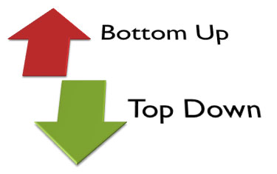
and the family
Personal Life Perspective
A Social Action Theory
Interactionist Approach – looking at the dynamics between people and the meanings they attach to their relationships.
A bottom up approach. How the meanings and actions of individuals (rather than large societal structures) shape their relationships.
Versus

Slide 6
Why Personal life?
Personal Life Perspective
The notion of a personal life, as now understood, is in part a creation of modern Western society.
People in the west, especially, place a high value on privacy, individualism and their pursuit of self-definition.
In modern times, many people have come to think of their personal lives as separate from their work. Work and recreation are distinct; one is either on the job or not, and the transition is abrupt. The common phrase "Work hard, play hard" illustrates this mind-set.

Slide 7
Personal life
Personal Life Perspective
The concept of personal life also tends to be associated with the way individuals dress, the food they eat, their schooling and further education as well as their hobbies, leisure activities, and cultural interests. Increasingly, in the developed world, a person's daily life is also influenced by their leisure use of consumer electronics such as televisions, computers and the Internet.
Other factors affecting personal life are an individual's health, personal relationships, pets as well as his home and personal possessions

Slide 8
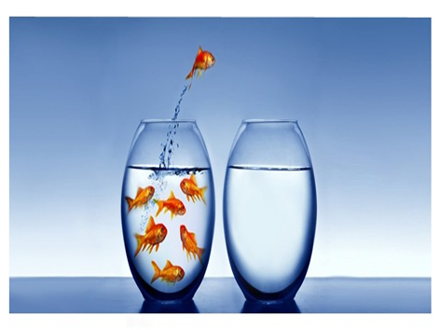
and the family
Personal Life Perspective
When does a ‘family’ mean more than blood or marriage ties?
pets
How legitimate is it to count pets, friends and dead relatives as family?
Give reasons

Slide 9
and the family
Personal Life Perspective
“I put the time an effort into raising my daughter. I can therefore be called her ‘mother.’ The definition of a mother should not be just about the cell that starts it off or a genetic/biological link”
donor conceived children
Nordqvist & Smart – Relative Strangers
Donor children make definition of family difficult.
Should families with donor children actually be called a ‘family’?
Would the personal life perspective include donor families in their definition of the ‘family’?

Slide 10
and the family
Personal Life Perspective
What different roles might be considered for a donor? Why might this change?
2) Lesbian couples with donor children: Why might people, other than the lesbian couple and the donor, become involved with a child? What does this tell us about the meaning of family?
3) How do donor children highlight the personal life view on the family?

Slide 11
Over to you….
Personal Life Perspective
Understand | Write a summary of the personal life perspective of the family using key terms: Interactionist, meanings, bottom up
Apply | Explain examples of ‘families’ that the personal life perspective helps us to explain. Explain what Nordqvist & Smart found about Donor children and how this highlights the personal life perspective.
Analyse | Compare the personal life perspective with functionalism. What are the similarities/differences?
Evaluate | Explain strengths and weaknesses of personal life perspective of the family.

Slide 12
and the family
Personal Life Perspective
Relationship with friends
Fictive kin – close friends you treat as family e.g. auntie
Gay and lesbian chosen families – supportive network
Relationships with dead relatives who continue to shape lives
Pets – children in particular (Tipper)
So unlike the other perspectives, the personal life perspective has enabled us to include all kinds of relationships into the definition of a ‘family.’

Slide 13
and the family
Personal Life Perspective
AO3 - how can you use this approach to evaluate structuralist theories?
Functionalism – explain how this criticises the idea of consensus
Can you also evaluate…
Marxism
Feminism

Slide 14
and the family
Personal Life Perspective
Exam Question
Using one example, briefly explain how the personal life perspective explains the family.
[2 marks]

