Slide 1

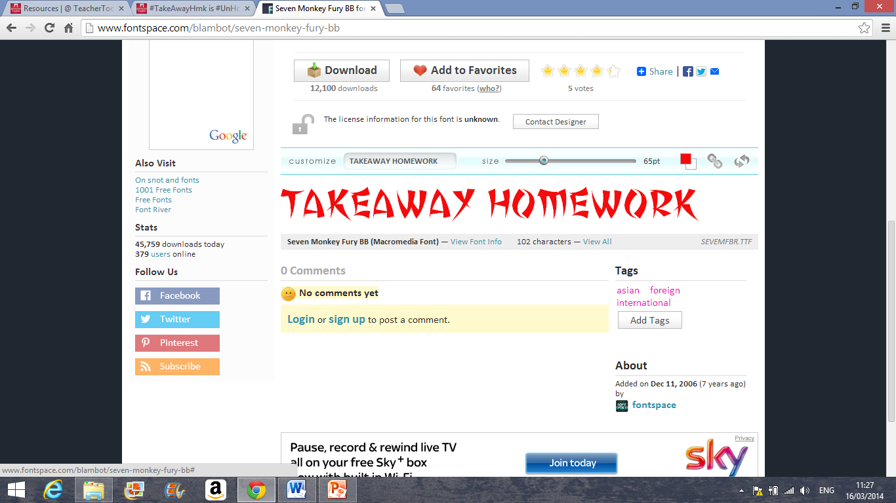




Sociology Starters
Main courses
A spicy selection of literacy-focused starters to whet your appetite!
Hit your homework hunger hard with this mouth-watering selection of main courses!
Tweet and Sour …………………………………………
Write a tweet (no more than 140 characters) explaining a Sociological key term we have covered in the Crime and Deviance unit.
Word Ton Soup ………………………………………….
Chose three key terms and put them into a sentence to summarise the Crime and Deviance unit.
Mixed Sociology Platter …………………………….
Explain the difference between Crime and Deviance in no more than two sentences.
Mini Spring Rules ………………………………..…….
List as many informal and formal rules as you can.
Speech Cocktail …………………………………………
Find a new article about a person breaking an formal rule and summarise it in your own words.
Spicy Baked Control………………………………
Explain in your own words what social control is and provide examples.
Yu Teach Tu …………………………………….………… Choose a topic from Crime and Deviance and design a revision task for the class to complete.
Aromatic Control……………………………………….
Create two scenarios of informal social control. What are the unwritten rules that are being followed ?
Photo Phuey ………………………………………………
Draw a number of images of agents of formal social control and quiz a member of the class on the images
Spicy Song Sauce ………………………………………
Write a song or a poem inspired by the Crime and Deviance unit.
Foo Yung Facebook ………………………………….
Create a Facebook profile for a criminal.
Assorted Quiz Questions …….…………………….
Create a ten question quiz for your classmates based on one area of the Crime and Deviance unit.
Photo Fritter ………………..……………………..…….
Draw as many key terms as possible from the Crime and Deviance unit. You are not allowed to write down any words to explain what they are.
Cross Curricular Curry …………………………
Choose a topic from another subject, other than English and Maths, and show how you can link it to Crime and Deviance.
Crispy Crossword ……………………………………… Make a crossword using only key terms from Crime and Deviance. Don’t forget to write detailed clues!
Creative Cracker …………………………….………… Produce a piece of artwork, or a 3D model, to demonstrate your understanding of Crime and Deviance.
King Plan Platter …………………………………….... Plan a lesson, using the ‘5 minute lesson plan’ summarising the Crime and Deviance unit.
Spare Ribs …………………………………………
Create a board game based on Crime and Deviance. It should test knowledge and understanding.
Authentic Sociology, independent learning and reflective cuisine
Welcome to Miss Coleman’s Express Takeaway homework menu, delivering fresh, hot and delicious homework tasks straight to your doorstep!
Choose a revision task from the menu. The chilli rating indicates the difficulty of each task, ranging from ‘mild’ to ‘spicy’ to ‘hot’. You can only try each dish once and you must order a different course each time! Enjoy your food!
How to order

Slide 2




Reflective desserts
Chef’s Specials
Sharers
Still hungry? Reflect on your progress with a tasty dessert!
Get your teeth into these extra spicy dishes! They come highly recommended but be warned: they’re not for the faint hearted!
Don’t want to eat alone? A meal with friends can be great fun, too! Try out one of these sensational sharers!
Progress Pie ………….……………………………………
Write your own teacher-style progress report for the Crime and Deviance unit showing your understanding.
Rapid Reflection Roulade ………………………….
Complete a ‘five-minute reflection plan’ based on the unit Crime and Deviance.
Edible Extension ……………….……………………….
Compose three extension questions, based on Crime and Deviance and research the answers.
Glace Graph………………………………………...…….
Produce a graph to demonstrate what you have learnt and the progress you have made in Crime and Deviance.
Twice Baked Marked Meringue ………..………
Choose one piece of marked work in your book and re-do it, ensuring that you are responding to feedback and making improvements where necessary.
Audit Ice Cream ……………………………………… Complete an audit of your written work in Sociology. What are your strengths? Where are your common errors? What targets could you set yourself for improvement?
Let’s play …….………………………………….………… Design a whole-class game that reflects on any skills that we have developed the unit Crime and Deviance.
Family Fondue……………………………………….... Teach a Crime and Deviance lesson to a family member or friend and mark the work that they produce.
Creative Crumble ….………………………………… Create a collage using images, words, photos, examples of work to demonstrate how you are using Sociology skills that you have developed this year.
Mixed Media Special …………………………………
Create a movie, a video blog, or a documentary explaining Crime and Deviance. This dish is served with free equipment hire and a video editing master class. Our Head Chef, Miss Coleman, recommends this dish to those with an eye for detail and an interest captivating the scientific interest of your peers. A lot of work involved here, but worth it in the end!
Spicy Storyboard Supreme ……………………….
Create an A3, full colour storyboard depicting key terms from Crime and Deviance. Recommended for all budding artists, this dish requires a keen eye for observation and the ability to select and summarise important information. Be sure of your facts if you’re brave enough to tackle this monster meal!
Hero Platter …………………..………………………….
Create a Sociology superhero and produce a comic book / photo story / film of one of their adventures. What powers would they have? How would they use them to stop crime? Use key terms to link it to Sociology. There’s no end of fun to be had with this super-sized, superhero dish!
Easy Bake Science Cake ……………………..…….
Bake a cake inspired by Crime and Deviance. One of the tastiest dishes on the Takeaway Menu! What better way to demonstrate your understanding of a key topic than designing a themed cake for your classmates to enjoy! The only edible entry on the menu!
Set Meal A ………………….………………………..……
In a group (max. four), plan and teach a 20 minute revision lesson, complete with resources, based on Crime and Deviance. You could use a PowerPoint, create worksheets, or record a video. Just ensure that everybody in your group takes on a significant role… no room for spectators with this dish!
Set Meal B ………………………………..……………….
In a group (max. four), write and perform a mini-play inspired by Crime and Deviance. This dish begins with a beautifully presented script, followed up by a gut-busting performance videoed for your classmates! Can you handle it?
Set Meal C ……………………..………………………….
In a group (max. four), plan and deliver an assembly for your year group based on Crime and Deviance. This dish is the ultimate test of nerves! Can you demonstrate expert knowledge and captivate an audience of your peers?! Only the bravest live to tell the tale and see their work on the school screens!

