Slide 1



Functionalism

Slide 2


Slide 3
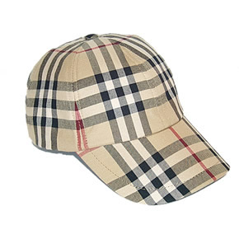
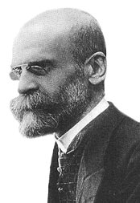
He wrote the rules of sociological method. 1895.
Durkheim
KEY CONCEPTS:
ANOMIE
crime as inevitable;
normal & functional;
social control mechanisms;
collective sentiments;
society of saints.

Slide 4
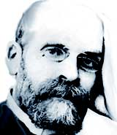
Durkheim and Anomie
Emile Durkheim developed the term anomie to explain why some people became dysfunctional and turned to crime.
Anomie means being insufficiently integrated into society’s norms and values.
Anomie causes society to become less integrated and more individualistic
Anomie causes individuals to look out for themselves rather than the community.

Slide 5
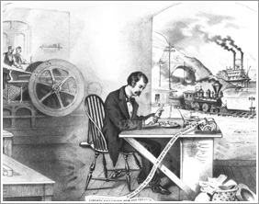
Crime Linked to Social Change
In times of social change individuals may become unsure of prevailing norms and rules
They are consequently more at risk of breaking them.
There is a weaker collective conscience of shared values to guide actions.
Durkheim saw Anomie expressed not just through crime, but also by suicide, marital breakdown, and industrial disputes.

Slide 6



He argued that crime is an inevitable, normal and necessary (functional) aspect of social life. “Crime is an integral part of all healthy societies.”
Crime is inevitable because not every one in society is going to be equally committed to the collective (shared) sentiments (values and morals). This is because we are all exposed to different influences & circumstances.

Slide 7
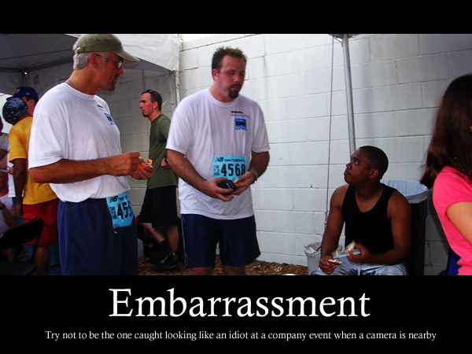
Even in a ‘society of saints’ with no crime at all, such high standards of behaviour would make even the smallest deviant act (like burping) stand out like a sore thumb – so deviance is inevitable & it will always be present in society.

Slide 8
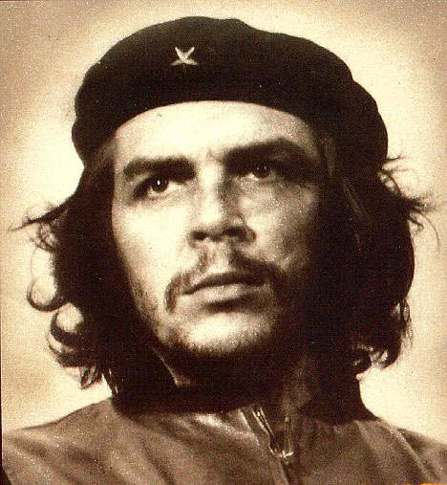
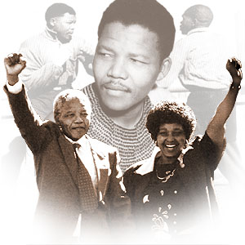
But that’s not a bad thing – Durkheim argued that deviance helped society to evolve; to review the way it does things and to learn from deviance and mistakes. “Yesterday’s deviance must become today’s normality.” Deviance leads the way to progress. If the collective sentiments are too strong, they will crush revolutionary spirits such as Mandela, Che and Ken Saro Wiwa.

Slide 9
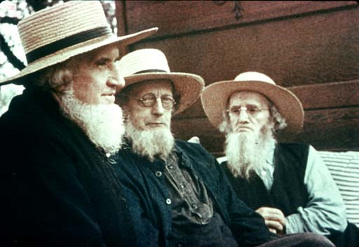
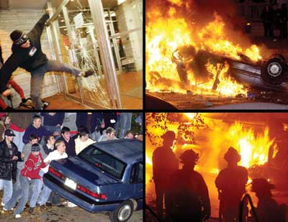
Crime & deviance only lead to dysfunction when their levels are either very low or very high. Very low rates lead to stagnation while high rates lead to social disorganisation & chaos and suggest that something has gone wrong with society.

Slide 10
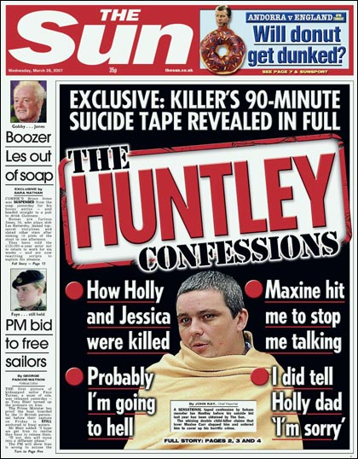
“Punishment serves to heal the wounds done to the collective sentiments.”

Slide 11
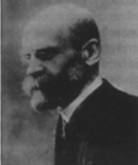
Critique of Durkheim
Durkheim's work is important for offering a social dimension to crime.
He links anomie to a deregulated, more individualistic, industrial society.
But he cannot explain why some people are more deviant than others.

Slide 12
RESEARCH METHOD: this is purely theoretical and therefore lacks any empirical basis.
WEAKNESSES: Theoretical data is an unreliable source as it is based on opinion. Not all crime is functional – victim support groups would find it very difficult to subscribe to the idea that violent crime against the person was a way of strengthening collective sentiments.
??
Check Key Terms
Anomie
Collective sentiments
Crime is inevitable and functional
Society of saints

Slide 13
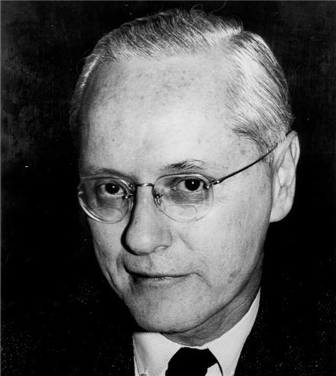
Merton
He wrote social theory & social structure. 1968.
KEY CONCEPT: value consensus; anomie; cultural goals; institutionalised means; conformity; innovation; ritualism; retreatism; rebellion.
Functionalist who argued that there are five responses to the value consensus – we can either love it, abuse it, neglect it, reject it or radically change it. http://www.youtube.com/watch?v=tC7T-079i-4
Notes:
13

Slide 14
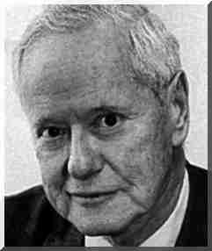
Robert Merton’s Strain Theory
Robert Merton (1910-2003, pictured left) regarded the concept of 'anomie' as used by Durkheim as too vague, so he developed its meaning.
As a functionalist, he recognised the importance of shared goals and values of society – in the USA particularly the ‘American Dream’.
But he recognised that not everyone has the same opportunity to share these goals and values.
He altered anomie to mean a society where there is a disjunction between goals and the means of achieving them.

Slide 15
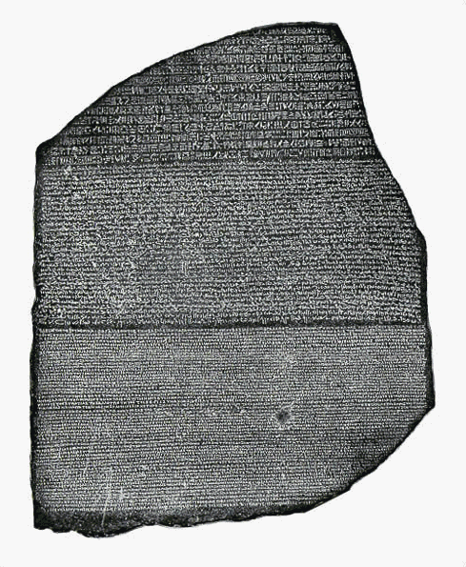




SUMMARY OF STUDY:
Because members of society are in different positions of the social structure, not everyone has the same relationship with the value consensus: some heartily embrace it (because they can), while others reject it (because they can’t meet the demands of the value consensus).
I have qualifications, a steady job & I’m straight!
I’ve not a single GCSE, my whole family’s out of work AND I’m a chav.
Value Consensus

Slide 16
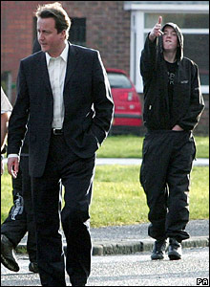

Slide 17

He used the lifestyle concept of the American Dream which places great emphasis on material success.

Slide 18

In Western societies there are cultural goals that we’re all socialised to want like big cars, big houses, splendid holidays etc…

Slide 19



and there are institutionalised means of achieving those goals; chiefly education and career (big pay packet).
Now we can afford BOTOX!

Slide 20


In American society there seems to be great importance attached to achieving the material goals, but no one seems to care where the money came from. When the rules are ignored to a greater extent, a situation of anomie or normlessness, occurs where deviance is encouraged. This is sometimes grumbled about as a breakdown in law and order and moral values…
The youth of today…? They’re running wild these days.

Slide 21

Merton outlined five possible ways that members of American society could respond to success goals:
Conformity – accepting both the goals and the institutionalised means of achieving them. This was the most common response.

Slide 22
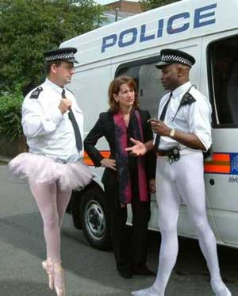
Innovation - accepting the goals but rejecting the institutionalised means. This involved finding other, more deviant ways.
Stuart Howatson, 31, of Bewdley, Worcestershire, duped his wife, family and friends into believing he was a Scotland Yard officer.
Over several years, Howatson detailed his "career" to friends. While on holiday in Spain, he convinced a friend that he could buy their property for £720,000 without a mortgage. He said he had come into an inheritance and supplied false bank statements and monthly deposits from the Metropolitan police and MPA (Metropolitan Police Authority) to prove his finances were sound, Worcester crown court heard.

Slide 23

Ritualism - rejecting the goals but going along with the institutionalised means (work and school). This deviant behaviour results from being strongly socialized to conform to expected behaviours.

Slide 24
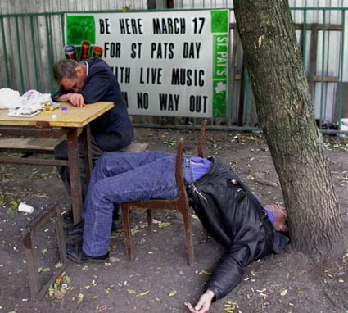
Retreatism – rejecting both the goals and the means, this group often descends into alcoholism &/or drug abuse.

Slide 25
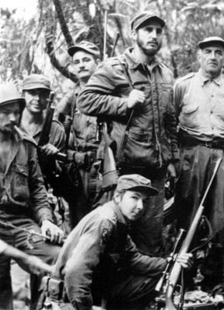
Rebellion - is a response that seeks to replace the cultural goals and institutionalised means with new ones that meet the norms and values of their particular group or culture.

Slide 26
Strain Theory and the Anomic Paradigm
Merton developed ‘strain theory’ to reflect the strain between goals and means with a five-fold 'anomic paradigm‘:
Responses | Means | Goals
Conformists | + | +
Innovators | - | +
Ritualists | + | -
Retreatists | - | -
Rebels | +/- | +/-

Slide 27

Merton (Continued)
Merton’s theory is 'structural‘: he locates the cause of crime in American society – support for the “American Dream”.
Being blocked from success leads to deviance, as ‘innovators’ they adopt illegitimate means to achieve the goals they cannot achieve legitimately.

Slide 28
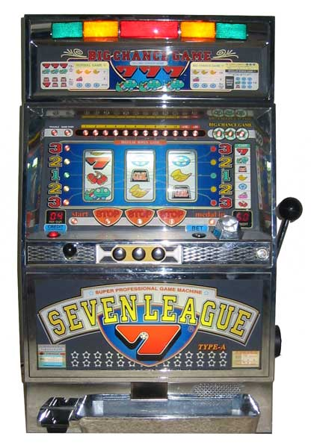
RESEARCH METHOD: this was a theoretical study.
WEAKNESSES: he neglects the bigger questions of ‘who makes the laws in society’ and assumes that there is one overarching value consensus in a country as massive as America.
It also over-predicts and exaggerates working class crime while underestimating middle class crime.
Strain Theory
Institutionalised means
Goals

Slide 29
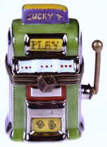
Critique of Merton
He can explain different patterns of deviance: for example, one person may steal (innovator) while another may take drugs (retreatist).
His work became a direct inspiration to subcultural theory
Laurie Taylor described it as the “fruit machine theory of crime”
However, as a functionalist he cannot explain where the rules come from in first place.

Slide 30

Travis Hirschi
Another key sociologist to be influenced by Emile Durkheim and the concept of anomie is Travis Hirschi .
To answer this, he argues, we need to understand what forces maintain conformity for most people in society.
He asks the question: why don't more people commit crime than they do?
Rather than the factors that drive a minority into deviant behaviour.

Slide 31
Hirschi’s ‘Bonds of Attachment’
He identified four bonds of attachment that help bind society together:
Attachment: the extent to which we care about other people's opinions and desires.
Commitment: the personal investment we put into our lives; in other words, what we have to lose if we turn to crime and get caught.
Involvement: how integrated are we so that we neither have the time nor inclination to behave in a deviant/criminal way.
Belief: how committed are individuals to upholding society's rules and laws?

Slide 32


Evaluation:
Sees crime as a form of ‘safety valve’ which can have a positive function for society.
Shows how deviance is necessary to kick-start social change.
Merton’s theory explains the rise of crime in Thatcher’s Britain due to excessive individualism.
Fails to challenge ‘whose’ value consensus we are expected to follow.
How can crime be ‘functional’ when it causes so much misery?
Neglects the nature of power in society and who it is that makes the laws to be broken and then punished.

Slide 33

1. crime as inevitable 2. normal & functional 3. social control mechanisms 4. collective sentiments 5. society of saints 6. value consensus 7. anomie 8. cultural goals 9. institutionalised means 10. conformity 11. innovation 12. ritualism 13. retreatism 14. rebellion

Slide 34
Essay Plan
Introduction – basic info on Functionalism , some brief evaluation.
Para 1 – Durkheim’s Anomie + EEA
Para 2 – Merton’s Strain Theory +EEA
Para 3 – Hirschi’s Bonds of attachment +EEA
Conclusion – Sum up which is the best ? Is Functionalism any good at explaining crime?
In January Exam – throughout the essay you will compare and contrast to other perspectives on crime which we have not covered yet.

