Slide 1
State Crime (Globalisation)
Within the sociology of Crime it is increasingly important to study what is
known as ‘State Crime’. This type of crime not only relates to Crime and Globalisation, but also to White Collar Crime, Environmental Crime, Human Rights as well as to many of the Theories of Crime that you have covered already.
Green & Ward (2005) define State Crime as:
‘All forms of crime committed by or on behalf of states or governments in order to further their policies’.
These include crimes such as:
> Genocide
> War Crimes
> Torture
> Assassination
> Imprisonment Without Trial

Slide 2
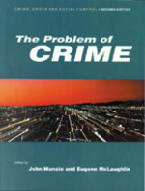
McLaughlin (2001) in ‘The Problem of Crime’ identifies 4 categories of State Crime:
1) Political Crimes
E.g. Corruption.
2) Crime by Security & Police Forces:
E.g. Genocide & Torture.
3) Economic Crimes:
E.g. Violation of Health & Safety Laws.
4) Social & Cultural Crimes:
E.g. Institutional Racism.
> Do you know of any examples of State Crimes that have gone on/ going on?

Slide 3
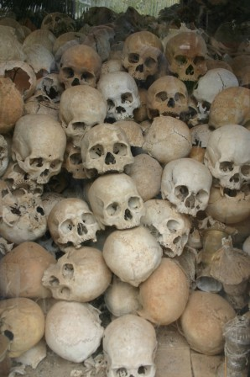
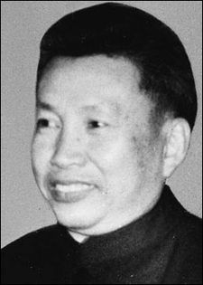
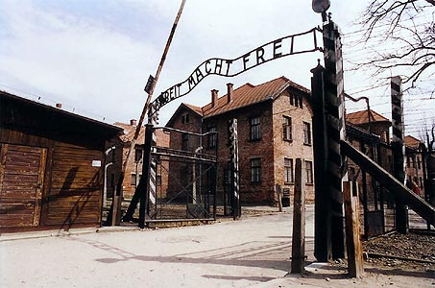
Examples of State Crimes:
In 1975, Pol Pot, the then leader of Cambodia forced Cambodians to work on collective farms or leave the country. Those who refused were executed whilst those who complied suffered from forced labour, malnutrition, exhaustion, poor medical care and ultimately execution. Around
2million Cambodians were killed during his time in power (1/5 of the population).
During World War II Adolf Hitler orchestrated the killing of over 16million people worldwide. These included the execution of the Handicapped, Gypsies, Homosexuals, Jehovah’s Witnesses, Catholics, Poles,
Prisoners of War & Political Dissidents.
Prior to the Civil Rights Movement, it could be argued that the U.S was guilty of institutional racism with it’s culture of apartheid. During these times it was expected that whites and non-whites (particularly blacks)
were segregated at work, in education, housing, and in the
general social and political spheres.

Slide 4
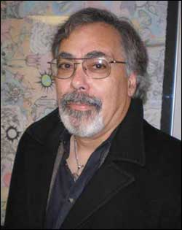
> Could the MP’s expenses scandal in Britain be seen as a state crime?
State crime is extremely serious for two main reasons:
1) The Scale of State Crime:
Michalowski & Kramer (2006): ‘Great Power & Great Crimes are Inseparable’.
‘We need to study the ways that economic & political elites can bring death, disease, & loss to tens of thousands with a single decision, & can affect entire human groups through the creation of criminal systems of oppression & exploitation’.
2) The State Makes the Law:
The state gets to define what crime is. In Nazi Germany a law was passed that permitted the sterilisation of the disabled against their will.

Slide 5
Questions:
What problems does it cause that the State get to define what crime is?
Why is it significant to highlight that the State enforces it’s own laws?
What problem does this create when studying crime?
What would Marxists say about State Crime?
How might Interactionists approach State Crime?
What might Feminists contribute to this topic?

Slide 6
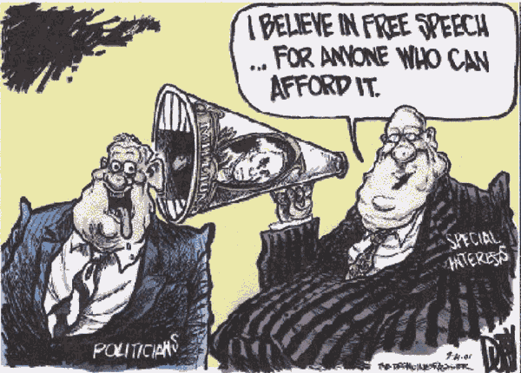
State Crimes & Human Rights
It is important to realise that State Crimes affect many people as a whole and are not an attack on individuals. As such it is easiest to think of State Crimes as Affecting the following:
Natural Rights:
Life, Liberty, Free Speech.
Civil Rights:
Voting, Privacy, Fair Trial, Education.
Herman & Julian Schwendinger (1970) believe that crime should be defined as violation of human rights rather than breaking legal rules. Therefore any state that denies anyone basic human rights should be classed as criminal. Most states are therefore Criminal just like individual criminals.
‘ A man who steals a paltry sum can be called a criminal, while agents of the State can legally reward men who destroy food so that the price levels can be maintained whilst a sizeable portion of the population suffers from malnutrition’.

Slide 7
Herman & Julian Schwendingers’ (1970) views are compatible with Marxism in that they are suggesting that the State is corrupt and inward-looking – looking after itself at the expense of others.
> Despite their seriousness, State Crimes do occur and many of them go on for long periods of time. Why do you think this might be the case?
The Spiral of Denial:
Cohen (2001) suggests that State legitimise and conceal their crimes by following a ‘Spiral of Denial’:
Stage 1) ‘It didn’t happen’ – Deny everything (If this fails in the light of evidence)….
Stage 2) ‘If it did happen, “it” is something else’ – claim it’s not what it looks like……
Stage 3) Even if it is what you say, it’s justified’ e.g. to prevent terrorism and protect national security.

Slide 8
Techniques of Neutralisation Theory:
Matza & Sykes (1957): The State attempts to ‘Neutralise’ or ‘Play Down’ their crimes using 5 techniques:
1) Denial of Victim – ‘They are terrorists!’, ‘They are used to violence’ etc.
2) Denial of Injury – ‘We are the victims, not them’.
3) Denial of Responsibility – ‘I was obeying orders’
4) Condemning the Condemners – ‘The world mistreats us’ e.g. Israel vs. Islam
5) Appeal to Higher Loyalty – ‘We are being loyal to the nation/ religion etc’.
Cohen argues that these techniques are not aimed at denying the crime/s have taken place but to ‘negotiate or impose a different construction of the event on the population’.
Why might labelling theory and the media be useful to examine here?
Where has this theory examined before in this topic?

Slide 9
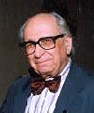
Social Conditioning by the State:
Hamilton & Kelman (1989) suggest that State Crimes occur because the people who are ordered to carry them out have been conditioned to obey and not question. As such these crimes seem ‘normal’ to these people and thus are not necessarily to blame themselves
There are 3 features that create such obedient people:
1) Authorisation – Orders come from those in power & therefore personal judgement must be ignored & detached
2) Routinisation – Activities become habitual due to repetition, they become mechanical.
2) Dehumanisation– Enemies are portrayed as sub-human and therefore morals do not apply.
How is this theory different to Neutralisation Theory/ The Spiral of Denial?
Are there any similarities between these 3 theories

Slide 10
REMEMBER:
The topic of State Crime can be linked to many other areas that you have/ will study within this crime unit such as:
> Crime and Globalisation
> White Collar Crime
> Environmental Crime
> Human Rights
> Theories of Crime
> Measuring & Researching Crime
It is important that you are able to make these connections as it will help your overall grasp of the unit – Do not see any topic within the Sociology of Crime as exclusive to itself- it will have relations to other topics!

