Slide 1

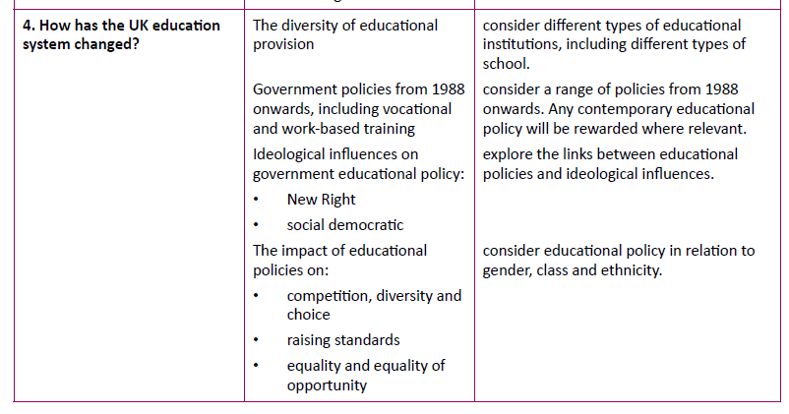
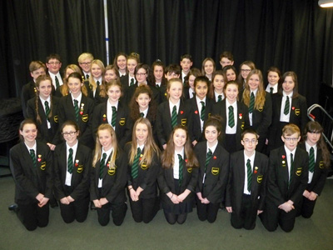
How has the UK education system changed?

Slide 2

Types of school in the UK
Produce a short presentation about one of the types of school
Types of school:
Community schools
Foundation schools
Academies (Traditional / OLD)
Academies (NEW)
5. Faith Schools
6. Free Schools
7. City technology colleges
8. State boarding schools
9. Private (/independent/public) schools
10 . Special schools
11. Grammar Schools
For each try to find out:
— The curriculum;
— The students (admissions)
— How they are paid for
— Governance
— Accountability
— An example of this type of school
https://www.gov.uk/types-of-school/overview
http://www.newschoolsnetwork.org/sites/default/files/files/pdf/Differences%20across%20school%20types.pdf

Slide 3
Community Schools
Faith Schools
Private schools
Free Schools
Academies (OLD)
City Technology Colleges

Slide 4
Foundation schools
Academies (NEW)
State Boarding Schools
Grammar Schools
Special Schools

Slide 5
What are the advantages and disadvantages of having so many different school types?
Advantages | Disadvantages

Slide 6
The New Right’s View of Education
Underlying principles of the New Right
They believe the state (government) cannot meet people’s needs.
The most efficient way to meet people’s needs is through the free market – through private businesses competing with each other.
Economic growth is an important overall goal – to be achieved by allowing individuals the freedom to compete with each other.
Key ideas of The New Right on Education-
The New Right created an ‘education market’ – Schools were run like businesses – competing with each other for pupils and parents were given the choice over which school they send their children to rather than being limited to the local school in their catchment area. This lead to the establishment of league tables
Schools should teach subjects that prepare pupils for work, Hence education should be aimed at supporting economic growth. Hence: New Vocationalism!
The state was to provide a framework in order to ensure that schools were all teaching the same thing and transmitting the same shared values – hence the National Curriculum
Social Democratic Views
Covers a broad range of views and elements can be found in Labour, LibDem and even Conservative policies.
Underlying principles of Social Democracy:
Social Democracy though is a middle way between the free market right and the socialist left.
It advocates a mixed economy and believes the state should help the poor and disadvantaged and act like a referee - ensuring people and society stick to the rules and behave properly.
There is a desire for meritocracy, but recognises that the system as it stands is unable to deliver. Social democrats believe that it is possible to work within the capitalism to create a fairer system. However they still argue that some inequality of outcome is inevitable and desirable.
Key ideas of Social Democrats on Education -
In education policy this has meant - providing state schools and free education for all, giving extra resources and help to those who need it. Providing grants and help for able pupils who cannot afford fee paying educational institutions, whether they be schools or establishments of higher education.
Halsey argued that the grammar-school system disadvantaged working- class children. The 11+ exam tested middle-class culture and falsely labellled working-class children as less intelligent. Social democrats beleived that the tripartite system should be abolished and replaced by the comprehensive system.
1960s | 1979-1997 | 1997-2010 | 2010-201…
Labour introduced comprehensive education | Conservative Influenced by New Right mainly | Labour Influenced by BOTH New Right and Social Democrats | 2010-2015 coalition with Conservative and Lib Dems 2015-present Conservative

Slide 7
Education and social policy
The key aims of the political parties has been (variously) to achieve the following:
Competition, diversity and choice
Raising standards
Equality and equality of opportunity
Identify policies that attempted to achieve each of these objectives. For each policy identify the following (where possible):
Date
Detail
How it reflects New Right / Social Democrat policy
Evidence of success / failure

Slide 8
Key policy: 1988 Education Reform Act
This is one of the most important pieces of educational legislation. It led to significant changes to the purpose, structure and delivery of education. You may be asked questions about how far the aims of the act have been met.

Slide 10
Conservatives 1979-1997
Competition Diversity & Choice | Raising standards | Equality & Equality of Opps

Slide 12
Conservatives 1979-1997
Evaluation:

Slide 13
Labour 1997-2010
Competition Diversity & Choice | Raising standards | Equality & Equality of Opps

Slide 15
Labour 1997-2010
Evaluation:

Slide 16
Conservatives 2010-present
Competition Diversity & Choice | Raising standards | Equality & Equality of Opps

Slide 18
Conservatives 2010-present
Evaluation:

Slide 19
Competition, Diversity and Choice

Slide 20
Raising standards

Slide 21
Equality and Equality of Opportunity

Slide 22
Social Class
Evidence of positive impact | Evidence of limited impact

Slide 23
Gender
Evidence of positive impact | Evidence of limited impact

Slide 24
Ethnicity
Evidence of positive impact | Evidence of limited impact

Slide 25
Exam questions to answer:
In what ways does a child’s ethnicity influence his or her educational attainment? 10 marks
To what extent are boys now under achieving in education compared to girls? 20 marks
Assess the extent to which policies of marketisation of education have helped to improve educational opportunities for all children. 40 marks

