Slide 1

Cybercrime
This refers to a wide range of criminal acts committed via the use of ICT – usually the internet. Cybercrime is the fastest growing criminal activity in the world (Browne 2009)
Cybercrime tends to be viewed as ‘Global Crime’ as many of the illegal activities that go on take place outside of the country of the offender
> Do you worry about Cybercrime? Explain your answer
> Why is it so important to focus on this type of crime in contemporary society?
> Why might people not worry about Cybercrime compared to other types of crime such a burglary and muggings? (Link to Labelling Theory)
> What might Marxists have to say about Cybercrime?
> Why might the nature of Cybercrime lend support to the Post-Modernist theory of crime?

Slide 2

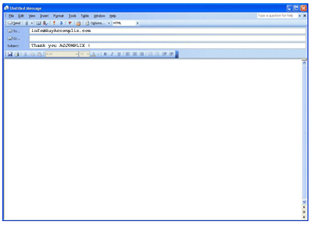
Macionis & Plummer (2005) point out how Cybercrime has created new forms of ‘Trouble’ and ‘New Worlds of crime’.
> What sorts of ‘trouble’ / ‘New Worlds of Crime’ might these
researchers be referring to?
> Internet-based fraud
>Identity Theft
>Child Pornography & Paedophilia
> Terrorist Websites & Networking: recruiting, Planning etc
> Organized Crime Rings
> Online Bullying & Harassment
> Hacking
> Phishing e.g. False Banking Emails
> Money-Laundering

Slide 3


Wall (2001) of the University of Leeds identifies 4 categories of Cybercrime:
1) Cyber-Deception & Theft:
E.g. Phishing, Piracy, illegal Downloads & File Sharing.
Swash (2009): 95% of available on the web is downloaded illegally.
2) Cyber-Pornography:
E.g. Child pornography & opportunities for children to view indecent images
3) Cyber-Trespass:
Crossing boundaries into others ‘Cyber-Property’ e.g. Sending Computer Viruses & Hacking
4) Cyber-Violence:
Creating psychological harm or inciting physical harm e.g. Cyber-Bullying, Terrorist Websites, Hate-Based Sites.

Slide 4

Policing Cybercrime
> Why might tackling Cybercrime be difficult?
> What effect might these problems have on Official Crime Statistics?
It should also be remembered that advances in ICT means that the police have new technologies for surveillance and control of the population.
> What effect might this have on crime & deviance?
> Why might over-surveillance and control lead people into deviance? (Think about Durkheim & Fatalistic Suicide)
IMPORTANT!:
Remember that Cybercrime as a topic refers to ‘new medias’ such as the Internet, Mobile Phones, Emails etc. As such you may well be asked about a question on how the media is related to crime.
> How could this topic by tied in to Labelling Theory & Crime?
> Can it be related to Marxism & Crime?
> Finally, can it be related to Control Theory, and if so, how?

Slide 5
Exam Style Question (12 Marks):
‘Examine the ways in which the media stimulate moral panics & create folk devils’.

