Slide 1
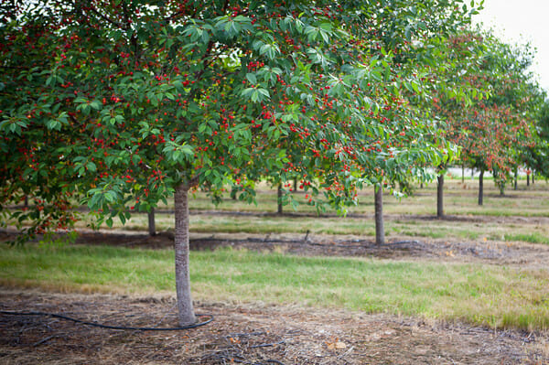
AQA
Education
Cherry-Picking Revision
1. Pick-Your-Own
2. Cherry-Picking
3. Pick-The-Best
4. Grow-Your-Own

Slide 2
Pick-Your-Own
Outline two reasons why marketisation policies may produce inequality of educational achievement between social classes.
[4 marks]
Quickly identify as many possible answers as you can to this question
Cherry pick the
2 best answers
and use them to answer the question
Notes:
Pick-Your-Own
Provide a question you want your students to answer.
Ask them to suggest key ideas that can be applied to answer the question.
Select the two best ideas and use them to answer the question.

Slide 3
Cherry-Picking
Outline two reasons why marketisation policies may produce inequality of educational achievement between social classes.
[4 marks]
?
A range of possible answers are ripe for picking.
Cherry pick the
2 best answers (or add your own)
and use them to answer the question
Silt-shifting
Cream-skimming
Cultural capital
Private education
Catchment
areas
League tables
Notes:
Cherry-Picking (1)
Click each blank cherry in turn to reveal a key idea that can be applied to answer the question. As you reveal each idea get your students to discuss it in terms of how it could be used to answer the question. One cherry is left blank in case students have an idea of their own they’d like to apply.
Once all the ideas have been revealed / discussed, your students should choose the two they will use to answer the answer.
Cherry-Picking (2)
Students are asked to pick any 2 out of the 7 cherries at random.
Use the ideas they have revealed to write an answer to the question.
If they happen to pick the blank cherry they must supply an idea they can apply to the question.
Cherry-Picking (3)
If you want your students to answer an essay-type question, use the Cherry-Picking (1) technique outlined above.
They have to apply each of the ideas revealed in turn to construct an essay answer.

Slide 4
Pick-The-Best
Outline two reasons why marketisation policies may produce inequality of educational achievement between social classes.
[4 marks]
League
tables
A range of possible answers are ripe for picking.
Cherry pick the
2 best answers
and use them to answer the question
I.Q.
testing
Key-stage
testing
Cultural capital
Natural abilities
Catchment
areas
Teacher labelling
Notes:
Pick-The-Best
Click each blank cherry in turn to reveal a key idea that can be applied to answer the question. As you reveal each idea get your students to think about how it could be used to answer the question.
Some Cherries are red-herrings.
Students should choose what they believe are the best ideas to answer the question.

Slide 5
Grow-Your-Own
Outline two reasons why marketisation policies may produce inequality of educational achievement between social classes.
[4 marks]
?
A range of possible answers are ripe for picking.
Cherry pick the
2 best answers (or add your own)
and use them to answer the question
Silt-shifting
Cream-skimming
Cultural capital
Private education
Catchment
areas
League tables
Notes:
Grow-Your-Own
If you want to create your own questions you can use this slide as a template.
Before you make any changes to the template it’s a good idea to save this Presentation under a name or your choice. That way, if it all goes pear-shaped you can reload the original and try again…
Edit the question box to add your own text.
Edit the instruction text if necessary.
The blue circles are the triggers to reveal the text within each cherry. They are off-centre to allow you to edit the “Cherry text” to add your own “key ideas” to each cherry that are relevant to the question you’re asking.
Move each blue circle so that it covers the Cherry text.
Right-click on each blue circle, select “Format Shape” then click the “Fill” option and set Transparency to 100%.
Delete the 4 previous slides and save the single new slide you’ve created for future use.

