Slide 1
Are criminals the same as us?
For
Against
Write down points for and against the idea that criminals are different in some way from normal people.

Slide 2
Vote for your viewpoint on the question
Are criminals different?
Key
20
19
18
Yes, very
17
16
15
Yes, a bit
14
13
12
Perhaps
11
10
9
Not really
8
7
6
Not at all
5
4
3
2
1

Slide 3
What are biological theories of criminality?
Assessment criteria 1
Describe biological theories of criminality.

Slide 4
Assumptions of biological theories of crime
Physical characteristics make some people more likely to commit crime than others.
Criminal tendencies can be inherited.
Investigation of the person’s genetic material, brain or body will reveal criminal tendencies.

Slide 5
Key names to research
Johan Casper Lavater
Cesare Lombroso
Charles Goring
William Sheldon

Slide 6
Tasks
1. Draw a typical criminal.
You have 5 minutes
Start the clock

Slide 7
Tasks
2. Look at the drawings of others in the group.
What physical characteristics do the drawings have in common?

Slide 8
Principles of research
Each of these people followed a simple procedure.
They looked at people in prison and identified traits that made them different from those who were outside prison.
Each suggested a theory to explain behavioural differences in biological terms

Slide 9
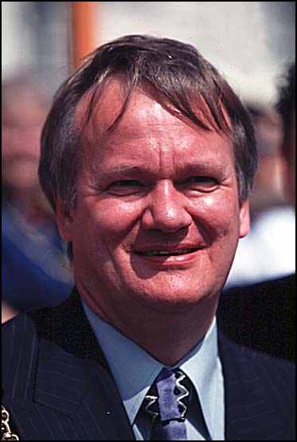
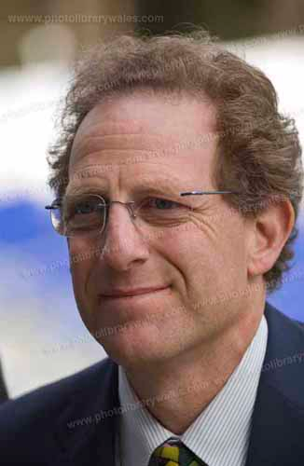
Which is the criminal?
Notes:
NOTE: Need to be very careful here. As yos say “These are eminent Welsh personalities, Russell Goodway, a former leader of Cardiff City Council and Henry Engelhardt founder and CEO of Admiral Group plc motor insurance” – what if they came across this resource somewhere?

Slide 10
Neither of these people!
These are eminent Welsh personalities, Russell Goodway, a former leader of Cardiff City Council and Henry Engelhardt founder and CEO of Admiral Group plc motor insurance

Slide 11
Modern biological theories
Seek to establish a link between testosterone, low intelligence and masculine behaviour.
Are likely to recognise a link between environment and behaviour, but view biology as being more important.

Slide 12
Can these approaches be criticised?
They assume that those in prison are guilty and those who are not in prison are innocent
There is evidence to suggest that people make assumptions about others on the basis of appearance, so some people are more likely to be assumed to be criminal by juries and the police

Slide 13
Control of criminal behaviour?
This is deterministic theory. People have no choice.
There is no point attempting to deter people because they are biologically programmed to be criminal.
The purpose of punishment is the protection of society.

Slide 14
Public policy and biological theory
In the 1920s and 1930s in both the USA and Germany, there were attempts to control criminality through the execution and forced sterilisation of those ‘with criminal tendencies’
Other ‘criminals’ such as alcoholics were ‘cured’ through psychosurgery such as lobotomy (which destroys part of the brain)

Slide 15
Discussion questions
Is there any value to this approach?
If scientists could establish a genetic link to criminal behaviour, how should society deal with those born with criminal tendencies?
Do these approaches simply reinforce stereotypes of criminals?

Slide 16
Independent Study before the next topic
Do further reading and research on the biological approach.
Make revision lists of arguments in favour or rejecting the biological approach to the origins of crime.

Slide 17
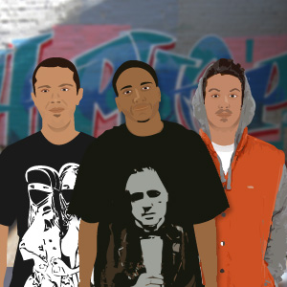
Scenario
There ‘s nothing for us to do around here!
We’re only minding our own business
We’re bored!
There is a group of young people, mostly boys in their teens, who have been harassing residents of old people’s sheltered housing over a period of months.
Notes:
Will animate these characters so that they say their bits.

Slide 18
Assessment skill
Write short report (one side of A4) applying one biological theory of the origins of crime to the scenario.
Make a reasonable suggestion as to how the behaviour of the boys can be either controlled or redirected using understanding of the biological approach
Do not copy and paste from any website or textbook. Refer to the sources that you used.

Slide 19
Final self review
How has your understanding of biological approaches affected or changed your opinions towards criminals or criminal behaviour?

