Slide 1
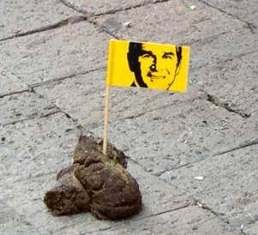
Brief summary of Marxist explanations of crime.
Capitalism causes crime – it is criminogenic
The Law benefits the rich and powerful
Middle and upper class crime is ignored
Laws are enforced selectively
Inequality caused by capitalism causes working-class crime – Robin Hood Theory
http://www.youtube.com/watch?v=LL0pqxiuh50
-.

Slide 2
Agree/Disagree
Benefits should be stopped for those not willing to go out and find a job.
Mother s with young children should not work full-time
Strikes are wrong and should not be encouraged by trade unions
Anti-social behaviour is caused by the poor attitudes of the working class
Developing countries gain more from the investment of western corporations than they lose.

Slide 3
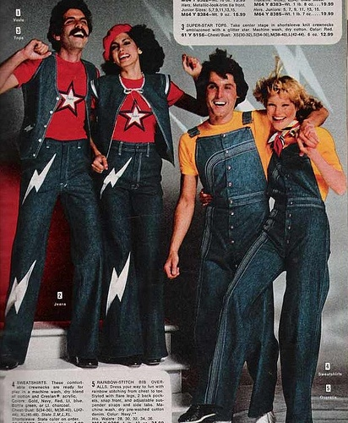
Marxist theories of crime and deviance became popular in the 1970s.

Slide 4
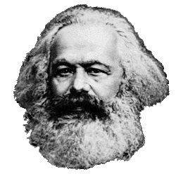
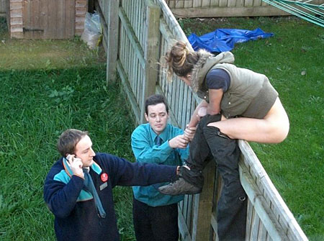
2. Traditional Marxist approaches argued that:
Crime is generated by the structure of capitalist society – crime’s inevitable in societies where some are richer than others.
Capitalism’s forced her to commit crime.

Slide 5
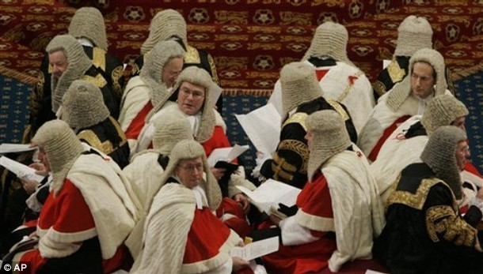
Laws reflect the interests of the dominant capitalist class – laws are made by and for the elite: those with loads of money and power.

Slide 6
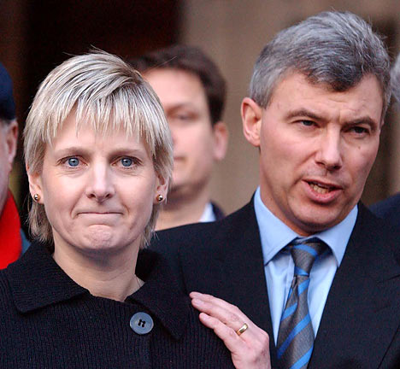
Laws are enforced selectively – there is bias in favour of those at the top.
Sally Clarke was jailed for life, convicted of murdering two of her three children. She was released on appeal because the evidence was dodgy. She died in March 2007, a broken woman.

Slide 7
Laws are enforced selectively – there is bias in favour of those at the top.
This is Nestle – they make Milky Bars, Yorkie Bars and Cheerios.
They aggressively marketed baby milk formula in developing countries in the 70s, 80s and 90s.
Their formula killed thousands of babies because of the contaminated water it was mixed with; led to higher birth rate because of depriving women of their natural contraception during breast feeding.
They have never faced charges or been made to account for their actions.

Slide 8
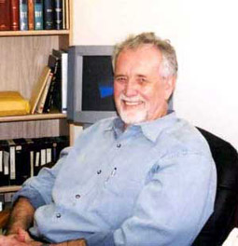
SCY6 Crime & Deviance: Classic Marxist theories
Chambliss
He wrote the article functional & conflict theories of crime. 1976.
KEY CONCEPT: non-decision making.

Slide 9
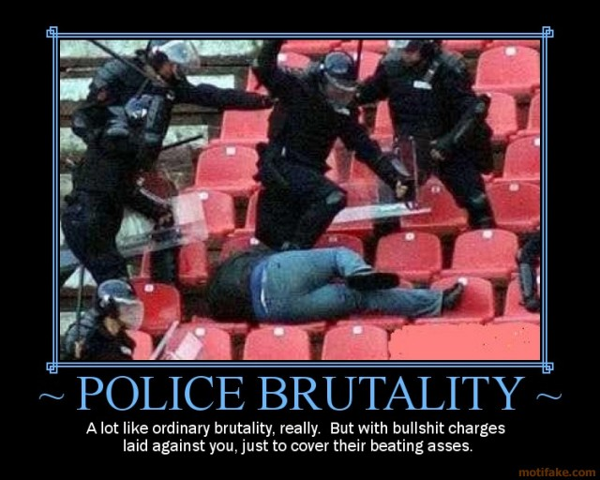
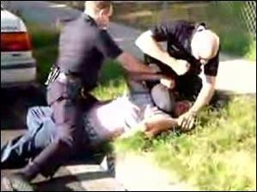
Crime and deviance are spread fairly evenly throughout the class structure: it is just that lower class offenders tend to be caught and processed as criminals more than middle class workers are.

Slide 10
Non-decision making is what happens in the creation of laws: many human needs are ignored in favour of the ruling class.
Chambliss gives the example of situations which might have been defined as criminal if the ruling class did not have so much power.
For example, why do footballers earn obscene amounts of money while some people, in the same country, can barely afford to eat?

Slide 11
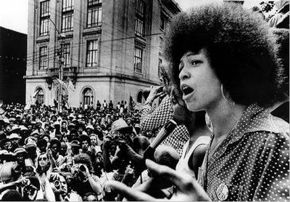
Angela Davis, former leader of the Black Panthers said;
“The real criminals in this society are not all the people who populate the prisons across the sate, but those people who have stolen the wealth of the world from the people.”

Slide 12
RESEARCH METHOD: purely theoretical.
WEAKNESSES: firstly, it’s purely theoretical which, although a useful springboard, lacks empirical rigour. Secondly, Health and Safety Laws are designed to protect the rights and health of all employees, particularly manual workers (mainly working class).

Slide 13
Louis Althusser
What is the Ideological State Appartus?

Slide 14
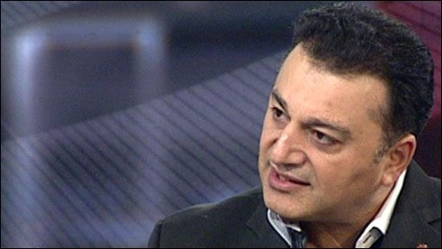
This is Ali Desai.
He was the highest ranking minority ethnic police officer in England.
He was jailed in February 2010 for corruption.

Slide 15
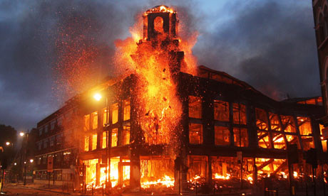
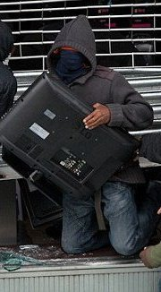
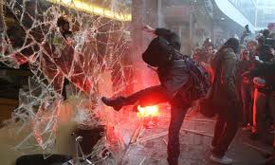
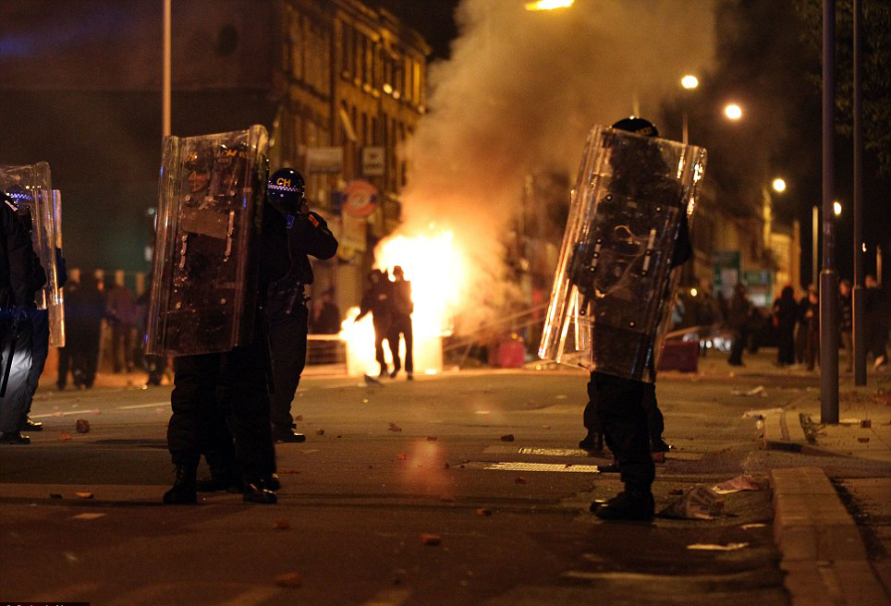
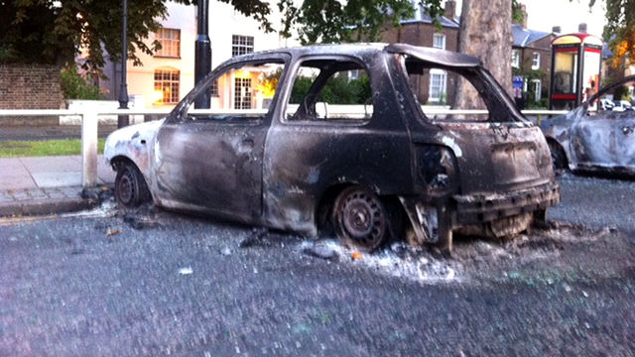
The Riots of August 2011
http://www.youtube.com/watch?v=UnWsQFPM4A0
What could this be an example of according to Phil Cohen?
Notes:
Video clip – riots in Tottenham

Slide 16
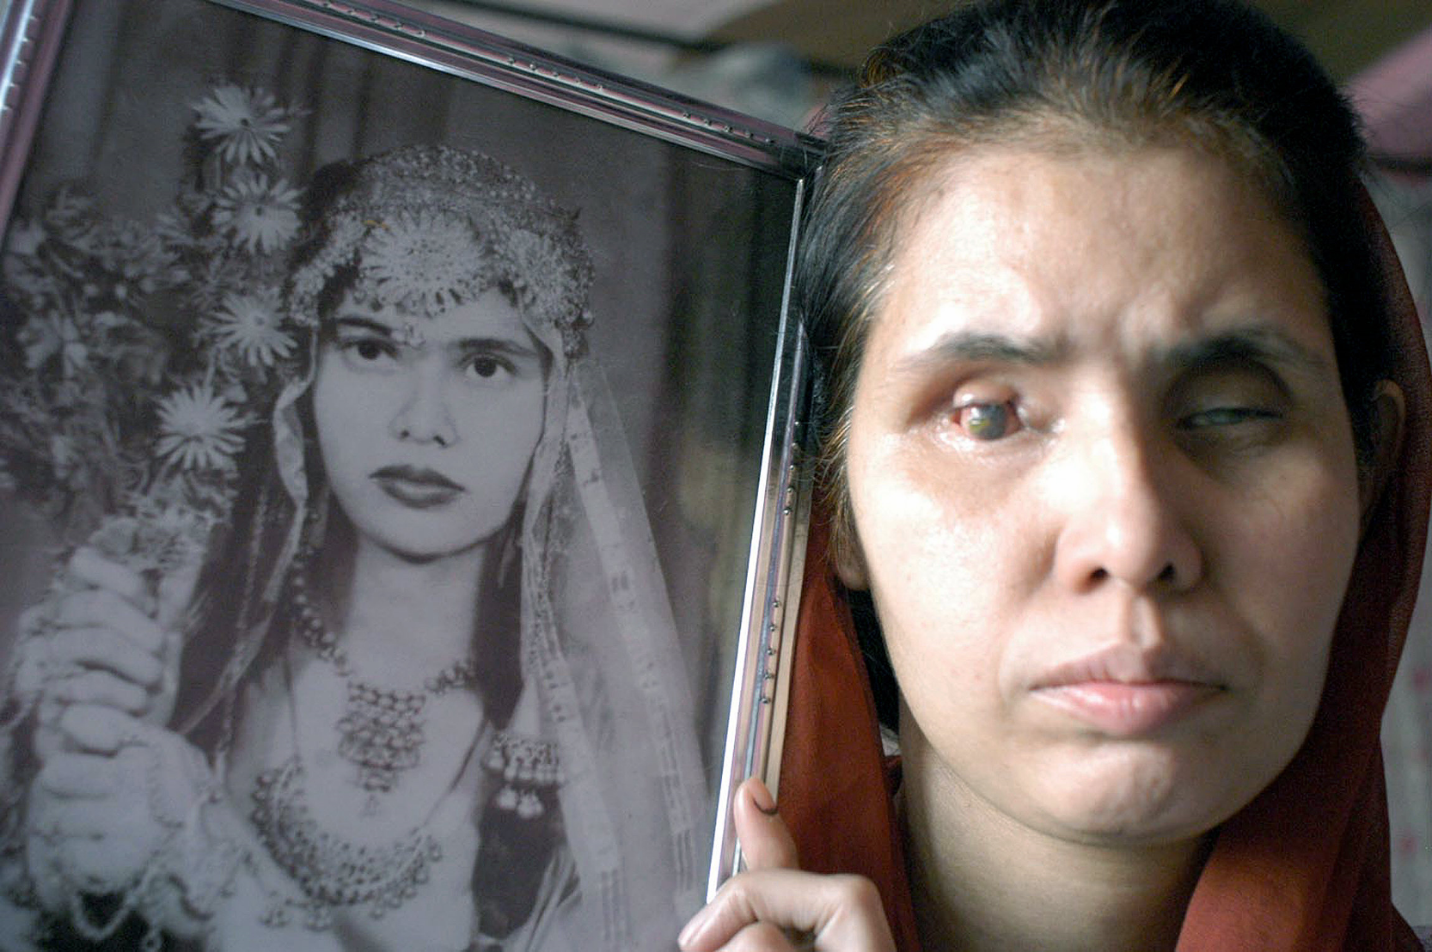
Laureen Snider Corporate crime is extremely harmful to individuals and communities, and is committed because of pressure on executives to cut costs and therefore corners, in order to maximise profits. The Bhopal Disaster.

Slide 17
Use these words to explain the key concepts of traditional Marxism and crime.
Criminogenic
Inequalities
Ideological state apparatus
Selective laws
Resistance
Corporate and white collar crime

Slide 18
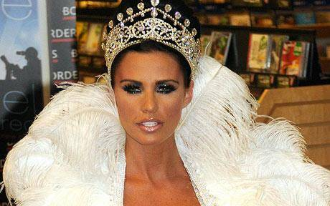
Radical criminology adopts a Marxist framework but includes other perspectives – for example, interactionism.
Radical criminology is often referred to as Neo-Marxism.
People choose to commit crime in capitalist societies.

Slide 19
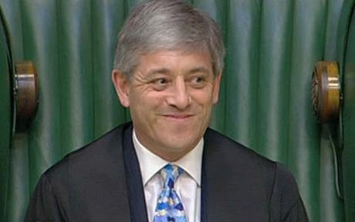
This is John Bercow, the Speaker of the House of Commons.
His job is to shout “Order”, among other things.
He is to receive more than £28,000 a year from renting out a flat on which he claimed more than £100,000 in expenses. (Daily Telegraph, 10th February 2010.)
Expenses for all MPs and parliamentarians are met by the British Taxpayer – that includes you, every time you buy anything with VAT on it; you’re helping to pay for one of these:

Slide 20
LOADED.
NOT LOADED.

Slide 21
Taylor, Walton & Young
They agree with Marx on the idea that to work out why people are criminal,
*we have to understand how the economy of a society is organised.
* In the UK, we have a capitalist system where some people have a lot of wealth and power and most have a lot less.

Slide 22
But where traditional Marxists say capitalism forces people to be criminal...

Slide 23
Neo-Marxists say capitalism makes people choose to be criminal.

Slide 24
Criminals are expressing their frustration at capitalist society by breaking the law.

Slide 25
Taylor, Walton and Young aim to provide a ‘fully social theory of deviance’ – to explain every aspect of deviance from the activity of the state to crime on the streets.

Slide 26
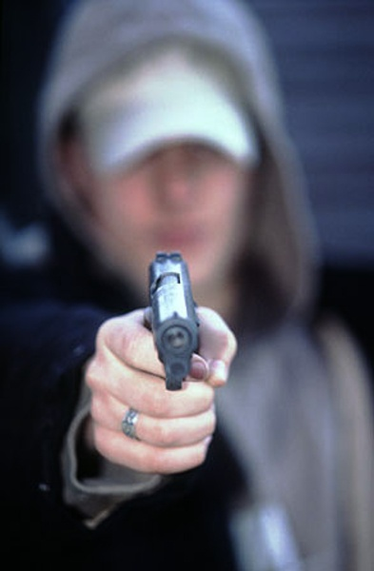
i. The criminologist first needs to understand the way in which wealth and power are distributed in society.
I live in the UK, it’s capitalist. I’m part of the underclass and can’t hope for anything better.

Slide 27
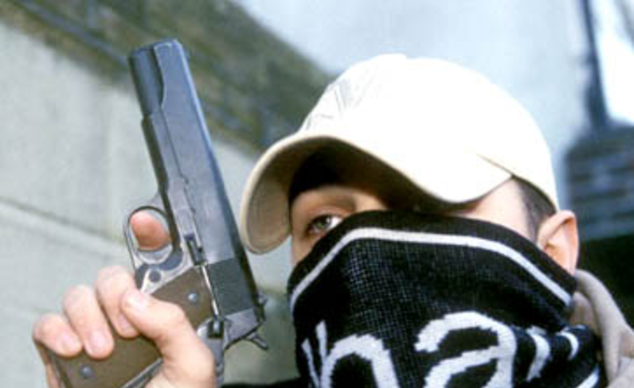
ii. He or she must consider the particular circumstances surrounding the decision of an individual to commit an act of deviance.
I’ve got no money, no prospects and no status. So I use a gun to get all three.

Slide 28
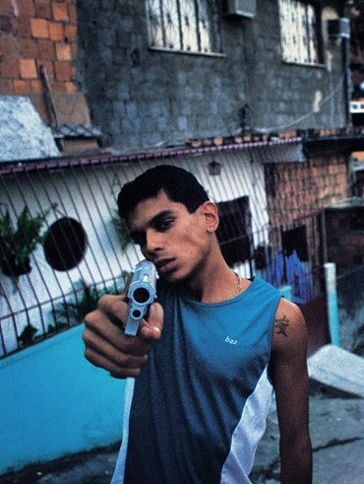
iii. It is necessary to consider the deviant act itself, in order to discover its meaning for the person concerned.
I’m waving this gun in your face to intimidate you into giving me your money.

Slide 29
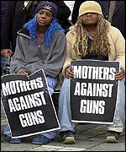
iv. The criminologist should consider in what ways, and for what reasons, other members of society react to the deviance.
Guns have robbed our families of our sons and robbed our community of trust and safety.

Slide 30
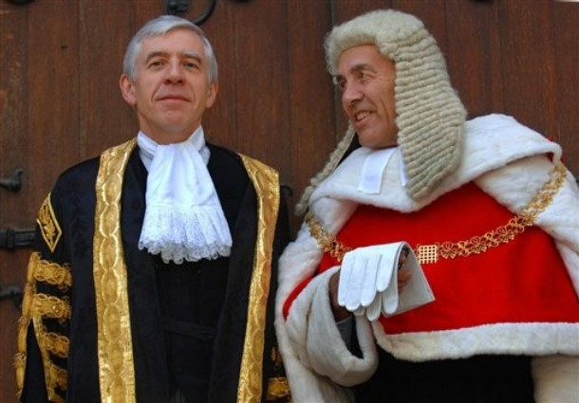
v. The reaction then needs to be explained in terms of the social structure. This means that the researcher should attempt to discover who has the power in society to make the rules, and to explain why some deviant acts are treated much more severely than others.
Armed police and farmers are allowed guns but no one else is.

Slide 31
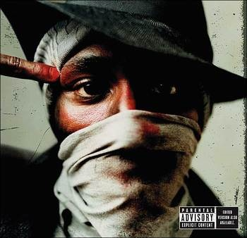
vi. It is necessary to study the effects of deviant labels.
People expect me to have guns in every orifice, so I get picked up a lot by the police and searched.

Slide 32
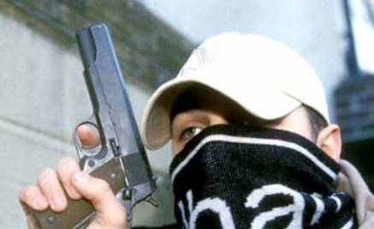
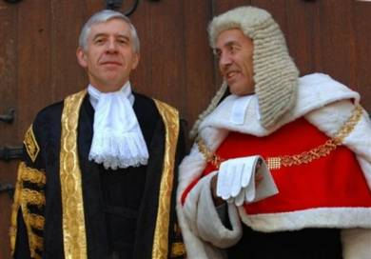
vii. The relationship between these different aspects of deviance should be studied, so that they fuse together into a complete theory.

Slide 33
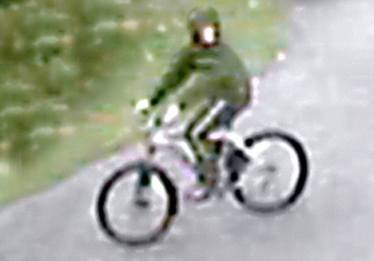
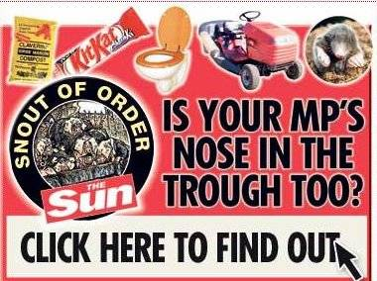
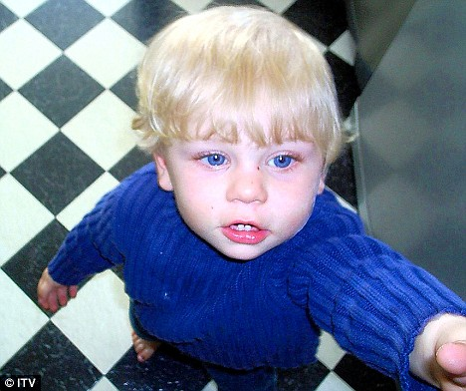
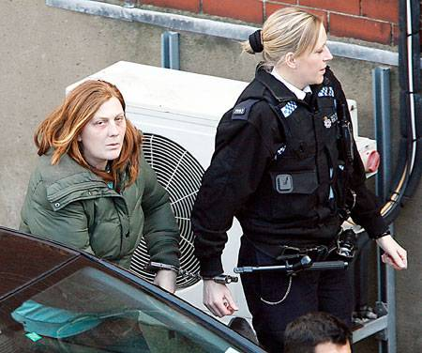
Apply the seven stages in Taylor, Walton and Young’s Fully Social Theory of Deviance to the following case studies:
MPs expenses.
Baby P.
Gun crime in Croxteth.
Shannon Matthews.
Recent crime stories
Find a ‘social’ cause if you can!
Jimmy Saville
PIP scandal
Question – How does corporate crime relate to Strain Theory?

Slide 34
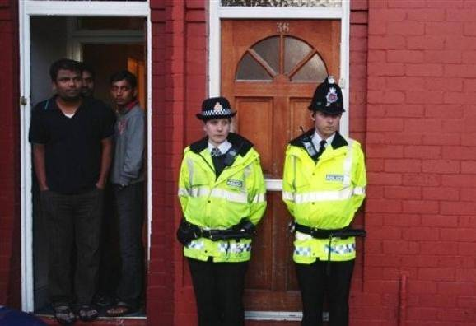
Policing the Crisis by Hall et al argued that * the state manufactures a crime problem; * justifies strengthening its control over the population; * certain groups such as young black men, in particular are heavily criminalized so they can be heavily controlled.

Slide 35
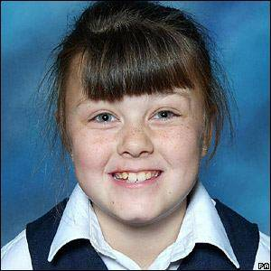
Radical criminology has been criticised for:
seeing the actions of the state and the agents of social control as solely serving the interests of the capitalist class.
What about examining how the law works to protect the vulnerable?

Slide 36
Downplaying the significance of crime and largely ignoring the victims of crime.
Bollocks to the Robin Hood and “woe is me” routine – I’m the victim here and my life is ruined.

Slide 37
&

Slide 38
Croall defined WHITE COLLAR CRIME as crime committed in the course of legitimate employment; an abuse of an occupational role.

Slide 39
White Collar Crime Case Study
Read the article and answer these questions.
http://www.huffingtonpost.com/2009/11/05/the-most-scandalous-white_n_347157.html?slidenumber=V%2BWmYg8t84Y%3D&slideshow#slide_image
What class are these offenders?
Why do you think they are so high profile in the media? Could there be any other reasons?

Slide 40
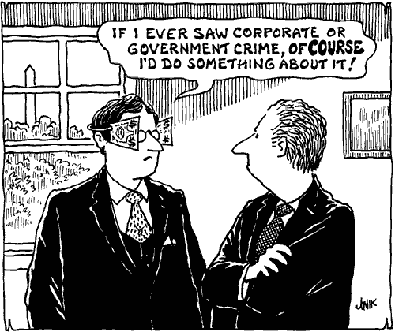
CORPORATE CRIME is when companies commit crimes.

Slide 41
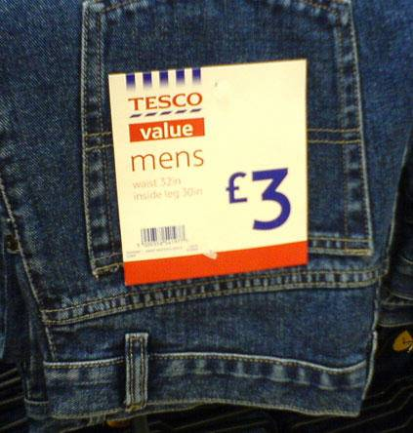
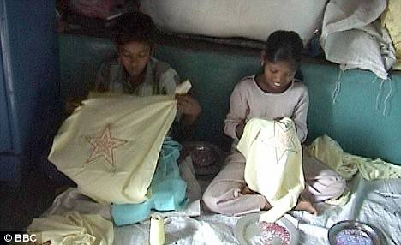
For instance, 500 a year die in British workplaces.
The Health & Safety Executive say 2/3 are caused by employer negligence.

Slide 42
So what happens to these companies that cause the deaths of their workers?
A fine? They’re loaded!

Slide 43
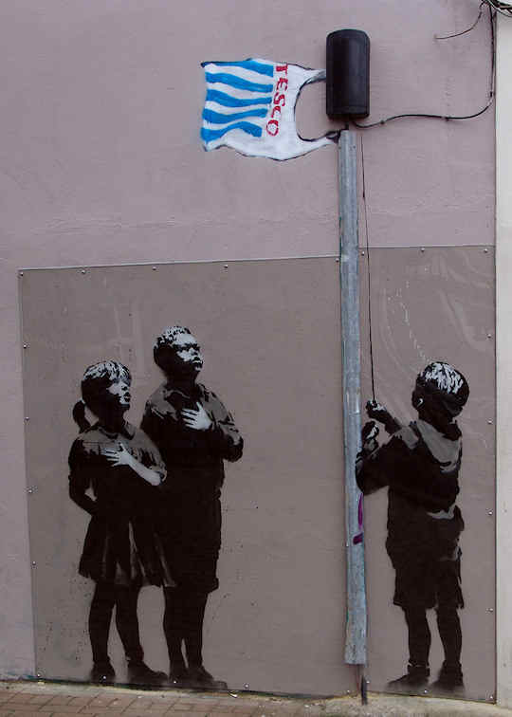
The boundary between organised crime and respectable large corporations is becoming increasingly blurred.

Slide 44
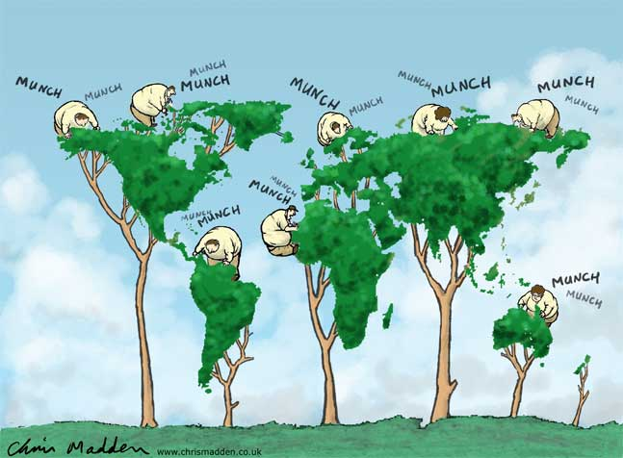
Corporate crime is increasingly taking on a global dimension as organisations gain the ability to move large amounts of money, staff and expertise swiftly around the world.

Slide 45
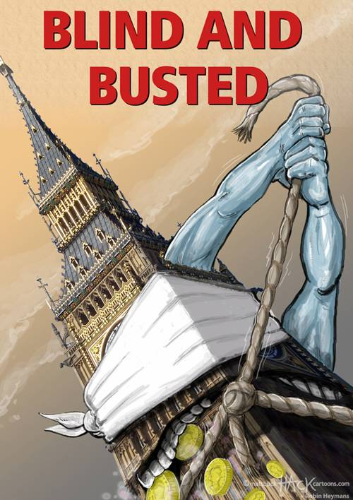
White collar crime causes large financial losses to organisations, but it is relatively under-investigated by the social control agencies.

Slide 46
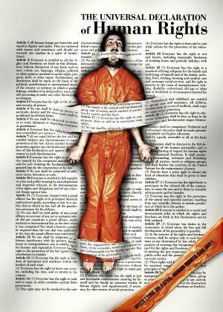
Governments also commit crimes, and increasingly so, and yet human rights legislation has gained legitimacy in many countries.
This contradiction is a feature of globalisation.
http://www.guardian.co.uk/world/2009/mar/09/torture-guantanamo-rendition

Slide 47
Key concepts...
Capitalism
Criminogenic
Ruling class
Subject class
Superstructure
Agencies of social control
Ideological state apparatus
Ruling class ideology
False class consciousness
Non-decision making
Corporate crime
White collar crime
Selective law enforcement
Socialism
Fully social theory of deviance
Labelling
The New Criminology

Slide 48
Comparison to other perspectives
Functionalism blames working class whereas Marxism blames capitalism
Functionalism trusts statistics whereas Marxism think they are distorted
Interactionists would argue Marxism too heavily focused on structure of capitalism and can’t see individual victims
Feminists would argue Marxists ignore the gender differences in crime e.g female victims

Slide 49
Essay Plan
Intro to marxism in general
Traditional Marxist theories , lots of examples, criticism and analysis
Taylor, Walton and Young New Criminology plus examples, criticisms and analysis
Discussion of white collar, corporate and state crimes plus evaluation and analysis.
Conclusion – can marxism be seen as a useful theory

