Slide 1
Sociological Dinner Party
SCLY 3
Perspectives of the Role of Religion

Slide 2
Starter:
The sociologist I would most like to invite to dinner is ……………… because …

Slide 3
Learning Objectives
ALL students will consolidate their understanding of different sociologists’ views of the role of religion by revising their individual standpoints and theoretical perspectives and comparing them to each other (E)
MOST students will consolidate their understanding by comparing them thoroughly and with good sociological insight (C)
SOME students will refine their understanding through a sensitive, well-informed comparison and with mature sociological insight (A*)

Slide 4
Cocktail Hour: Drinks and canapés

Slide 5
Cocktail Party: Effective introductions
As any good host knows, the key to a successful drinks party is often effective introductions. As your guests sip cocktails and eat canapés… you will need to introduce them to each other with thoughtful anecdotes or a basic introduction to help get them talking and feeling comfortable with everyone.
ALL – Basic introductions that summarise the sociologist’s views on religion “This is Durkheim, he believes…”
MOST – Concise (and hopefully interesting/witty) introductions
SOME – Think about how you could introduce sociologists to each other… “Durkheim, this is Talcott Parsons, you might be interested in his ideas about….. Because…..”

Slide 6
Time for dinner!

Slide 7
Exciting! You’re hosting a sociological dinner party… As any good host knows, the key to a successful dinner party is often the seating arrangement.
Your task is to:
consider the conversational interests of your guests – jot down their likely topics of conversation on the paper plates (i.e. key ideas/concepts etc)
and devise a seating plan that will generate interesting conversation
Be prepared to justify your decisions!

Slide 8
Further guidance
Avoid seating guests with very similar opinions together – you want to avoid cliques.
However, also try to avoid seating guests who have directly opposing views – you also want to avoid heated arguments!

Slide 9
Guest List
Durkheim
Malinowski
Parsons
Bellah
Marx
Gramsci
Althusser
Maduro
Woodhead
Armstrong
De Beauvoir
El Saadawi
Helen Watson
Vladimir Lenin

Slide 10
Review seating plans
Justify your own seating plan
Have a look at another group’s seating plan – do you approve of their decisions? Can they justify them?
(Amend seating plans if you wish)

Slide 11
As any good host knows, it’s important to ensure everyone is having a good time and getting along well (or at least engaged in passionate debates)
Working as a group, can you predict:
ALL: What your guests (or small sections of your table) are likely to talk about?
MOST: Areas of consensus and conflict between the table or small sections of your table?
SOME: Precise examples of consensus and conflict between the table or small sections of your table? Which sociologists might dominate the discussion? Who will get along well with who?

Slide 12
Plenary
What have you learnt this lesson?
How could this dinner party lesson help you write better essays?
Who do you need to get to know (AKA revise) better?

Slide 13
Resources to print:

Slide 14
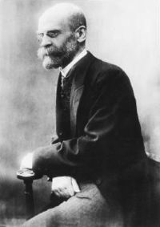
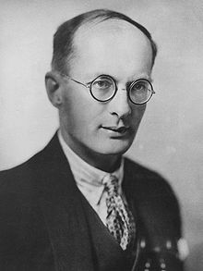
Emile Durkheim
Bronislaw Malinowski

Slide 15
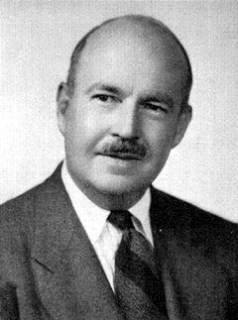
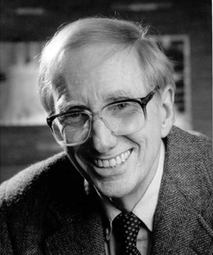
Talcott Parsons
Robert Bellah

Slide 16
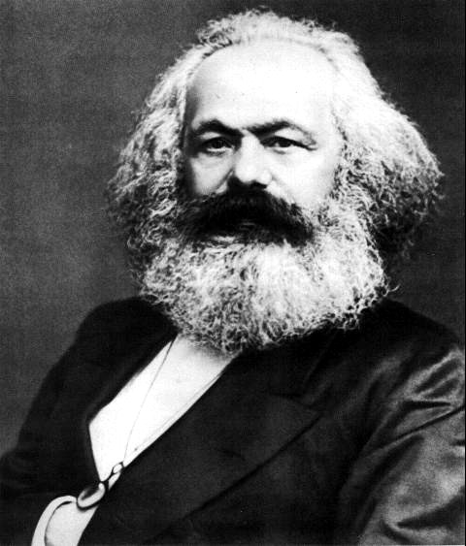
Karl Marx
Louis Althusser

Slide 17
Antonio Gramsci
Otto Maduro

Slide 18
Karen Armstrong
Linda Woodhead

Slide 19
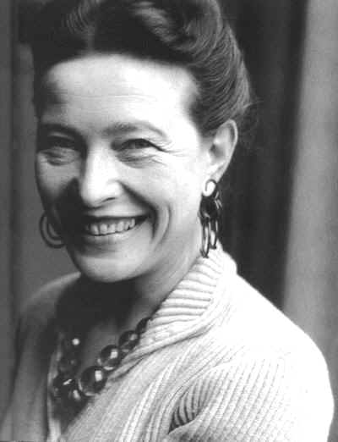
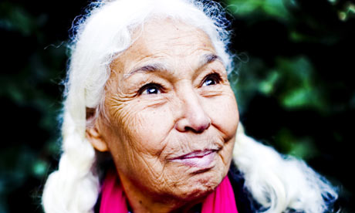
Simone de Beauvoir
Nawal El Saadawi

Slide 20
Helen Watson
Vladimir Lenin

