Slide 1
How do sociologists explain crime?
Recap: Crime & Deviance
Discuss the moral dilemma cards on your table
Is it a crime?
What punishment does it deserve?
Crime; deviance; theories of crime
Revise my crime and deviance knowledge

Slide 2
How do sociologists explain crime?
Revising Crime and Deviance so far. . . .
Get your brain back in gear!
Today you will create a revision tool (e.g mind map, concept map) revisiting all C&D knowledge covered so far.
You will sit a pop quiz at the end of this lesson/start of tomorrow’s lesson
It needs to include:
Definitions of crime, deviance, social order/control, informal/formal rules
Marxist, New Right, subcultural explanation of crime
Labelling theory
Use notes and reading pack!

Slide 3
How do sociologists explain crime?
Pop Quiz
________ is behaviour, beliefs and physical characteristics that produce negative social reactions.
Both crime and deviance are socially constructed concepts. T or F?
The government is an example of an agency of _________
A discouraging look is an example of ________ sanction
How did Lombrosso explain criminal activity?
Give one New Right explanation for criminal activity?
How does the opportunity structure explain criminal activity?
According to Marxists, why does a culture of materialism cause crime?
What characteristics does a delinquent have?
Why would someone labelled as a delinquent be more likely to recieve a harsher punishment?

Slide 4

How do sociologists explain crime?
Measuring Crime
How is this image similar to official crime statistics?
Victim surveys
Self-report studies
Official statistics
describe the main sources of statistical data (victim surveys, self-report studies, official statistics)
Analyse and evaluate the extent to which official statistics on recorded crime measure the extent of crime

Slide 5

How do sociologists explain crime?
Who am I?
I ask around 50,000 people a year questions about their experiences of crime. I cover the whole of Britain.
I question people about their own offending. I deal with offences that are not necessarily dealt with in court.
I am created by the police and published by the government. I can make comparisons of crime over time.

Slide 6

How do sociologists explain crime?
What are the advantages/disadvantages?
Using your notes, populate the table below in your books
Official Statistics |  | Victim Surveys |  | Self-report studies
+ | - | + | - | + | -
15

Slide 7
1.You experience date rape in your partner’s flat.
2.Your best friend hits you when you claim to be in love with his/her partner.
3.Your brother has taken £5 from your wallet or purse.
4.You see people beating up someone on the street.
5.You discover someone who has been stabbed to death.
6.You see a bunch of fourteen year olds buying alcohol in a pub.
7.Someone has scratched your car door.
8.You see one of your neighbours breaking into someone’s house.
9.Someone has stolen milk from your doorstep.
10.You think, but you are not certain, that the old lady in Tesco was shoplifting.
11.Your bicycle was stolen.
12.Your house was burgled.
Discuss as a table
Would you report all of these crimes to the police? Why? Why/not?

Slide 8

How do sociologists explain crime?
The dark figure of ‘crime’
What does this phrase refer to?

Slide 9
How do sociologists explain crime?
Are crime statistics socially constructed?
Sociologists would argue that crime statistics are the outcome of a series of choices and decisions made by various people involved in reporting crime.
Discovery
Reporting
Recording
Draw a diagram to show how each stage of the process has barriers preventing the accurate recording of crime.
Use statistics and facts to illustrate your diagram.
Challenge: Read the news report. Analyse it from a sociological perspective. Why might violence against women have increased recenty?

Slide 10
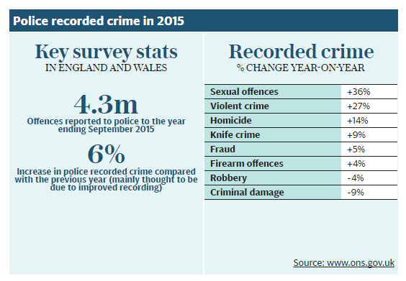
How do sociologists explain crime?
Critique the statistics!
Check your I cans…
Homelearning:

