Slide 1

Learning Objective:
To understand the future of crime

Slide 2
New technologies and inventions have created new crimes.
For example: mobile phone theft.
How many can you and your group come up with?
Make a list in your books.
You have 5mins.

Slide 3
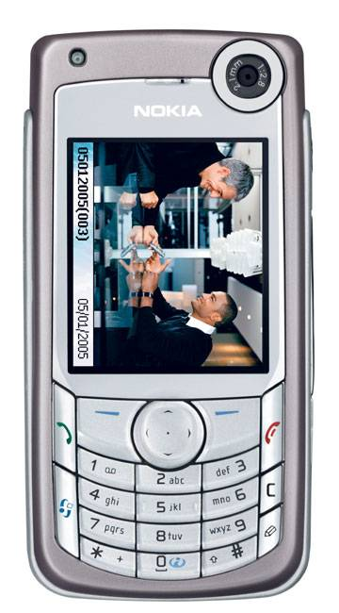
New crimes
Mobile theft
Hacking
Piracy
Credit fraud
Identity fraud
Illegal use of internet
Drug trafficking
Computer viruses
Downloading music
Internet theft

Slide 4
New agencies of social control- things/people who enforce the law or help to catch criminals.
In the past The Police, courts and prison service dealt with almost all criminal activity, things are very different today
Many private companies exist to ensure people are following rules and written laws.
New technologies exist to tackle new crimes and increasingly clever criminals.
For example- speed cameras.
Can you think of any more examples?

Slide 5

New agencies of social control- things/people who enforce the law or help to catch criminals.
Security guards
Bouncers
Car park attendants
CCTV
Speed cameras
Electronic tags
Chip and pin
Eye or finger print identification
Identity cards
DNA testing
Tracking devices

Slide 6
Globalisation
Crime is increasingly not confined to one area or country, any crime committed via the internet could affect people around the world and things like terrorism are happening across the globe.
This creates bigger problems for Police and governments as criminals can be hard to track down.
However, it also means countries can work together to fight crime by extraditing criminals and using things like Interpol to track suspects.
Like in catch me if you can!!!

Slide 7
Task:
Under the heading- the future of crime, write a paragraph explaining how crime has changed recently- include the types of crime and how agencies of social control are changing as a consequence.

