Slide 1
Learning Objective:
To understand how crimes are reported and measured.
To understand how useful crime reports are.

Slide 2
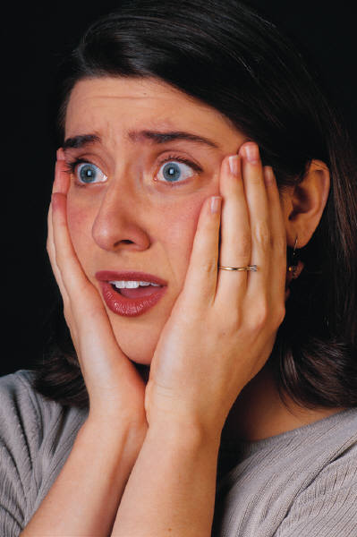
Crime in Mirfield
How you would find out:
How much crime takes place in Mirfield?
What types of crime are committed?
Who commits the most crime?
Who are the victims of crime?
What other questions might you want to ask?

Slide 3
Official Statistics
These are published annually by the government and are available in news papers and online.
What are the advantages of this?
What types of things will the statistics tell us?

Slide 4
Problems with official statistics
Do officials statistics tell us the whole story?
NO
What might be the problem with official statistics?

Slide 5

If the following thing happened to you what would you do or think?
You went out with a £5 note in your pocket and now its gone (You didn’t spend it!)

Slide 6
1.Some crimes go unnoticed- Why? What types of crime?
Some crimes are too small or insignificant to even notice sometimes.
You may just think the £5 note got lost when in fact it was actually taken from you by a thief.

Slide 7
If the following thing happened to you what would you do or think?
You fall out with your best friend and the two of you have a massive fight. You punch them but they punch you back even harder and break your nose.

Slide 8
Why is this? What types of crime might not be reported?
Petty crimes that involve small sums of money.
Private crimes like domestic violence or the fight with your friend.
The Police can’t or won’t do anything
No loss to victim- insurance claims might actually mean your profit from a theft
Dealt with by school or work- you steal some stationary and get caught.

Slide 9

If the following thing happened to you what would you do or think? What would the Police do?
Your neighbours phone the Police because you and your friends are making too much noise playing in the back garden.

Slide 10
3. Some crimes are not recorded by Police. Why?
Police may feel it’s not necessary.

Slide 11
4. Policing
Police may focus on certain crimes like speeding, bike theft or drink driving and this can make the figures invalid or unreliable.
More people are prosecuted for drink driving at Christmas because Police are looking out for drunk drivers and being harsher on offenders. More people are not necessarily drinking and driving they just get caught and prosecuted more making those statistics both invalid and unreliable.

Slide 12
Can the statistics really be trusted?
Valid statistics= give a true reflection of what is really happening- do we really know how many crimes have taken place by looking at official statistics?
Reliable statistics= if you repeat the study will you get the same results? If you ask the same people the same questions will they give the same answers? It’s like when you repeat science experiments.

Slide 13
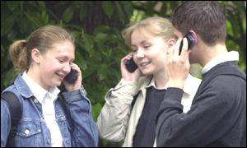
Mobile Phone Theft
How would you go about finding out how many pupils at the MFG have had their phone stolen?
Would your results be valid & reliable?
Why not?

Slide 14
The Hidden/Dark figure of crime
As we now know, many crimes go unnoticed, aren’t reported or aren’t recorded by Police.
The official statistics say that 330,000 mobiles were stolen last year, a recent study says that in reality 700,000 were actually stolen. The 370,000 that aren’t in the official statistics are chuffin known as the dark figure of crime.

Slide 15
How can we
find out the
dark figure
of crime?

Slide 16
Self report studies
On scrap piece of paper write down in silence all of the crimes you have committed.
Your paper is confidential (no names please!)
It will be passed on to Mirfield Police so they can have a more accurate figure on the numbers & types of crimes committed.

Slide 17
Self Report Studies
Sometimes self report studies are conducted to help gain a better picture of the crimes that are taking place in our society.
Self report studies are confidential surveys that ask people to tick from a list of deviant and criminal acts the ones that they have done or been involved with. As they are confidential people do not risk being punished. They are usually given to teenagers about things like graffiti.
What are the advantages and disadvantages of these types of studies?

Slide 18
Self report studies
Advantages
Get a more valid and reliable picture of crime
Get info on crimes that haven’t been detected, reported or recorded.
Disadvantages
Unethical if asked to hardened criminals.
People may not cooperate.
People may not tell the truth.

Slide 19
Victim studies
Now write down what crimes you’ve been a victim of.
Again no names please.
Mirfield Police can use your info to get a better idea of the number & types of crimes committed.

Slide 20
Victim studies
Victim studies can also be used to gain a better picture of crime in Britain.
Basically instead of asking people to tick which crimes or deviant behaviour they’ve committed, they ask people which crimes they have been victims of.
What are the advantages and disadvantages of this?

Slide 21
Victim studies
Advantages
Get a more valid and reliable picture of crime
Get info on crimes that haven’t always been reported or recorded.
Disadvantages
Could upset people
People may not cooperate.
People may not tell the truth or may exaggerate the crimes they have witnessed.

Slide 22
Learning Objective:
To understand how crimes are reported and measured.
To understand how useful crime reports are.

Slide 23
Summary
The Crime Rate/ Official Statistics
Self Report Studies
Victim Surveys
Explain in a sentence what each one means
Give one advantage and one disadvantage of each

Slide 24
The Dark Figure of Crime
Draw a picture to show what is meant by the “dark figure of crime”
Think Icebergs!

