Slide 1
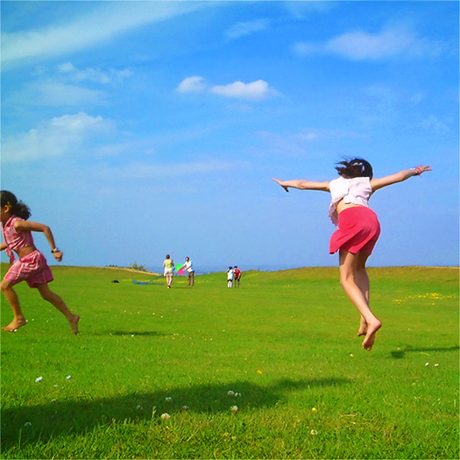
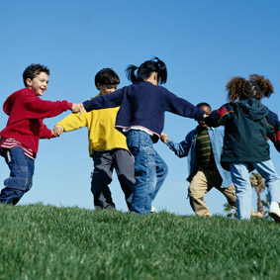
Has the position of children improved?
Learning Objectives: To examine whether the position of children has changed

Slide 2
Has the emergence of childhood as a distinct life stage led to an improvement in the status/position of children?

Slide 3
March of Progress View
The March of progress view…
YES….. children are:
More valued
Better cared for
Protected
Educated
Better health
More rights

Slide 4
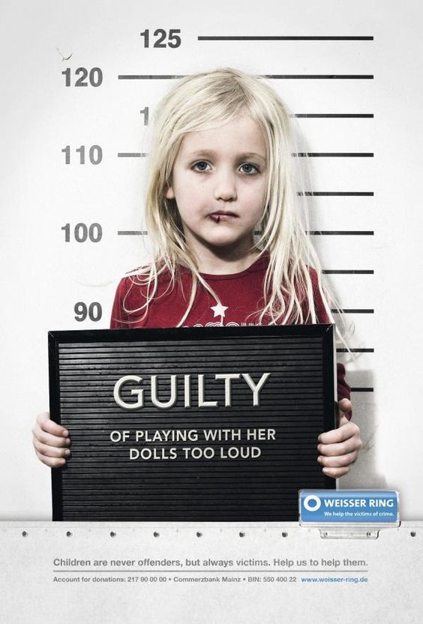
Protected…
Today’s children are more protected from harm and exploitation by laws against child abuse and child labour, and a number of professionals caters for their educational, psychological and medical needs.

Slide 5
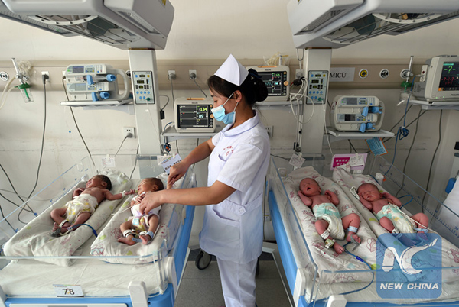
Better healthcare and higher standards of living…
Babies have a much higher chance of survival now than 100 years ago. In 1900, the infant mortality rate was 154 per 1,000 live births; today, it is 4 per 1,000.

Slide 6
March of Progress View
Families are child-centred…
Smaller families (down from 5.7 births per woman in the 1860s to 1.83 in 2014) means that parents can afford to provide for their child’s needs properly.
Cost per child on average
£227, 000 at age 21
The family is more child centred

Slide 7
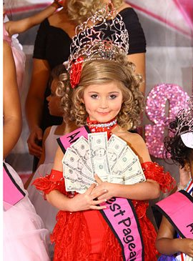
March of Progress View
Families are child-centred…
Children are no longer to be ‘seen and not heard’
Now the focal point of the family, consulted on many decisions
Parent invest a lot emotionally and financially, having high aspirations for them and their future.
Society is now also child-centred e.g. media and many leisure acitivites are desigined specifically for children.

Slide 8
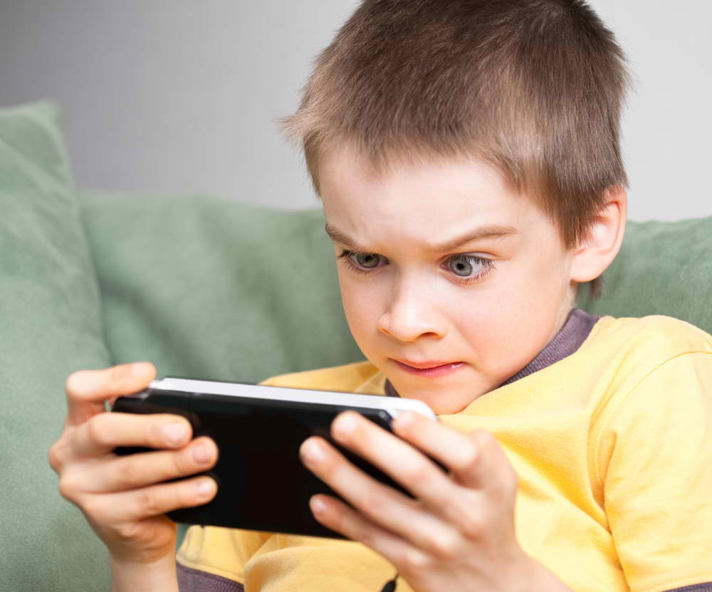
March of Progress View
‘Toxic childhood’
Palmer argues that rapid technological and cultural changes have damaged children’s physical, emotional and intellectual development
E.g. junk food
Computer games
Intensive marketing to children
Long working hours by parents
More testing for children in education
Child-centredness does not necessarily mean well looked after

Slide 9
Conflict view
NO…the position of children has not improved.
Conflict theories criticise the march of progress view on two grounds:
Inequalities among children
Inequalities between children and adults.

Slide 10
Inequalities among children
Different nationalities:
Not all children share the same status or experiences. Some children from different nationalities are likely to experience different life chances. 90% of the world’s low birth-weight babies are born in developing countries.
Gender differences:
Hillman (1993) found that boys are more likely to be allowed to cross or cycle on roads, use buses, and go out after dark unaccompanied. Girls do more domestic labour – especially in lone parent families, where they do 5x more housework than boys.

Slide 11
Inequalities among children
Ethnic differences:
Brannen (1994) study of 15-16 year olds found that Asian parents were more likely than other parents to be strict towards their daughters. Ideas of izzat (family honour) could be a restriction, particularly on the behaviour of girls.
Class differences:
Poor mothers are more likely to have low birth-weight babies, which is linked to delayed physical and intellectual development.
Children of manual skilled workers are over 3x more likely to suffer from hyperactivity and 4x more likely to have conduct disorders.
Children born into poor families are more likely to die in infancy, suffer long-term illnesses, be shorter in height, fall behind at school, and placed on the child protection register.

Slide 12
Conflict view – control:
Control over children’s space
Control over children’s time
Exclusion from paid work = powerless
Neglect & abuse
Control over children’s bodies
Control over access to resources
Age patriarchy (Gittins – adult domination)

Slide 13
Evidence for oppression
Age patriarchy
Gittins (1998)
Age patriarchy of adult domination and child dependency.
Patriarchy = rule of the father
Power of the male head over the members of the household, including the children

Slide 14
Evidence for oppression
Age patriarchy
Hockey & James
Resist restrictions and oppressions of childhood
‘acting up’ (acting like adults; smoking, drinking, swearing)
‘acting down’ (immaturity)
Childhood is a position from which children want to escape

Slide 15
AO3 criticisms of conflict view:
Children cannot make rational decisions for themselves.
Not as powerless due to legal rights to be protected and consulted.

Slide 16
The ‘new sociology of childhood’
Mason and Tipper (2008) show how children actively create their own definitions of who is ‘family’ – which may include people who are not ‘proper’ aunts or grandfathers etc., but who they regard as close.
Smart (2001) study on divorce found that, far from being passive victims, children were actively involved in trying to make the situation better for everyone.

Slide 17
Construct:
Create a summary table of whether the position of children has improved.
Write a brief conclusion in the final row.

Slide 18
Review:

Slide 19
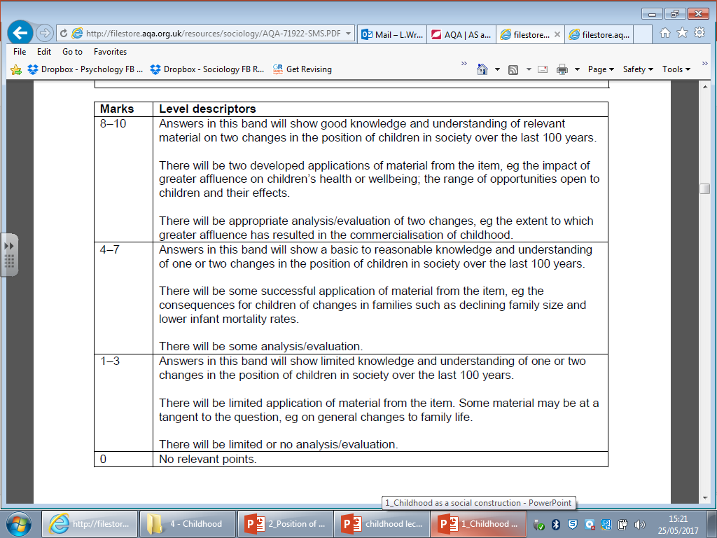
Review:

