Slide 1
Marxist views on Crime and Deviance
Robbing a bank is no crime compared to owning one.’ Bertolt Brecht.

Slide 2
Lesson Objectives
Review knowledge of Marxism
Understand Marxist explanations of both the causes and consequences of crime.

Slide 3
‘What is the crime of robbing a bank compared with the crime of founding one.’ - Bertolt Brecht
What point is being made here?

Slide 4
Notes:
https://www.youtube.com/watch?v=tWZMMPLvNgU TV Nation from 1994. Use as revision for the idea of corporate crime.

Slide 5
Notes:
https://www.youtube.com/watch?v=IwPSDMUtNmk Bhopal disaster. Easy case of corporate crime.

Slide 6
Notes:
Allan Stanford and the Ponzi Scheme. How the rich can make money.
https://www.youtube.com/watch?v=llHXdMiguUM

Slide 7
Notes:
https://www.youtube.com/watch?v=aVnvM1HUjwY Jimmy Saville. Talk about how the powerful can sometimes get away with heinous crimes.

Slide 8
What common themes come up across the videos?

Slide 9
Marxism and Crime
‘Where justice is denied, where poverty is enforced, where ignorance prevails and where any one class is made to feel that society is in an organised conspiracy to oppress, rob and degrade them, neither persons nor property will be safe.’
Frederick Douglas, Speech on the 24th Anniversary of emancipation, Washington 1886.

Slide 10
Marxism and Crime and Deviance
Crime is a product of poverty
Crime is brought about by capitalism

Slide 11
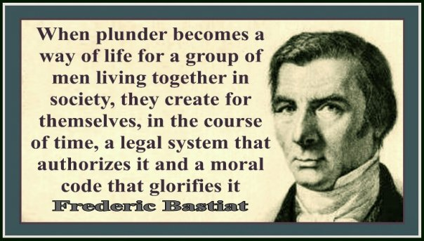
Marxism

Slide 12
MANIPULATION OF VALUES
Manipulation of the basic values and morality of a society
Society is dominated and controlled by those at the helm
Control is maintained via the socialisation process and threat

Slide 13
MANIPULATION OF VALUES
VALUES OF ‘FREEDOM’
SELF-INTEREST
COMPETITION
CONSUMERISM
INDIVIDUALISM

Slide 14
LAW CREATION
Law is a reflection of the will of the powerful
As economic power guarantees political and social power, the rich can manipulate the rest of us and pass laws that benefit them
They ‘set the agenda’
Notes:
http://www.guardian.co.uk/commentisfree/2011/mar/28/free-protest-clegg-oh-dear/print
http://www.guardian.co.uk/uk/2011/apr/02/uk-uncut-fortnum-mason-protest/print

Slide 15
LAW ENFORCEMENT
‘Street crime’ is more likely to be pursued by police than ‘white collar’ crime
Intensified policing and punishment of poorer individuals and communities
The poor are filtered into the criminal justice system while the rich are filtered out

Slide 16
Dole ‘cheats’ are demonised, while corporate and individual tax avoidance is tolerated. Richard Murphy of Tax Research estimates that avoidance now amounts to £25 billion a year, evasion to £70 billion and outstanding debts to the tax service to £28 billion: a total of £120 billion. Benefit fraud amounts to around £1.1 billion annually.

Slide 17
INDIVIDUAL MOTIVATION FOR CRIME
In capitalist societies the cultural stress in on competition, not cooperation, and the acquisition of wealth
Desire for money can lead those who are blocked off from legitimate chances of gaining wealth to turn to criminal methods (anomie)
Greed is built into the capitalist system

Slide 18
William Chambliss
‘A Study of Crime in Seattle’ (1978)
Chambliss identified selective law enforcement in Seattle.
70% of arrests were for public drunkenness, while white collar crime involving leading politicians, police and big business – some of it relating to organised crime involving prostitution – was all but ignored.

Slide 19
William Chambliss
Strengths
Criticisms
Notes:
Use the textbook to identify the strengths and weaknesses of Chambliss’ approach.

Slide 20
‘If the demoralisation of the worker passes beyond a certain point, then it is just as natural that he will turn into a criminal – as inevitably as water turns into steam at boiling point.’
(Engels 1844)
Strongly disagree
Strongly Agree
To what extent do you agree with this statement?

Slide 21
‘Power in the form of money and influence is the key factor which determines who gets arrested and who does not.’
Chambliss (78)
Strongly disagree
Strongly Agree
To what extent do you agree with this statement?

Slide 22
‘The state is reluctant to pass – or enforce – stringent laws against pollution, worker health and safety, or monopolies. Such measures scare off much sought after investment and engender the equally dreaded loss of confidence.’
Chambliss (78)
Strongly disagree
Strongly Agree
To what extent do you agree with this statement?

Slide 23
‘Many of the most serious anti social and predatory acts committed in modern industrial countries are corporate crimes.’
Chambliss (78)
Strongly disagree
Strongly Agree
To what extent do you agree with this statement?

Slide 24
“the pimp, mugger and prostitute use what they have to get what they can, whereas those in higher income brackets have more effective means to grab a slice of the cake”
Chambliss (78)
Strongly disagree
Strongly Agree
To what extent do you agree with this statement?

