Slide 1
Globalisation and Crime
Key Themes
Gangs – Green Crime – State Crimes and Human Rights

Slide 2
Definition
Globalisation refers to the way in which the world has become more interconnected, the cultural and political boundaries which once separated countries are dissolving.
A result of this process is new opportunities for crime, and new types of crime.

Slide 3
Types of global crime
Castells (1998) Identifies a number of typical global crimes.
Arms trafficking
Nuclear materials trafficking
21st Century slavery - People trafficking, trafficking illegal immigrants/prostitutes
Cyber crimes
Sex tourism in developing countries
Terrorism
Drugs
Money laundering

Slide 4
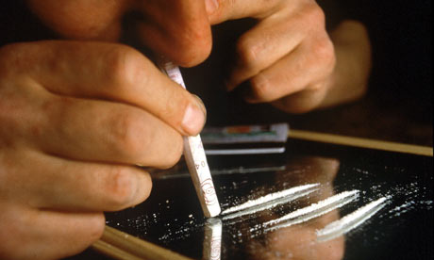
Supply and demand economics?
Castells argues
“Most global crime is supply side economics provided by developing countries, feeding the demand being led by developed countries”.

Slide 5
Global crime impacts on all social classes
Taylor (1997)
Claims globalisation creates crime at both ends of the social spectrum.
Lower social groups
Lack of legitimate employment opportunities caused by outsourcing to cheaper labour pools means illegal options become more rational.
Higher social groups
Globalisation of money markets has led to an increase of insider trading, tax evasion and wide scale fraud.

Slide 6
Globalisation and gangs
Hobbs and Dunningham (1998)
Use the term Glocal Organisation to explain how new types of gang structures have emerged to facilitate new global markets, particularly with international drug deals.
Such new structures do not have the old rigid family based hierarchical structures typified by the Italian-American Mafia of the 1930 – 1950’s
Rather they’re much more fluid, flexible and faster to respond to emerging opportunities.

Slide 7
Glenny (2008) - McMafia
Claims the recent increase of eastern European gangs are an illustrative example of the social, cultural and political changes since the fall of communism in 1998.
Many corrupt KGB (Russian Secret Police) officials bought up coal, steel and mineral industries at low prices and sold them on western markets, making billions in the process.
Many ex-KGB have morphed into criminal gangs with global connections.

Slide 8
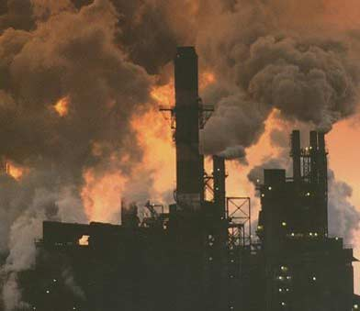
Green Crime
These are crimes committed against the environment, it’s a highly subjective and contested concept.
Globalisation ensures that nation states can no longer act as separate entities.
Pollution from a factory in one country can cause pollution in another.
Traditional criminology examines national laws to see if a crime has been committed.
This approach is now challenged as it’s argued large corporations (who cause the most environmental damage) have too much power in influencing challenges to environmental protection laws. ( ie lobby groups, large donations to political parties)

Slide 9
Green Criminology
Takes a more radical approach to traditional criminology.
As different countries have different laws, green criminology seeks to overstep national laws by focusing on the damage which is being done.
Therefore, green criminology adopts a global perspective on crimes against the environment.
In a similar approach to Marxism, it challenges powerful corporations and demonstrates how their unacceptable practices are defended as legitimate business interests.

Slide 10
Green Criminology Anthropocentrism V’s Ecocentrism
The anthropocentrism view states that humans have the right to dominate nature for their own ends. (Multinational corporations/big business interests)
The Ecocentric view sees humans and the environment as interdependent – harming the environment ultimately harms humans. (Green criminology)

Slide 11
Green Criminology – An Evaluation
G.C. has helped to focus the global ramifications of many legal and illegal, but morally suspect actions.
However, because of its very global concerns it is difficult to define the boundaries of right and wrong.
Some argue the debate is too biased on subjective issues involving ethics and values as opposed to realist and pragmatic solutions towards solving issues such as fossil fuel dependency.

Slide 12
Human Rights and state crimes
Human rights involve:
Civil rights – rights to vote, a fail trial, rights to own property, etc…
Natural rights – issues involving life itself, freedom from slavery, freedom of thought, freedom of speech etc…
A right refers to something you are entitled to. It is a basic philosophy underpinning all western societies.
They are enshrined in law – the Universal Deceleration of Human Rights.

Slide 13
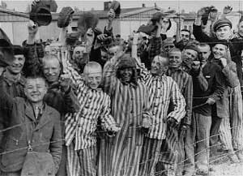
H&J Schwendinger (1971)
Claim that all crimes should be defined in relation to human rights as opposed to just breaking criminal laws.
Why? Because any country can make up laws to suit the purposes of the political party in power.
Eg – Nazi party making it legal to persecute Jews.
They argue that definitions of crime need to be based on transgressions from human rights laws.

Slide 14
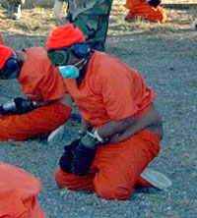
S. Cohen (2001)
Cohen is interested in how countries cover up or try to legitimise their human rights crimes.
Dictatorships often deny acts of torture (eg Assad – Syria)
Democracies often use complex laws to legitimise acts of torture (eg USA - Guantanamo Bay)

Slide 15
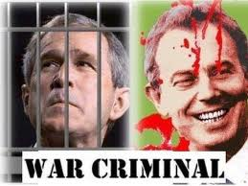
Techniques of Neutralism
Cohen borrows Matza’s idea to show how governments use the same techniques as people to explain/excuse their actions.
1. denial of victim – they are terrorists etc..
2. denial of injury – they started it/it’s self defence etc..
3. denial of responsibility - We were following orders etc…
4. Condemning the condemners – they are picking on/victimising us etc…
5. Appealing to higher loyalty… there is a bigger cause and sacrifices are inevitable – protecting Israel, protecting Judaism , protecting Islam etc etc….….

Slide 16
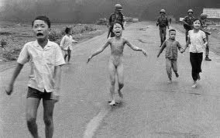
Kelman and Hamilton (1989)
Examine how social conditions in modern society can lead to horrific crimes being committed.
Looked at the Mai Lai massacred – an infamous incident during the Viet Nam war where 400 civilians were massacred by US soldiers.
They identify 3 features that can result in ‘crimes of obedience’

Slide 17
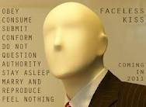
1. authorisation
This is where ‘acts’ are ordered by someone in charge.
Milgram famously demonstrated this principle in his ‘electrical shock’ research – obedience to authority.
Normal moral principles are overruled by the need/desire to obey authority.

Slide 18
2. Routinisation
This is where pressure from the hierarchy/organisation/government etc.. Turns the act into a routine so it can be performed again, repeated in a detached manner.

Slide 19
3. Dehumanisation
The enemy is made to look as non-human as possible – eg refused clothing, shaved head, id number replaces name etc..
It makes it easier to do unpleasant thing to them (eg torture)
Bauman (1989) – argues that the features of ‘modernity’ (science, technology, divisions of labour etc…) all help to create to conditions where such acts have become more acceptable and common.

