Slide 1

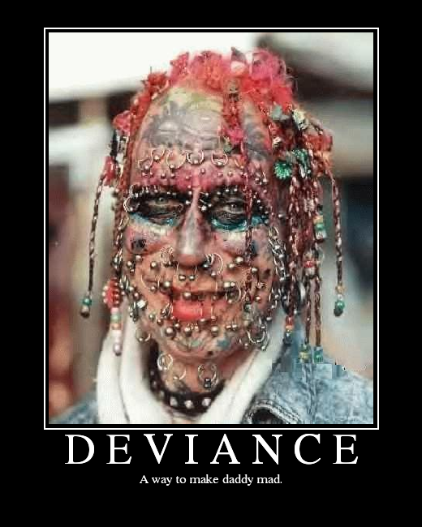
What is the difference between crime and deviance?

Slide 2
Crime: An act which breaks the criminal law of a society
Deviance : behaviour that is disapproved of by most people in society and does not conform to a societies norms and values

Slide 3
Socially Defined
Many sociologists believe that deviance is socially defined.
This means that whether an act is considered deviant or not depends on the setting in which it takes place
Crime and deviance is relative: it can only be defined in relation to a particular standard of behaviour in a particular culture at a particular moment in time.
Time, place, culture, social setting

Slide 4
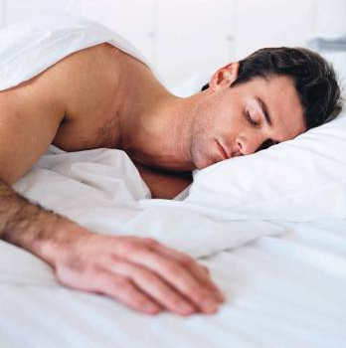

Slide 5
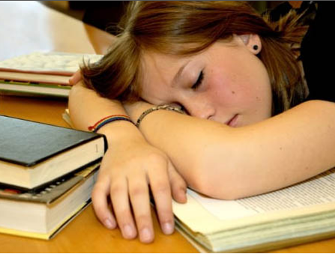

Slide 6


Slide 7
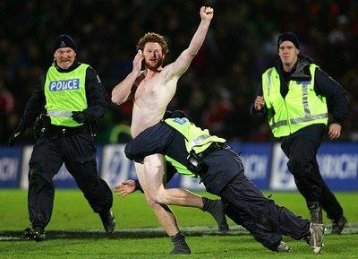

Slide 8
Reactions to deviance
Sociologists argue that what is considered deviant depends NOT on the act itself, but on how people react to it; how they see, define and label and act.
Deviance, therefore is defined according to the social setting in which the act takes place - it is socially defined.

Slide 9
Social control:
Refers to the methods that are used to control individual and group behaviour
Leads to conformity to the rules of that particular society
Types:
Informal, e.g. work, friends, family
Formal, e.g. the police, religion

Slide 10
Marxists
Agents of social control are there in order to keep the classes separate. Laws reflect the interests of the richest and most powerful in society, who have managed to impose their way of thinking on people through agencies of social control.
Powerful keep their power by saying anything against their interests is illegal/deviant.

Slide 11
Functionalists
Agents of social control are actually agents of social integration. Social rules and laws are made and enforced for the benefit of everyone. They are a valuable part of society without which society would not function properly.
Crime threatens these norms and values
But it also strengthens bonds and reaffirms values
Crime being punished demonstrates clear values

Slide 12
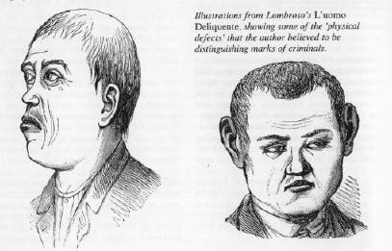
Explanations – biological
Are some people naturally inclined to be criminals?
Lombroso (1876) – a person’s character can be assessed from physical characteristics e.g. shape of skull
Jones (1994) – genes
and environment interact
– influences of biology are
always developed by society

Slide 13
Sociological explanations of crime and deviance
Socialisation
Influence of the peer group
Labelling theory
The opportunity structure
Poverty – relative deprivation – Marxism

Slide 14
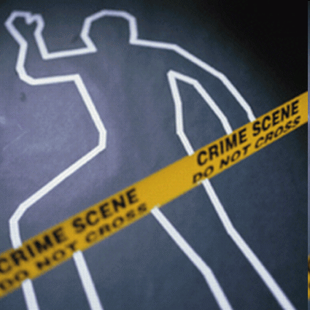
How do we measure the amount of criminal behaviour?
Official Statistics: Statistics collected from police reports
Self report studies: questionnaires where people own up to committing crimes, whether they have been discovered or not
Victim Surveys: people admitting to being the victim of a crime, whether or not they have reported it.
There are problems with all of these methods….

Slide 15
Not all crimes are included in official statistics…
Many crimes are undetected (e.g. small amounts of money being taken from a wallet)
Many crimes are unreported
Fear of criminal/police
Too ‘private’ e.g. domestic violence
Sensitive or embarrassing, e.g. rape
Crime in the workplace – no need for police?
Only about 40% of crimes reported are recorded by the police.
Too trivial?
Not a crime?
Investigation justified?
THEREFORE, CRIME STATISTICS LACK VALIDITY

Slide 16
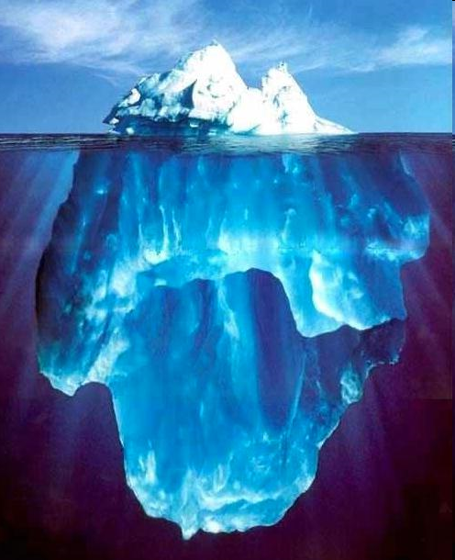
The dark Figure of Crime
Reported
Crime -------
Unrecorded
And
Unreported
Crime --------

Slide 17
Who commits crime?
Crime and gender
Statistics show men commit more crimes than women
Explaining the differences
Different socialisation
Opportunity to commit crime
Social control
Chivalry thesis
Inaccurate statistics

Slide 18
Who commits crime? 2
Crime and age
Statistics tend to suggest that most people receiving criminal convictions will be between 14 and 24 years of age
Crime and ethnicity
Afro-Caribbean males and Asian males are over-represented in the prison population

Slide 19
Who commits crime?
Crime and social class
Socialisation – different values?
Material deprivation
Anomie (sense of ‘normlessness’)
Education – low paid jobs – lack of ££
White collar crime
Hard to research
Many crimes ‘victimless’
Fear of reporting - may lose public confidence?

