Slide 1
Crime & Deviance

Slide 2
Starter Task:
Have you or your family ever been the victim of crime?
Explain what happened and what your thoughts & feelings were.
You have 3 minutes!!!

Slide 3
Learning Objectives:
To understand what sociologists mean by crime & deviance.
To identify why some crimes are not deviant.
To understand how crime & deviance are related to time & place.
To examine the ways in which deviancy can be created.

Slide 4
Learning Objective 1: What do sociologists mean by crime & deviance?
Watch the following images and decide if they are:
Acceptable Behaviour
OR
Unacceptable Behaviour
ALSO
Is the action a crime? Tick if it is.
Tick the correct box/boxes on your worksheet.

Slide 5
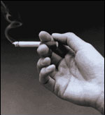
No. 1

Slide 6
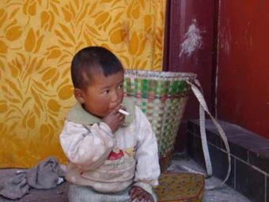
No. 2
This boy is three years old

Slide 7
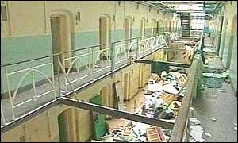
Prison inmates riot with Police
No. 3

Slide 8
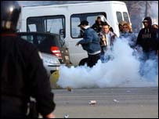
No. 4
Football fans riot with Police

Slide 9
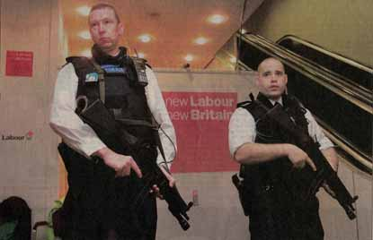
Police carrying guns
No. 5

Slide 10

Children carrying guns
No. 6

Slide 11
Doing 120 miles per hour on a formula one race track.
No. 7

Slide 12
Speeding outside a school in a 30mile an hour zone
No. 8

Slide 13
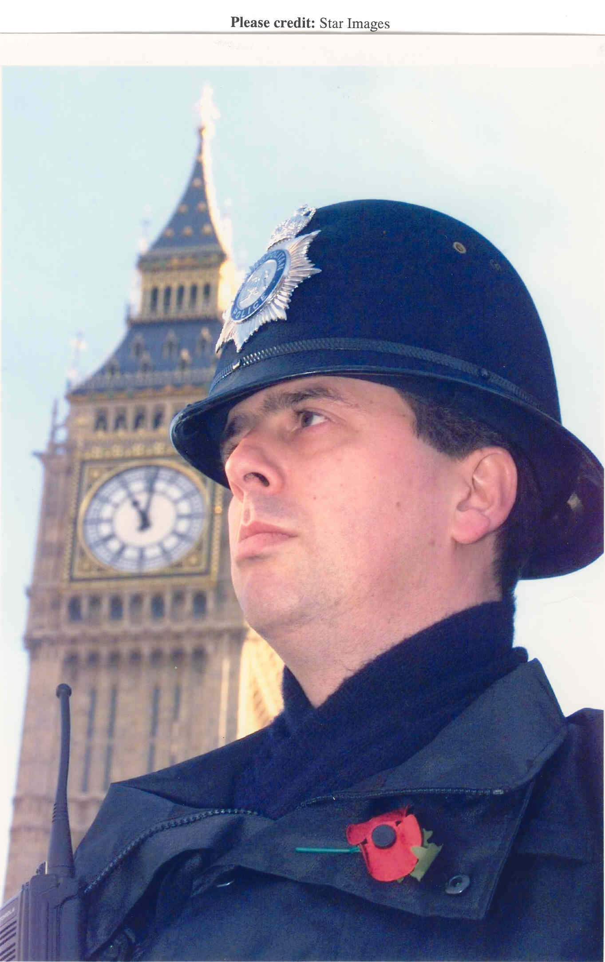
So, what is a crime? Write your own definition on your worksheet
Breaks a written law of society.
Can be punished by the Police and Law Courts.
For example, drink driving.

Slide 14
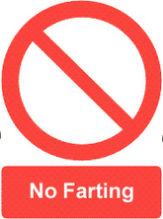
What is deviance? Which actions have you said are unacceptable? Add your own definition to your worksheet
Break the ‘norms’ of society.
Acts that are ‘not the done thing.’
Deviant acts are the actions that we frown upon and believe to be ‘unacceptable.’
For example, farting really loudly in assembly.

Slide 15

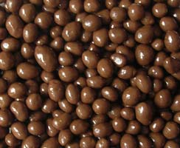
Barred from Sainsbury’s for stealing a sweet!
A Mum has been banned from Sainsbury's for life after taking a chocolate nut from a pick and mix display and eating it as she shopped at her local store.
Garden centre manager Penny Beckett popped the chocolate into her mouth before taking a selection of sweets which she paid for along with a pounds 156 bill for the rest of her shopping.
But when mother-of-one Penny - who spends around £9,000 at the store each year - went to leave she was stopped by three security guards. They showed her CCTV footage of how she ate the nut - and then handed her a letter telling her that she was banned from the supermarket's 727 UK stores for life. Last night Penny, 37, said: "I find it disgusting and I'm very angry. I want Sainsbury's to know how stupid the system is. I have been shopping at Sainsbury's for 22 years and spend a lot of money there. I do shopping for my home there and also buy loads of stuff for my work colleagues.

Slide 16
Not all crimes are considered deviant acts. Why is okay to break some laws and not others? Explain your answer on the worksheet.
You have 5 mins
Loads of people do it, so it’s ok E.g. Speeding on Motorway
It’s not harming anyone is it? E.g. Streaking at a football match
It’s not like you’ll get caught. E.g. Stealing Pick n Mix
It doesn’t really cost anyone anything/much. E.g. ‘Borrowing’ £10 without asking.

Slide 17
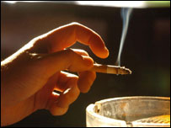
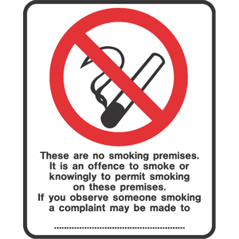
Learning Objective No.3:
To understand how crime & deviance are related to time & place.

Slide 18
Where & when acts take place can change whether it’s considered a crime or deviant act.
Take smoking for example. In the past smoking was seen as a good thing to do.
It wasn’t a crime to smoke anywhere and it wasn’t thought of as a deviant act.
Look at the following adverts promoting smoking, they certainly weren’t trying to put people off the act of smoking or saying that it is frowned upon by the public.

Slide 19
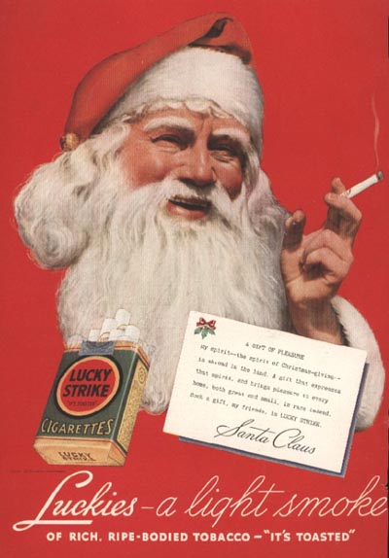

Slide 20
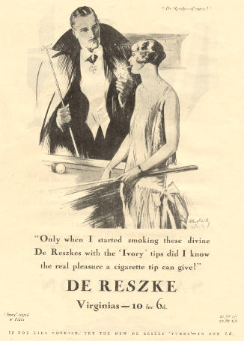

Slide 21
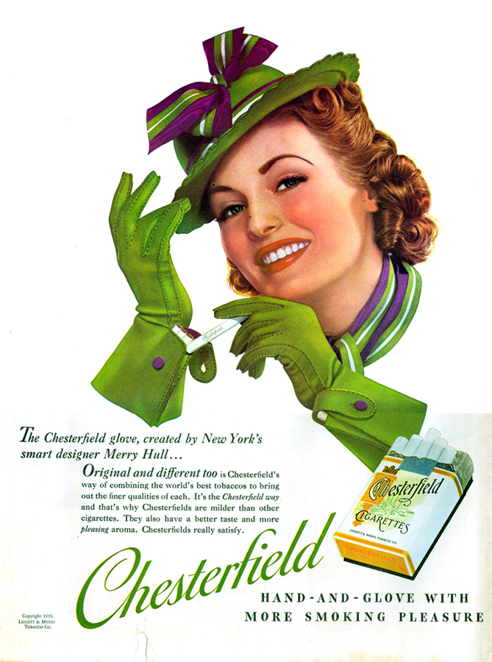

Slide 22
It’s a very different situation now.
Firstly smoking is slowly becoming an illegal, criminal act in certain places and situations.
Secondly, smoking is being considered more and more deviant. Non-smokers are a lot more vocal about their dislike for smokers and people are discouraged from smoking in public places.
So time & place have changed the deviancy of smoking.

Slide 23




Here a just a few of
the signs that are
beginning to appear
in public and work places.

Slide 24
To understand how crime & deviance are related to time & place.
Task:
Can you think of any other actions that have become more deviant or less deviant over the years, or actions that are deviant in some situations but not deviant if done elsewhere?
You have 5 mins

Slide 25
Deviancy related to time & place?
Nudity- okay in private not in public.
Drinking alcohol- okay if you’re over 18 or at certain times of the day- not at 7:00 AM!
Drink driving- used to be okay, not now.
Shooting someone- normally not okay but okay during combat.

Slide 26
Learning Objective No.4:
To examine the ways in which deviancy can be created.
Now that we’ve seen how deviancy can change depending on when & where the actions take place, we will examine how non-deviant acts become deviant.

Slide 27
Making an action illegal doesn’t always make the action deviant. So, how do actions become deviant?
Why is smoking more deviant than ever?
Think about what we said about some crimes not being deviant, how does society make a crime a deviant act too?

Slide 28
Society Creating Deviancy Smoking has become a deviant act because…
You have 5 mins
We are more aware of the harm it does.
There are more victims of smoking related diseases & illnesses.
People are more aware of the chances of being caught- smoking is a punishable offence in some places now.
Passive smoking is now a big concern so everyone has become a victim.

Slide 29
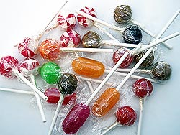

Homework Objective: To examine the ways in which deviancy can be created.
After many serious Pick n Mix crimes Sainsbury’s has decided to start an advertising campaign encouraging people not to steal Pick n Mix.
Basically, although stealing Pick n Mix is a crime Sainsbury’s feel that it is not considered deviant by most shoppers. They have employed you to design the advert that will be displayed around all of their stores. They hope to make stealing Pick n Mix a deviant act that people feel is wrong.
Your Homework is to design that advert. Think about… How will you put people off from stealing Pick n Mix? How will you make it ‘not the done thing?’

Slide 30
Learning Outcomes: What have we learned today?
Do you understand what sociologists mean by crime & deviance?
Have we identified why some crimes are not deviant?
Do you understand how crime & deviance are related to time & place?
Have we examined the ways in which deviancy can be created?

