Slide 1

Mr Howard wants to know how students at his school feel about interactions with their teachers.
He knows that you study sociology and has asked your advice about this important piece of social research.

Slide 2
Mr Howard is a very busy man and has decided that he does not have the time, or money to ask every single pupil in the school
He needs a SAMPLE
His first idea, is to nip up to the library and quickly ask the students who are in there
Is this a good idea? Why?

Slide 3
Learning Objectives
Explain key concepts of sampling: research population, sample, sampling frame, representativeness and different sampling techniques: random, systematic, stratified random, snowball (C)
Evaluate different sampling techniques (identify strengths and limitations) (B)
Apply knowledge by writing a research proposal (A)

Slide 4
Sampling
Key concept | Definition | Example in this context
Research population
Sample
Sampling frame
Representativeness
Random
Systematic
Stratified random
Quota
Snowball

Slide 5
Knowledge and Understanding (AO1)
Key concept | Definition | Example in this context
Research population | The wider group that the research findings will apply to | All the pupils from a school
Sample | The group chosen to study, who in most cases will represent the research population | The pupils selected to be part of the research
Sampling frame | The list from which the sample is picked | Register
Representativeness | If the sample has the same characteristics in the same proportions to the research population, generalisations can be made | If the sample has the same characteristics as the rest of the school, eg in terms of sex, year group, ability, social class, ethnicity etc
Random | Everyone on the sampling frame has an equal chance of being picked | School registers used in a random name generator/names out of a hat
Systematic | Every nth name from the sampling frame | Picks every nth name from the school register
Stratified random | Sampling frame is divided into sub-groups from which participants are then randomly picked | Register divided into strata eg sex, ability etc and then participants picked randomly from these sub-groups
Quota | Researcher has a list of people with certain characteristics | Eg finding first/most convenient five girls and boys in each year group
Snowball | Sample grows through recommendation | Find one eligible participant, ask them to recommend another

Slide 6

Decide your starting point
Not many correct | Some correct or want to start independently | Most correct
I’d like this explaining to me Teacher explains | I’m pretty sure I understand but want to brush up on a few things Jelly Babies activity | I’ve got it Look up anything that wasn’t correct Exam questions Research proposal

Slide 7
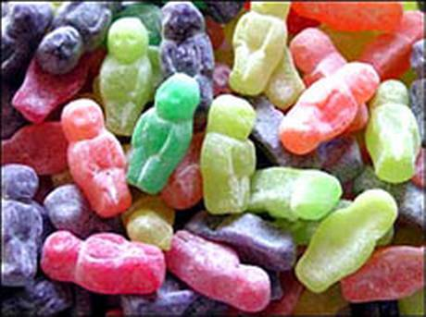
Jelly Babies sampling
Represent each sampling technique using jelly babies.
C – explain
B – strengths & limitations
Annotate with board pens.
Take pictures for own records.

Slide 8
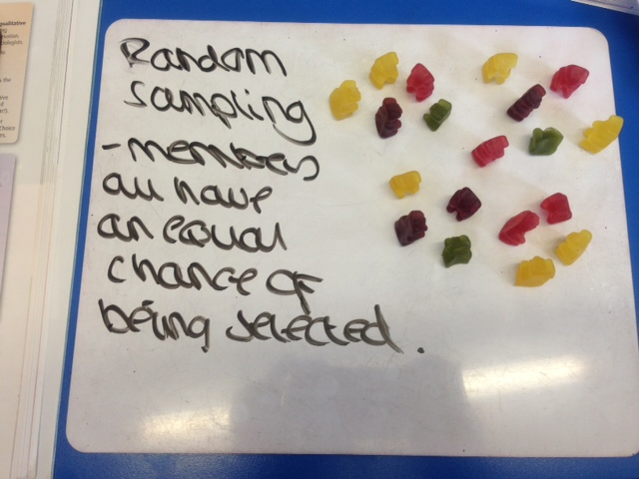

Slide 9
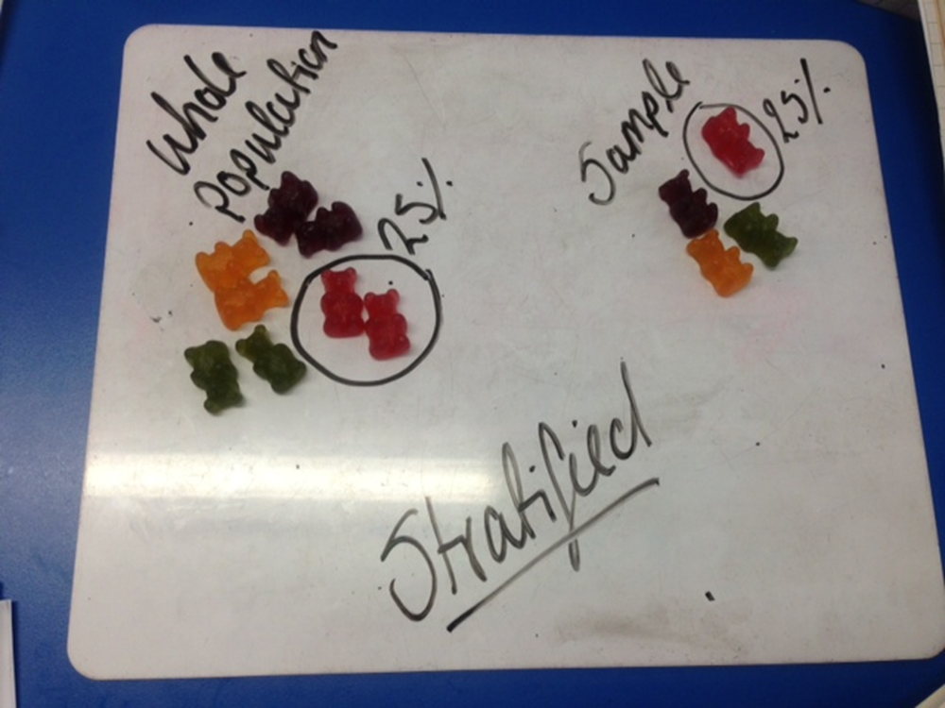

Slide 10
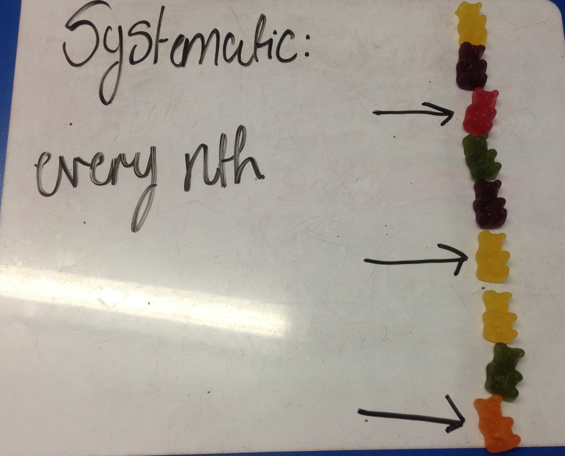

Slide 11
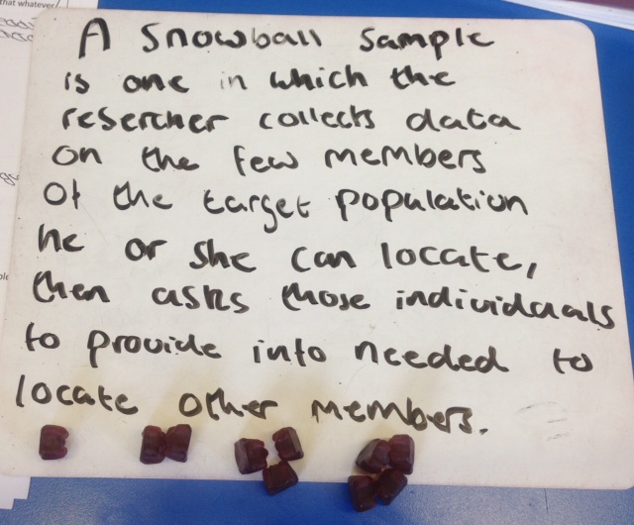

Slide 12
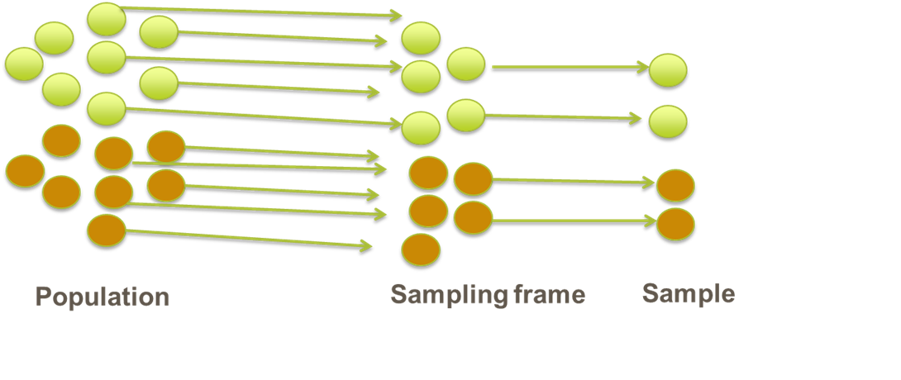

Slide 13
Research population
Sample
The people who we want our research to apply to
Every pupil at HGSC
The term “sampling frame” is used to describe the list of people who make up the research population
The smaller, sub-group who we actually research

Slide 14
Representativeness

Slide 15
Different ways to select a sample:
Random
Systematic
Stratified
Quota
Snowball
Find out what these terms mean – move on to the jelly babies!

Slide 16
Which sampling method has Mr Howard used?
MWB plenary

Slide 17
Which sampling method has Mr Howard used?
He prints out all of the school registers, cuts them up so that each name is on a separate piece of paper. He puts them all in a huge hat, and picks out names with his eyes closed.

Slide 18
Which sampling method has Mr Howard used?
Mrs Reynolds gives Mr Howard a list. It tells him to find five girls and boys in each year group.

Slide 19
Which sampling method has Mr Howard used?
Mr Howard prints out all the names on the school register.
He divides the names into sub-groups, e.g. sex and year group
And then picks at random from these sub-groups
E.g. randomly selects five girls and boys in each year group

Slide 20
Which sampling method has Mr Howard used?
Mr Howard finds a student who he think will be useful for his research.
He then asks this student to recommend other students who would be good to interview.

Slide 21
Which sampling method has Mr Howard used?
Mr Howard prints out all of the school registers
And selects every 10th name until he has selected 20 students

Slide 22
Exam Qs SCLY2
Identify two sampling techniques used by sociologists in their research. (4 marks)
Explain the difference between a sampling frame and a sample. (4 marks)
Identify two forms of stratification that a sociologist may use when constructing a stratified random sample. (4)

