Slide 1



Sampling and Questionnaires

Slide 2
Starter
Recap the following on your mini- whiteboards:
What is Secondary data?
What is Primary data?
Name three examples of official statistics
Name two advantages of qualitative secondary data
Name two disadvantages of quantitative secondary data
What is a content analysis?
What is Backwards PERVERT?

Slide 3

Learning objectives
Describe the key sampling methods
Apply the different types of questionnaires
Evaluate the strengths and limitations of questionnaires

Slide 4

Sampling
Sociologists rarely have time or funds to question everyone on a large scale, therefore collect information from a smaller group known as the sample (however, in some cases it is possible to question every member for example the government surveys entire population of UK in the census every 10 years)
Survey population
Representative sample
Sampling frame
Sampling methods

Slide 5
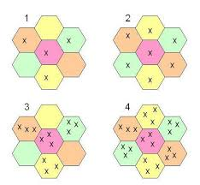
Types of sampling
In groups, use your previous knowledge:
Name as many types of sampling methods as you can
Briefly explain - examples can be used

Slide 6
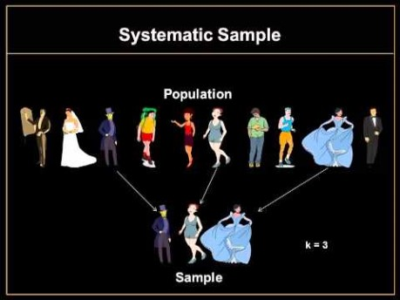

Slide 7

Advantages and Disadvantages
Complete the table

Slide 8

Questionnaires
Consider the following:
What are questionnaires?
Do we have different types? Expand
Why would you use a questionnaire?
Which theory would prefer questionnaires and why?

Slide 9


Design
What would you need to think about when designing a questionnaire?
Draw up a five question questionnaire on the attitudes to education (or another sociological topic you have covered)
Test this on 5 different people in the class (not on your table)
Identify any difficulties that you came across
Amend questions where necessary

Slide 10
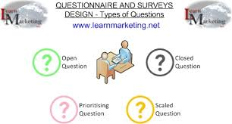
Types of questionnaire
Three types:
Pre-coded or closed questionnaires
Open – ended or open questionnaires
Postal/Mail or online self-completion questionnaires
In groups briefly note down key characteristics of the above types of questionnaires using examples where possible.

Slide 11

Advantages and disadvantages
List as many advantages and disadvantages of pre-coded or closed questionnaires
List as many advantages and disadvantages of open - ended or open questionnaires
List as many advantages and disadvantages of Postal/Mail or online self-completion questionnaires

Slide 12
Validity of questionnaire research
What would an interpretivists view be on questionnaires? – explain your answer
Imposition
Validity

