Slide 1

Five a day:
Name two types of data used by sociologists.
Which type of data is presented as numbers?
Which type of data is presented in written form?
Which group of sociologists believe society can be studied scientifically?
Which group of sociologists do not believe the above?

Slide 2
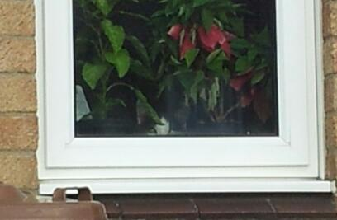
Cwk
How do sociologists collect samples?
Today you will know:
The different ways that sociologists collect their data.
AO1 – demonstrate knowledge and understanding of sociological theories, concepts, evidence and methods.
AO2 – apply knowledge and understanding of sociological theories, concepts, evidence and methods.
AO3 – analyse and evaluate sociological theories, concepts, evidence and methods for each component, make judgements and draw conclusions.

Slide 3
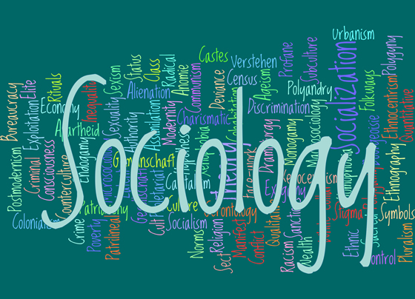
Why do sociologists use samples?
Sociologists aim to study certain groups, which may mean everyone in Britain, but often they may target particular age, gender, social class, religion or ethnic groups. The group they wish to study are the target population.
Samples are a way of finding out about the target population, by studying a small manageable number of the group.
Write the words in purple and their definitions into your books and highlight them.

Slide 4

What do sociologists mean by representativeness?
Samples need to be fair in order to work. For it to be fair the sample should represent the whole target population. This means that the make up of the sample should reflect the make up of the population, for example the proportions of male and female. If the sample includes to many females it will be difficult to generalize from the findings. Generalizations are general statements and conclusions that apply to the whole population, not just the sample.
Write the words in purple and their definitions into your books and highlight them.

Slide 5
What kinds of samples are there?
Getting access to a sample may require permission and some groups are hard to read. A sampling frame is the list where you sample is selected from. The telephone directory or electoral (voting) register are examples of this. They are not perfect as some people will not be listed on these.
Some examples of different types of sample are:
Random sample
Systematic sample
Quota sampling
Stratified sampling
Snowballing
Opportunity or convenience sample

Slide 6
Working out the target population
You are going to work out the target population using skittles! Then we are going to use the skittles to illustrate the different sampling methods.
Draw the table into your book.
Tip all the sweets out of the cup and record how many of each colour there are in the table below.
Count up how many sweets there in total.
Work out the percentage no. of each colour, e.g. divide the number of red ones by the total no. of sweets and then multiply by 100.
Colour | Number | %

Slide 7
Random samples
The ideal kind of sample is seen as a random sample. Random samples are selected by chance using names out of a hat or computer-generated lists. To be random every person in the target population must have an equal chance of being selected.
Copy the table below into your books.
Pick out 20 sweets at random one at a time and record how many of each you get in the table.
Colour | Number

Slide 8
Systematic samples
If a random sample is not possible, systematic samples are a good alternative. If your school was the target population, the school roll would be the sampling frame. Systematic sampling could mean taking every tenth name on the list for example.
Draw the table below into your books.
Line up all the skittles.
Select every fifth skittle.
Record your results in the table
Colour | Number

Slide 9
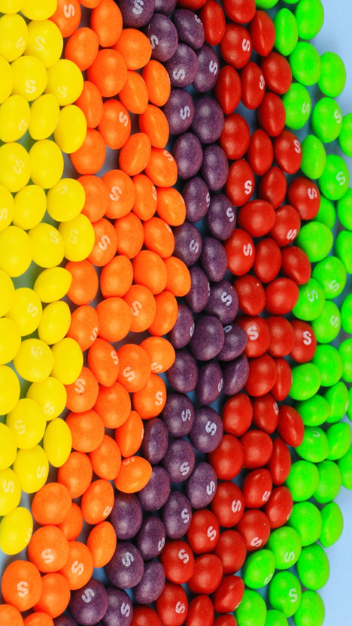
Quota sampling
Quota sampling is when the researcher makes sure that they ask a certain number of different sorts of people. The researcher checks the person they are interviewing is the correct age, gender, etc.
Group your skittles by colour.
Decide on your quota (how many of each other you want).
Pick the first skittles that you see of that colour.

Slide 10
Stratified sampling
This one is a little more difficult… You need to create a sample of 25 sweets that is similar to the target population in the percentage of each colour.
So… If you have 25% of red sweets in your target population, you need 25% red sweets in your sample. How???
25% of 25 = (25 ÷ 100) x 25 = 6.25. Therefore you will need 6 sweets to show 25% of the sample.
Colour | % in target population | Number of sweets needed for sample

Slide 11
Snowball, opportunity or convenience sampling
Snowballing is very useful for outsider groups, such as criminals. The researcher uses one contact to introduce them to a second contact and so on.
Finally, even less random is the sampling method often used by students. An opportunity or convenience sample is used, which means anyone who is available and willing to take part.
As you eat the skittles please answer the question below in your books:
What type of sampling method would be best suited to studying the following? Give reasons for your choice.
Students being bullied at a secondary school
Homeless people
People who use public transport
Heroin addicts
People who do graffiti

Slide 12
Heading
Information, key names, new key words, old key words
Table heading | Table heading | Table heading
Text | Text | Text
Instruction
Challenge
Source
Interpretation
Exam question

Slide 13
Heading
Information, key names, new key words, old key words
Table heading | Table heading | Table heading
Text | Text | Text
Instruction
Challenge
Source
Interpretation
Exam question

Slide 14
Heading
Information, key names, new key words, old key words
Table heading | Table heading | Table heading
Text | Text | Text
Instruction
Challenge
Source
Interpretation
Exam question

