Slide 1
The Stanford Prison Experiment
Haney, Banks & Zimbardo (1973)

Slide 2
Aim
Zimbardo et al aimed to show that situational (environmental) rather than dispositional factors (personality) caused negative behaviour and thoughts patterns found in prisons by conducting a prison simulation with ‘normal’ participants playing the roles of guard and prisoner.

Slide 3
Procedure
Participants answered newspaper adverts. From 75 volunteers, 24 were selected. They were judged to be emotionally stable and physically healthy They also had no history of psychiatric problems and had never been in trouble with the police. They were all white, middle class students from across US, who were strangers to each other and were randomly allocated to either prisoner or guard roles. Prisoners signed a consent document which specified that some of their human rights would be suspended and al participants were to receive $15 a day for up to two weeks.

Slide 4
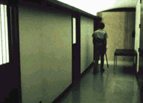
Procedure
Zimbardo converted a basement corridor in Stanford University Psychology department in to a set of prison cells with a solitary confinement room, a ‘yard’ and an observation screen (through which covert video and audiotape data recoding could take place).

Slide 5
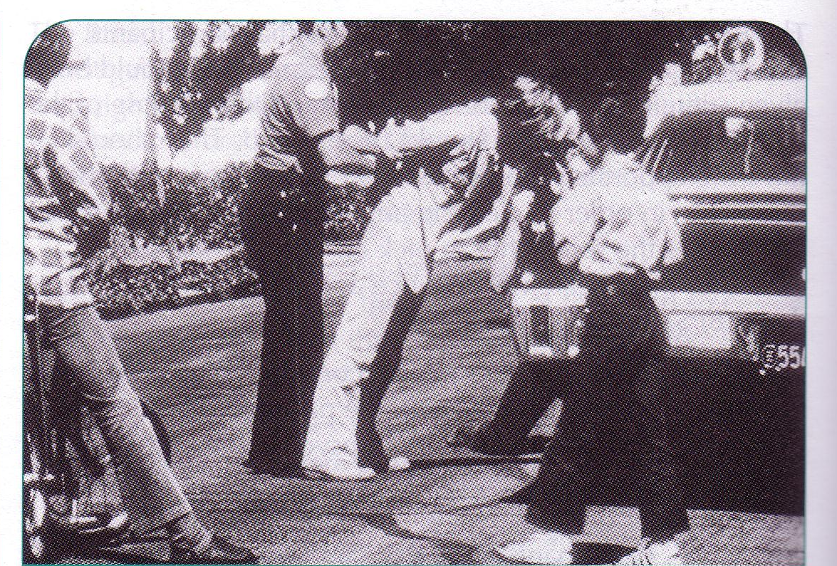
Procedure
Those allocated to the prisoner role were arrested by the local police outside their houses by surprise. They were charged with a felony, read their rights, searched, handcuffed and taken to a real police station for finger printing and processing. They were then taken blindfold to the basement prison. On arrival they were stripped naked and issued with a loose fitting smock, no underwear.

Slide 6
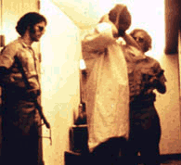
Procedure
Their ID number was printed on the front and back and they had a chain bolted around one ankle. They wore a nylon stocking to cover their hair, were referred to by number only and were allocated to a cell, three to a cell. Prisoners remained in the prison 24 hours a day and followed a schedule of work assignments, rest periods and meal/ toilet visits.

Slide 7
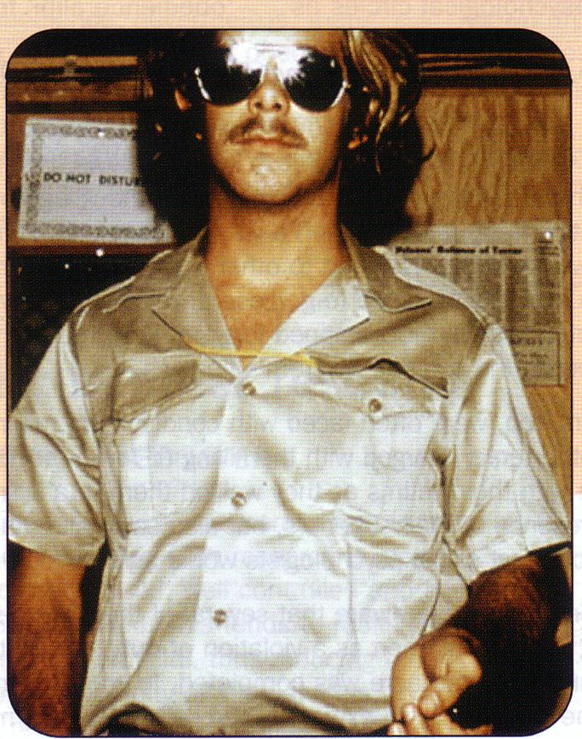
Procedure
The guards wore military style khaki uniforms and silver reflector sunglasses (making eye contact impossible). They carried clubs, whistles, handcuffs and keys to the cells. There were guards on duty 24 hours a day, each working 8 hour shifts. They had complete control over the prisoners but were given no specific instructions apart from to maintain a reasonable degree of order within the prison and were told not to use physical violence.

Slide 8
Findings
An initial ‘rebellion’ by the prisoners was crushed. After this, they began to react passively as the guards stepped up their aggression. They began to feel helpless and no longer in control of their lives.
Every guard at some time or another behaved in an abusive, authoritarian way. Many seemed to really enjoy the new found power and control that went with the uniform. They woke prisoners in the night and got them to clean the toilet with their bare hands. All prisoners’ rights were redefined as privileges (going to the toilet, eating and wearing eye-glasses became rewards), and punishment with little or no justification was applied with verbal insults. Some volunteered to do extra hours without pay. The participants appeared to forget that they were only acting. Even when they were unaware of being watched they played their roles.

Slide 9
Findings
After less than 36 hours, one prisoner had to be released because of controlled crying, fits of rage, disorganised thinking and severe depression. Three others developed the same symptoms and were released on successive days. Another prisoner developed a rash over his whole body. They became demoralised and apathetic and started to refer to themselves (and others) by their numbers.
Zimbardo et al. intended the experiment to run for two weeks. But it was abandoned after just six days because of the prisoners’ pathological reactions.
Full debriefing and assessment of participants took place, weeks, months and years afterwards.

Slide 10
Conclusions
This experiment shows that situational factors, not dispositional ones (personality) are more important in shaping behaving.
This means we all are capable of acting out of character when placed in certain situations.

Slide 11
Evaluation
This study has been fiercely criticised for its ethics and validity.
Are these criticisms justified?
Complete the evaluation exercise and decide for yourself.
How would you have acted?

