Slide 1
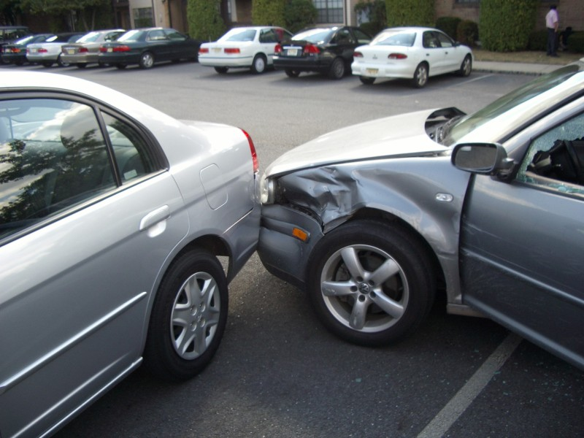
Loftus & Palmer (1974) -
Aim: - To see the effect of leading questions on Eye Witness Testimony

Slide 2
Procedure
A laboratory experiment. Three groups of students, after watching a film of a car crash were asked questions (an independent measures design): -
The first group were asked – “How fast were the cars going when they hit each other?”
For the other group the words: - smashed into each other were substituted.
A control group were not asked about speed.
A week later they were re-interviewed and asked: - “Did you see any broken glass?”

Slide 3
Results
The smashed group’s average estimated speed was 41mph
The hit group’s average estimated speed was 34mph
Although there was no broken glass at the scene 32% of the participants who heard the word smashed said there was, compared to only 14% of the hit group and only 12% of the control group.

Slide 4
Conclusion
These words have very different connotations regarding speed and force of impact. The word smashed tends to imply broken glass and it is feasible to expect broken glass at a car accident. The participants had unconsciously incorporated these connotations into their memory of the event and it had affected their judgement of speed and memory of the scene.

Slide 5
Evaluation
Strengths | Weaknesses
Classic Study Controlled Experiment Real Life implications for EWT Reliability | Lacks Ecological Validity (Not real Life) Demand Characteristics Ethics – some Ps may have found the experience distressing Loftus’s Ps were students and therefore may not be a representative sample

