Slide 1
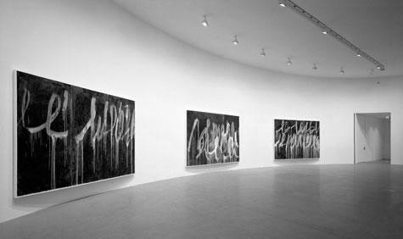
Exit
Chris
Livesey
Visualising Class Structures

Slide 2
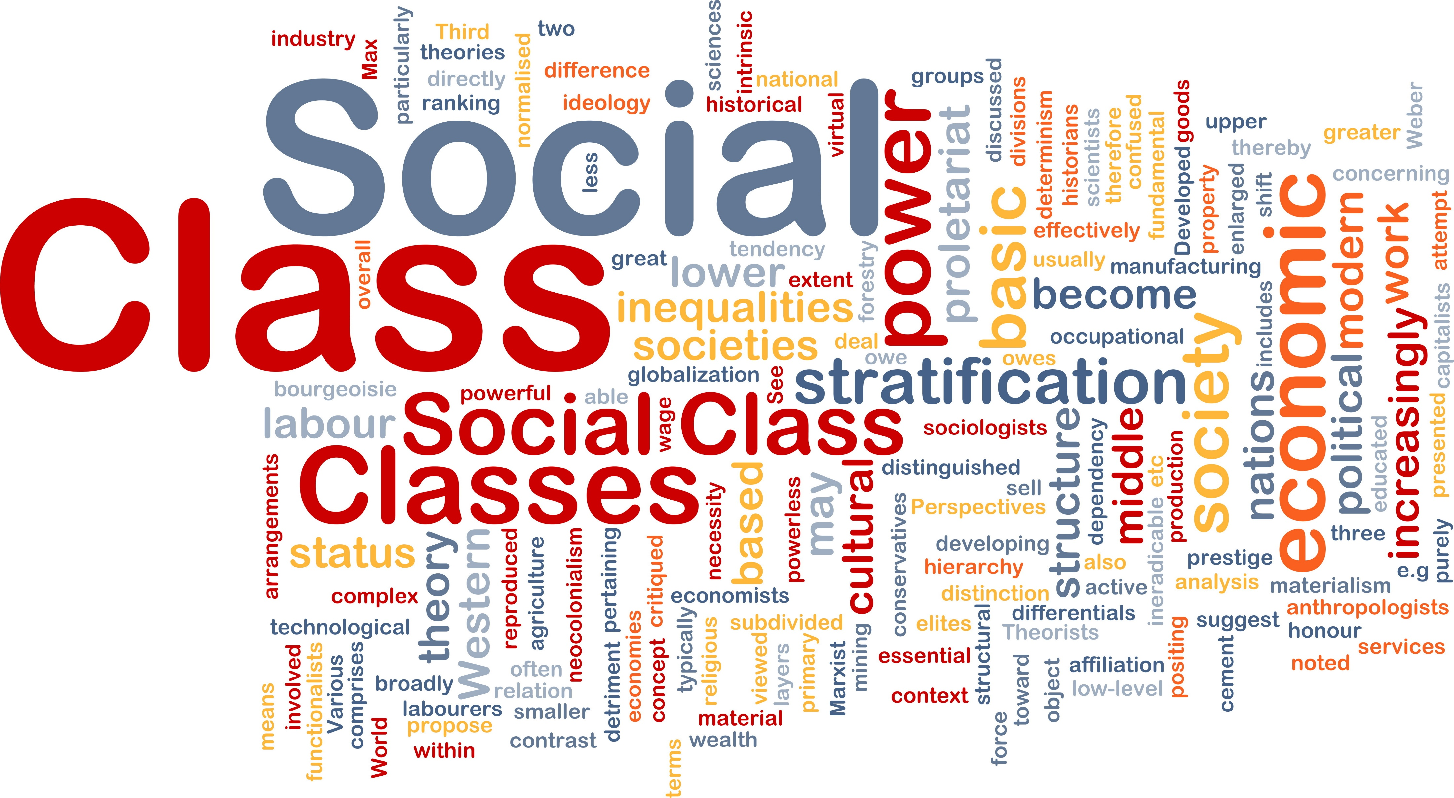
The Pyramid
NS-SEC
The Pentagon
Alternative Pentagon
Embourgeoisement
Relational
Flatlining
40:30:30
The Precariat
Polarised Convergence
End

Slide 3
The Pyramid
NS-SEC
The Pentagon
Alternative Pentagon
Embourgeoisement
Relational
Flatlining
40:30:30
The Precariat
Polarised Convergence
End
Upper
Middle
Lower
The Pyramid
Notes:
The Pyramid
Class refers to classifying people on the basis of something they have in common; this conventionally involves using occupation to group people based on what they do or produce (hence the idea of production classes).
Structure refers to how each class relates to other classes. Conventionally this has involved ranking classes - usually upper, middle and lower - hierarchically.
For most of the 20th century the class structure has normally been portrayed as a pyramid, larger at the base (the lower class) and smaller at the apex (the upper class) to reflect both the numbers in each class and that those nearest the top own and control greater social resources.
This pyramid shaped class structure relates to an industrial society, one where manufacturing industries, such as coal-mining, shipbuilding and car production, dominated the economic landscape.
Occupation-based but occupations may be allocated to different class categories on basis of:
Manual – Non-manual distinction
Social status of different occupations

Slide 4
5 classes
8 classes
3 classes
1. Managerial and professional
2. Intermediate
3. . Small employers /
self-employed
4. Lower supervisory and technical
5. Semi-routine and routine
1. Large employers, managers, professionals
2. Lower managers, professionals
3. Intermediate (service)
4. Small employers, self-employed
5. Lower supervisory and technical
6. Semi-routine
7. Routine occupations
8. Never worked /
long-term unemployed
1. Managerial and professional
2. Intermediate
3. Routine and manual
The Pyramid
NS-SEC
The Pentagon
Alternative Pentagon
Embourgeoisement
Relational
Flatlining
40:30:30
The Precariat
Polarised Convergence
End
Labour market situation
Weberian
Work situation
NS-SEC
Notes:
Socio-Economic Classification (NS-SEC)
This has three versions – the main scale divides occupations into 8 general categories and this can be collapsed into 5 class and 3 class models for statistical continuity / comparisons.
Official UK government classification - useful because official statistical data about social inequality (such as income or educational achievement) can be consistently related to these categories.
Rose et al. (2005): classification measures ‘employment relationships’ and reflects a Weberian approach to classification by combining two ideas:
1. Labour market situation: assessments for each occupational group of income levels, relative levels of work security and promotion/career development prospects.
2. Work situations: ideas about different levels of power, authority and control within the workplace.

Slide 5
The Pentagon
The Pyramid
NS-SEC
The Pentagon
Alternative Pentagon
Embourgeoisement
Relational
Flatlining
40:30:30
The Precariat
Polarised Convergence
End
Upper
Post-industrial society
Upper Middle
Managerial revolution
Lower Middle
Weberian
Lower
Globalisation
Notes:
The Pentagon
Based on concept of post-industrial society characterised by the domination of (non-manual) service industries and long-term decline in manual industries
From a Weberian perspective the class structure has evolved into a pentagonal shape; a relatively small upper class with an expanded middle class slowly tapering towards a declining lower class.
Upper levels
This level has seen a decline in number, mainly because of a greater diversity of ownership through wider shareholding.
Blurring of ownership and control has occurred because of the rise of the joint stock company –businesses owned by shareholders rather than single all-powerful individuals.
The spread of ownership fragments the upper class because ownership now extends across the class structure in two ways:
1. Massive pension funds that invest the pension payments of large numbers of workers
2. The expansion of middle-class managers and professionals who increasingly own part of the company for which they work.
“Managerial revolution“: class structure was changing because of the expansion of the middle classes.
Globalisation: replacement of organisations based around mass production (pyramid class structure) with network structures operating across national boundaries and maintaining a fluid organisational structure that makes them responsive to new technological developments and economic opportunities.
These organisations have multiple shareholders (mainly financial institutions’, such as banks and pension funds) but rarely individual owners.
Middle levels
Service / knowledge economy and expansion of middle-ranking occupations.
Class fragmentation: Relative growth at the expense of both the working and upper classes.
Increase in higher-level (well-paid, high-status) service work associated with the ‘knowledge economy’
Expansion of routine service work (such as call centres) that is little different to the routine types of manual work it has replaced.
At one extreme ‘super-rich elite middle class’.
At the other, a range of low-level, routine occupational positions that, although defined as middle class, are difficult to distinguish from their working-class counterparts in terms of income, status and general life chances.
Lower levels
Manufacturing decline and progressive decline in "traditional working class employment“.
Some movement into “proletarianised” service work

Slide 6
Alternative Pentagon
The Pyramid
NS-SEC
The Pentagon
Alternative Pentagon
Embourgeoisement
Relational
Flatlining
40:30:30
The Precariat
Polarised Convergence
End
Upper
Marxist
Middle
New technology
Lower
Deskilling
Proletarianisation
Notes:
Alternative Pentagon
Marxist interpretation where broad shape of the class structure stays the same but distinction between manual (lower class) and non-manual (middle class) work has broken down.
Proletarianisation of workforce involves idea many ‘middle-class occupations’ are no longer distinguishable from ‘working class occupations’ in terms of pay and conditions.
Introduction of new technology into the workplace has created two distinct processes:
1. Routinisation: A growth in routine service jobs that, although traditionally defined as non-manual and middle class, are little more than the low-skill, low-status, low pay work.
2. Deskilling: Many types of skilled employment - whether at the lower levels of the old middle class (book-keeping, secretarial work and so forth) or the upper levels of the lower class (such as skilled craft workers) - have been deskilled because the work to which these skills once applied can be performed more easily and cheaply by machines (automation) or with machinery that only requires lower-skill operators (mechanisation)
More-recently while computer / information technology has started to remove traditional low-skill, low-pay, working-class employment it is now starting to move into traditional middle-class forms of higher-skill, higher-pay employment (from routine clerical work to various forms of knowledge-work – law, education, medicine etc.).

Slide 7
Embourgeoisement
The Pyramid
NS-SEC
The Pentagon
Alternative Pentagon
Embourgeoisement
Relational
Flatlining
40:30:30
The Precariat
Polarised Convergence
End
Upper
Embourgeoisement
Middle
Reskilling
Service Economy
Lower
Notes:
Embourgeoisement
Alternative interpretation of these economic transformations
Zweig (1961), for example, argued the class structure was becoming increasingly middle class as the working classes took on similar income, status and lifestyle characteristics to their middle class counterparts.
Goldthorpe et al (1968) suggested a ‘new form of working class’ was emerging; one where affluent, home-centred (privatised) workers displayed different lifestyles to their less affluent, working-class peers.
More recently embourgeoisement revived in a more sophisticated form, focused around reskilling - the idea contemporary service and knowledge economies need workers with different skills to those required in the past. Where the children of manual workers would once have also gone into manual work they now enter the service economy at a variety of points – most at the low level of physical services (shop workers, for example), others in the higher level of knowledge services.
Suggests a contraction of the working class and an expansion of the middle class to produce a diamond-shaped class structure.

Slide 8
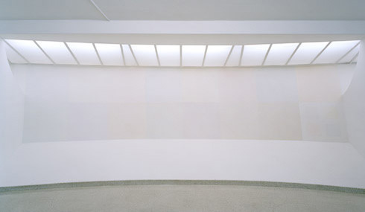
Relational
The Pyramid
NS-SEC
The Pentagon
Alternative Pentagon
Embourgeoisement
Relational
Flatlining
40:30:30
The Precariat
Polarised Convergence
End
Capitalist
Labour
Higher middle
Lower middle
 | Class Position Criteria
Class | Own Means of Production | Buy labour of others | Control over others | Sell own labour
Capitalist | √ | √ | √ | x
Higher Middle Class | x | x | √ | √
Lower Middle Class | √ | x | x | x
Labour | x | x | x | √
Neo-Marxism | Globalisation | Forms of Capital | Overlapping class relationships
Notes:
Relational Structures
Most class structure representations are hierarchical – different classes ranked in various ways.
Wright and Perrone (1977) argue for non-hierarchical, non-occupational four-class model based on social relations to production.
Individual positions in the class structure are based on ownership and control of the means of production, and the most important variable is represented by the social relationships that surround the production process (the major class groupings – whether you buy, control or sell labour, for example), with actual occupation being a relatively subsidiary category.
Neo-Marxists argue capitalism has undergone major developments, such as globalisation.
Wright and Perrone (1977) suggest the growth of not just a "third (or middle) class" but of two distinct "middle classes" consisting of intellectuals, knowledge workers, professionals and managers at the higher levels and the self employed / small shopkeepers at the lower complicates the general class picture.
Now more difficult to link economic differences directly to class inequalities.
Need, therefore, to think in terms of additional forms of capital - cultural and social.
Relational approach blurs class boundaries and makes each class less rigidly defined. Eg. some members of the working-class, (such as routine supervisors) although sharing things like poor working conditions, lower pay and so forth, can be included in the Capitalist, Higher Middle or Lower Middle class because of their supervisory role. In other words, class position is not a feature of what you do (occupational class) but your relationship to others in the production process (relational class).
Produces a broadly “flat” class structure with hierarchical elements.

Slide 9
The Pyramid
NS-SEC
The Pentagon
Alternative Pentagon
Embourgeoisement
Relational
Flatlining
40:30:30
The Precariat
Polarised Convergence
End
postmodern
redundancy
consumption
Decentred
identities
Flatlining
Notes:
Flatlining
Associated with postmodern writers like Waters (1997)
Social class, defined in terms of economic production, has lost meaning.
Arguments over ‘how and why’ a "class structure" has changed largely redundant because “traditional proletariat” has disappeared.
Social divisions based around consumption as a source of identity rather than occupation.
"Class" no-longer has a privileged position in either sociological analysis or peoples' lives.
Decentred identities
Class structures can’t be conceived in objective terms; class is an inherently subjective concept that means different things to different people at different times and in different situations.

Slide 10
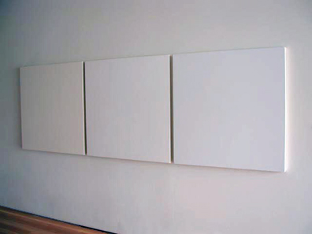
The Pyramid
NS-SEC
The Pentagon
Alternative Pentagon
Embourgeoisement
Relational
Flatlining
40:30:30
The Precariat
Polarised Convergence
End
40:
30:
30
Dual labour markets
The Advantaged
Primary (The Advantaged)
Secondary
(Insecure / Disadvantaged))
The Newly-Insecure
Long-term labour market changes
The Disadvantaged
Notes:
40:30:30
Hutton (1995) uses dual labour market theory to develop occupational model based on ‘deep, long-lasting and profound changes’ in the economic and class structure.
Primary labour markets – secure, well-paid, long-term jobs
Secondary labour markets – mix of casualised work, zero-hours contracts
The Advantaged: Top 40%
Full-time / self-employed - held their job for 2 years
Part-time workers - held their job for 5 years
Strong / effective Unions or Professional Associations
Range of work-related benefits
Mainly male workers
Newly-Insecure: Intermediate 30%
Part-time / casual workers
Declining employment protections / few benefits
Large numbers of female workers
Fixed-term contract workers
The Disadvantaged: Bottom 30%
Unemployed (especially long-term)
Families caught in poverty trap (e.g. lone parents)
Zero-hours contract workers
People on government employment schemes
Casual part-time workers

Slide 11
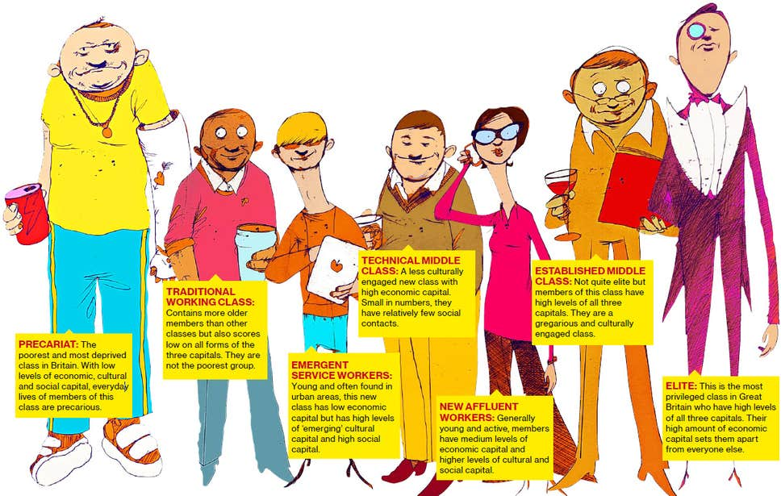
The Precariat
The Pyramid
NS-SEC
The Pentagon
Alternative Pentagon
Embourgeoisement
Relational
Flatlining
40:30:30
The Precariat
Polarised Convergence
End
Notes:
The Independent
“Britain now has 7 social classes - and working class is a dwindling breed” (2013)
“Following a BBC survey of more than 160,000 people, academics established that Britons can no longer be boxed in to the traditional “upper”, “middle” and “working” classes.
Instead, you could be a home-owning “elite” with highbrow cultural interests and savings of £140,000. Their “sheer economic advantage” sets them apart from the other classes, according to Professor Mike Savage of the LSE, and they make up just six per cent of the population.
The findings, presented at a British Sociological Association convention, show that at the very bottom lies the “precariat”. Typically shopkeepers, drivers and cleaners, they represent 15 per cent of people in the UK and lack “any significant amount of economic, cultural or social capital”.
The categories in between are: established middle class; technical middle class; new affluent workers, traditional working class and emergent service workers.
The results were obtained by analysing people’s income, assets, the professions of their peer group and their social activities. Professor Fiona Devine, of the University of Manchester, said: “There’s a much more fuzzy area between the traditional working class and traditional middle class.”
The social classes
Precariat: This is the most deprived class of all with low levels of economic, cultural and social capital. The every day lives of members of this class are precarious.
Traditional Working Class: This class scores low on all forms of the three capitals although they are not the poorest group. The average age of this class is older than the others.
Emergent Service Workers: This new class has low economic capital but has high levels of 'emerging' cultural capital and high social capital. This group are young and often found in urban areas.
Technical Middle Class: This is a new, small class with high economic capital but seem less culturally engaged. They have relatively few social contacts and so are less socially engaged.
New Affluent Workers: This class has medium levels of economic capital and higher levels of cultural and social capital. They are a young and active group.
Established Middle Class: Members of this class have high levels of all three capitals although not as high as the Elite. They are a gregarious and culturally engaged class.
Elite: This is the most privileged class in Great Britain who have high levels of all three capitals. Their high amount of economic capital sets them apart from everyone else.

Slide 12
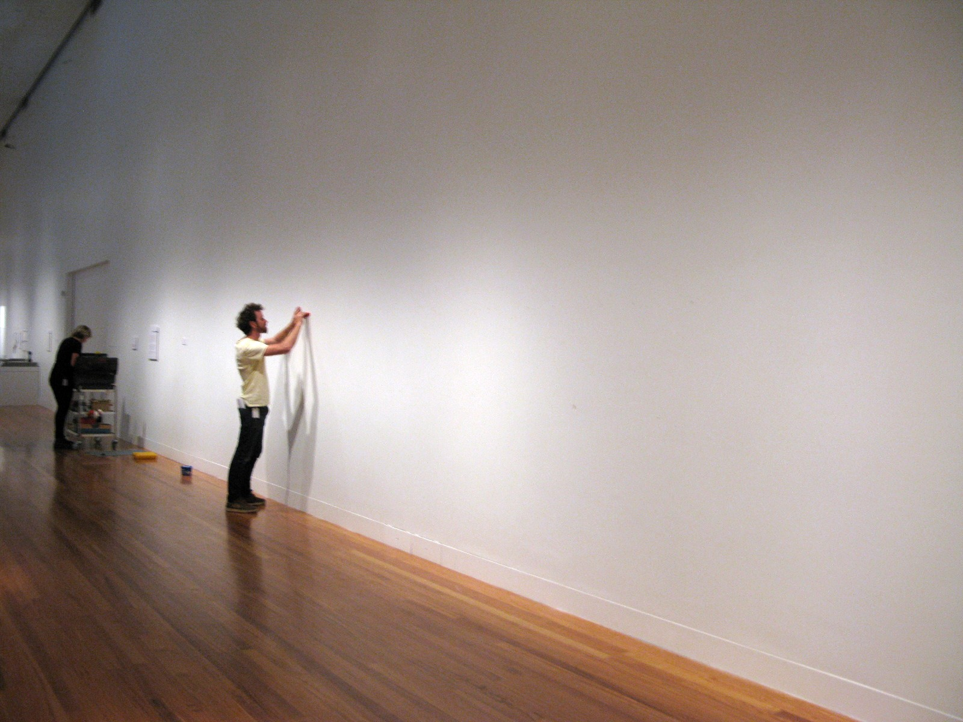
Super-rich
The Pyramid
NS-SEC
The Pentagon
Alternative Pentagon
Embourgeoisement
Relational
Flatlining
40:30:30
The Precariat
Polarised Convergence
End
Polarised
Convergence
Class realignment
Polarisation
Service class
Convergence
Underclass
Notes:
Polarised Convergence
Contemporary model based on:
Although there is a general class convergence, polarisation exists ‘at the margins’ - there are ‘spikes’ at either extreme of the class structure. Ainley (2004), for example, suggests a new “middle-working class” now finds itself wedged between the 'super-rich of large employers and their direct agents (a so-called “service class”) and a “socially excluded”, unemployed, or “unemployable”, so-called “underclass”’.
Class polarisation between the super-rich and underclass (sometimes called the precariat)
Convergence in the middle between variety of service industry occupations (which are increasingly routinised).

Slide 13
Exit
Chris
Livesey
Visualising Class Structures

