Slide 1
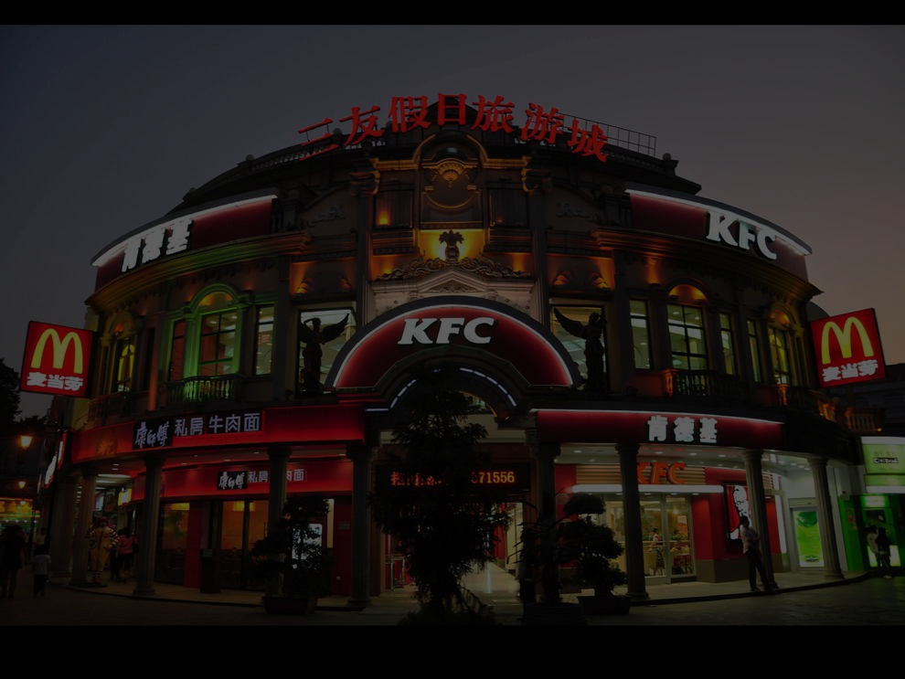
Global Culture
How do global cultural influences impact on local and national cultural behaviours?
And vice versa?
Three views...
Notes:
Photo by WanderingtheWorld (www.ChrisFord.com) - Creative Commons Attribution-NonCommercial License https://live.staticflickr.com/1283/4663275780_dabe062123_b.jpg

Slide 2
Global Culture
Convergence and Homogenisation
1
This view argues the general trend is for cultural differences to gradually disappear as all societies start to adopt ideas and attitudes broadly similar in style and content – the main cause of this being the behaviour and influence of global corporations, media (such as the Internet) and advertising.
Diversity and Heterogeneity
2
This view argues the ebb-and-flow of different cultural ideas and influences create hybrid cultural forms representing “new forms of difference” that arise from the way culture is actively constructed and reconstructed. Globalised culture, therefore, refers to the way local or national cultural developments can spread across the globe – picked-up, shaped and changed to suit the needs of different groups across and within different societies.
3
Homogenisation and Diversity
This view argues for both convergence and homogeneity within global cultural groups but diversity and heterogeneity between such groups. In other words, groups of like-minded individuals share certain cultural similarities across national boundaries, but there groups are potentially many and varied.
End
Notes:
Photo by WanderingtheWorld (www.ChrisFord.com) - Creative Commons Attribution-NonCommercial License https://live.staticflickr.com/1283/4663275780_dabe062123_b.jpg

Slide 3
Global Culture
Commodification creates a consumer culture where standardised, homogenised (much the same) commodities are promoted by global marketing campaigns to create similar lifestyles. Lechner (2001) calls this “Coca-Colonisation”.
Convergence and Homogenisation
Commodity
Homogeneity
Ritzer’s (1993) characterisation of contemporary corporate cultural products as standardised, homogenised and formulaic; every McDonald’s hamburger, wherever it’s sold in the world, is the same basic product made to the same standard formula. Such cultural products are increasingly predictable, unthreatening and safe.
The claim knowledge, ideas and other cultural elements in the global world exist only to be packaged and purchased.
The commodification of culture converges around the economic behaviour and power of giant global companies like Coca-Cola, Nike, Facebook, Amazon and McDonalds.
Diversity and Heterogeneity
McDonaldisation
McWorld
Culture
Homogenisation and Diversity
Berger’s (1997) claim global (popular) culture is increasingly Americanised: music, fashion, TV and films, food, video games, software – all converge around a similar, Americanised, standard of predictability and safety.
End
Notes:
Photo by WanderingtheWorld (www.ChrisFord.com) - Creative Commons Attribution-NonCommercial License https://live.staticflickr.com/1283/4663275780_dabe062123_b.jpg

Slide 4
Global Culture
These represent new forms of difference. Culture is not simply something “given” to people but rather it is actively constructed and reconstructed into new and dynamic forms by the meeting and interplay between different cultures.
Convergence and Homogenisation
How local or national cultural developments spread across the globe: to be picked-up, shaped and changed to suit the needs of different groups across and within different societies. Global culture is facilitated by the development of the Internet.
Cultural Hybrids
Globalised culture
Diversity and Heterogeneity
Social networking
Ebb and Flow
Facebook, YouTube and Twitter represent social spaces and communities - new cultural forms - actively constructed and reconstructed by the people who use them.
This strand emphasises how the ebb-and-flow of, and interplay between, different cultural ideas and practices creates cultural hybrids.
Acultured Commodities
Individuals are freed to produce and consume cultural ideas and products using the tools provided by global commercial enterprises. While the content itself is not controlled (cf. McDonaldisation) commodification does occur through things like advertising.
Homogenisation and Diversity
End
Notes:
Photo by WanderingtheWorld (www.ChrisFord.com) - Creative Commons Attribution-NonCommercial License https://live.staticflickr.com/1283/4663275780_dabe062123_b.jpg

Slide 5
Global Culture
Where features of local cultures (their uniqueness, individuality etc.) become a feature of globalised cultures. Rather than the globalisation of culture being an homogenising process it involves the spread of diverse cultural beliefs and practices across the globe in ways that create new and diverse cultural forms.
Convergence and Homogenisation
Globalised cultural forms are adapted and changed by local cultural tastes and behaviours. Western “rock music”, for example, is a global product of Anglo-American construction consumed and filtered through many different cultures and cultural influences. In this respect we find “unique cultural interpretations” of globalised phenomena.
Diversity and Heterogeneity
Particularization of Universalism
Universalism of Particularism
Like-minded individuals and groups share global cultural similarities: business groups may dress in similar ways, have similar work-based interests and interact in English.
Like-minded individuals and groups who promote their particular ideas globally, within and across different cultures. Western academics, for example, may be involved in promoting feminism or neo-liberal economics in non-western cultures.
Homogenisation and Diversity
Convergence
Divergence
End
Notes:
Photo by WanderingtheWorld (www.ChrisFord.com) - Creative Commons Attribution-NonCommercial License https://live.staticflickr.com/1283/4663275780_dabe062123_b.jpg

Slide 6
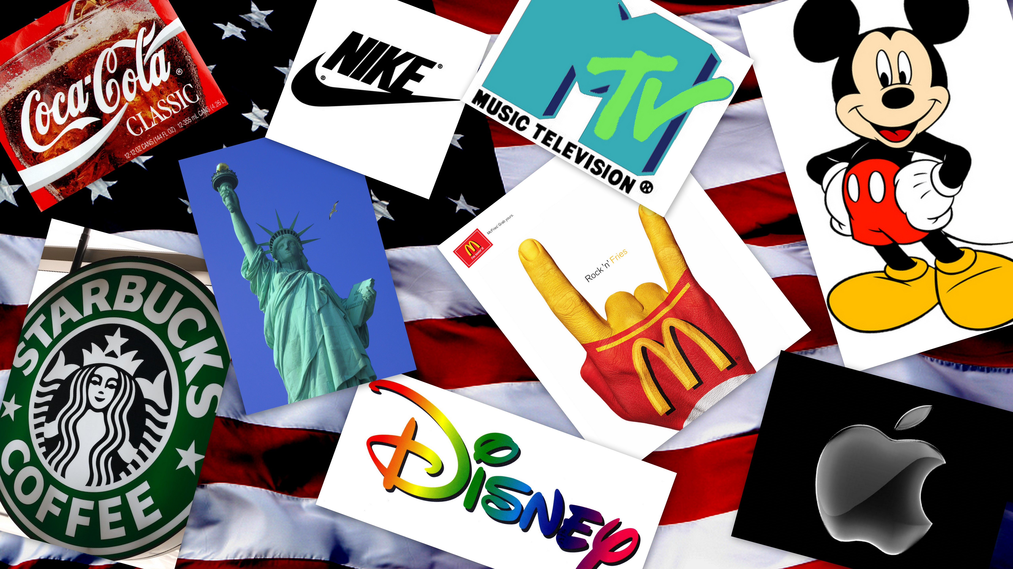
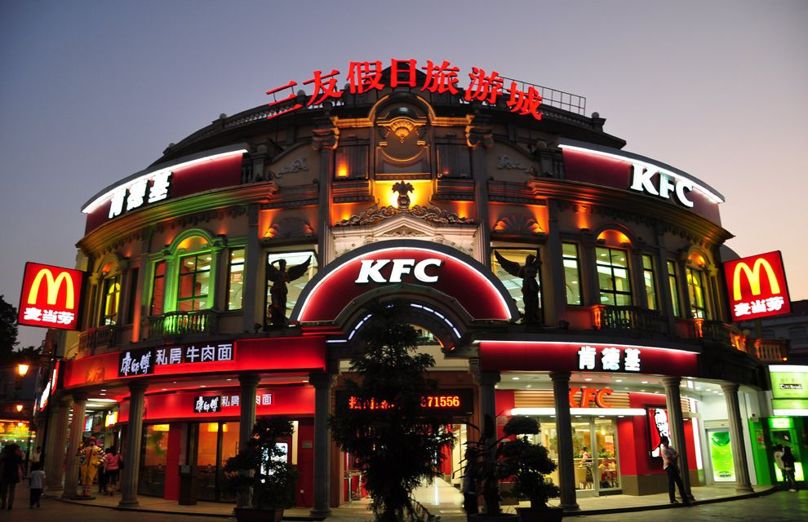
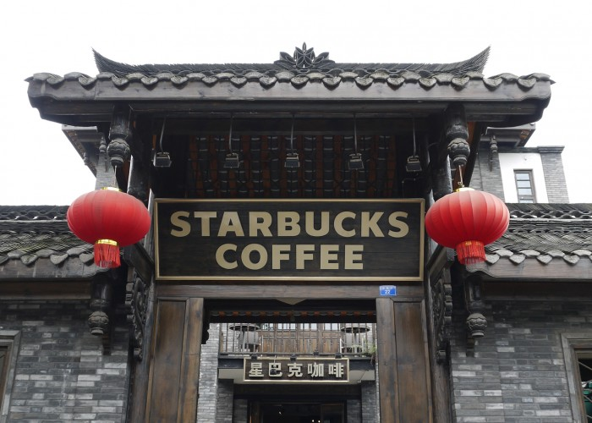
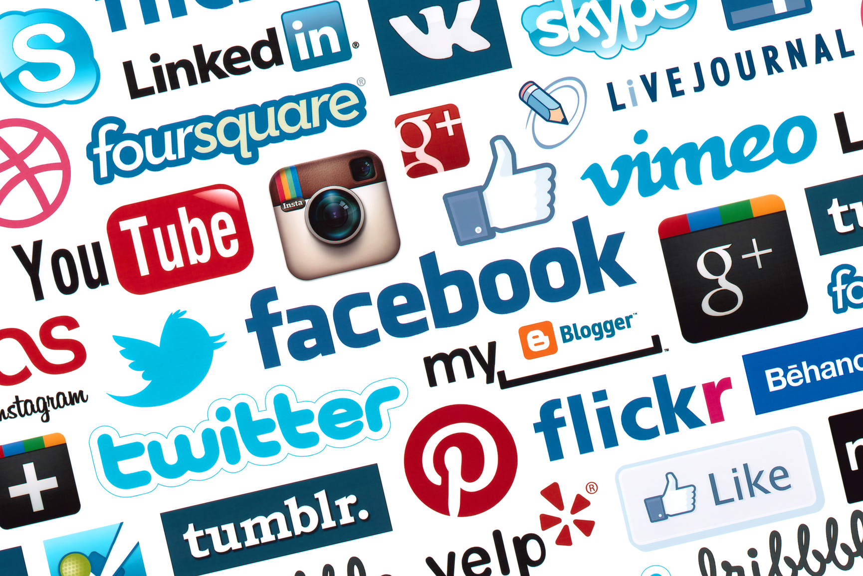
Global Culture
Shortcutstv
shortcutstv.com
© 2019
Notes:
Photo by WanderingtheWorld (www.ChrisFord.com) - Creative Commons Attribution-NonCommercial License https://live.staticflickr.com/1283/4663275780_dabe062123_b.jpg

