Slide 1

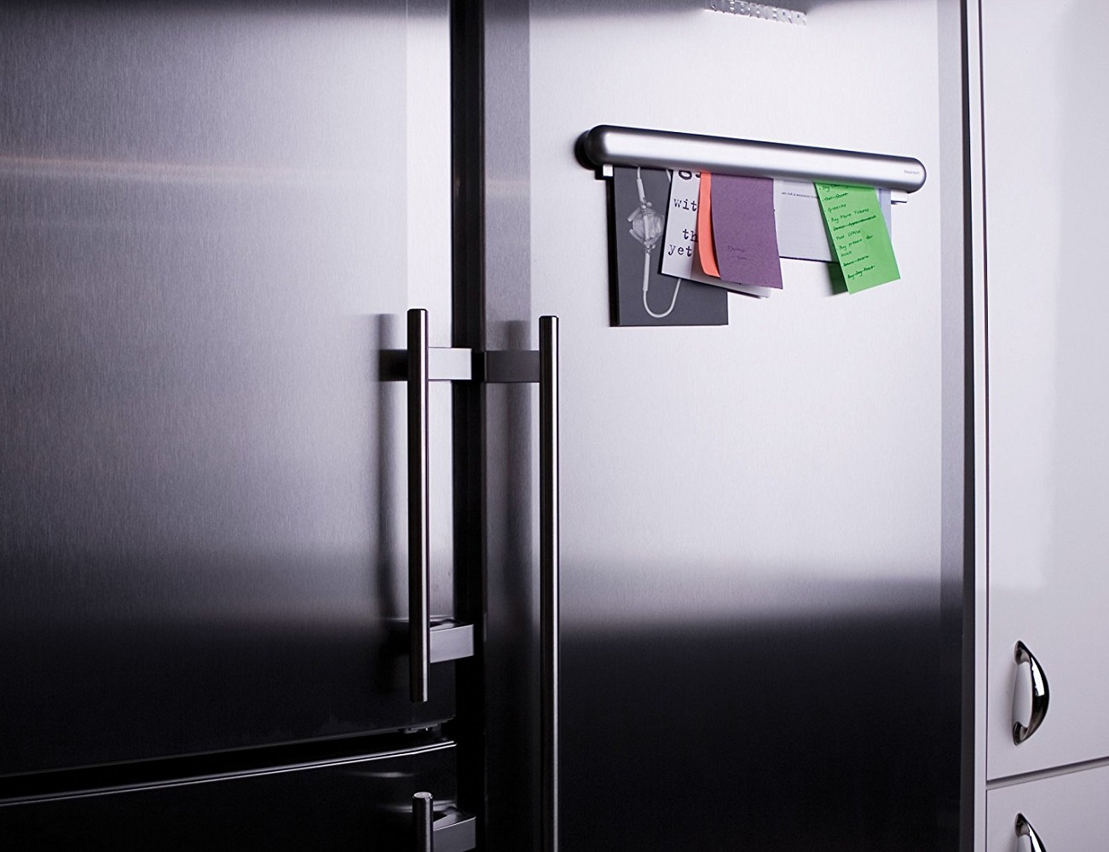
Graphic Organiser
W3

Slide 2
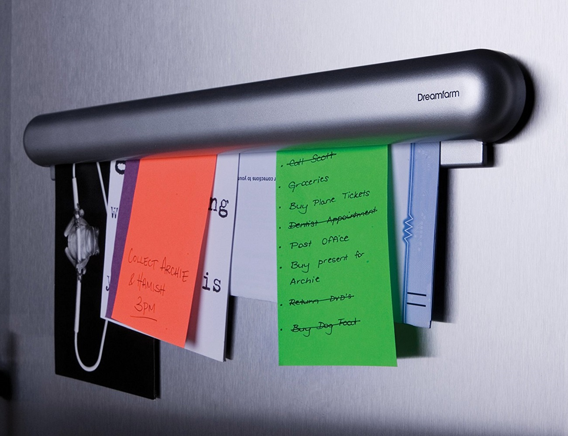
Graphic Organiser: W3
Topic?
What?
Why?
Where?
For:
Against:

Slide 3
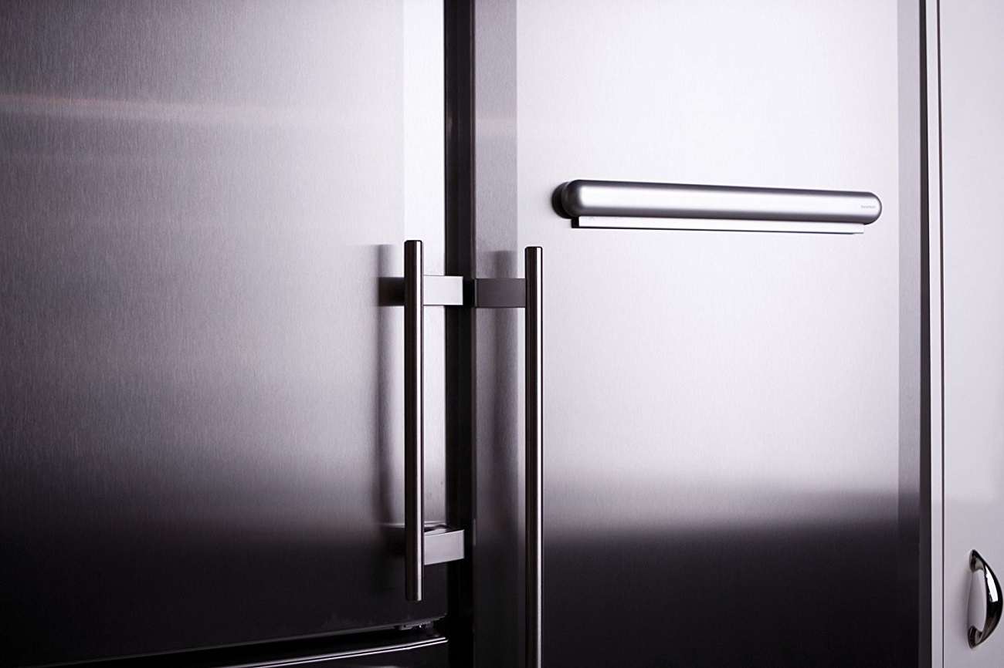
Graphic Organiser: W3
ShortCutstv
www.shortcutstv.com
© 2018

