Slide 1

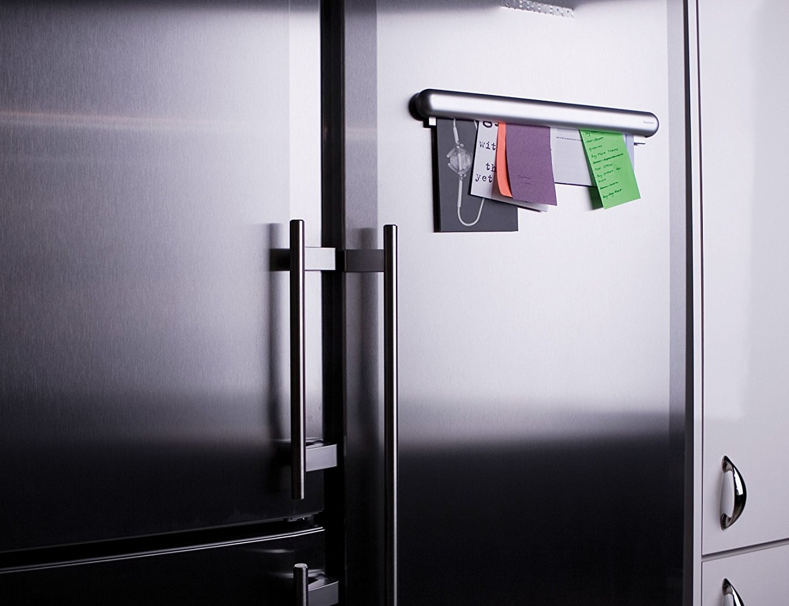
Graphic Organiser
Hierarchies

Slide 2
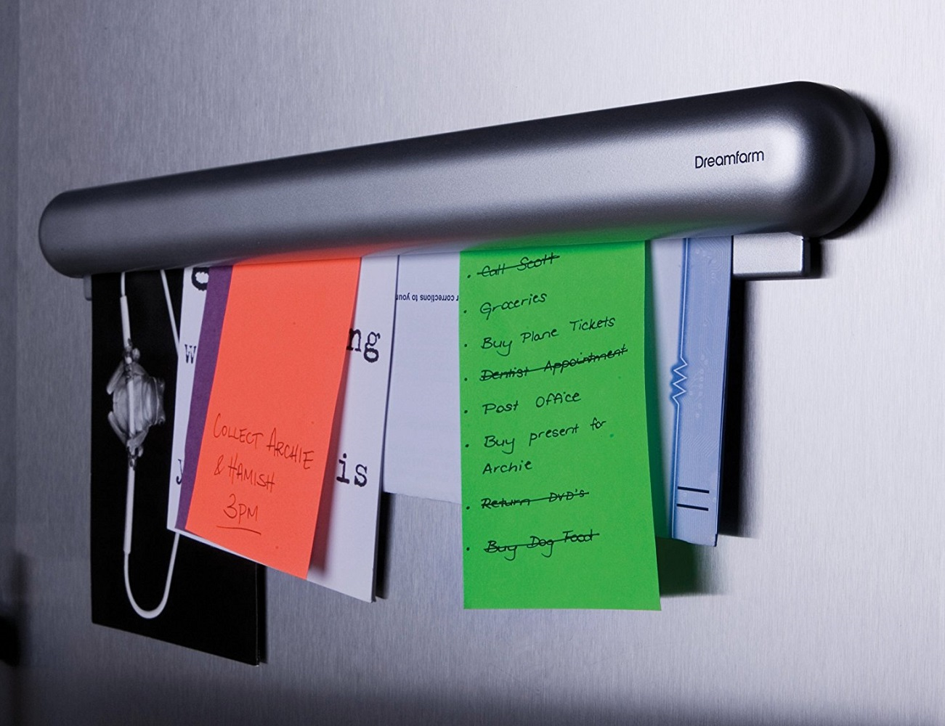
Graphic Organiser: 3-Level Hierarchy

Slide 3

Graphic Organiser: 3-Level Hierarchy
ShortCutstv
www.shortcutstv.com
© 2018

