Slide 1

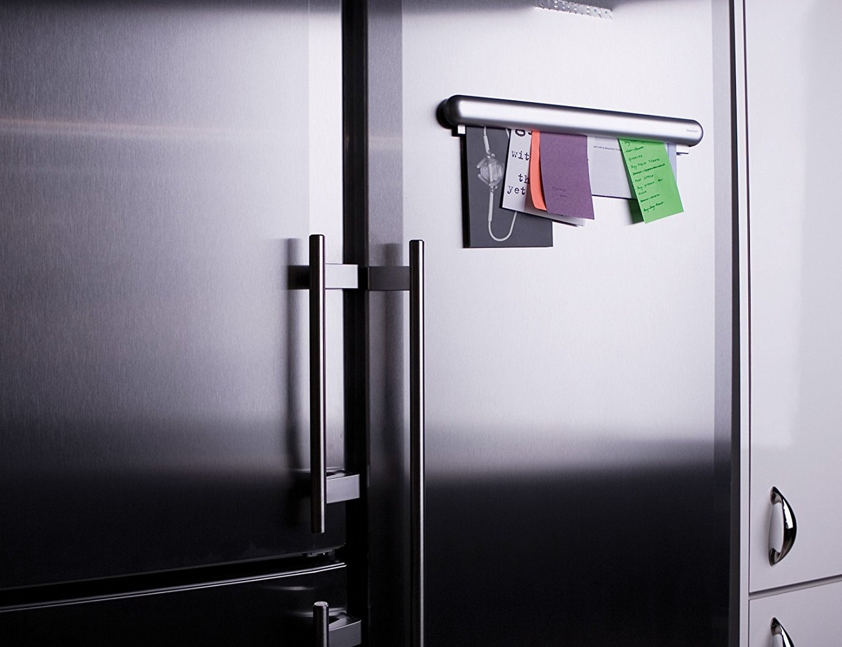
Graphic Organiser
The 5 Points of the Star

Slide 2
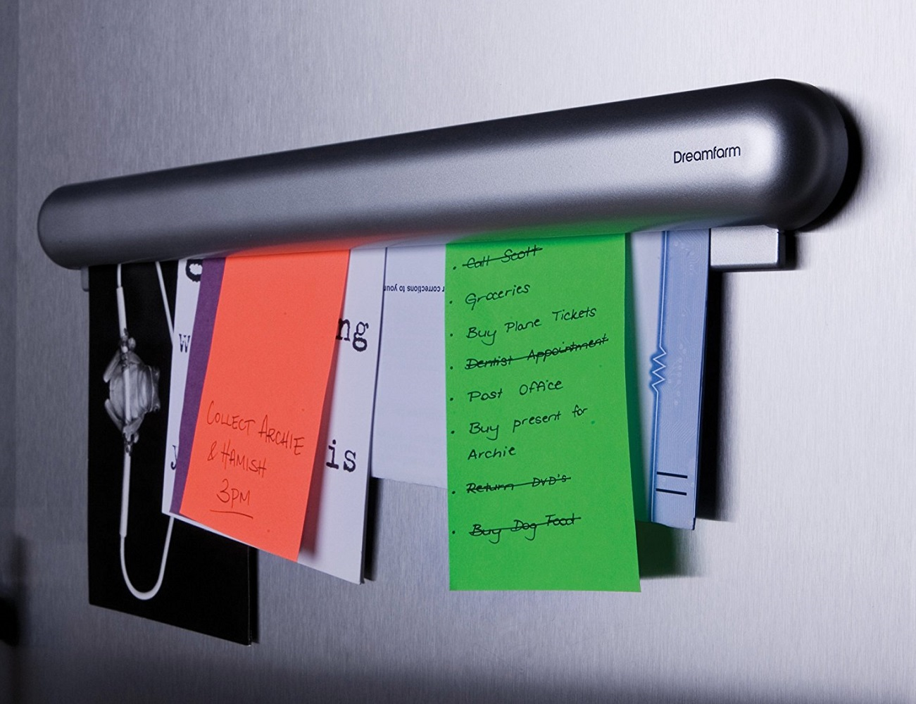

Graphic Organiser: The 5 Points of…

Slide 3
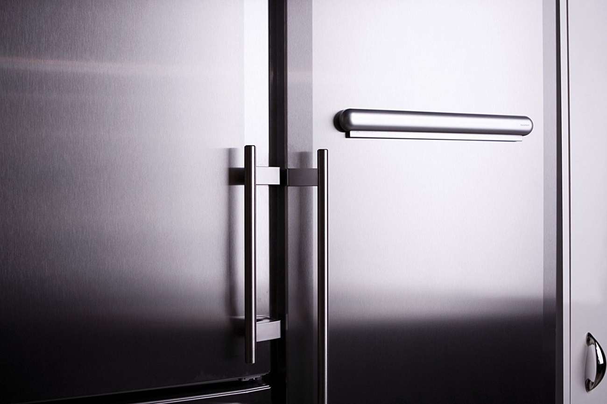
Graphic Organiser: The 5 Points of the Star
ShortCutstv
www.shortcutstv.com
© 2018

