Slide 1
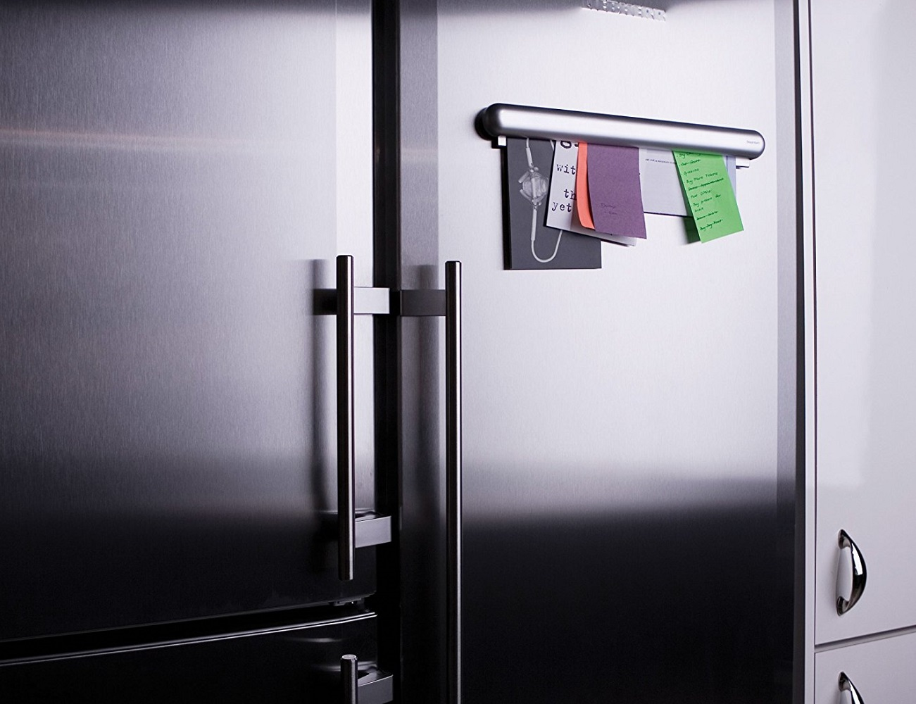
Graphic Organiser
Hierarchies

Slide 2
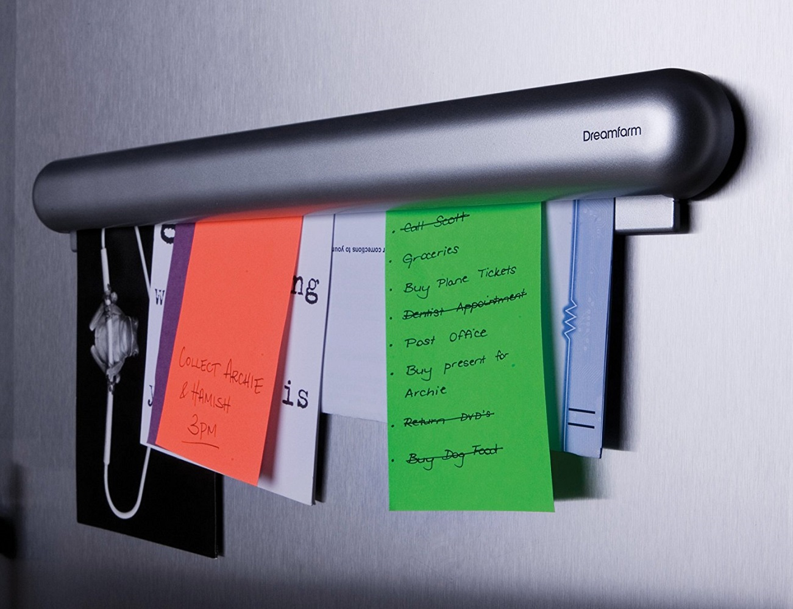
Graphic Organiser: 3-Level Hierarchy

Slide 3
Graphic Organiser: 3-Level Hierarchy
ShortCutstv
www.shortcutstv.com
© 2018

