Slide 1

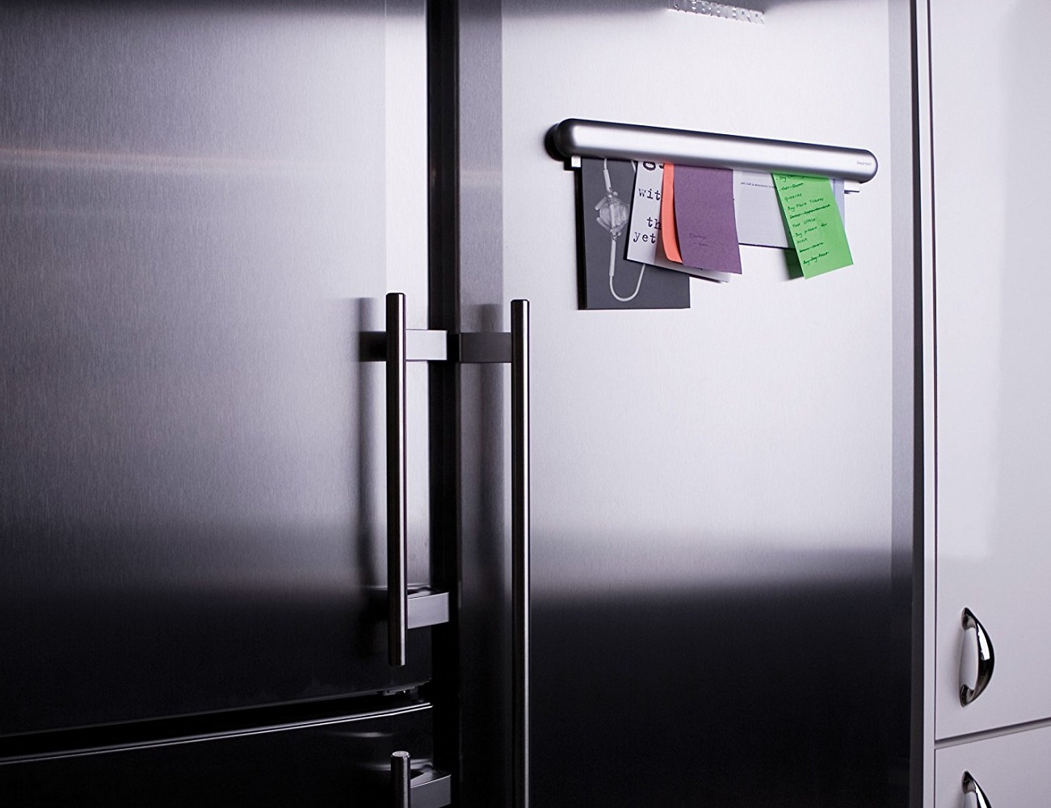
Graphic Organiser
The Frayer Model

Slide 2
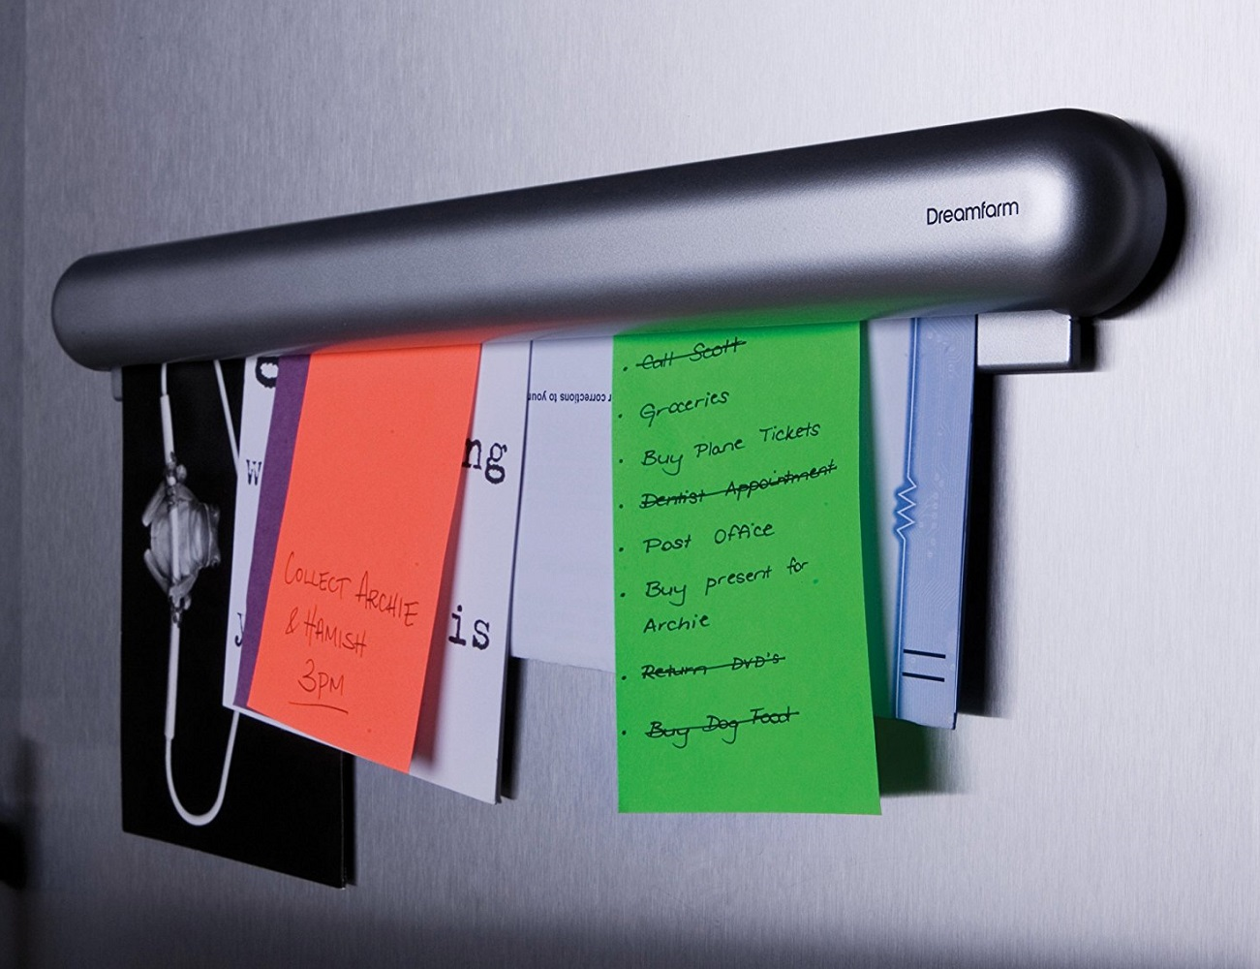
Graphic Organiser: Sandringham Version
Definition
Characteristics
Examples
Linked idea / concepts

Slide 3
Graphic Organiser: Alternative Version
Definition
Examples
Key Strengths
Key Weaknesses

Slide 4
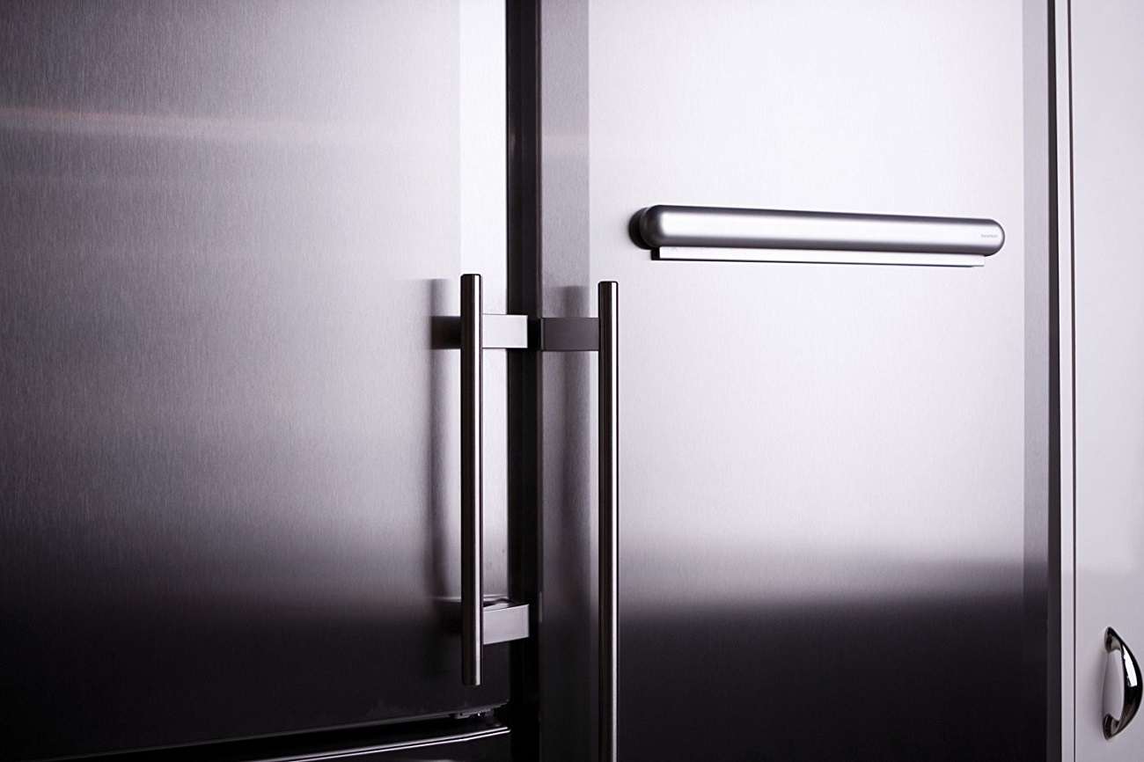
Graphic Organiser: The Frayer Model
ShortCutstv
www.shortcutstv.com
© 2018

