Slide 1
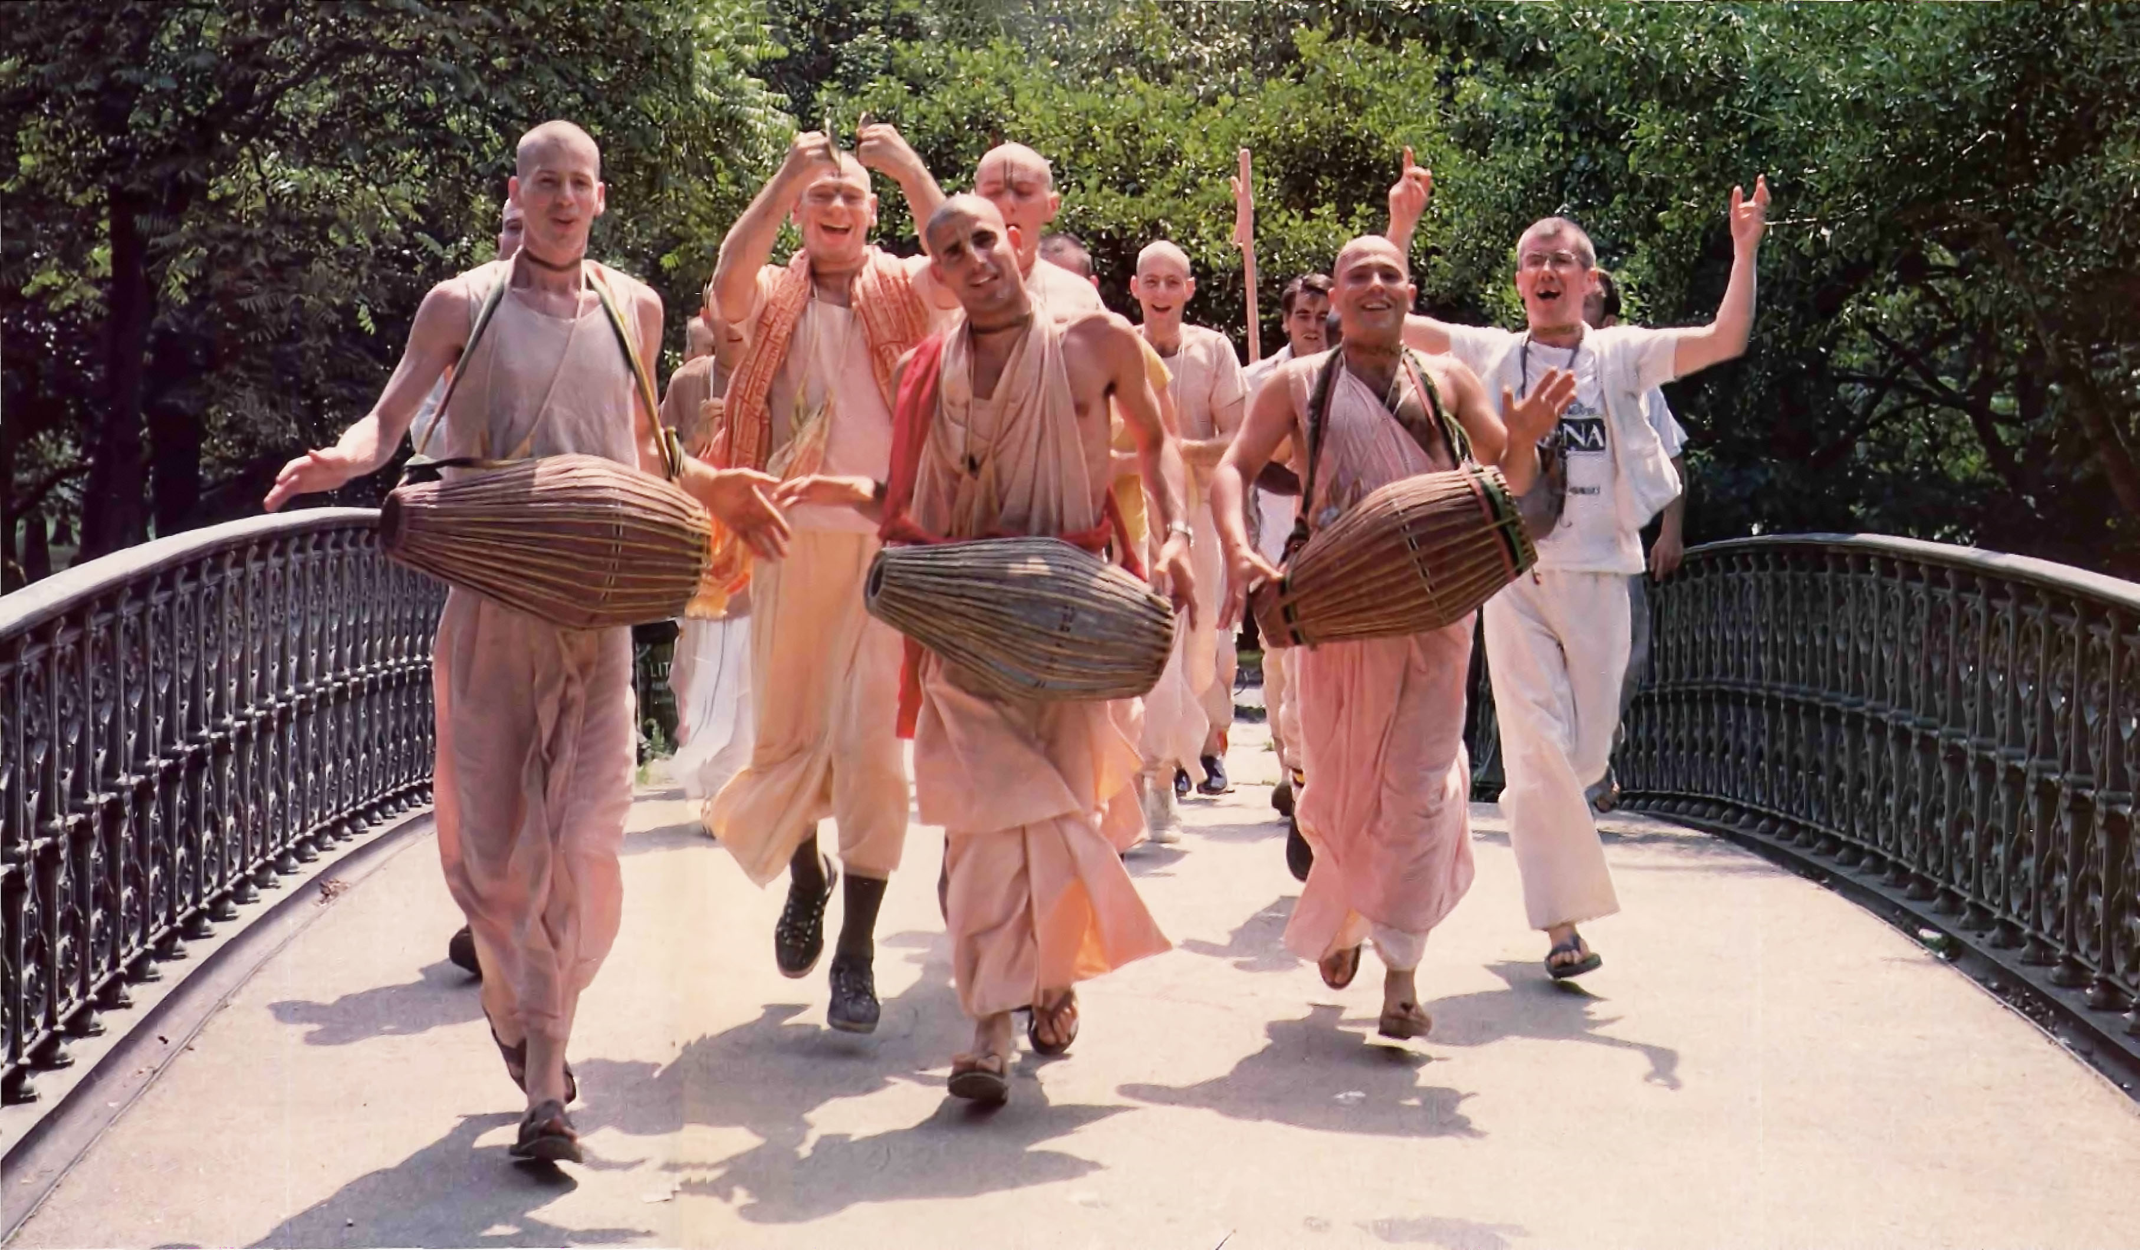
New Religious Movements
Barker (1999)
Who Joins?

Slide 2
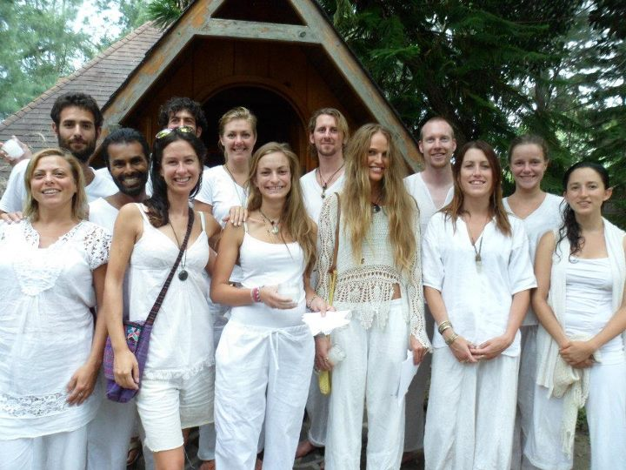

New Religious Movements
Barker (1999)
Exit
Escape
Excitement
Seeking
Belonging
Self-Actualising
Escape
“The individual is escaping from something, perhaps from a loving but over-possessive family, an unhappy partnership or an uninteresting or unpromising career.”
Excitement
“Recruits may believe that traditional religions are dull, boring, hypocritical and apathetic, and / or that life in the wider society has little to offer but the opportunity to be a cog in a vast, impersonal and materialistic rat-race.”
Self-Actualising
“The attraction is the promise they can develop their careers or their relationships through discovering their ‘true selves’.”
Seeking
“Some are looking for (or susceptible to the suggestion they are looking for) a closer relationship with God, or a better world. They may even be persuaded they can play a role in bringing the Kingdom of Heaven on Earth.”
Belonging
“This group are attracted to the idea of belonging to a friendly family or community of like- minded people, sharing values they believe to be absent in the wider society. “
Notes:
Notes
Almost by definition, the members are first generation converts, and, like all converts, they tend to be far more enthusiastic and committed - even fanatic - than those born into a religion.

Slide 3
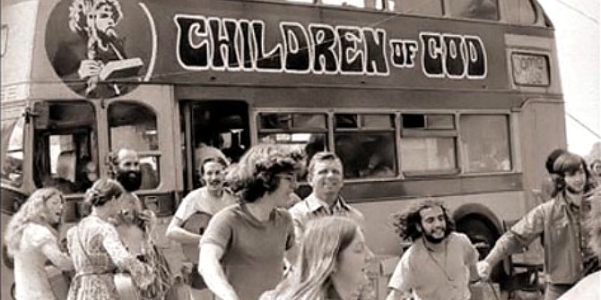
ShortCutstv
www.shortcutstv.com
© 2018

