Slide 1
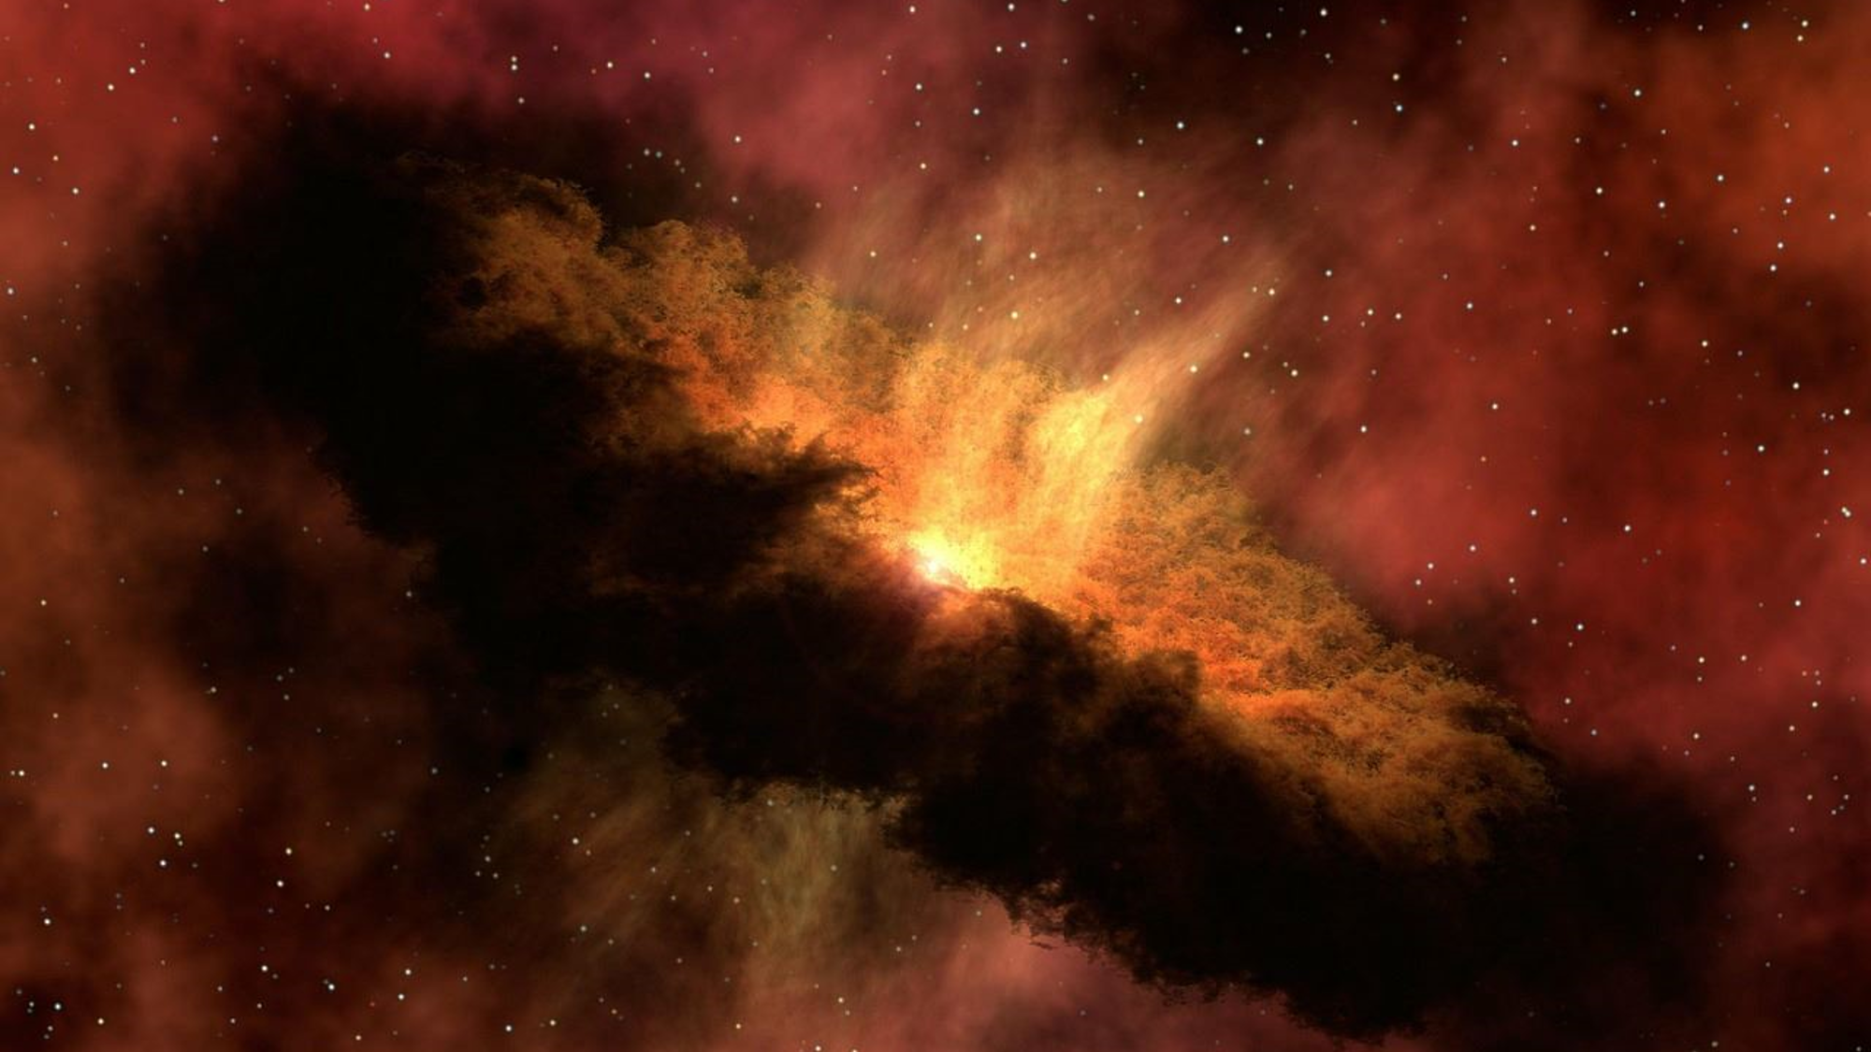
New Religious Movements
Eileen Barker
Six Characteristics

Slide 2
New Religious Movements
Eileen Barker
Six Characteristics

Slide 3
New Religious Movements
1. converts |
first generation
enthusiastic
committed
Eileen Barker
Notes:
Notes
Almost by definition, the members are first generation converts, and, like all converts, they tend to be far more enthusiastic and committed - even fanatic - than those born into a religion.

Slide 4
New Religious Movements
2. membership |
atypical of society
young
middle class
above average education
Eileen Barker
Notes:
Notes
The membership tends to be atypical of society as a whole, with the movements that became visible around the 1970s appealing disproportionately to young adults from the middle classes who have a somewhat above average education. If one considers for a moment the implications of having a group of young, inexperienced enthusiasts unencumbered by the responsibilities of mortgage payments or dependants such as children or the elderly, one immediately begins to understand some of the behaviours associated with the movements.

Slide 5
New Religious Movements
3. leadership |
founder / leader: usually male
charismatic authority
unbound by tradition or rules
governs all aspects of movement life
Eileen Barker
Notes:
Notes
There is often a founder or leader who wields charismatic authority – that is, he (or
sometimes she) will be unbound by tradition or rules, but may be accorded by the
followers the right to pronounce on all aspects of their life –whom they marry, whether or
not they have children, what sort of work they should do, what sort of clothes they should
wear and food they may eat, where they should live, perhaps even whether they should
live.

Slide 6
New Religious Movements
4. creed |
the Truth
clear-cut vision of Truth
founder embodies The Truth
Eileen Barker
Notes:
Notes
New religions tend to have far more clear-cut versions of The Truth than
older religions, which have accommodated to generations throughout the ages.

Slide 7
New Religious Movements
5. identity |
clear distinction between Them and Us
Us: homogeneously good and godly
Them: homogeneously bad / ungodly
Eileen Barker
Notes:
Notes
There is frequently a sharp distinction made by the group between ‘them’ and ‘us’, the former being homogeneously good and godly, the latter equally homogeneously bad and, perhaps, satanic.

Slide 8
New Religious Movements
6. relationships |
maybe suspicion of / from wider society
maybe antagonism of / from wider society
Eileen Barker
Notes:
Notes
There is often (though not always) suspicion and/or antagonism from the wider society to which the group offers an alternative.

Slide 9
ShortCutstv
www.shortcutstv.com
© 2018

