Slide 1
Identity and digital communication
Age

Slide 2
Think back to the introduction of this course.
Who were the main users of the most commonly used social media?
Facebook
Whatsapp
Snapchat
Instagram
Twitter
Linkedin
Pinterest

Slide 3
Think back to the introduction of this course.
Pairs discussion:
What impact do you think social media has on young people’s lives?
Try to think of positive and negative points.

Slide 4
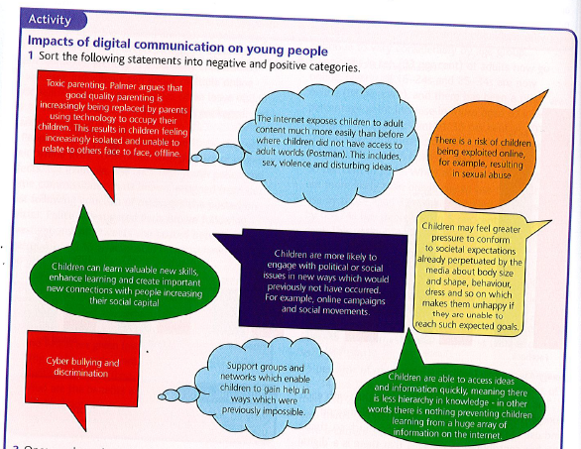
Positive or - negative divide these statements up and write them into your book with positive on one side and negative on another

Slide 5
Age
Without doubt age has a major impact on how, why and in which ways digital communication is used. In the exam you may be asked to provide evidence of these differences. Some potential questions:
With reference to the Sources, explain how digital communication may impact on identity. [9]
With reference to the Sources, discuss the view that digital communication has a negative effect on the social relationships of young people. [10]
With reference to the Sources, discuss the view that developments in digital communication have been positive for young/old people. [10]

Slide 6
Gathering the evidence
Using the table provided, fill in the evidence provided in your text that shows the differences in how the young and older generations use digital communications.

Slide 7
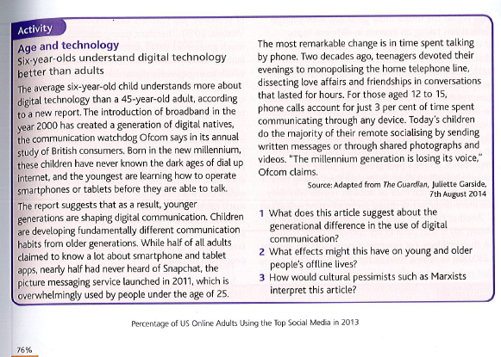
Some studies…
Stick the studies/articles into your book and answer the questions underneath.

Slide 8
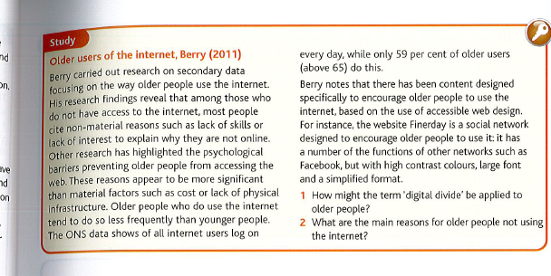

Slide 9
Homework

